Slide 1


Establishing an Open Education Community of Practice at a Bilingual University - Year 1 Reflections
Open Education Conference 2022
Mélanie Brunet and Michelle Brown, University of Ottawa Library
Unless otherwise specified, the contents of this presentation are made available under a Creative Commons Attribution 4.0 International licence
Notes:
[Michelle] - Welcome to our presentation titled “Establishing an Open Education Community of Practice at a Bilingual University - Year 1 Reflections”

Slide 2
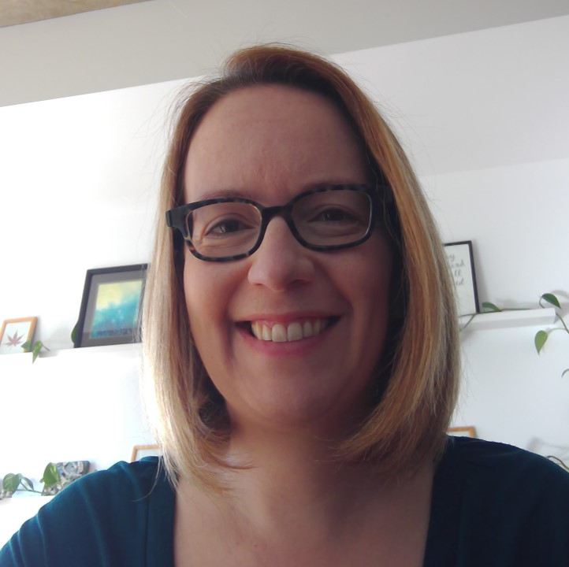

Presenters
Mélanie Brunet
Open Education Librarian
Michelle Brown
Head, Learning and Student Success
Notes:
Script: [Michelle]
Your presenters are: Mélanie Brunet, Open Education Librarian, and Michelle Brown, Head - Learning and Student Success. We are both Librarians at the University of Ottawa.

Slide 3

1.
Context at the University of Ottawa
University of Ottawa Coat of Arms by University of Ottawa, Wikipedia Commons, CC BY-SA 4.0
Notes:
[Michelle]
The University of Ottawa is a public research university located on the unceded ancestral land of the Algonquin people in the heart of Canada’s capital city, Ottawa, Ontario, Canada. It is the largest bilingual (English-French) university in the world and offers 550 undergraduate, master’s, doctoral and professional programs. It provides courses, resources and services in both English and French.

Slide 4
44,700 students
70% English
30% French
Source: University of Ottawa, “Quick Facts 2020,” https://www.uottawa.ca/institutional-research-planning/resources/facts-figures/quick-facts
Notes:
Script: [Michelle]
There are about 44,000 students at the University of Ottawa. 70% of those students study in English while only 30% of students study in French.

Slide 5
1,223 regular professors
1,376 adjunct and part-time professors
Source: University of Ottawa, “Quick Facts 2020,” https://www.uottawa.ca/institutional-research-planning/resources/facts-figures/quick-facts
Notes:
Script: [Michelle]
It is also important to note that the majority of teaching staff at the university are adjunct and part-time professors rather than full-time and tenured faculty. This can sometimes pose a challenge for CoP and other types of groups since there can be a lack of continuity among the staff.

Slide 6
2.
Creation of the OER Community of Practice
Notes:
[Michelle] - We will now speak to the creation of the community of practice.

Slide 7

Origins of the Community of Practice
Open and Affordable Learning Materials Working Group report findings (2020)
Student-led OER created at the University of Ottawa:
General Chemistry for Gee-Gees, https://ecampusontario.pressbooks.pub/genchemforgeegees/, CC BY-NC-SA 4.0
Notes:
[Michelle]
uOttawa’s strategic plan, “Transformation 2030,” signalled administrative support for the promotion and development of French language OER and Open Education in general. This was an important first step leading to the creation of the Open & Affordable Learning Materials Working Group, which found that the campus had pockets of innovation, but the larger university community lacked a cohesive vision for the use, creation, and dissemination of OER.

Slide 8
Origins of the Community of Practice
Open and Affordable Learning Materials Working Group report findings (2020)
Recommended a CoP on open education to create a cross-campus collaborative culture of open pedagogy
Student-led OER created at the University of Ottawa:
General Chemistry for Gee-Gees, https://ecampusontario.pressbooks.pub/genchemforgeegees/, CC BY-NC-SA 4.0
Notes:
[Michelle]
One of the recommendations of the working group was to strike a community of practice on Open Education. The CoP was meant to be a vehicle for awareness building, information sharing, and support, as well as to lay the foundation for a culture of open pedagogy at the university.

Slide 9
Origins of the Community of Practice
Open and Affordable Learning Materials Working Group report findings (2020)
Recommended a CoP on open education to create a cross-campus collaborative culture of open pedagogy
Recruiting members among known OER champions on campus
Student-led OER created at the University of Ottawa:
General Chemistry for Gee-Gees, https://ecampusontario.pressbooks.pub/genchemforgeegees/, CC BY-NC-SA 4.0
Notes:
[Michelle]
The CoP set out to recruit known OER champions on campus to become members. These included professors, students and other staff who had demonstrated an interest and advocacy for open education or those who had already created OER or used OER in their classrooms.

Slide 10
Origins of the Community of Practice
Open and Affordable Learning Materials Working Group report findings (2020)
Recommended a CoP on open education to create a cross-campus collaborative culture of open pedagogy
Recruiting members among known OER champions on campus
All at uOttawa are welcome in the CoP
Student-led OER created at the University of Ottawa:
General Chemistry for Gee-Gees, https://ecampusontario.pressbooks.pub/genchemforgeegees/, CC BY-NC-SA 4.0
Notes:
[Michelle]
After careful planning, the OER CoP met for the first time in October 2021 and is open to all at the uOttawa.

Slide 11
3.
Overview of Year 1
Notes:
[Michelle] For this overview of the first year, we will focus on our membership, the themes discussed and some of the benefits and successes we have identified.

Slide 12
Membership*
By Status
50%
of membership
Professors | 15
Librarians | 15
Staff members | 12
Administrators | 8
Students | 7
Instructors | 3
Total | 60
* Members of the OER CoP Teams channel as of July 2022, excluding the two co-leads who are channel owners
Notes:
[Michelle] After a year, the Community of Practice had 60 members, with full-time professors and librarians representing half of the membership, with 15 members each.

Slide 13
Membership*
By Status
Professors | 15
Librarians | 15
Staff members | 12
Administrators | 8
Students | 7
Instructors | 3
Total | 60
* Members of the OER CoP Teams channel as of July 2022, excluding the two co-leads who are channel owners
Notes:
[Michelle] Staff, administrators, students and part-time instructors made up the other half. The latter are the most underrepresented group with only 5% of the membership, reflecting two known trends at uOttawa: 1) part-time instructors are notoriously difficult to reach even through official channels and 2) their working conditions are precarious. Finding out teaching assignments a week before classes start is not conducive to adapting a course around OER. By contrast, full-time faculty have the privilege of investing time in OER use, adaptation or creation.

Slide 14
Membership*
Library | 23
Arts | 6
Social Sciences | 5
Teaching and Learning Support Service | 5
Science | 4
Management | 2
Engineering | 2
Education | 1
Health Sciences | 1
Law | 1
Other services | 3
By Faculty or Service (employees only)
* Members of the OER CoP Teams channel as of July 2022, excluding the two co-leads who are channel owners and students
Notes:
[Michelle] Library employees represented 43% of the membership. Far behind were the faculties of Arts, Social Sciences and Science, representing around 10% each. This overrepresentation of the Library reflects the main centre of OER support on campus.

Slide 15
Meetings
9 meetings from October 2021 to June 2022
Virtual
Average of 14 participants
Announcements - presentation - discussion
Notes:
[Mélanie] The community met 9 times from October to June. All meetings were virtual, averaging 14 participants. The first two meetings were devoted to reviewing the Terms of reference and planning activities for the year while the others started with announcements, followed by a presentation by a guest speaker and a discussion.

Slide 16
Meeting Themes
Month | Theme | Guest Speaker | Language
December | Selection of course materials | Internal | Bilingual
January | OER, equity and linguistic minorities | Internal | Bilingual
February | eCampusOntario services and support | External | English
March | Openwashing and fauxpen | External | English
April | OER and peer review | External | English
May | OER co-creation (panel) | Internal | English
June | OER, copyright and licences | Internal | Bilingual
Notes:
[Mélanie] Meetings covered a variety of themes and external guest speakers were invited when expertise was not available internally, which contributed to making English the dominant language of communication. While slides were translated into French and participants could ask questions in either language, meetings with presentations primarily in English extended into discussions that were overwhelmingly in that language as well.

Slide 17
Benefits and successes
Presence of students, administrators and representative of university press
Notes:
[Mélanie] However, some benefits and successes from our first year include:
The presence of students, administrators and even a representative from the university press. These stakeholders were mostly absent from OER outreach activities until then and got to learn from each other. The participation of students was especially enlightening, providing professors with first-hand examples of how commercial textbooks are problematic.

Slide 18
Benefits and successes
Presence of students, administrators and representative of university press
Themes suggested by members
Notes:
[Mélanie] The themes were suggested by members and then curated by the organizing committee, which made for a programme that reflected their interests and addressed the knowledge gaps they identified.

Slide 19
Benefits and successes
Presence of students, administrators and representative of university press
Themes suggested by members
Networking among members
Notes:
[Mélanie] The CoP facilitated networking among members, especially with the professor-student co-creation panel that raised awareness about OER champions in different faculties.

Slide 20
Benefits and successes
Presence of students, administrators and representative of university press
Themes suggested by members
Networking among members
OER support at Library and beyond
Notes:
[Mélanie] While the Library is overrepresented in the membership, the community has served as a channel to promote the OER support available at the Library, at the University and beyond, such as eCampusOntario and Rebus Community.

Slide 21
4.
Challenges and Lessons Learned
Notes:
[Mélanie] While members and meeting participants surveyed in July 2022 indicated being satisfied with the first year of activities, there are some challenges the organizing committee need to address and some lessons learned.

Slide 22
Challenges and lessons learned
Virtual only
Notes:
[Mélanie] Since it started during the COVID-19 pandemic, the community has only met virtually so far, which is not optimal for networking among members. However, the vast majority of members are interested in maintaining the option to connect remotely instead of meeting solely in person.

Slide 23
Challenges and lessons learned
Virtual only
Platform (Teams or Zoom)
Notes:
[Mélanie] While the community still uses Teams to host its documentation and post updates, this platform proved problematic for external guests. The last three meetings were held and recorded on Zoom, which was easier to use. The openness of the Teams channel - meaning anyone with a uOttawa email address can join - was also a challenge, with some documents being deleted by visitors. A backup folder was created in a locked sub-channel as a solution.

Slide 24
Challenges and lessons learned
Virtual only
Platform (Teams or Zoom)
Structure (speakers series or conversation)
Notes:
[Mélanie] The focus on presentations has turned the CoP into a sort of speaker’s series, some presentations leaving little time for discussion, thus hindering exchange among members. Dedicated time for a “tour de table” among attendees and questions shared ahead of meetings are being considered to encourage members to share their thoughts on different subjects instead of arranging to have guest speakers every month.

Slide 25
Challenges and lessons learned
Virtual only
Platform (Teams or Zoom)
Structure (speakers series or conversation)
Level and focus
Notes:
[Mélanie] The community is open to all at the University, wherever they may be in their OER journey. The first-year approach leaning heavily on presentations by experts may not be addressing more basic issues of interest to members who are new to OER.

Slide 26
Challenges and lessons learned
Virtual only
Platform (Teams or Zoom)
Structure (speakers series or conversation)
Level and focus
Bilingualism
Notes:
[Mélanie] Meetings were overwhelmingly conducted in English, in large part due to the topics and guest speakers who were invited to present. Efforts should be made to invite more francophone or bilingual guest speakers, although the persistent gap in the availability of OER in French is an indicator of the state of open education in these two languages. Focusing on discussion topics rather than inviting experts may be more conducive to bilingual conversations.

Slide 27
Challenges and lessons learned
Virtual only
Platform (Teams or Zoom)
Structure (speakers series or conversation)
Level and focus
Bilingualism
Membership
Notes:
[Mélanie] Finally, full-time professors and librarians representing half of the membership is not a coincidence. They are already OER champions and advocates. In that sense, the community is not necessarily raising awareness about OER among the uninitiated when we know that most professors and instructors are not familiar with OER.

Slide 28
Thank you!
Questions?
melanie.brunet@uottawa.ca & @MelanieBrunet
michelle.brown@uottawa.ca & @LibraryGurrl
Fidele template from SlidesCarnival, CC BY 4.0 (modified colour)
Notes:
[Michelle] Thank you so much for your interest in our lighting talk!

