Slide 1
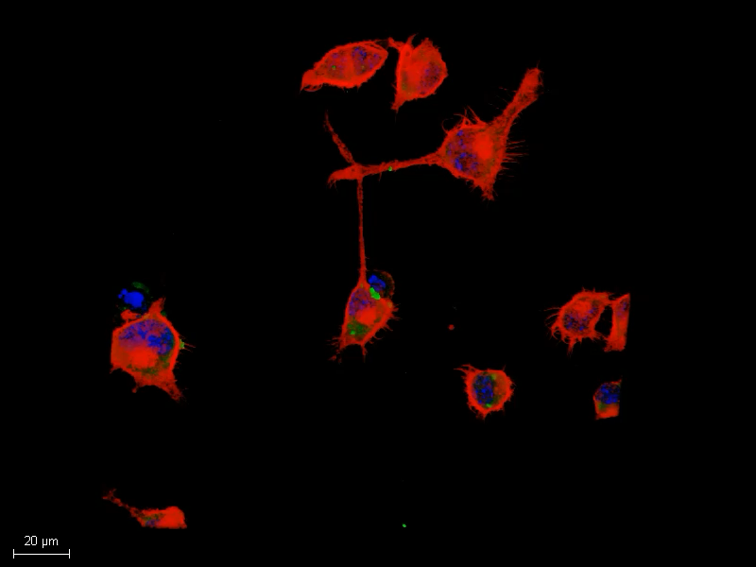
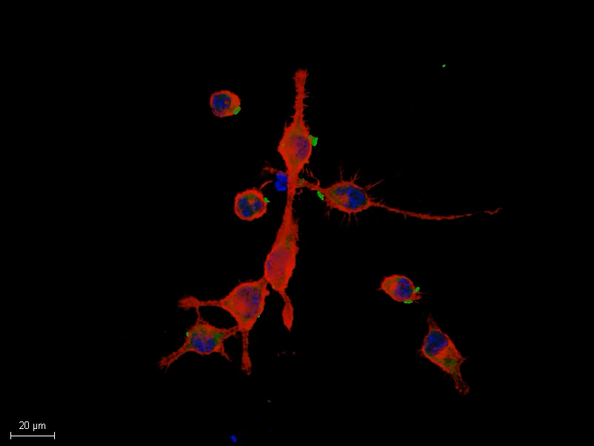
Figure S1. Localization of cell-derived ASC specks in ASC-αSyn complex-treated cells.
Notes:
Figure S1. Localization of cell-derived ASC specks in ASC-αSyn complex-treated cells. 3D projection movies and representative 63x magnification images of microglia treated with ASC-αSyn complexes revealing intracellular and extracellular ASC specks localization with respect to F-actin. *Arrowheads show ASC specks, which are ~1 µm in size. Yellow arrowhead points to the ASC speck shown in Figure 11, highlighting its intracellular localization. Scale bars, 20 and 50 µm.

