Slide 1

Heather Morrison
Open Access Week 2013 University of Regina
Whose scholarship? Our scholarship!

Slide 2
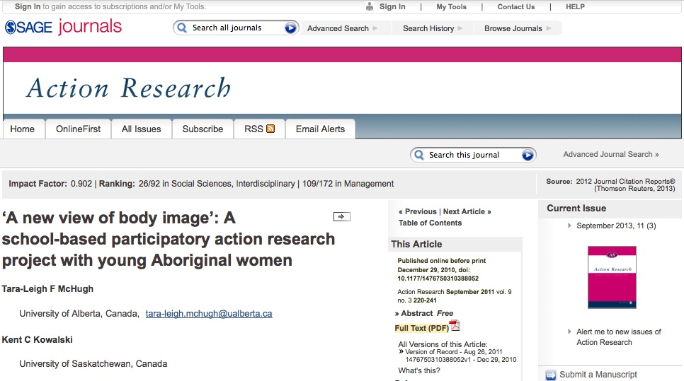
Why open access?
Heather Morrison

Slide 3
Sage paywall options
Purchase Short-Term Access
Pay per Article - You may purchase this article for US$25.00. You must download your purchase, which is yours to keep, within 24 hours.
Regain Access - You can regain access to a recent Pay per Article purchase if your access period has not yet expired.
Heather Morrison

Slide 4
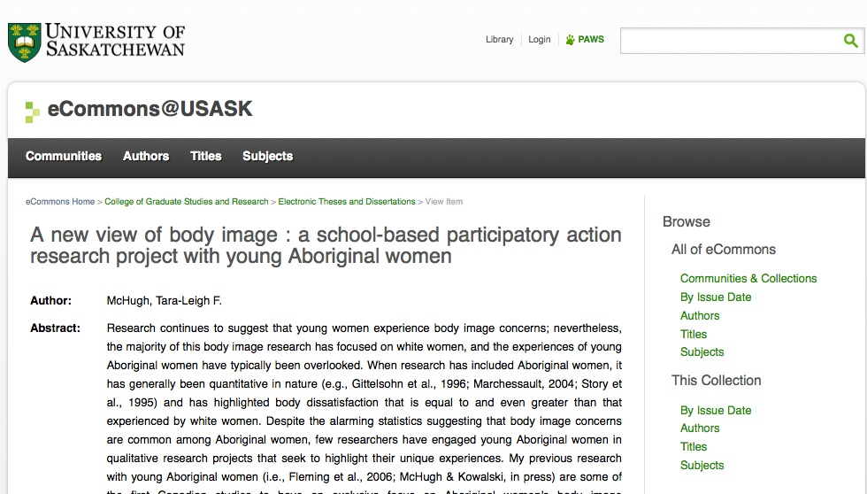
Heather Morrison

Slide 5
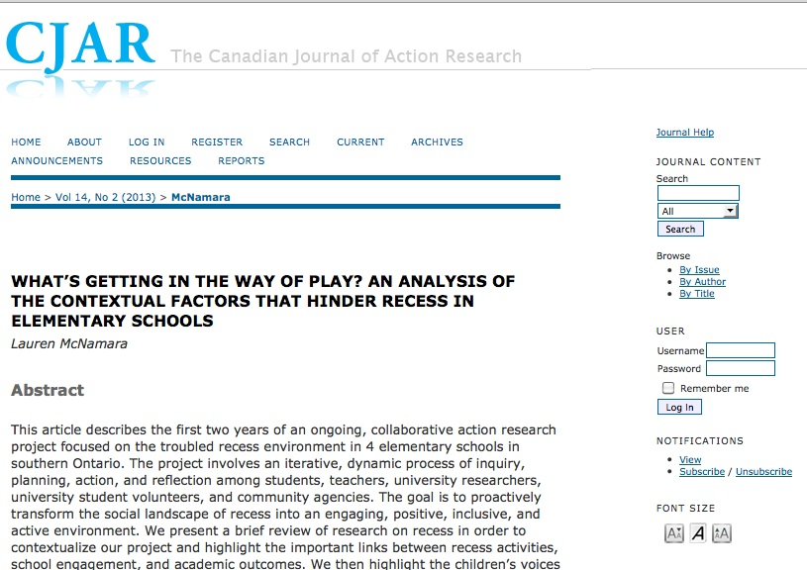
Heather Morrison
Notes:
Canadian Journal of Action Research – Nipissing University

Slide 6
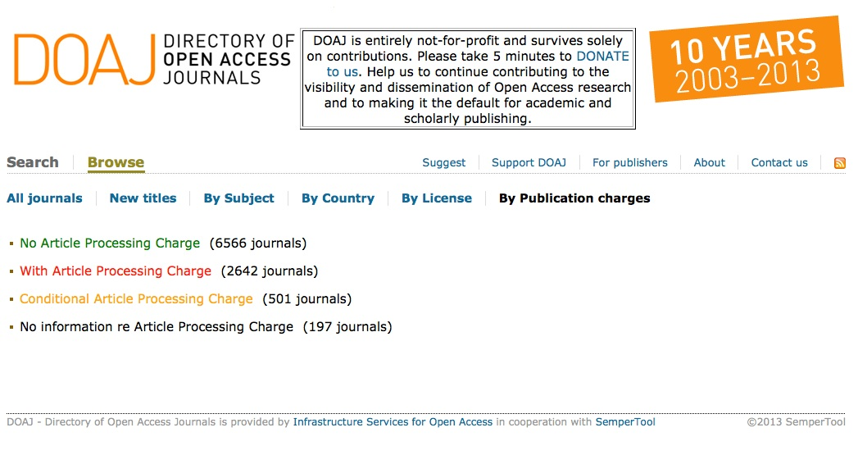
Heather Morrison
Notes:
The Canadian Journal of Action Research is similar to most open access journals in that it does not charge article processing fees. It is a common myth that OA journals charge APCs. Here we see the Directory of Open Access Journals’ “by publication charges” page. Of the just under 10 thousand journals listed in the DOAJ, 6,566 or about two-thirds have no article processing charges. How is this possible? There are a number of underlying factors including a variety of subsidies, both direct and indirect. A lot of the system, though, depending on the voluntary work of us scholars.

Slide 7
The scholar-volunteer
Heather Morrison
Notes:
We scholars do a lot of volunteering, don’t we? – I would argue that the long hours many of us put in make our jobs essentially half-job / half-volunteer work. Who here does peer review? Editing? Volunteer to help organize conferences, other volunteer work for scholarly associations? And no doubt many of us do a lot of volunteer work for our communities as well. Perhaps we even engage in a little bit of active democracy, whether through signing or distributing petitions, talking to our MPs or the media… Let’s start off with a little informal survey, a test of our volunteer spirit. But no worries, this test is not being marked! ~ and I know how busy all of us scholars are, so no actual commitment is assumed!

Slide 8
Volunteer for this organization?
The strong portfolio of products within the [company] stable allows the group highly favourable valuation characteristics including:
Excellent free cash generation
High return on capital employed
Excellent quality of earnings - significant subscription revenues with high renewal rates
High margins especially on data and subscription products
Heather Morrison
Notes:
Before I decide whether to get involved with an organization, I like to know a little bit about the organization. Sometimes it helps to look at the company’s website. Here is some information from an organizational website that I came across the other day. What does this tell us about the organizations? It sounds like they make an awful lot of money, a whole lot of profit!! Isn’t that heartwarming? Doesn’t this make you want to just go home, curl up with your computer and spend hours and hours doing free work for this company? [wait] Now, I am sure that you are wondering, who is this company, and where do I sign up?...next slide

Slide 9
Volunteer for this organization?
The strong portfolio of products within the [company] stable allows the group highly favourable valuation characteristics including:
Excellent free cash generation
High return on capital employed
Excellent quality of earnings - significant subscription revenues with high renewal rates
High margins especially on data and subscription products
From:
informa (owner of Taylor & Francis)
“For investors”.
Heather Morrison
Notes:
And the good news is – if you’re in the humanities and social sciences, you probably already are signed up! This is how the multinational organization informa, owner of the scholarly-friendly-sounding “brand” Taylor & Francis, describes their company when they are speaking to investors. If you write, peer review, edit, or buy their journals, you are already giving informa a hand up with that “excellent free cash generation”.

Slide 10
Help out with the debt?
2.5 billion euros of debt…[which] will include euro- and dollar denominated leveraged loans that are "covenant lite," a structure that offers little or no protection for lenders.
Heather Morrison
Notes:
What about all the poor people and organizations struggling with debt? Wouldn’t you like to do something to help them out? What about this organization – 2.5 billion euros of debt. Think of the interest payments? Shouldn’t we all work really, really hard to help them out with this? You may be wondering where I got this…

Slide 11
Springer history
2004: created by Candover and Cindven (Europe’s largest buyout firm) by merger of Kluwer Academic Publishers and BertelssmanSpringer
2008: Springer buyers BioMedCentral, world’s largest open access publisher
2009: Springer bought by private equity firms EQT and GIC (investment arm of government of Singapore
2013: sale to “buyout firm” BC partners – a private equity firm – includes debt. Financed by: “the purchase will be backed with around 2.5 billion euros of debt provided by Barclays, Credit Suisse, Goldman Sachs, JP Morgan, Nomura and UBS, banking sources said”.
(Reuters, 2013).
Heather Morrison
Notes:
This is from a Reuters news announcement about the sale of Springer earlier this year. The news announcement outlines the recent history of the company. In 2004, two private equity firms, Candover and Cindven (which at the time described themselves as Europe’s largest buyout firm) created Springer Science+Business Media by acquiring and merging two other publishing firms. A buyout firm is just what it says – a company that buys other companies and re-sells them later. To make money, a buyout firm has to sell the company for a higher price than it paid to buy it. In 2008, Springer bought BioMedCentral, the world’s largest open access publisher. In 2009, Springer was sold to another set of private equity firms, and earlier this year, Springer was sold again to another buyout firm, BC partners. The creditors who loaned the money to finance the sale include Goldman Sachs and JP Morgan. This means that any time you write, peer review, edit for, or buy a Springer or BioMedCentral journal or service, you are contributing to the bottom lines not only of Springers, but also Goldman Sachs and JP Morgan. Let’s consider what happens when a company like this changes hands in this way four times in less than a decade. No doubt Kluwer and BertelssmanSpringer, Candover and Cindven, BioMedCentral, EQT and GIC all negotiated for the very best price for their companies that they could get. I haven’t checked to see if loans were arranged to finance the purchase each time there was a turnover, but if there was, that wouldn’t be surprising. What does this mean for how the company runs? When we pay for a subscription or an open access article processing charge for a Springer or BioMedCentral journal, the money doesn’t just cover the operations of the journal – the editing, technical support, and marketing, the functions we are familiar with. The money is also needed to pay off the loans that financed the sales and to feed the profits of the companies that have bought and sold the company in the past few years.

Slide 12
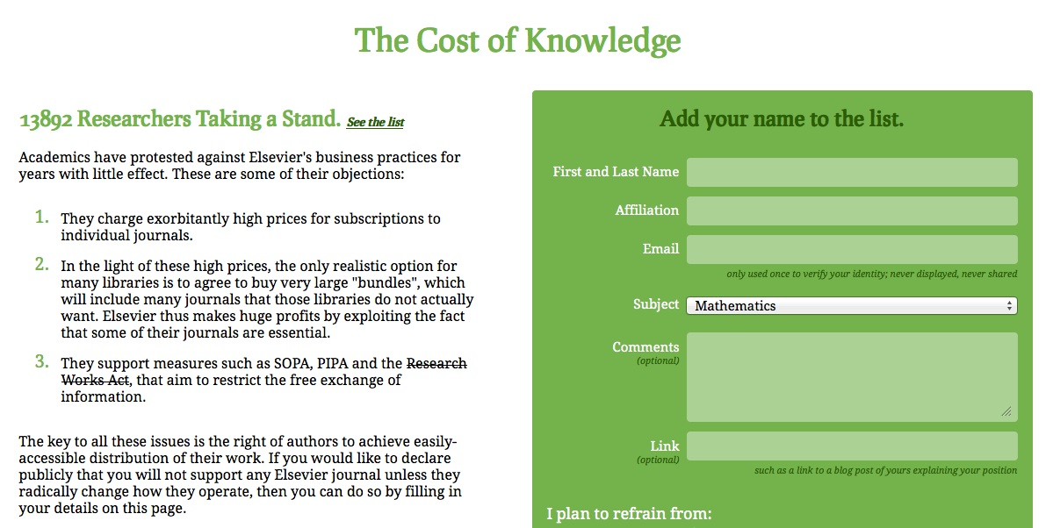
Elsevier boycott:
The Cost of Knowledge http://thecostofknowledge.com/
Heather Morrison
Notes:
This is from a Reuters news announcement about the sale of Springer earlier this year. The news announcement outlines the recent history of the company. In 2004, two private equity firms, Candover and Cindven (which at the time described themselves as Europe’s largest buyout firm) created Springer Science+Business Media by acquiring and merging two other publishing firms. A buyout firm is just what it says – a company that buys other companies and re-sells them later. To make money, a buyout firm has to sell the company for a higher price than it paid to buy it. In 2008, Springer bought BioMedCentral, the world’s largest open access publisher. In 2009, Springer was sold to another set of private equity firms, and earlier this year, Springer was sold again to another buyout firm, BC partners. The creditors who loaned the money to finance the sale include Goldman Sachs and JP Morgan. This means that any time you write, peer review, edit for, or buy a Springer or BioMedCentral journal or service, you are contributing to the bottom lines not only of Springers, but also Goldman Sachs and JP Morgan. Let’s consider what happens when a company like this changes hands in this way four times in less than a decade. No doubt Kluwer and BertelssmanSpringer, Candover and Cindven, BioMedCentral, EQT and GIC all negotiated for the very best price for their companies that they could get. I haven’t checked to see if loans were arranged to finance the purchase each time there was a turnover, but if there was, that wouldn’t be surprising. What does this mean for how the company runs? When we pay for a subscription or an open access article processing charge for a Springer or BioMedCentral journal, the money doesn’t just cover the operations of the journal – the editing, technical support, and marketing, the functions we are familiar with. The money is also needed to pay off the loans that financed the sales and to feed the profits of the companies that have bought and sold the company in the past few years.

Slide 13
Estimated annual revenue & profit 4 largest commercial scholarly publishers
U.S. $ billions
 | Revenue (U.S. $ billions) | Profit (U.S. $ billions) | % profit | notes
Elsevier | 3 | 1 | 37% | revenue up 3%, profits up 6%
Springer | 1.4 | .5 | 35%
Wiley | .98 | .27 | 28% | revenue rose 5%; adjusted contribution to profit rose 13%
Informa (T&F) | .5 | .2 | 33%
Total | 6 | 2 | 35%
Based on Most recent financial report / scholarly pub. Section Bank of Canada currency conversion Oct. 22, 2013 Quarterly / half results multiplied
Heather Morrison

Slide 14
Not all publishers are like this!
Many scholarly society journals are free to both authors and readers
Many scholarly society journals have always had, and still have, modest subscription charges and revenues
Many university presses are subsidized, and many are struggling
Heather Morrison

Slide 15
So a few companies are making lots of money. What’s the problem?
Heather Morrison
Notes:
So what’s wrong with that? We live in a capitalist society. From a shareholder perspective, this sounds like a great deal, doesn’t it? Do our pension plans know about these companies? Well, let’s have a look at where that money is coming from.

Slide 16
International Association of Scientific, Medical and Technical Publishers (STM): Copyright & Legal Affairs
An Introduction to Copyright & Legal Affairs
“As the voice of academic and professional publishers, STM actively engages with an international community of stakeholders on copyright and legal issues in the digital age”
The Aims of the Copyright & Legal Affairs Committee
To pursue, within the limits of the STM Association's aims and objectives, the highest possible level of international protection of copyright works
Heather Morrison

Slide 17
What do I get from STM? What we do
Copyright, Legal & Legislative Efforts
Defence of publisher and rights-holder positions in precedent-setting copyright disputes and proposed government legislation

Slide 18
STM Copyright, Legal & Legislative Efforts: Recent Actions
“Advocacy for strong copyright laws in Canada, Brazil, India. Slowed Canadian Bill C-32 until Bill fell in elections; forced Brazilian copyright act to go back to drawing board; partial success in India”
Enforcement Task Force
Negotiate with major libraries engaged in the business of document supply to find licensing solutions to unauthorised "international library document supply services

Slide 19
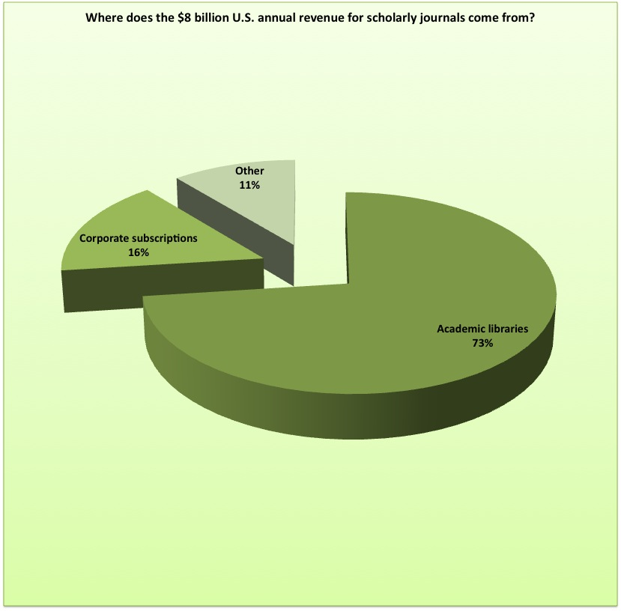
Where does the $8 billion annual revenue for scholarly journals come from?
Other:
$.9 billion
Academic libraries: $5.8 billion (73%)
Other library subscriptions: $1.3 billion
Heather Morrison
Notes:
Elsevier, Springer, Wiley & Informa are only 4 of the companies and not-for-profit publishers involved in scholarly publishing. Altogether the scholarly journals “business” is worth about $8 billion a year. Most of the revenue for this business comes from academic libraries, 73% or about $5.8 billion annually, with another large chunk coming from other library subscriptions. Altogether libraries account for about 90% of the revenue for this industry.

Slide 20
To recap…
Scholar volunteers do the work of writing, editing & review
Universities pay scholars
Universities fund scholarly publishers through subscriptions
A few scholarly publishers are making billions with profit margins in the 30% range
…how are scholars and universities doing?
Heather Morrison

Slide 21
State of the university: be open to change
“the university needs to move forward with the realization that Alberta is curtailing spending on post-secondary education along with most governments in North America. The university community, she said, must be “open to change," and to considering courses of actions we once hoped to avoid—including the voluntary severance program.
“We have had to make some difficult decisions,” she said, recounting the $28 million in spending cuts this year. With a further $56 million to cut in 2014-15,
- Samasekera, University of Alberta Sept. 2013
Heather Morrison
Notes:
The cuts at the University of Alberta have been particularly deep, but the U of A is by no means alone in this – many universities in the US have had double-digit cuts year after year since the budget crisis. In 2010, the UK government announced that they would end funding for humanities and social sciences teaching altogether. Certainly in Ontario budgets are tight. Any new expenditure has to be justified, and the government is taking a tough look at existing expenses with an eye to eliminating duplication. Perhaps this is different at the University of Regina?

Slide 22
The PhD now comes with food stamps
“Some adjuncts make less money than custodians and campus support staff who may not have college degrees. An adjunct's salary can range from $600 to $10,000 per course, according to the Adjunct Project, a crowdsourced database about adjuncts' salaries and working conditions. The national average earnings of adjunct instructors are just under $2,500 per course, according to the American Association of University Professors”.
(Patton, Chronicle of Higher Education)
Notes:
75% of courses in the U.S. now taught by adjuncts or sessionals – not sure of the situation in Canada.

Slide 23
Students: “a generation in debt”
“Federal and provincial government decisions are forcing students to take on more education-related debt than any previous generation, while middle class earnings have largely stagnated in the past twenty years.”
The Canadian student fiscal cliff: in 2010 total ‘official debt’ reached maximum of $15 billion
(Canadian Federation of Students)

Slide 24

Heather Morrison

Slide 25
More impact on universities..
Greek universities closed
U.S. government – world’s largest funder of medical research, major funder across the disciplines – shut down for 2 weeks earlier this year
2010 UK government announced it would eliminate funding for humanities and social sciences teaching
Heather Morrison

Slide 26
EBSCO Serials Price Projections for 2014
“At the time of writing, we expect the overall effective publisher price increases for academic and academic/medical libraries for 2014 (before currency impact) to be in the range of 6 to 8 percent”.
Heather Morrison
Notes:
+ hybrid OA article prcoessing fees

Slide 27
The problem: an inelastic market
Inelastic market = a market that does not respond to normal market signals (like major financial stresses for suppliers and consumers)
Flat or declining budgets for universities, fewer secure jobs for scholar / authors, debt burden for students but no impact on the scholarly publishing industry that evolved to serve all of these groups
So how did this happen?
Heather Morrison

Slide 28
Impact Factor!
Must publish in high impact journals for tenure & promotion
Must subscribe to do research
= publisher power!
Are we helpless?
Heather Morrison

Slide 29
Dramatic Growth of Open Access
~ 10,000 journals (Directory of Open Access Journals)
> 1,500 books (Directory of Open Access Books) (> 57 publishers)
> 2,200 open access archives (OpenDOAR)
> 50 million documents (Bielefeld Academic Search Engine)
Heather Morrison

Slide 30
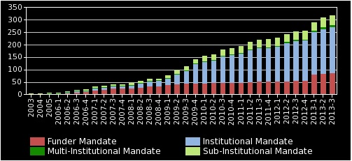
Open access policies (ROARMAP)
Heather Morrison

Slide 31
We’ve come a long way… what else needs to be done?
Transitioning economics
More and better policies
Academic voices are needed
Critical reflection on options

Slide 32
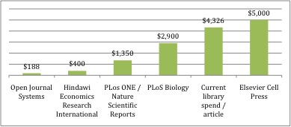
Per-article costs
Heather Morrison
Notes:
If you divide the $5.8 billion annually that libraries are spending on scholarly journals by the approximately 1.5 million scholarly articles published every year, you get a ballpark figure of about $4,300 that academic libraries around the world spend for every article published in subscriptions journals. As you can see from this chart, a number of open access journals have per-article costs that are much lower than this. Edgar & Willinsky conducted a survey of over 900 journals using Open Journal Systems and found an average per-article expenditure of $188 / article. The PLoS ONE fee of $1,350 per article is about a third of the per-article cost under the subscription model – and recently PLoS posted a surplus of 23%! The hybrid OA fee for an Elsevier Cell Press journal is $5,000. The key point is that a global transition to open access opens up the possibility for tremendous savings for academic libraries, and hence universities. However, we cannot take this as a given. At the OJS average rate libraries could save 96%. If PLoS ONE were the average rate, libraries could save two-thirds of current costs. On the other hand, if we pay companies like Elsevier $5,000 for open access article processing fees as average, that would increase the global cost of scholarly publishing.

Slide 33
Potential savings with full transition to open access
OJS $188: about 4% of current spend
PLoS ONE: about 1/3 of current spend
Key is not just OA but cost-effective publishing
More research needed on library publishing

Slide 34
Why do we need savings?
Academic jobs!
2/3 of $5.8 billion current academic library expenditures = $3.9 billion.
At average annual salary of $100,000, that 39,000 jobs!
If average RA = $6,000, that’s 650,000 RAs!
8% increase on $1 million subscription = 1 senior or two junior faculty positions
New needs!
Research data management & preservation
Archiving scholarly blogs and websites
Heather Morrison

Slide 35
Altmetrics?
Heather Morrison

Slide 36
San Francisco Declaration on Research Assessment (DORA)
General Recommendation
1. Do not use journal-based metrics, such as Journal Impact Factors, as a surrogate measure of the quality of individual research articles, to assess an individual scientist's contributions, or in hiring, promotion, or funding decisions.
Heather Morrison

Slide 37
Redefining impact
Solve global warming
Find clean energy solutions
Develop an economic system that works – and is stable and sustainable
Achieve world peace
Maximum quality of life / minimum illness
Evidence-based practice
Heather Morrison

Slide 38
Impact for the real world: how to get there?
Open research
Collaboration
Human genome project
Heather Morrison

Slide 39
Open access mandate policies
About 13 Canadian funders’ open access policies
Institutional policies
Tri-agency draft open access policy

Slide 40
Draft tri-agency open access policy (comments due Dec. 13)
Preamble:
As publicly funded organizations, the Agencies have a fundamental interest in promoting the availability of findings that result from the research they fund, including research publications, to the widest possible audience, and at the earliest possible opportunity. Societal advancement is made possible through widespread and barrier-free access to cutting-edge research and knowledge, enabling researchers, scholars, clinicians, policy-makers, private sector and not-for-profit organizations and the public to use and build on this knowledge.
CIHR already in effect – NSERC and SSHRC proposed Sept. 1, 2014
Heather Morrison

Slide 41
Draft tri-agency open access policy: principles
Committing to academic freedom, and the right to publish;
Maintaining the high standards and quality of research by committing to academic openness, integrity and ethics;
Promoting recognized research best practices and standards across disciplines, and embracing and sharing emerging practices and standards;
Advancing academic research, science and innovation;
Effective diffusion of research results; and
Aligning activities, programs and policies between Canadian and international research funding agencies.
Heather Morrison

Slide 42
Draft tri-agency open access policy: policy statement
Grant recipients are required to ensure that any peer-reviewed journal publications arising from Agency-supported research are freely accessible within 12 months of publication, either through the publisher's website (Option #1) or an online repository (Option #2).
Heather Morrison

Slide 43
Draft tri-agency open access policy: option 1
Option #1: Grant recipients submit their manuscript to a journal that offers immediate open access to published articles, or offers open access to published articles within 12 months.
The Agencies consider the cost of publishing in open access journals to be an eligible expense under the Use of Grant Funds.
Heather Morrison

Slide 44
Draft tri-agency open access policy: option 2
Option #2: Grant recipients archive the final peer-reviewed full-text manuscript in a digital archive where it will be freely accessible within 12 months (e.g., institutional repository or discipline-based repository). It is the responsibility of the grant recipient to determine which publishers allow authors to retain copyright and/or allow authors to archive journal publications in accordance with funding agency policies.
Grant recipients must acknowledge Agency contributions in all peer-reviewed publications, quoting the funding reference number.
Heather Morrison

Slide 45
Draft tri-agency open access policy: publication-related research data (CIHR only)
Recipients of CIHR funding are required to adhere with the following responsibilities: deposit bioinformatics, atomic, and molecular coordinate data into the appropriate public database (e.g. gene sequences deposited in GenBank) immediately upon publication of research results;
retain original data sets for a minimum of five years (or longer if other policies apply).
t
Heather Morrison

Slide 46
Draft tri-agency open access policy: additional information
Information on publicly available archives or repositories in which researchers can deposit journal publications is available on the following Web sites:
Canadian Institutional Repositories PubMed Central Canada (repository for health sciences) Directory of Open Access Repositories (international)
A list of funds available from Canadian universities that assist authors in making their publications open access, can be found at the Canadian Association of Research Libraries Web site.
Heather Morrison

Slide 47
Draft tri-agency open access policy: public submissions (to date)
Stevan Harnad (UQAM) http://mailman.ecs.soton.ac.uk/pipermail/goal/2013-October/002235.html
Heather Morrison http://poeticeconomics.blogspot.ca/2013/10/canadas-tricouncil-draft-open-access.html
In progress: Advocates for Canadian Open Access (ACOA)
Heather Morrison

Slide 48
ACOA draft response to tri-agency open access policy: key points
Overall: model policy
Supports transition to open access publishing
Because OA publishing is an option, not a requirement, allows market forces to operate
Supports academic freedom by not forcing authors to choose OA journals
Needs work: open access archiving in a Canadian-based repository should be required, even when authors publish open access
Embargoes overly generous, should be shortened to 6 months with view to eventual elimination
Heather Morrison

Slide 49
Advocates for Canadian open access (ACOA) / Les avocats pour libre accès canadien (APLAC)
Publishers actively lobbying, libraries & administrators part of the conversation
Scholars’ voices needed! Why?
  Don’t take money from research funds!
  Don’t make more work for scholars without taking some away (my comment – once in the repository, shouldn’t have to reformat for grant application CV ever again)
Heather Morrison

Slide 50
ACOA / APLAC – please join!
https://docs.google.com/document/d/1C4HksXi399pqUNitVy0eEcIn0cTC9hU1g5tmUYA4OQI/edit?usp=sharing
Heather Morrison

Slide 51
Institutional open access policy
Librarians, Archivists & OURspace
Faculty permissions policy (Harvard, MIT) – copy text of MIT
Top-down policy – Liège
Heather Morrison

Slide 52
MIT Faculty Open Access Policy
“Each Faculty member grants to the Massachusetts Institute of Technology nonexclusive permission to make available his or her scholarly articles and to exercise the copyright in those articles for the purpose of open dissemination. In legal terms, each Faculty member grants to MIT a nonexclusive, irrevocable, paid-up, worldwide license to exercise any and all rights under copyright relating to each of his or her scholarly articles, in any medium, provided that the articles are not sold for a profit, and to authorize others to do the same. The policy will apply to all scholarly articles written while the person is a member of the Faculty except for any articles completed before the adoption of this policy and any articles for which the Faculty member entered into an incompatible licensing or assignment agreement before the adoption of this policy. The Provost or Provost’s designate will waive application of the policy for a particular article upon written notification by the author, who informs MIT of the reason”.

Slide 53
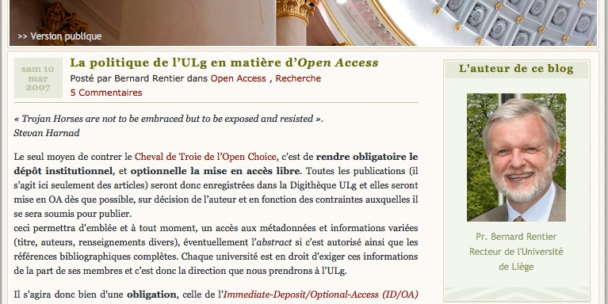
Université de Liège http://recteur.blogs.ulg.ac.be/?p=103

Slide 54
Use UR services – and demand more!
OURspace
UR library publishing services
Author’s fund?
Ask questions!
Notes:
Demand more – e.g. what about making changes / more flexible (SFU; changed to Drupal SUMMIT); RSS feed to communication department. I want to be able to approve docs myself!

Slide 55
Research & critical reflection needed
Open Access Directory – Research Questions
Sustainability for scholar-led publishing (resource requirements, infrastructure costs)
Article Processing Charges – open research
Policy analysis
Mapping open access and creative commons
Heather Morrison

Slide 56
Conclusion
Scholarly communication should be, and can be, about sharing and building together the collective knowledge of humankind, to develop solutions to our common problems and to satisfy our inherent curiosity.
We can make this happen. First, we need to understand the current overlapping set of systems, the scholarly gift economy and the multi-billion dollar business. Then we need to look at the options, and advance towards the choices that are consistent with our ultimate goals. This is what I call rational rationality – but that’s a topic for another time.
Heather Morrison

Slide 57
References
Canadian Association of University Teachers. March 2013. A bad budget for the future of post-secondary education, research and training. http://www.caut.ca/news/2013/03/22/a-bad-budget-for-the-future-of-post-secondary-education-research-and-job-training
Canadian Federation of Students. Student Debt. Retrieved October 2013 from http://cfs-fcee.ca/the-issues/student-debt/
*** Declaration on Research Assessment (DORA).
EBSCO. Serials Prices Projections 2014. http://www2.ebsco.com/en-us/Documents/PriceProjections2014.pdf
Edgar, B.D. & J. Willinsky, 2010. “A survey of the scholarly journals using open journal systems”. Scholarly and Research Communication 1:2, at http://src-online.ca/index.php/src/article/view/24, accessed Feb. 11, 2013.
Informa. For investors. Retrieved from http://www.informa.com/investor-relations/
International Association of Scientific, Technical and Medical Publishers (STM). Copyright and Legal Affairs. Retrieved from http://www.stm-assoc.org/copyright-legal-introduction/
MIT Faculty Open Access Policy. http://libraries.mit.edu/scholarly/mit-open-access/open-access-at-mit/mit-open-access-policy/

Slide 58
References
Patton, S. 2012. The PhD now comes with food stamps. The Chronicle of Higher Education May 6, 2012 http://chronicle.com/article/From-Graduate-School-to/131795/
Reed Elsevier. 2013 Interim Results. Retrieved from http://www.stm-assoc.org/copyright-legal-introduction/
Reuters. June 19, 2013. BC Partners to buy Springer for 3.3 billion Euros http://www.reuters.com/article/2013/06/19/us-springerscience-sale-idUSBRE95G17120130619
Samasekera. September 2013. State of the university: be open to change. University of Alberta Press Release. http://news.ualberta.ca/newsarticles/2013/september/state-of-the-university-be-open-to-change#sthash.3rvo8P2Q.dpuf
San Francisco Declaration on Research Assessment. http://am.ascb.org/dora/
Springer. Overview 2012. Retrieved from http://www.springer.com/about+springer/company+information/annual+report?SGWID=0-175705-0-0-0
Wiley reports first quarter 2014 results. Retrieved from http://ca.wiley.com/WileyCDA/PressRelease/pressReleaseId-109504.html

Slide 59
Questions? Contact:
Dr. Heather Morrison
Assistant Professor
École des sciences de l'information / School of Information Studies
University of Ottawa
http://www.sis.uottawa.ca/faculty/hmorrison.html
The Imaginary Journal of Poetic Economics http://poeticeconomics.blogspot.com
Heather.Morrison@uottawa.ca
Heather Morrison

