Slide 1

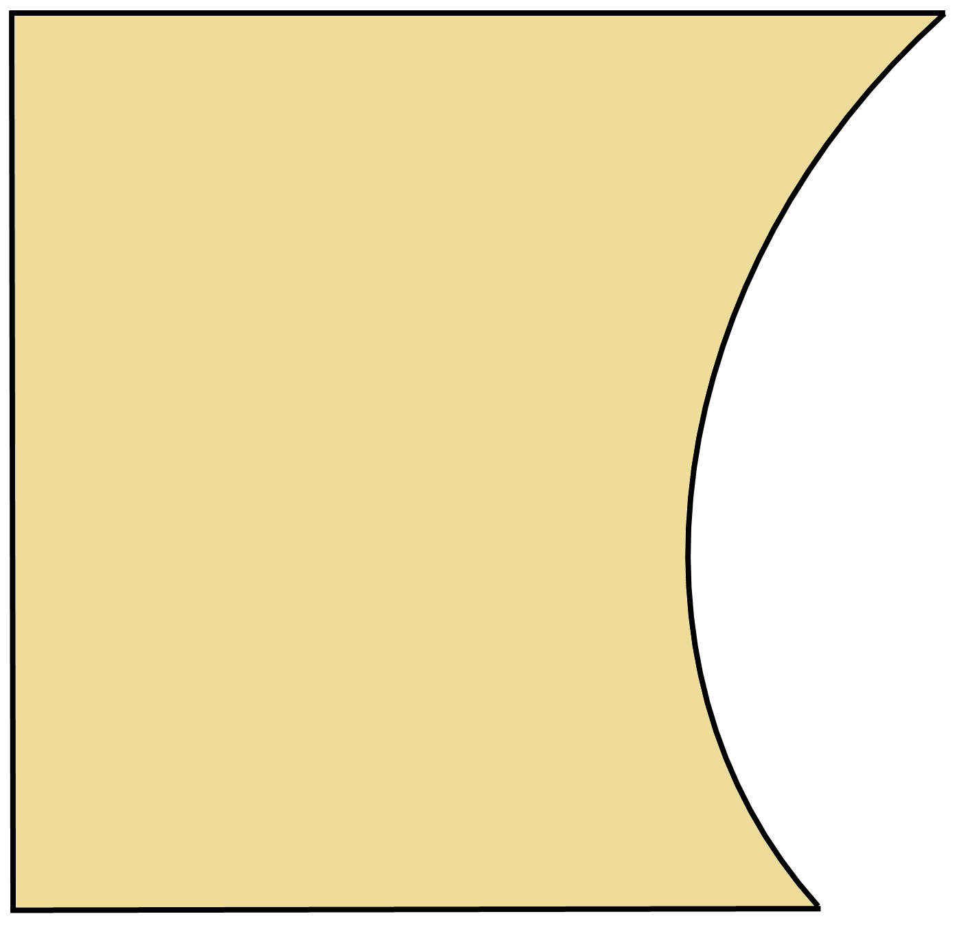
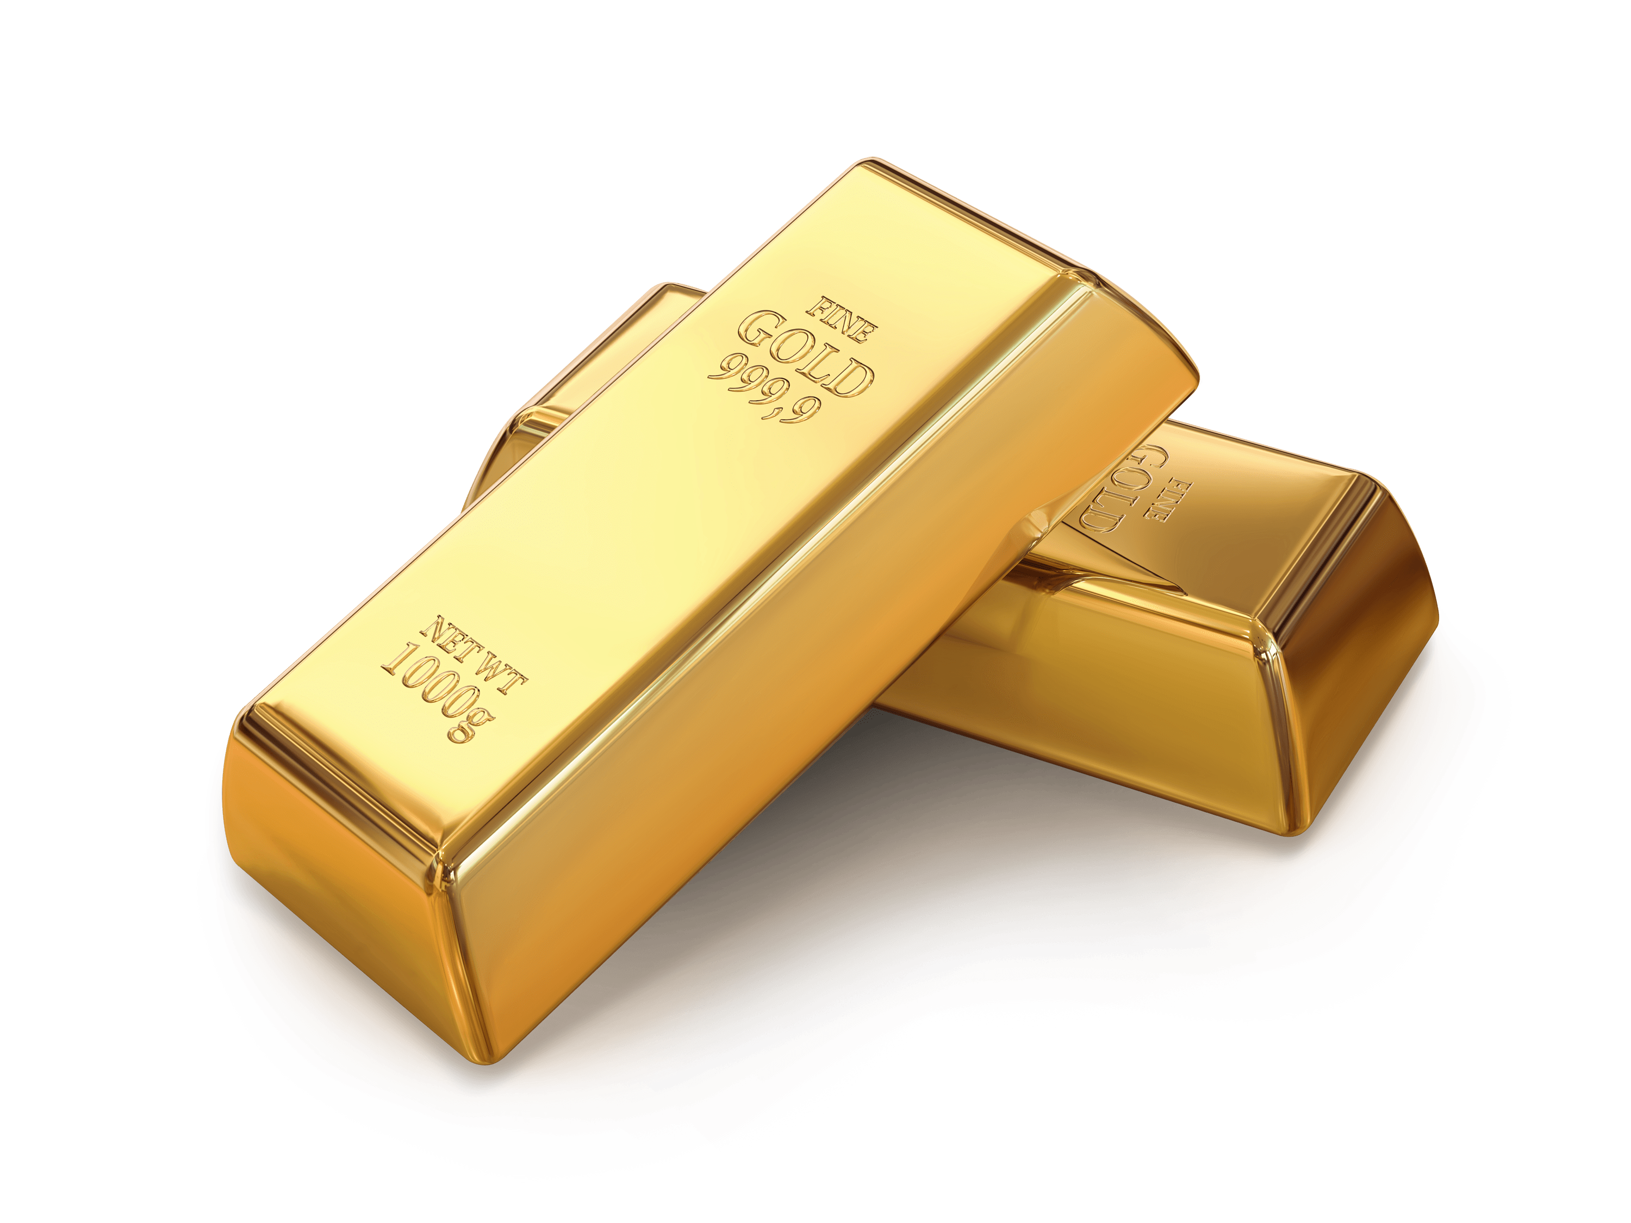

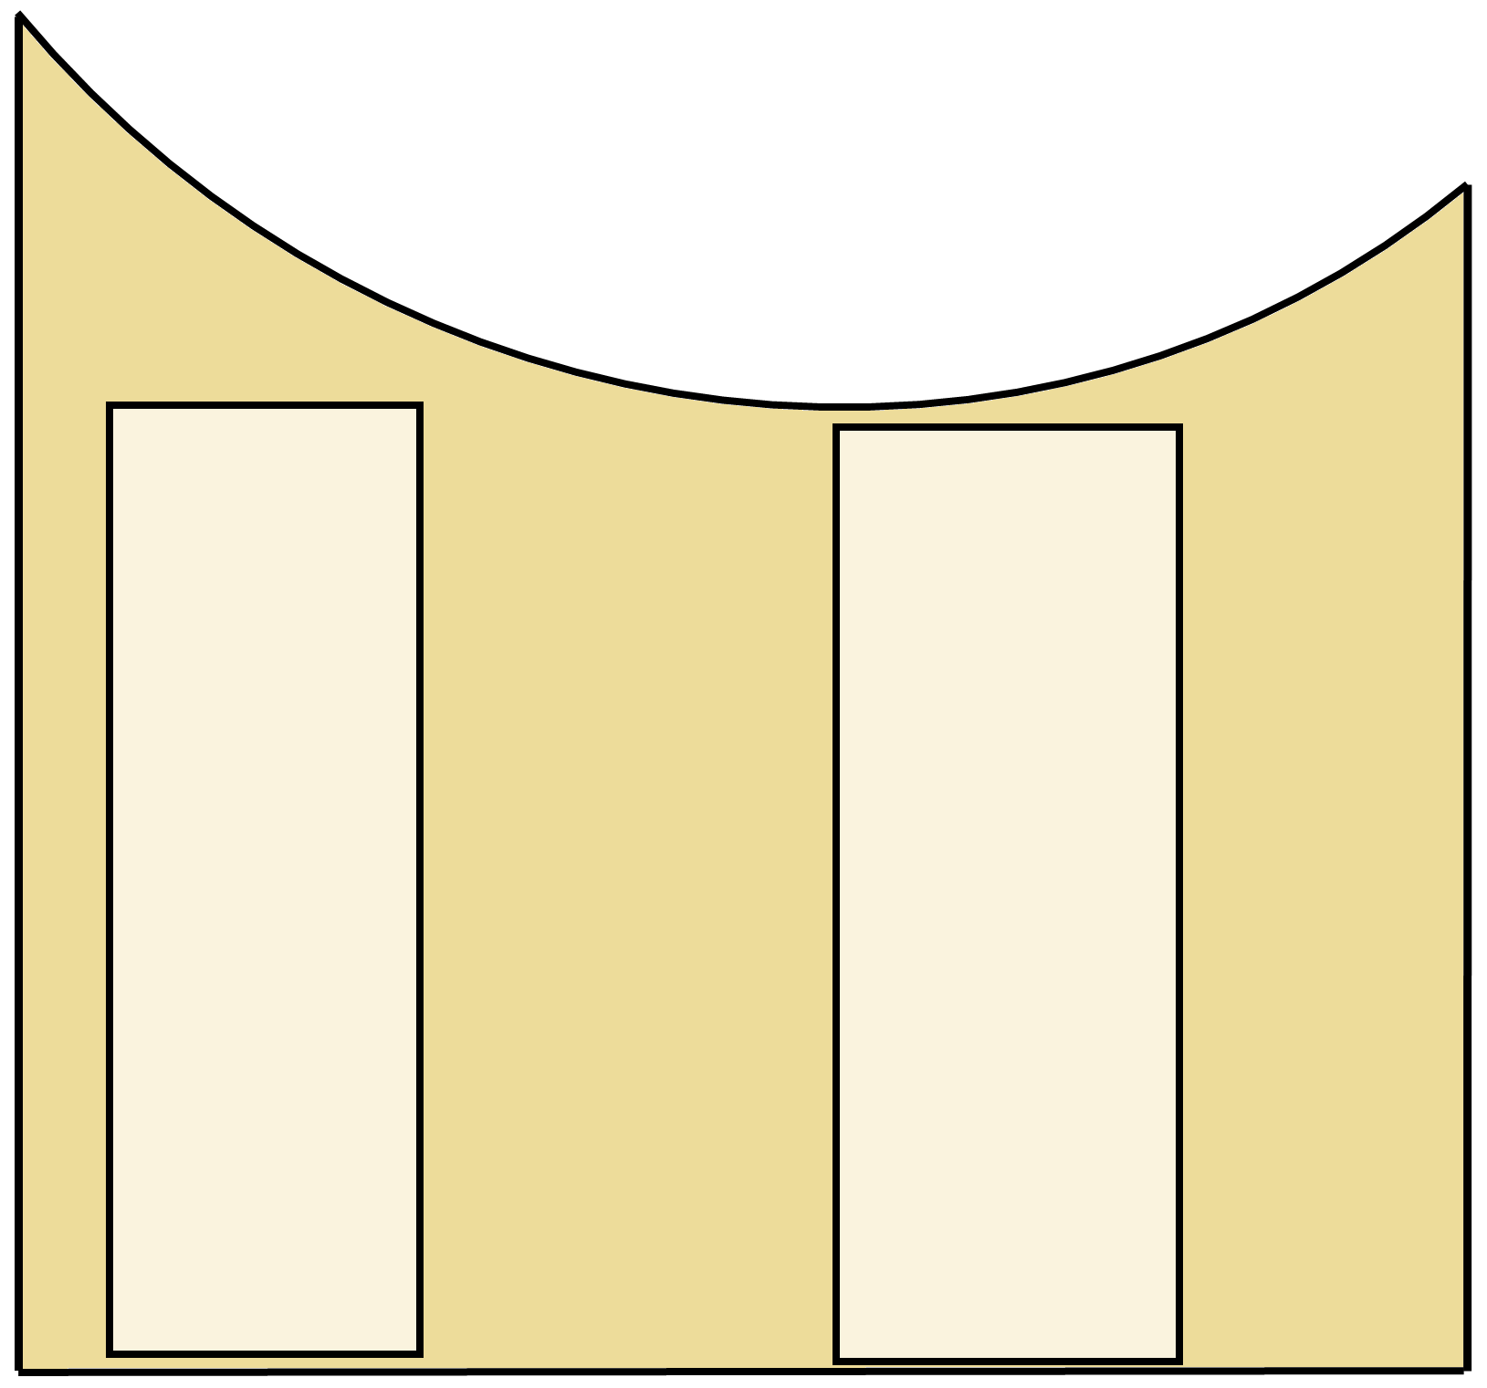
Aromatization using gold catalysis
D. Campeau; Q. Zhao; D. Leon Rayo; M. Sanita; M. Daenen; D. Dong; F. Gagosz*
Faculty of Sciences & Dept. of Chemistry and Biomolecular Sciences, University of Ottawa.
Gold Catalyst
Introduction
During the past few decades, gold (I) has
been emerging as an interesting source of
catalyst.
Catalysts are molecules that reduce the amount of time and energy needed for
a given reaction.
Catalysts can help to reach higher
complexity in organic molecules.
Gold (I) has a distinct reactivity due to
its strong affinity for π insaturations
(i.e. double or triple bonds).
Conclusion
Indicated on the left is the
proposed reaction mechanism.
The reaction is dual gold
catalyzed (i.e. two molecules
of gold are involved in the
process.
The good yields from 30+
substances studied in the
scope indicate this reaction is
efficient and broadly applicable.
By changing the nature of the
substituents used, intermediate
5 can be pushed towards the
formation of azulenes and fulvenes.
Intermediate 4 could be potentially
trapped using other nucleophilic sources.
In this study, we observe the
rearrangement of an easy to access,
linear molecule into a more complex
polycyclic product.
Methodology
Discovery of New Reaction
Optimization of Reaction Conditions
Scope of Reaction & Mechanistic Studies
Concept Extensions
Proof of Concept
Idea for New Reaction
Acknowledgments :
Scope
I thank the University of Ottawa and Dr. Gagosz for the opportunity to participate in this work. I also thank the Undergraduate Research Opportunity Program for providing financial support.
This work is supported by a Discovery Grant from NSERC.
I arrived here!
References :
For a review on gold & platinum catalysis, see:
A. Fürstner, P.W. Davies. Angew. Chem. Int. Ed., 2007, 46, 3410-3449
For an account on dual gold catalysis, see:
A.S.K. Hashmi. Acc. Chem. Res. 2014, 47, 864–876
Image used on this poster:
http://www.stickpng.com/img/objects/money/gold-ingots
(this study in green)
*with 0.5 eq. 3,5-dibromopyridine

