Slide 1

Module 0: Introduction
(Knowing Your Audience)
Curtesy of:
Dr. Erin Parkes
Jenna Richards
CC-BY NC SA 4.0

Slide 2

Purpose of the intro module
Introduce neurodiversity and disability topics to provide a foundation for Modules 1-3 in the OER

Slide 3

Today’s Class
Review Learning Objectives
Introduce inclusivity and accessibility
Define neurodiverse and disability
Discuss common diagnoses amongst audience members
Compare/contrast music therapy & performance practices
Outline further reading

Slide 4
Learning Objectives
Define terminology relevant to inclusivity and accessibility in the performing arts
1
Identify common diagnoses of individuals who may attend performing arts events
2
Compare & contrast music therapy and music performance
3

Slide 5
Defining Disability
Ontario Human Rights Commission: “defines ‘disability’ as:
Any degree of physical disability, infirmity, malformation or disfigurement that is caused by bodily injury, birth defect or illness and, without limiting the generality of the foregoing, includes diabetes mellitus, epilepsy, a brain injury, any degree of paralysis, amputation, lack of physical co-ordination, blindness or visual impediment, deafness or hearing impediment, muteness or speech impediment, or physical reliance on a guide dog or other animal or on a wheelchair or other remedial appliance or device,
A condition of mental impairment or a developmental disability,
A learning disability, or a dysfunction in one or more of the processes involved in understanding or using symbols or spoken language;
A mental disorder, or
An injury”
https://www3.ohrc.on.ca/en/policy-ableism-and-discrimination-based-disability/2-what-disability#:~:text=A%20disability%20may%20be%20the,people's%20full%20participation%20in%20society.

Slide 6

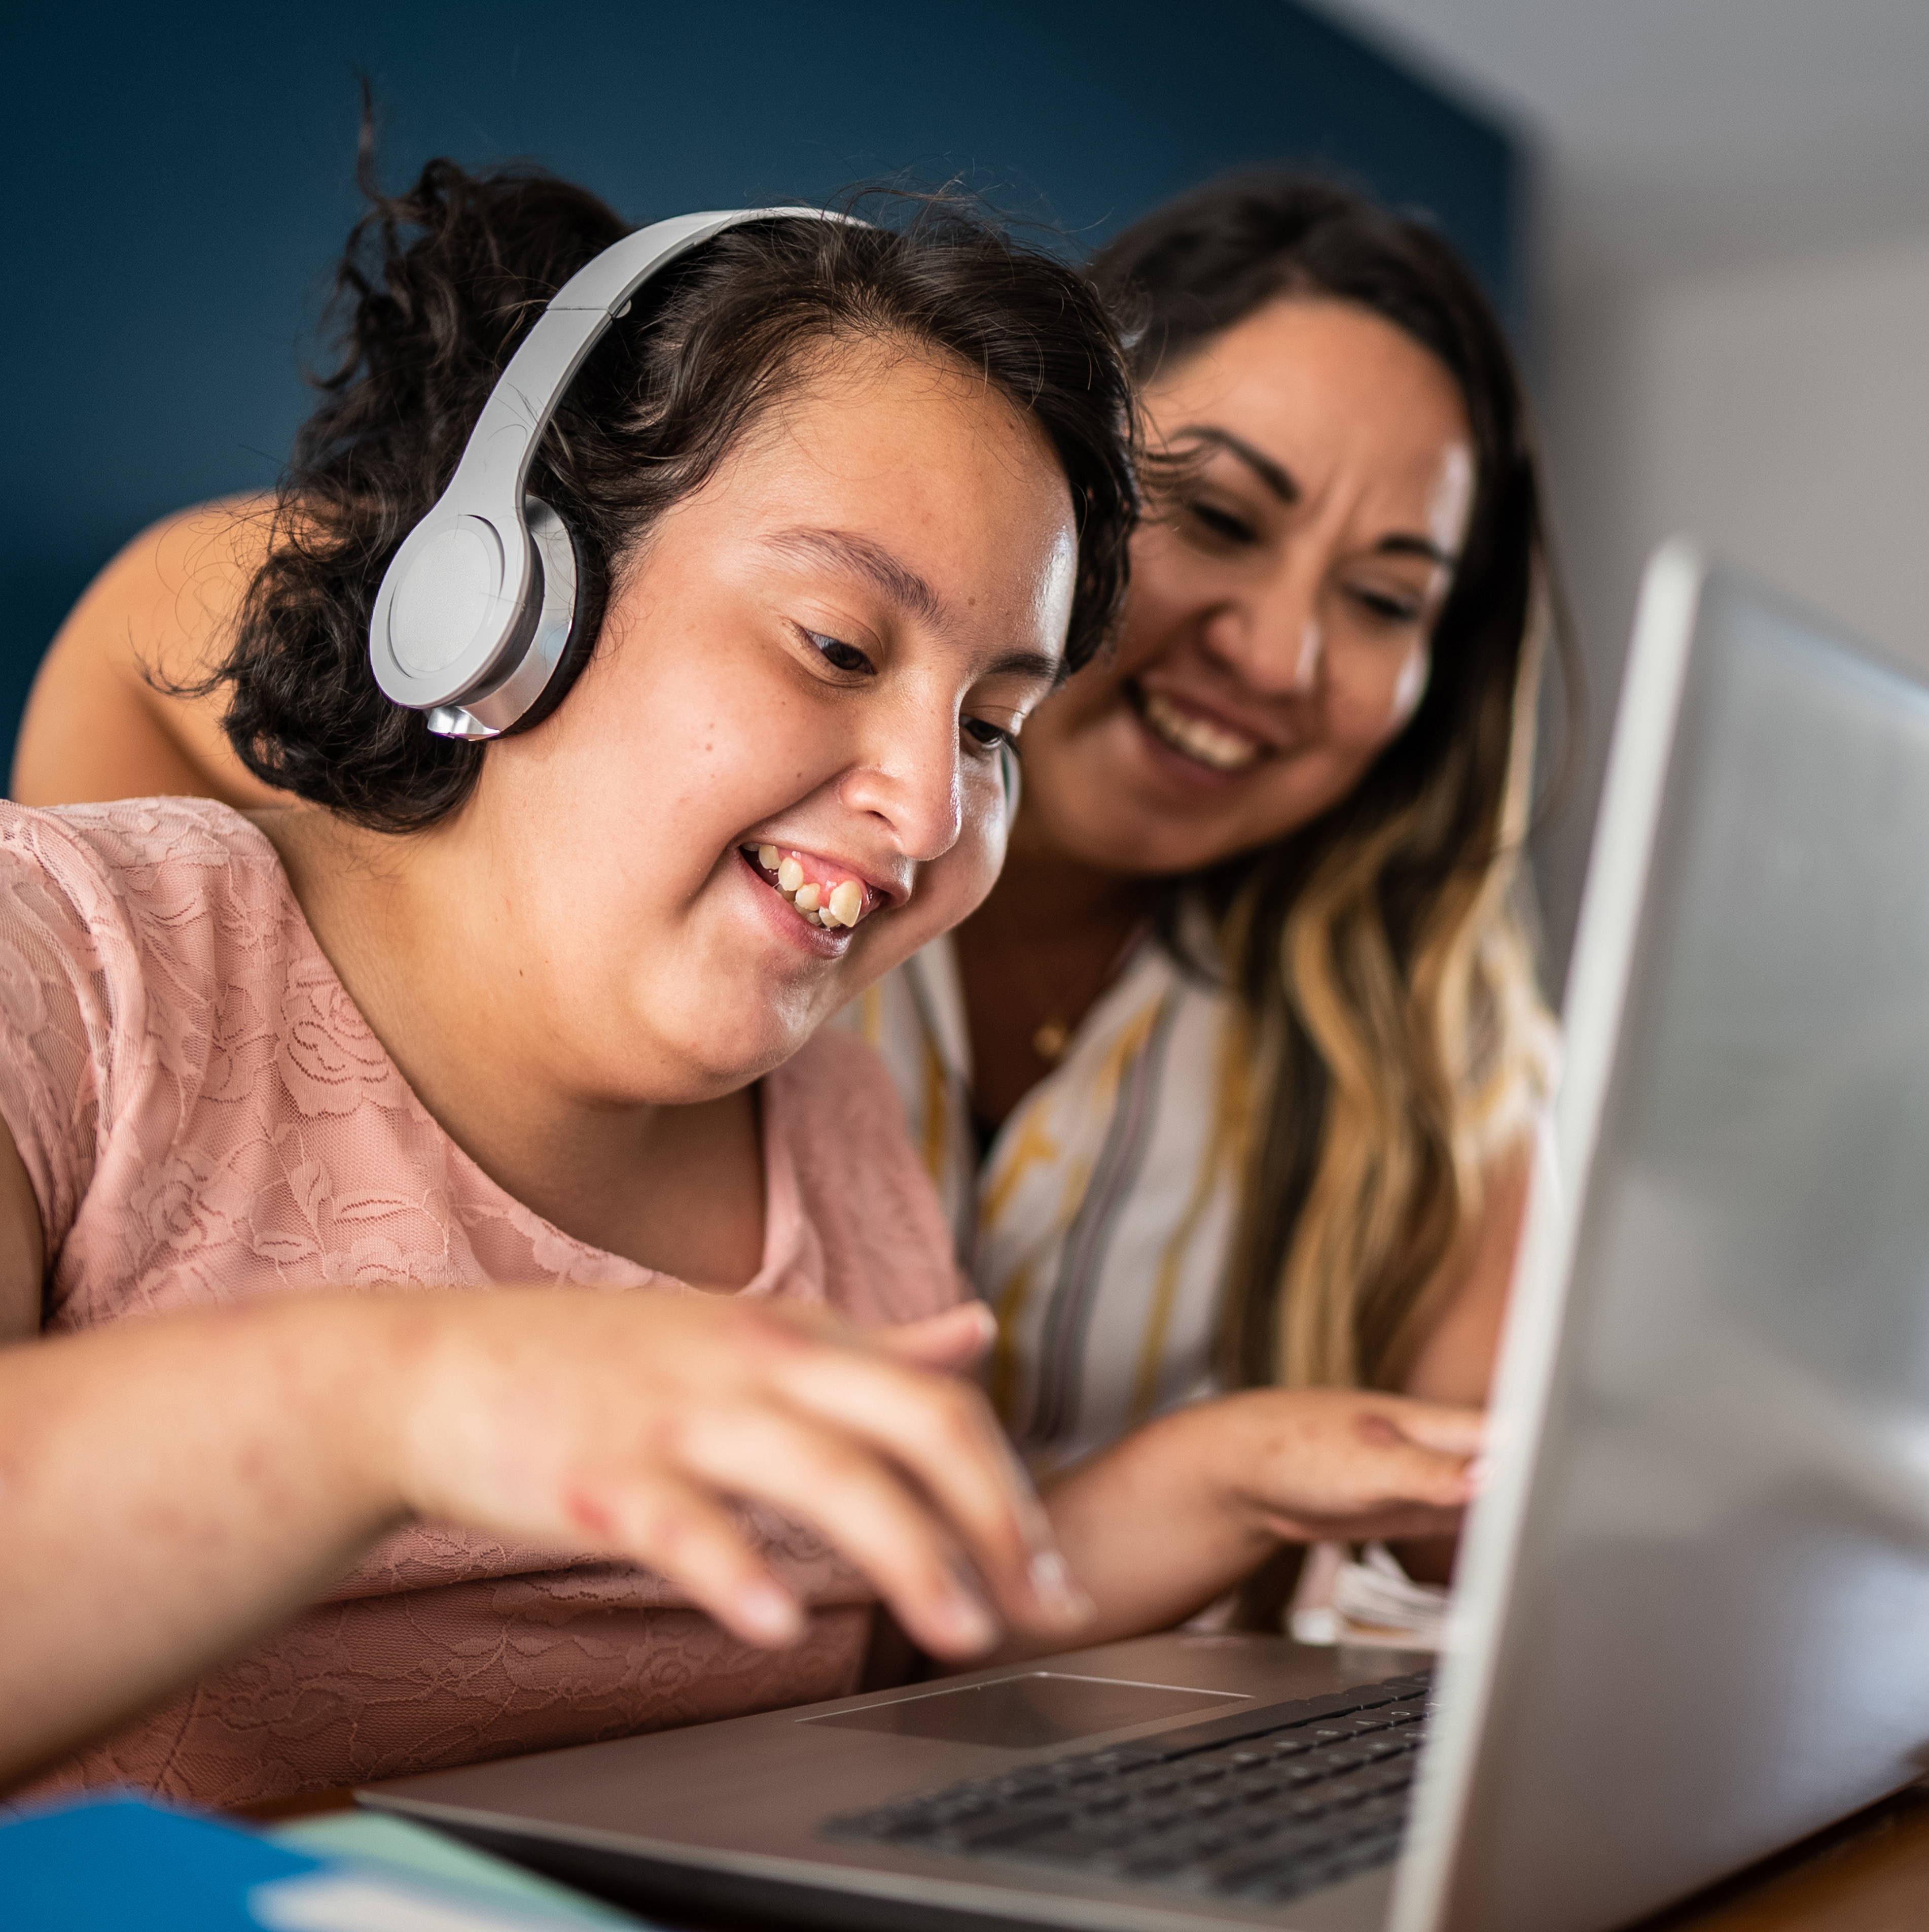
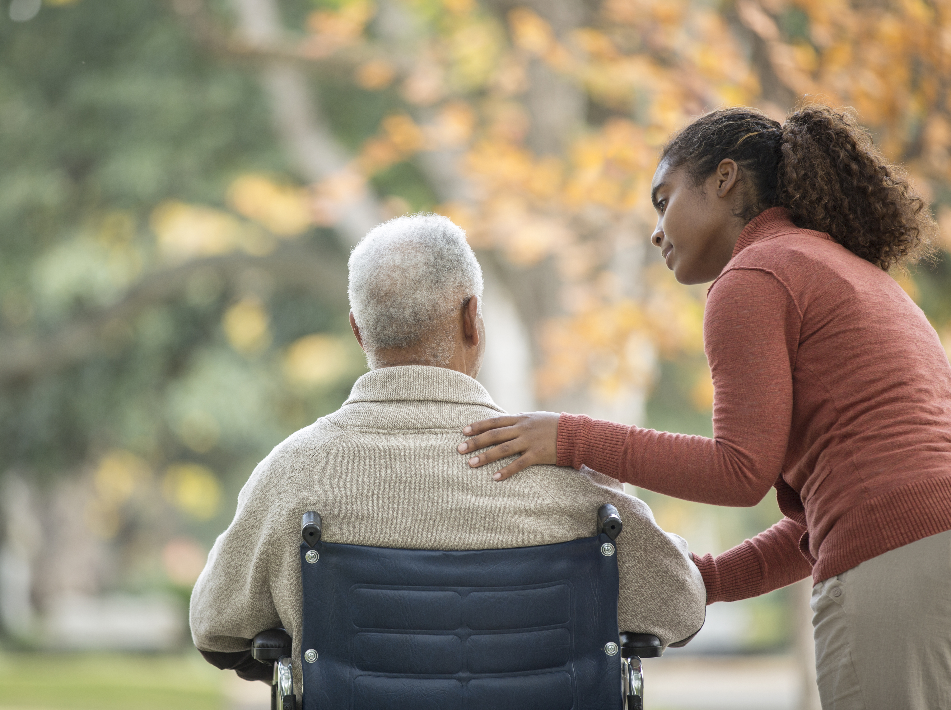
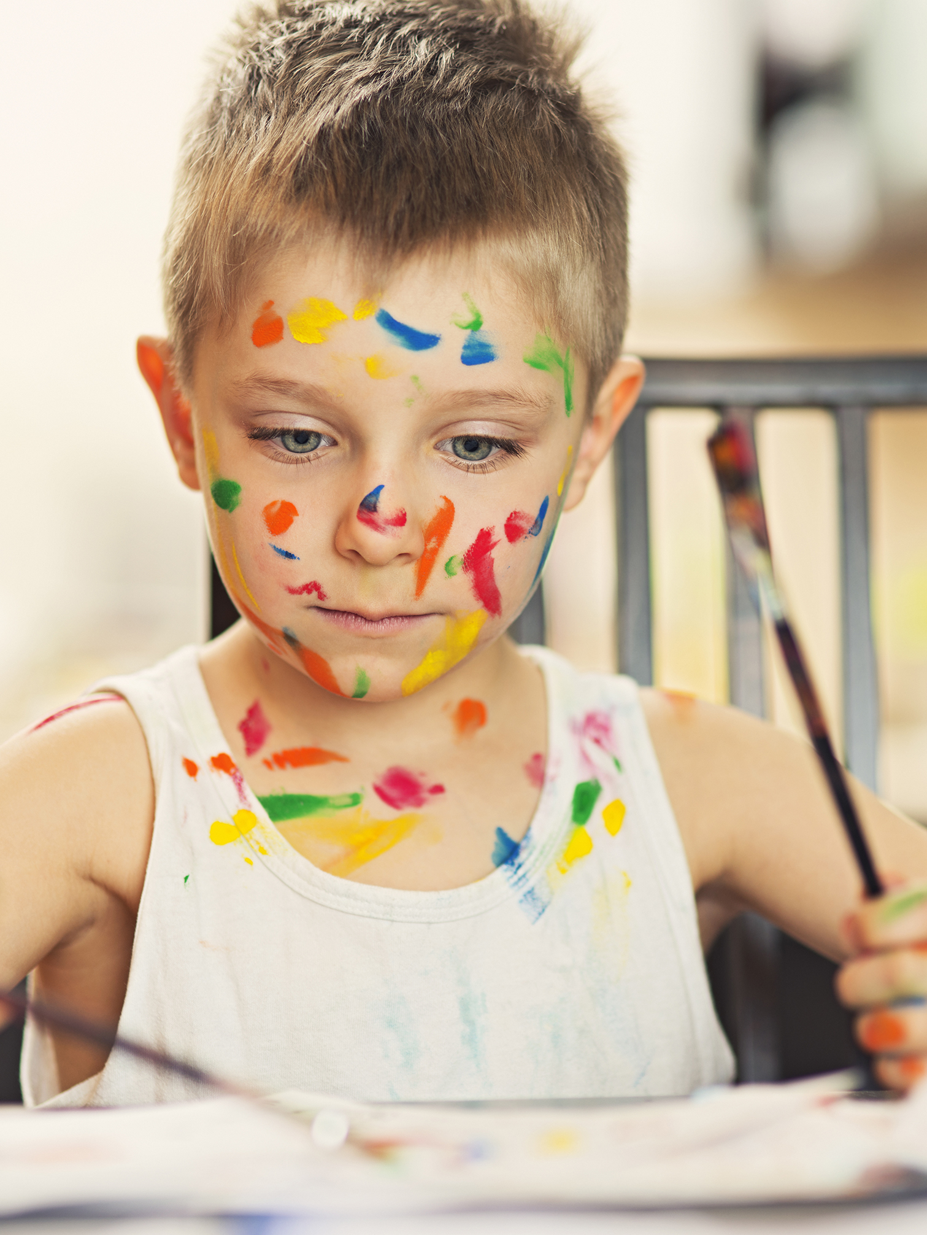

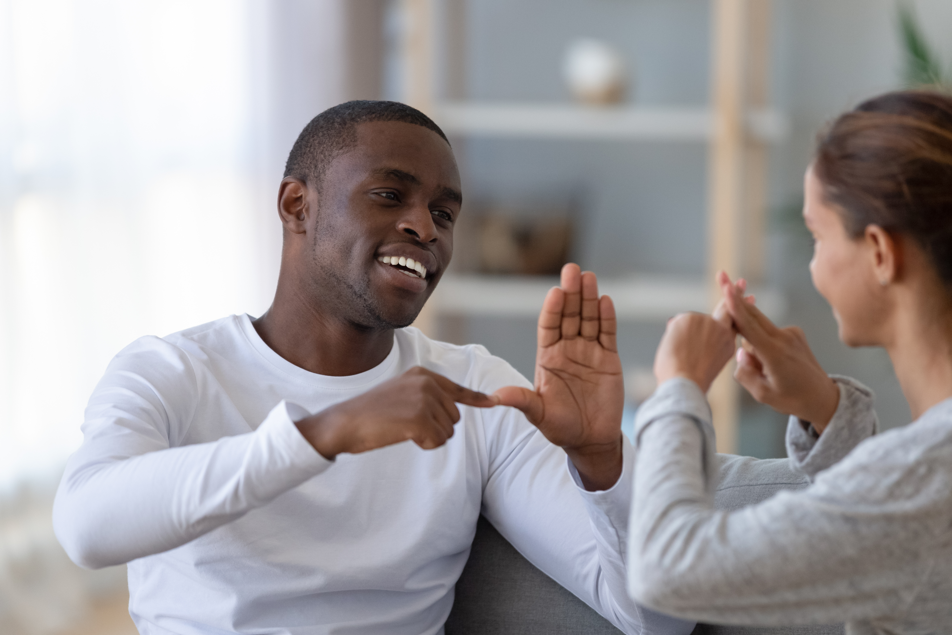
Disability
Complex phenomenon – interaction between a person’s body/mind and society
Birth or any point in life
Permanent, temporary, or episodic
Many communities

Slide 7
Social Model of Disability
Way of understanding disability focusing on barriers society creates
Developed by disabled people
Aims to remove barriers so disabled people may participate in society equally
Differs from medical model of disability, which views disability as a person's impairment

Slide 8
Defining Neurodivergence
Natural neurodiversity, like other forms of diversity (race, gender identity, etc.)
Neurotypical - the societal “norm”
Neurodivergent - “atypical” neurological development or function
Neurodiverse - groups of people who are neurotypical and neurodivergent

Slide 9
Common Diagnosis
Autism Fetal Alcohol Syndrome Disorder (FASD) ADHD/ADD Intellectual disability Down Syndrome Dementia Alzheimer’s ‘Developmental delay' or ‘Global development delay’ | Sensory sensitivities Physical disabilities Mental illnesses OCD Tourette’s syndrome Traumatic brain injury Neurodivergence (general) …and many many others!

Slide 10
Person-First vs Identity-First Language
Person-First Language (PFL) | Identity-First Language (IFL)
Person before the disability | Disability/neurodivergence integral to identity
“Person with autism” Preferred by many disability rights organizations More common for intellectual disabilities, mental illnesses, and medical conditions | “Autistic person” Emerged through self-advocacy, particularly from autistic and deaf communities Argument that identity is inseparable from lived experience

Slide 11
PFL vs IFL
Respect individual preferences – both are used
Community norms should be followed
Avoid outdated and offensive terms
Follow the person’s lead (do not assume or assign terminology to someone)

Slide 12

Autism
1/100 children worldwide (1/36 in US)
Significant variation
1/3 non-speaking
Repetitive behaviours
Structure and planning

Slide 13

FASD
ADHD
- Significant mental health concerns
- Emotional, sensory processing, memory, and cognitive challenges
- Trouble with concentration
- Impulsive reactions and impatience
- Hyperactivity
- Sensory differences

Slide 14
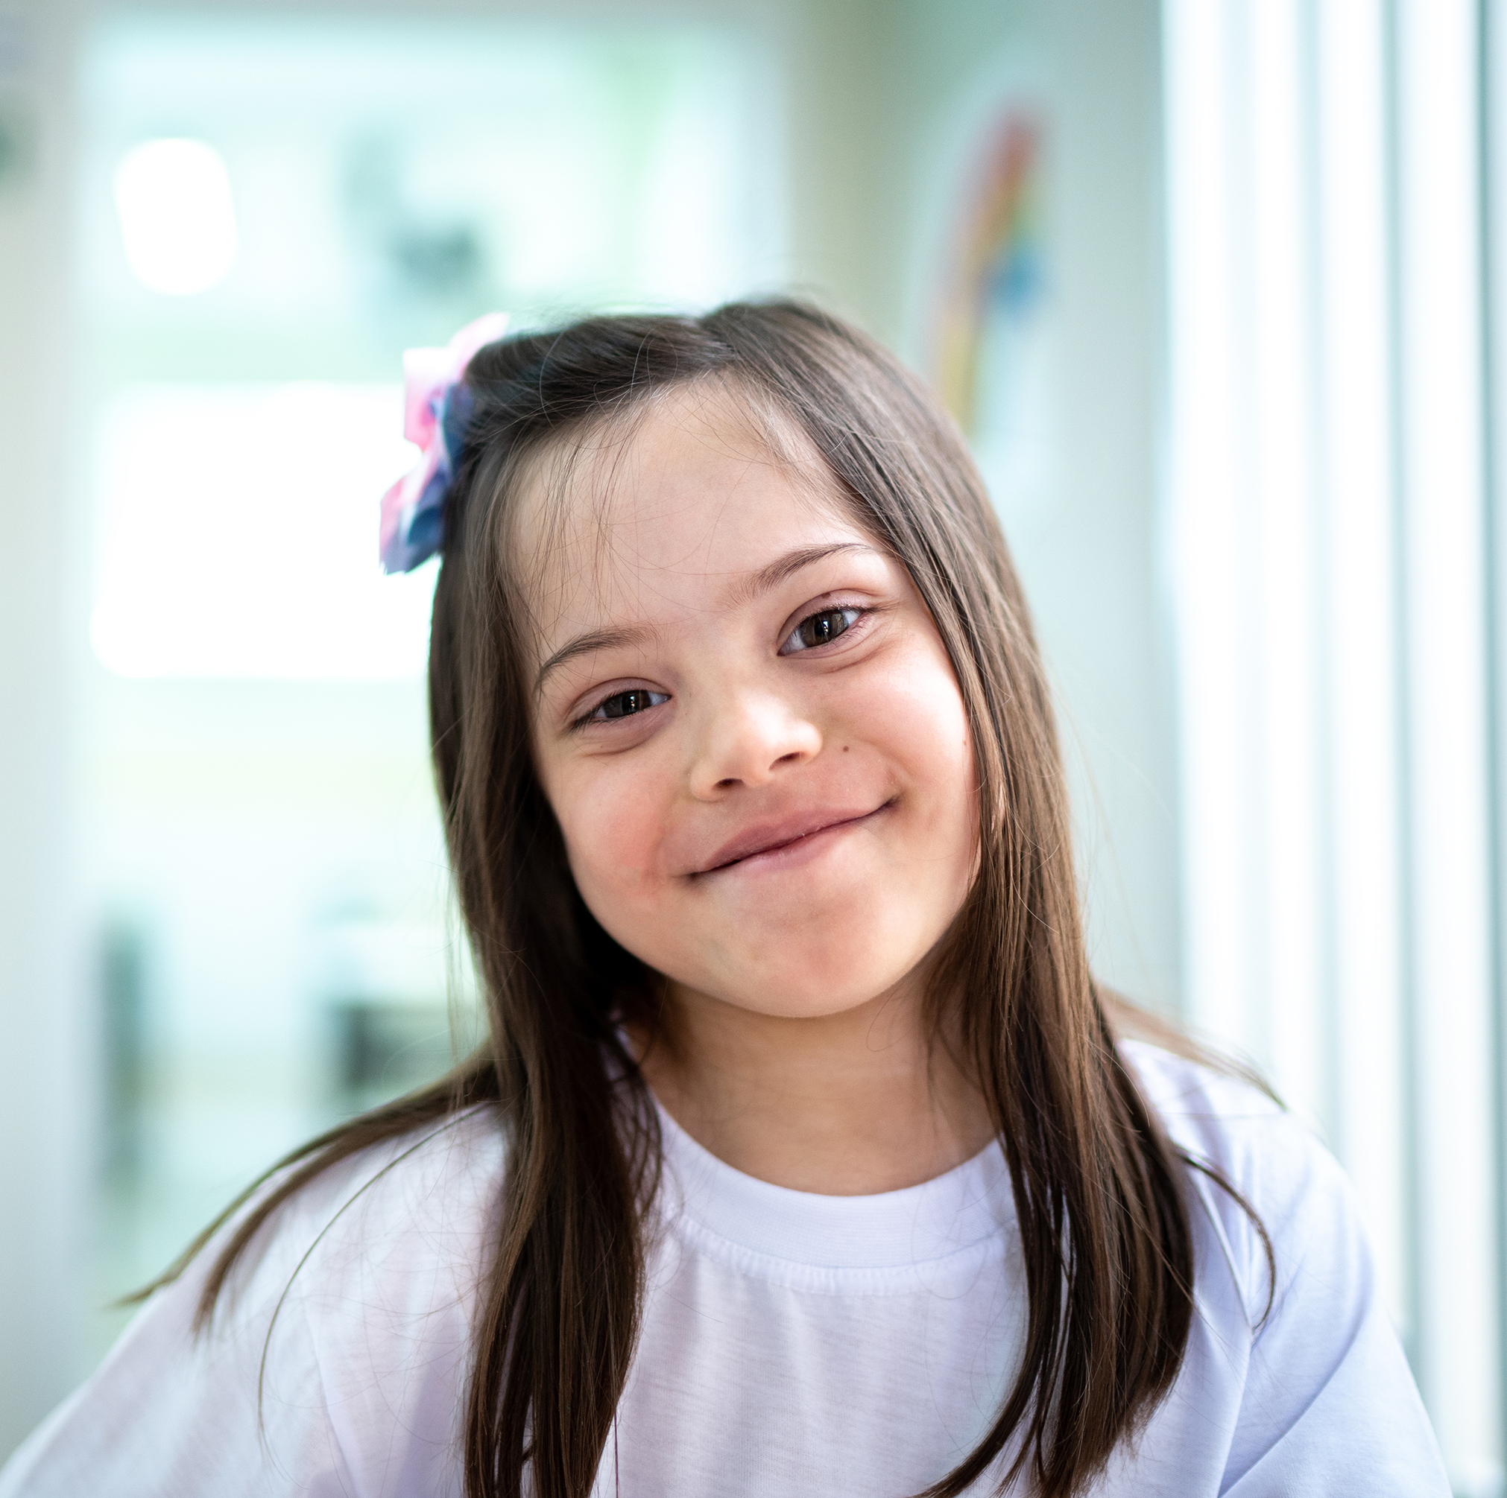
Down Syndrome
  Extra chromosome
  May have low muscle tone
  Moderate to mild cognitive impairments
  Prone to mental health issues

Slide 15
Intellectual disabilities
  Defined as IQ less than 70
  May impact ability to learn and capacity to retain information
  May affect social skills

Slide 16
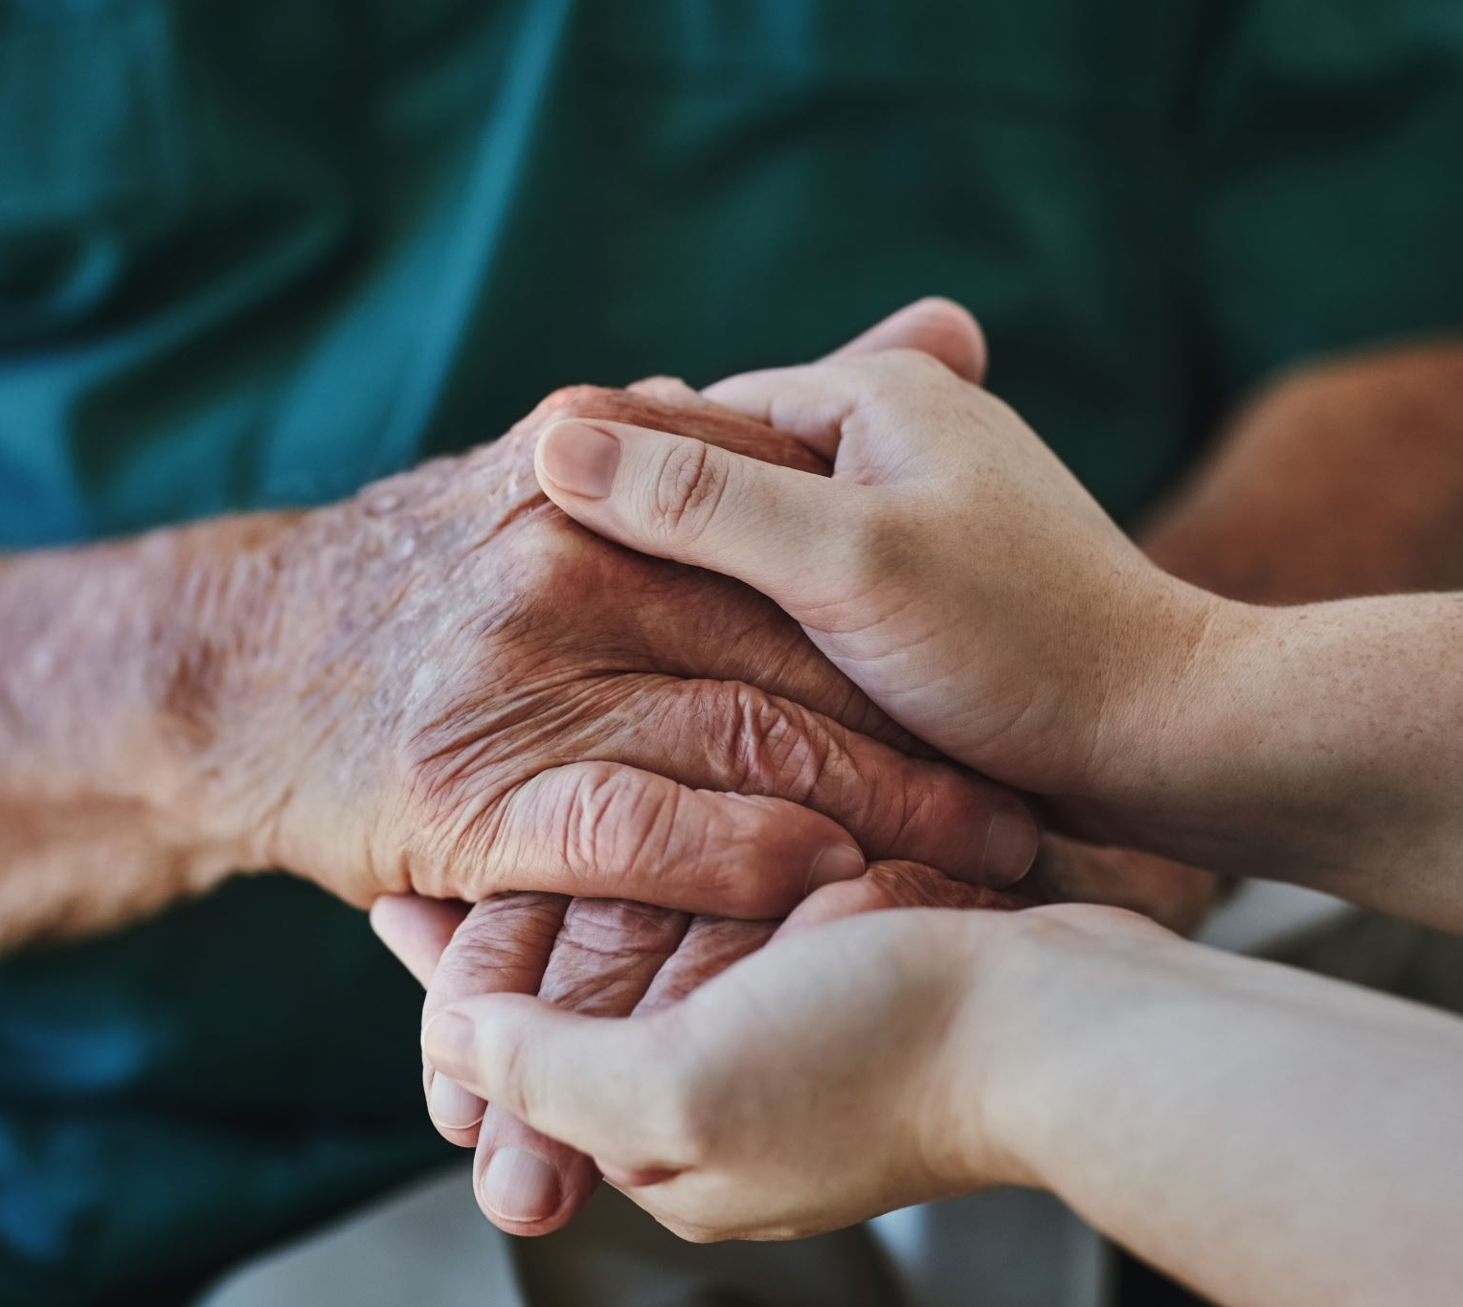
Dementia and Alzheimer’s
  Confusion
  Comprehension and language challenges
  Paranoia

Slide 17
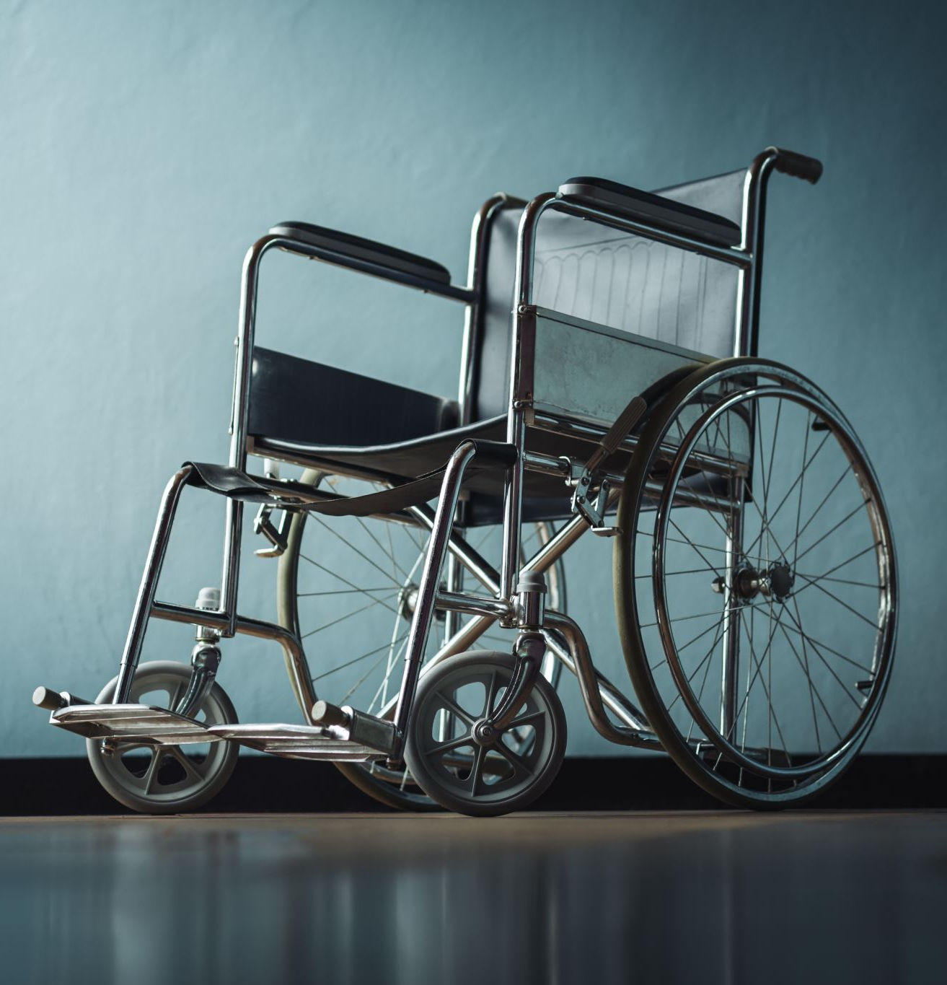
Physical Disabilities
From upper body limitations to need for assistive devices (e.g., canes, walkers, or wheelchairs) to full paralysis
Sometimes “visible” compared to other conditions

Slide 18

Blind/low vision
Partial or complete vision loss
May use screen readers, braille, magnification tools
Support by providing verbal descriptions, ensuring digital accessibility, and offering tactile materials

Slide 19

Deaf/Hard of hearing
Individuals with partial or complete hearing loss
May use sign language, lip-reading, or assistive technologies like hearing aids
Support by providing captions/transcripts, sign language interpreters, and visual aids

Slide 20
Sensory Disabilities or Sensitivities
Sensory sensitivity - natural variation in processing sensory info
Describes individuals who experience sensory input differently
About 75% of autistic individuals experience sensory sensitivities

Slide 21
Tourette Syndrome
Involuntary repetitive movements or sounds (tics)
Ex: repeated blinking, blurting out random or offensive words, repeatedly shrugging shoulders

Slide 22
Anxiety
Common mental health condition
Excessive worry and fear
Not necessarily considered a neurodivergence, but comorbid with many other conditions

Slide 23
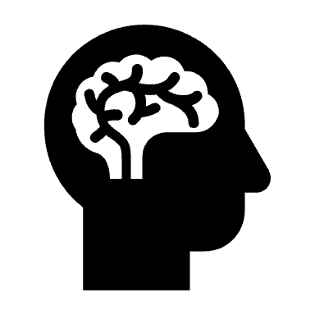
OCD
Obsessive-Compulsive Disorder
Unwanted thoughts or fears (obsessions)
Repetitive behaviours (compulsions)
May affect daily activities & cause significant distress

Slide 24
Global Development Delay
Diagnosis for delays in at least two areas of development:
  Motor skills
  Speech and language skills
  Cognitive skills
  Social and emotional skills

Slide 25
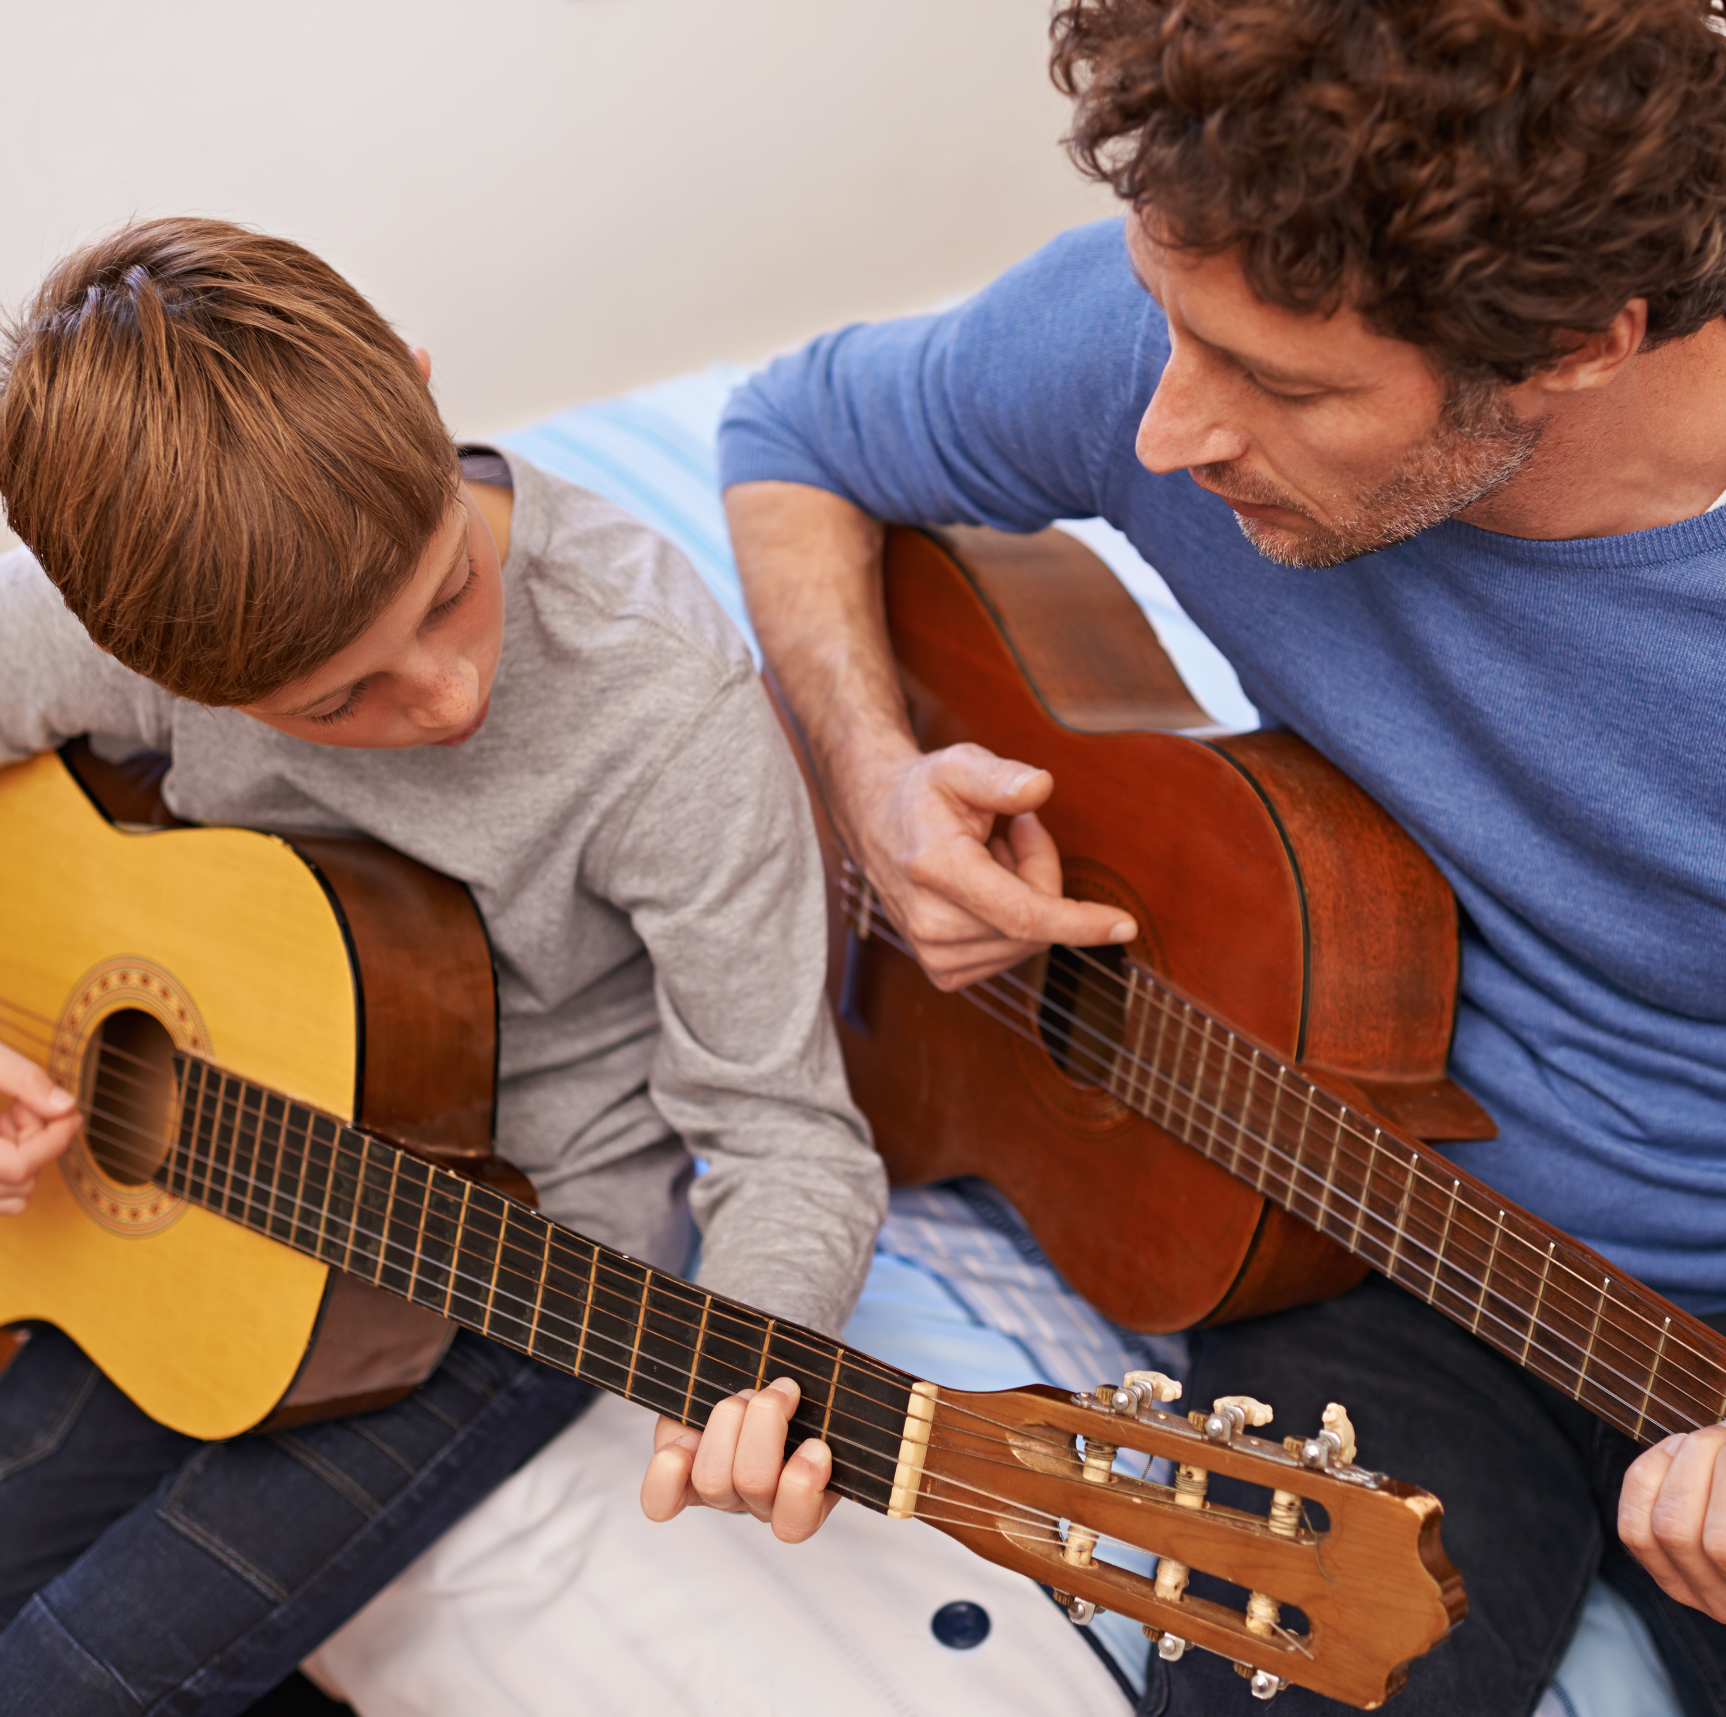
Performing Arts initiatives
Music Therapy – “intervention”
Community Music Therapy – “musiking”
Inclusive performance practice – sociocultural experience
Address human rights – often societal attitudes, not disabilities, that prevent attendance

Slide 26
Conclusion
Many evolving definitions of disability
Neurodiversity - natural diversity of neurology amongst a group with neurotypical (societal “norm”) and neurodivergent (“atypical”) individuals
Common diagnoses include autism, FASD, ADHD, Down Syndrome, Dementia, physical disabilities and more
Music therapy differs from adaptive performances

Slide 27
Modules 1-3: Improving Inclusivity and Accessibility in the Performing Arts
Full OER provides basis for better inclusivity and accessibility considerations by artists, presenters, educators, policy makers, students, etc.
Module 1 addresses inclusivity and accessibility in the arts
Module 2 introduces adaptive performances
Module 3 more on adaptive performances, including practical examples and activities

Slide 28
Reflection Questions
Were you familiar with neurodiverse terminology before this module?
Do you have friends or family members who may be part of the disability and/or neurodiverse community who may enjoy music, theatre, or dance, but struggle to attend cultural events?
How might music/dance therapy contribute to performance and vice versa?

Slide 29

Further Reading
See resources from the OER Improving Inclusivity and Accessibility in the Performing Arts: Adaptive Performance Resources, Practices, and Learning Materials (Dr. Erin Parkes and Jenna Richards) for further information on social model of disability, inclusivity and accessibility in the arts, and examples of adaptive performances via organizational websites

Slide 30


