Slide 1





How to attribute Creative Commons-licensed content: Best practices
Note: These best practices can also be applied when attributing content under other types of open licences, such as:
Open Government Licence - Canada
Unsplash License
Pexels License
Pixabay License
RECOGNIZING CREATIVE COMMONS LICENCES
You will recognize content under a Creative Commons licence in one of three ways:
1. The button with the CC logo and conditions icons:
2. The long written out version:
Creative Commons Attribution-NonCommercial-ShareAlike 4.0 International Licence
3. The short version:
CC BY-NC-SA 4.0
The six Creative Commons licences are a combination of four conditions:
For more information about what the six licences mean, consult About CC Licenses.
The basic condition of all Creative Commons licences is Attribution (BY), thus the importance of knowing how to attribute content available under a CC licence.
Attribution (BY) ShareAlike (SA)
NonCommercial (NC) NoDerivatives (ND)
Page 1

Slide 2


TITLE, AUTHOR, SOURCE, LICENCE
A good rule of thumb is to use the acronym TASL, which stands for Title, Author, Source, Licence.
Title - What is the name of the material?
If a title is provided, include it. You could also use the name of a file. If no title or file name is provided, add a descriptive title (ex. image, photo, illustration, etc.).
Author - Who created the material and owns the right to it?
Name the author(s) of the material in question. It could be a person or an entity like an organization or a company, or even a pseudonym (like a username).
Source - Where did you find the content?
Provide the source of the content so others can access it too. This is usually a URL or a hyperlink where the material resides.
Licence - How can you use it?
While you are able to use the content for free because it is under a CC licence, you also need to indicate that licence in your attribution. Name the licence and provide a link to it.
Ex.: https://creativecommons.org/licenses/by/4.0/ for CC BY 4.0
Note about versions: 4.0 refers to the latest version of the licences, which are applicable internationally. Previous versions were more location specific but are still valid. Make sure to refer to the correct version in your attributions.
EXAMPLES OF ATTRIBUTION
Here is a photo.
This is an ideal attribution:
“Cat” by Tom Houslay is licensed under CC BY-NC 2.0
Because:
Title: “Cat”
Author: Tom Houslay (with link to photographer’s profile on Flickr)
Source: Flickr (the title of the image is linked to the original Flickr page)
Licence: CC BY-NC 2.0 (with a link to licence deed)
This is a good attribution for material you modified slightly:
“Cat” by Tom Houslay, used under CC BY-NC 2.0 / Desaturated from original
Because:
Title, Author, Source and Licence are all noted.
Modification is indicated: “Desaturated from original”.
Page 2

Slide 3
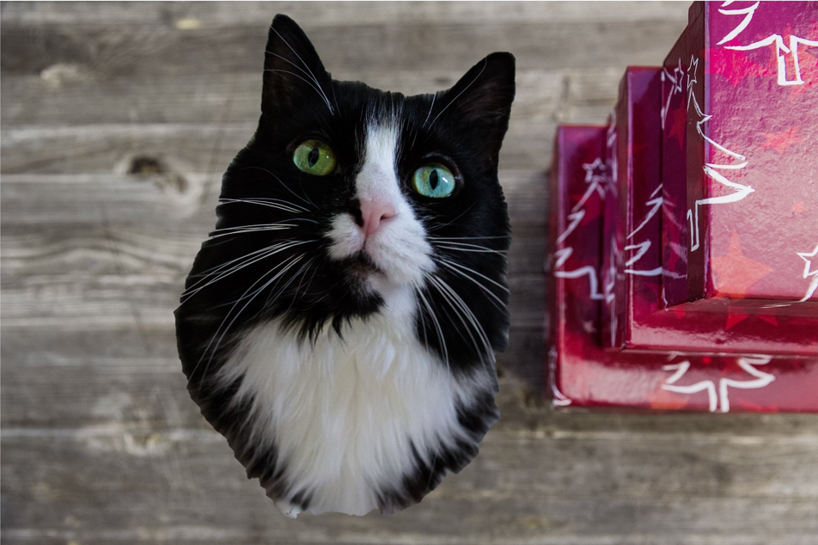
This is a good attribution for material from which you created a derivative work (i.e. an adaptation):
This work, “Presents for kitty,” is a derivative of “Cat” by Tom Houslay, used under CC BY-NC 2.0 and Photo by Markus Spiske, used under Pixabay License. “Presents for kitty” is licensed under CC BY-NC 4.0 by Mélanie Brunet.
Because:
Original Title, Author, Source and Licence are all noted.
Derivative is indicated.
New author and licence of the derivative work are also indicated.
When you are creating a derivative or an adaptation, this new work acquires its own copyright and therefore you will add your own Creative Commons licence to it. Use the CC License Chooser to select the appropriate licence for your needs and context.
WHERE TO ADD THE ATTRIBUTION
Best practice is generally to add the attribution as close as possible to the content being reproduced, for example in the caption under or next to an image. But this can depend on the medium with which you are working.
Video:
Add a list of attributions in the form of end credits in the video itself.
  Example: “Video Editing and Shot Techniques: Study of jump cuts, match cuts and cutaways” by New Media Rights (end credits with attribution start at 3:13)
Add attributions in the information about the video on the hosting platform or webpage.
  Example: This video features the song “Memories Erased (Instrumental)” by RYYZN, Audio Library, licensed under CC BY 3.0
Page 3

Slide 4
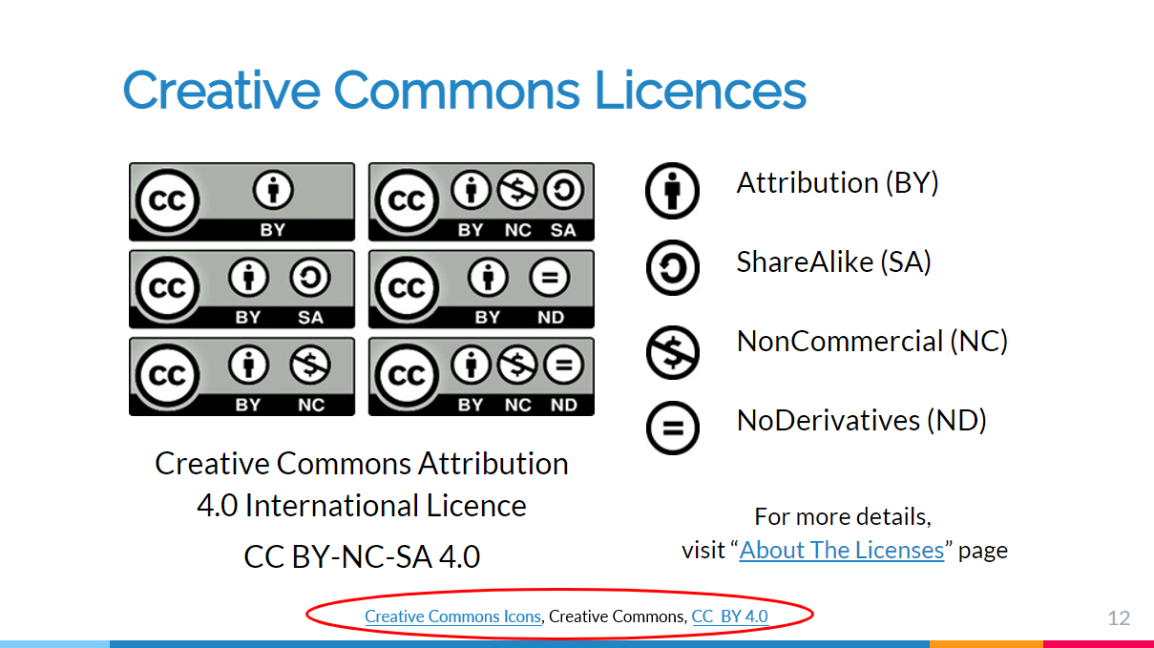
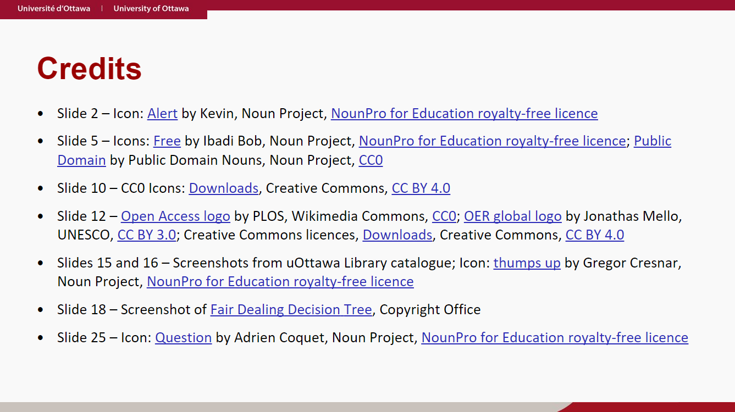
Slides:
Add the attribution close to the item being reproduced.
  Example:
Another option is to create a “credits” slide, usually at the very end, to add a list of attributions.
  Example:
Page 4

Slide 5
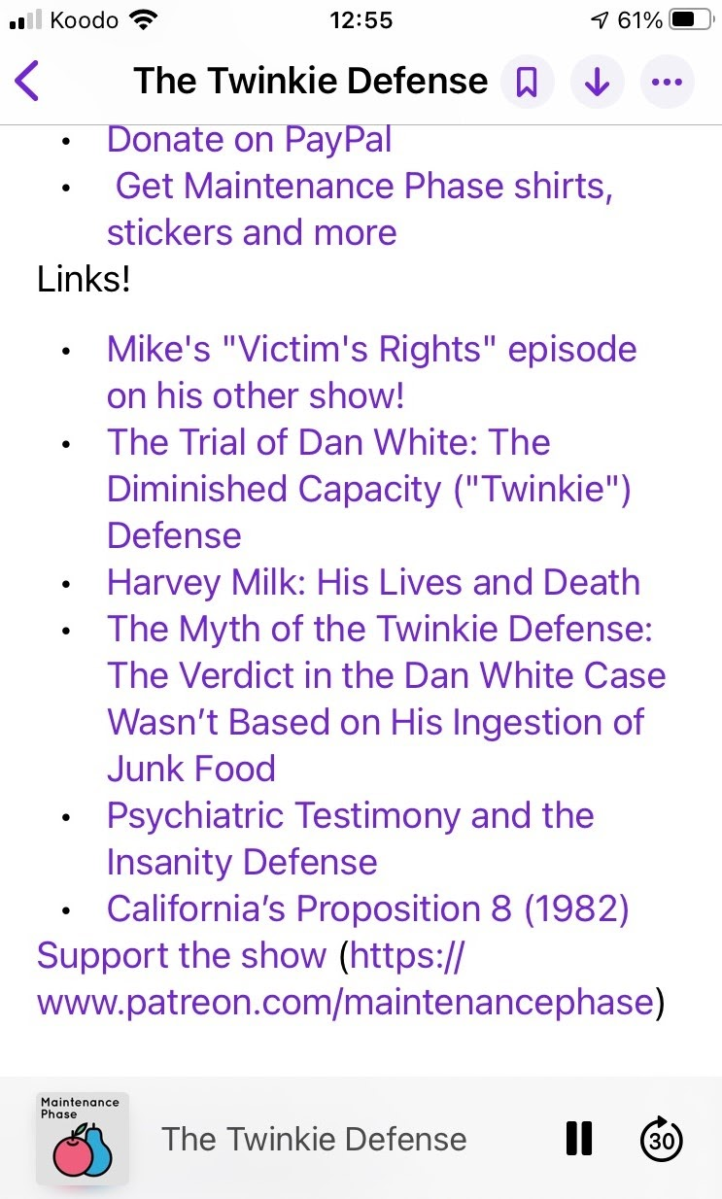
Audio file:
Add a list of attributions in the information about the file on the hosting platform, like it is sometimes done for podcasts in the episode notes.
  Example: Links for the episode “The Twinkie Defense” by Michael Hobbes and Aubrey Gordon, Maintenance Phase [podcast], as seen on the Apple Podcast interface
Another option is to recite the attributions at the end of the recording.
  Example: “Down and Out in the Magic Kingdom read-loud part 08” by Cory Doctorow, Internet Archive, under CC BY-NC 3.0 (credits start at 30:33)
This guide is an adaptation of Creative Commons, Best practices for attribution, Creative Commons Wiki, licensed under CC BY 4.0.
All Creative Commons Icons from Creative Commons, licensed under CC BY 4.0.
© Mélanie Brunet and Catherine Lachaîne, 2021. Unless otherwise noted, the content of this guide is made available under a Creative Commons Attribution 4.0 International licence.
Page 5

