Slide 1











Creative Commons Licences and Finding Open Content
Take Action! Open Education Week 2019
Mélanie Brunet, Ph.D., Copyright Services Librarian
This presentation is licensed under a Creative Commons Attribution 4.0 International licence.

Slide 2
Outline
OER, copyright and Creative Commons
Creative Commons Licences
Finding existing OER
Finding content to create or adapt OER

Slide 3
What is an OER?
Open educational resource
A learning object freely and openly available that can be adapted and distributed, often under the terms of a Creative Commons licence.
Notes:
Simplified definition.
First example that comes to mind are open textbooks, but an OER can be other types of material: course, module, quiz, video, podcast, website, etc. digital or physical object.

Slide 4
What can you do with an OER? The 5Rs
Retain: right to download, duplicate, store
Reuse: right to use content in wide range of ways (in class, on a website, in a video, etc.)
Revise: right to adapt, adjust, modify, translate content
Remix: right to combine original or revised content with other material to create something new
Redistribute: right to share copies of original content, revisions or adaptations
From David Wiley, “Defining the ‘Open’ in Open Content and Open Educational Resources,” http://opencontent.org/definition/, CC BY 4.0.
Notes:
Openly, without having to ask permission from the copyright holder.

Slide 5


Approaches to copyright
Commercial
textbooks
Open
textbooks
All rights reserved
Use/reproduction/adaptation often requires permission (and financial compensation)
Some rights reserved (open licensing)
Use/reproduction/adaptation does not require permission or additional costs if it follows the terms of the CC licence
Copyright symbol, Pixabay, Pixabay License and Creative Commons Logo, Creative Commons, CC BY 4.0
Notes:
Let’s start with copyright:
What makes an OER an OER is not just that it’s free in a monetary sense; it is also open, meaning free of the usual constraints imposed by copyright. If you remember, copyright provides its owner (the creator or the publisher) a set of exclusive rights and for others to use and reproduce these copyright-protected creations, permission is often required, sometimes in exchange for financial compensation.
By default, any original expression of an idea or fact in a fixed medium is protected by copyright, so that means that much of what you find online is protected even if accessible for free. Therefore, it is important to indicate the openness of an OER to show users that the usual copyright constraints don’t apply (i.e. not all rights reserved, but only some rights reserves). Creative Commons licences are a simple and legal way to communicate that information to potential users. It works with copyright and can be applied by the copyright owner to text, music, video, images, etc. They do not require registration, you simply add the information to your work.

Slide 6
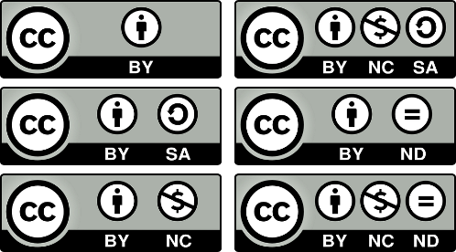




Creative Commons Licences
Attribution (BY)
ShareAlike (SA)
NonCommercial (NC)
NoDerivatives (ND)
Creative Commons Attribution 4.0 International Licence
CC BY NC SA 4.0
About the licences: https://creativecommons.org/licenses/?lang=en
Creative Commons Icons, Creative Commons, CC BY 4.0
Notes:
Creative Commons; not-for-profit organization created in 2001 in the United States, but now has some 30 chapters around the world, including one in Canada.
Its main product are the six licences available for free to creators to indicate which rights they wish to keep while communicating which types of usage the public can make of their work without having to ask for permission. When a creator chooses to apply a CC licence to their work, they keep their copyright but make their work free of the usual copyright constraints: for example sharing, remixing and reusing the work legally without having to ask permission or pay additional fees, as long as the conditions of the licence are respected.
There are now over 1.4 billion works under a Creative Commons licence.
The licences are used on many platforms that you know already: Flickr, Vimeo, YouTube, Wikipedia, Internet Archive, etc. And they are also used by many publishers of journals and books available in open access.
The six licences are composed of two elements: the CC logo and icons representing a combination of conditions (which can also be represented by two letters).
The four conditions are:
Basic condition: Attribution (BY) – work can be used as long as the creator is credited
ShareAlike (SA) – adaptations of this work must be licensed under the same licence
NonCommercial (NC) – work can be used only for non-commercial purposes (note: it does not prevent a commercial entity from using the work without permission – non-commercial applies to the « use » being made, not the « user »
NoDerivatives (ND) – reusers cannot share adaptations of the work (adaptation can be made for private purposes only)
Can also be expressed in writing: 2 examples
4.0 is a reference to the latest version, which is applicable worldwide (previous versions were more location specific)
Why is it important to know about CC licences in the context of creating or adapting OER? As a creator or adapter of an OER, you need to know how you can find and then incorporate existing CC-licensed (i.e. open) content in your creation/adaptation. You also need to know how to apply a CC licence to your new ressource because this is how you are going to communicate to potential users its level of openness, i.e. what they can do with your resource without having to ask for permission.

Slide 7
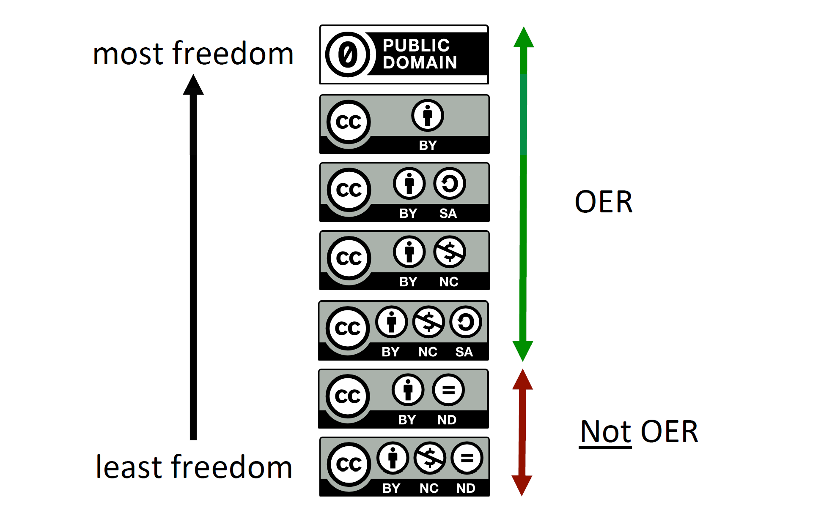
OER and Creative Commons Licences
Fig. 9: CC licenses arranged from most to least permissive, p. 37, from C. Green, 2017. Open Licensing and Open Education Licensing Policy. In: Jhangiani, R S and Biswas-Diener, R. (eds.) Open: The Philosophy and Practices that are Revolutionizing Education and Science. Pp. 29–41. London: Ubiquity Press. DOI: https://doi.org/10.5334/bbc.c, CC-BY 4.0.
Notes:
Not all CC licences allow for the 5Rs – two licences with the ND (NoDerivatives) condition go against two fundamental principles of OER: revision and remixing.
Public Domain (CC0) – no restrictions at all = like when copyright has expired, but the author has waived their rights on more recent content, even attribution is not necessary. Not often chosen for an OER, but content in the public domain can be used to create or add to an OER.

Slide 8
Combining CC-licensed content
Collection (or compilation)
Selection of existing materials still distinguishable once brought together
(TV dinner).
Existing content does not acquire new licence/copyright.
New copyright on additions of new content only (introduction, conclusion, commentary, cover).
Adaptation (or derivative)
Combination of existing materials that are not easily distinguishable once combined (smoothie).
To acquire a new licence/copyright, new creation based on existing content needs to be original enough (i.e. involve judgement and skill).

Slide 9
Combining CC-licensed content
ShareAlike (SA)
A work with SA restriction can be used in a collection without having to apply the same restriction to the entire collection. However, if it is modified or is part of an adaptation, the new work needs to be shared under the same licence (or will require permission of copyright owner).
NoDerivatives (ND)
A work with ND restriction can be used in a collection since it is not being modified. However, it cannot be used in an adaptation if this new work is going to be shared with others. Sharing publicly requires the permission of the copyright owner.

Slide 10
Finding existing OER

Slide 11








OER Repositories
https://www.merlot.org/merlot/index.htm
http://open.umn.edu/opentextbooks/
https://openstax.org/
https://textbooks.opensuny.org/
https://teachingcommons.us/
https://ocw.mit.edu/index.htm
https://www.oercommons.org/
https://nsdl.oercommons.org/
Notes:
Not an exhaustive list, focus on resources for the postsecondary sector. These are the sites best known for open textbooks and learning objects; mostly in English
Wikibooks: https://en.wikibooks.org/wiki/Main_Page
FreeTechBooks: http://www.freetechbooks.com/
But it is clear that there are a variety of free resources on the web that are not specifically called OER

Slide 12



OER in Canada
https://open.bccampus.ca/find-open-textbooks/
https://openlibrary.ecampusontario.ca/
http://albertaoer.com/content/repository
Notes:
Here are the leaders in Canada, especially BC Campus: provincial governments are investing in access to higher education.

Slide 13




Francophone OER
Portail des ressources éducatives libres
http://ceres.vteducation.org/app/index.jsp?lang=fr
https://bneuf.auf.org/#!/resource
https://oer.avu.org/handle/123456789/89
Notes:
Mix of older networks for distance education, but not updated in a number of years, some links don’t work and what is left is not explicitly available openly (plenty of “all rights reserved” appearing).
Here are some platforms that are still active or were launched recently.
VTÉ (Vitrine technologie-Éducation), financée par gouvernement du Québec – Ceres est un projet qui offre un catalogue collectif de ressources d’enseignement et d’apprentissage rassemblées par divers organismes oeuvrant dans la production de ressources éducatives utilisant des technologies de l’information et de communication. Mais il faut faire attention; techniquement, pas toutes les ressources répertoriées sont clairement des REL
Portail des ressources éducatives libres BNEUF = Bibliothèque numérique de l’espace universitaire francophone (relevant de l’AUF, Agence universitaire de la Francophonie)
Université Virtuelle Africaine: clairement des REL avec des licences CC

Slide 14
Finding content to create or adapt an OER

Slide 15
Content under a Creative Commons licence
OER repositories
Open Access repositories (ex. uO Research)
  OpenDOAR and ROAR
Open Access journals
  DOAJ
Open Access books
  DOAB and OAPen Library
Creative Commons (CC) Search
Notes:
Double-check the licence

Slide 16
Content under a Creative Commons licence
Images: Google Images (filtered by usage rights), Flickr, Pixabay, Pexels, Visual Hunt, Unsplash
Videos: YouTube, Vimeo
Sound/Music: Jamendo, Free Music Archive, Freesound, SoundCloud
Multimedia : Wikimedia Commons, Internet Archive
Notes:
Double-check the licence

Slide 17
Suggested Sources of Open Content
Google Images
https://images.google.com/
Images
Search and then filter by licence under “Tools” -- “Usage rights”
Flickr
https://www.flickr.com/
Images
Search and then filter by licence under “Any license”
Pixabay
https://pixabay.com/
Images
In CC0 (public domain)
Pexels
https://www.pexels.com/
Images
Under Pexel licence
(similar to CC0 public domain)
Visual Hunt
https://visualhunt.com/
Images
Under various CC licences
Search and then filter by licence type
Unsplash
https://unsplash.com/
Images
Under Unsplash licence
(similar to CC0 public domain)
YouTube
https://www.youtube.com/
Videos
Look under “Show More” for licence;
search and then filter by Creative Commons under “Filters”
Vimeo
https://vimeo.com/
Videos
Search and then filter by licence under “More filters” -- “License”

Slide 18
Suggested Sources of Open Content
Jamendo Music
https://www.jamendo.com/
Audio
Under various CC licences
Free Music Archive
http://freemusicarchive.org
Audio
Under various CC licences
Freesound
http://freesound.org/
Audio
Under various CC licences
SoundCloud
https://soundcloud.com/
Audio
Search for Creative Commons
Internet Archive
https://archive.org/
Multimedia
Under various CC licences
Creative Commons (CC) Search
https://search.creativecommons.org/
Multimedia
Pulls CC-licensed content from various independent platforms
Wikimedia Commons
https://commons.wikimedia.org
Multimedia
Under various CC licences
(click on item for more details)

Slide 19
Attribution of CC-licenced content
Title, Author, Source, Licence (TASL)
Including the licence deed (human-readable)
Suggested tool:
Open Attribution Builder
http://www.openwa.org/attrib-builder/

Slide 20
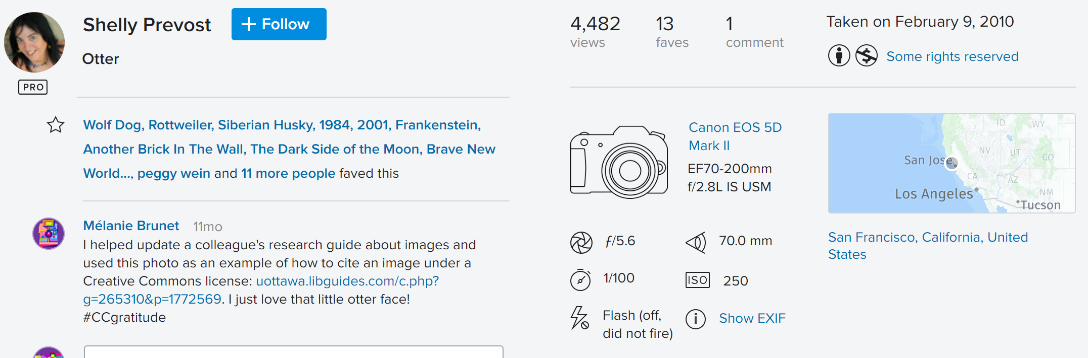
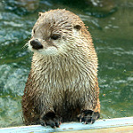
Example of attribution
Flickr:
Ideal attribution:
“Otter” by Shelly Prevost licensed under CC BY NC 2.0
Link to photo on Flickr
Like to author profile on Flickr
Link to CC licence deed
Creative Commons, “Best practices for attribution,” https://wiki.creativecommons.org/wiki/Best_practices_for_attribution

Slide 21

Content in the public domain
  for which copyright has expired
  over which author has waived their right
Linking
  ISED, What is a copyright? (Canada), YouTube, 7 Sept. 2016
Insubstantial use
  Short quotes, still from a video
CC0
Notes:
When does copyright expire? In Canada, it’s 50 years after the death of the author…

Slide 22
Content you have created and for which you still own copyright
Content for which you have obtained permission from the copyright owner to include in an OER

Slide 23
What about fair dealing?
OER are made available publicly, i.e. “published” as defined in the Copyright Act.
Education, research, private study as fair dealing purposes do not apply neatly in that context (as opposed to a password protected environment like Virtual Campus).
Ask the Copyright Office! (copyright.uottawa.ca)

Slide 24
More about OER in French
uOttawa, Ressources éducatives libres, https://communicationsavante.uottawa.ca/ressources-educatives-libres
UNESCO, Lignes directrices pour les ressources éducatives libres (REL) dans l’enseignement supérieur, http://unesdoc.unesco.org/images/0023/002328/232842f.pdf
Organisation internationale de la francophonie, Référentiel de compétences REL v1.1, https://www.francophonie.org/IMG/pdf/referentiel-competence-rel-v1-1.pdf
Organisation internationale de la francophonie, Référentiel de compétences REL: Guide du formateur, https://www.francophonie.org/IMG/pdf/guide_formateur-rel.pdf

Slide 25
Additional Resources
uOttawa, Open Educational Resources, https://scholarlycommunication.uottawa.ca/open-educational-resources
Moist, S. (n.d.). Faculty OER Toolkit. Victoria, BC: BCcampus. https://pressbooks.bccampus.ca/facultyoertoolkit/
Aesoph, L.M. (2016). Adaptation Guide. Victoria, BC: BCcampus. https://opentextbc.ca/adaptopentextbook/
Aesoph, L.M. (2018). Self-Publishing Guide. Victoria, BC: BCcampus. https://opentextbc.ca/selfpublishguide/
Queen’s University Library, Open and Affordable Course Materials, http://guides.library.queensu.ca/oer/about

Slide 26
Merci! Thank you!
Questions?
Mélanie Brunet
Bibliothécaire des droits d’auteur / Copyright Services Librarian
Melanie.Brunet@uOttawa.ca
copyright.uottawa.ca
droit-auteur.uottawa.ca

