Slide 1
Individualized research consultations in academic libraries: Useful or useless? Let the evidence speak for itself
Karine Fournier
Lindsey Sikora
Health Sciences Library, University of Ottawa
Ottawa, Ontario, Canada

Slide 2
Acknowledgements: Two research grants received
University of Ottawa Library Research Grant ($600)
Canadian Association of Research Libraries (CARL): Research in Librarianship Grant ($1,500)

Slide 3
Background Information
Context
Definition of IRCs
University of Ottawa
(+40,000 students)
Health Sciences Library
(Faculties of Medicine and Health Sciences)
Individualized research consultations (IRCs) are scheduled appointments designed to help researchers and students with their research projects (including, but not limited to, the literature review process).

Slide 4
Three Phase Research Project
Scoping review
Survey
Assessment
A Scoping Review of IRC Practices and Evaluation Methods
Fournier K, & Sikora L. (2015).
Results: 3 studies that used quantitative methods were identified --> mixed results.
Surveyed Canadian academic librarians on their IRC practices and their evaluation methods.
Results were presented at the 11th Northumbria Conference, UK (2015).
Results: only 1% of respondents used an assessment of some sort to evaluate IRCs.
To assess the impact of IRCs on students' search techniques and self-perceived confidence levels.

Slide 5
Our inspiration:
Sixth Frame: Searching as Strategic Exploration
ACRL Framework for Information Literacy for Higher Education

Slide 6
Research Questions
Do IRCs improve students’ information searching techniques?
Do IRCs influence students’ confidence level in performing effective search strategies?

Slide 7
Objectives
1. Assess students’ search techniques before and after they meet individually with a librarian.
2. Determine what factors influence students’ self-perceived search techniques proficiency and their self-perceived confidence level of such search techniques.
3. Determine if IRCs influence students’ confidence level in developing an effective search strategy.
4. Explore student expectations and their satisfaction levels with the IRC.

Slide 8
Methods

Slide 9
Data Collection
Population:
Participants were undergraduate and graduate students from the Health Sciences and Medicine Faculties at the University of Ottawa.
Recruitment Procedure:
Students who contacted a librarian for research help were sent an invitation by email to participate in the study.
Data Collection took place from February to September 2016.
Aim was to gather 30 completed pre- and post-tests.

Slide 10
Acknowledgements: Two research grants received
The University of Ottawa Library Research Grant ($600)
  $10 for each questionnaire (pretest and post-test)
CARL Research in Librarianship Grant ($1,500)
  Money used for research assistant

Slide 11
Questionnaires
Pre- and post-test questionnaires → mixed-methods
Open-ended questions to assess students’ search techniques
  Choice of keywords
  Search string
Self-reflective questions (open-ended, and likert scales)
  To assess students’ self-perceived proficiency with:
    search techniques
    confidence level in their search techniques
    their expectations and satisfaction regarding the IRC

Slide 12
Results

Slide 13
Results
29 completed pre and post-tests were gathered.
A rubric was used to code open-ended questions about search techniques.
  Paired t-tests were performed using SPSS.
Pre- and post-test open-ended answers were coded and analyzed using the QSR NVivo software.
Multiple choice and scale questions were analyzed using SPSS.

Slide 14
Rubric to assess, code and compare the pre- and post-test results
Requirement | Insufficient (0) | Acceptable (1) | Superior (2)
Uses appropriate keywords | -No keywords provided, or if keywords provided, very little connection to the research question or topic and are too broads -No use of synonyms | -The keywords provided are connected to the research question or topic, but not all subjects are covered. The keywords are somewhat focused and not too broad -Synonyms used, if applicable -Very little, or no use of subject headings (optional) | -The keywords provided are connected to the research question or topic and all subjects are covered. The keywords are well focused -Good use of synonyms, if applicable -Good use of subjects heading (optional)
Builds appropriate search string | -No search string provided | -Search string provided with some errors or missing elements (i.e. : not all keywords (and/or synonyms) are presents, mistakes in the use of Boolean operators) | -Search string provided with no errors and all elements are presents (all keywords (and/or synonyms) are presents, no mistakes in the use of Boolean operators)

Slide 15
Objective 1: Assess students’ search techniques
Paired-samples t-tests results:
The first t-test shows that students’ ability to use appropriate keywords from the pre-test (M = 1.00, SD = .66) to the post-test (M = 1.34, SD = .72), t (28) = -1.98, p > .05 (two-tailed) was approaching statistical significance.
The second t-test shows a statistically significant increase in students’ ability to use appropriate search strings from the pre-test (M = .21, SD = .41) to the post-test (M = .76, SD = .79), t (28) = -3.59, p = .001 (two-tailed).

Slide 16
Objective 2: Factors influencing students’ self-perceived proficiency and confidence level
Before the appointment
Negative and positive factors were stated in almost equal measure
  Negative factors:
    “lack of available research”, “research topic difficulty”, “lack of prior knowledge”, and “difficulty using databases”.
  Positive factors:
    “prior knowledge” and “help from other people (colleagues, supervisors)”.

Slide 17
Objective 2: Factors influencing students’ self-perceived proficiency and confidence level - Continued
After the appointment
Almost all positive factors:
  “new or prior knowledge”, “support from others”, and “strength of research question or search string”.

Slide 18
Objective 3: Determine if IRCs influenced students’ confidence
Paired-samples t-test result:
There was a statistically significant increase in confidence level from the pre-test (M = 5.93, SD = 1.46) to the post-test (M = 7.24, SD = 1.46), t (28) = -4.34, p < .001 (two-tailed). The mean increase in confidence was 1.31 units with a 95% confidence interval ranging from -1.93 to -.69.

Slide 19
Objective 3: continued
Did the appointment with a librarian influenced their confidence level?
Student comments grouped into themes:
“found useful resources.”
“learned how to search databases”
“learned how to do a search strategy”
 | Frequency | Percentage
“Yes” | 28 | 96.6
“No” | 1 | 3.4
Total | 29 | 100

Slide 20
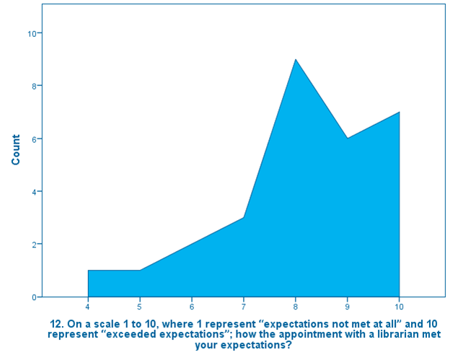
Objective 4: Students’ expectations and satisfaction
Using a scale from 1 to 10, participants were asked if their expectations were met after meeting with a librarian.
86.1% of respondents answered 7 or higher.

Slide 21
Objective 4: continued
Vast majority of respondents indicated that their expectations were met
  Main themes identified were:
    Gaining resources and information seeking knowledge
    Learned how to search
Very few negative comments:
  “...time used during the appointment to teach how to use the resources rather to find all available information.”
  “...expected more concrete results from the appointment.”

Slide 22
“I appreciated the pleasant manner in which the librarian handled my appointment. It made the learning interesting and engaging. I found the session very helpful.”

Slide 23
“She taught me more than I expected.”

Slide 24
Discussion

Slide 25
Discussion
Two paired t-tests showed a statistically significant difference from the pre-test to the post-test
One paired t-test approached statistical significance.
The analysis of our qualitative results also support our statement of IRCs having a positive impact.

Slide 26
Discussion: continued
Before appointment:
12 respondents = confidence level 7 or higher
had a high self-perceived confidence in their search techniques
After appointment:
Confidence level increased significantly, new knowledge acquired (factor)
Participants think they are self-sufficient, but they still learn new resources or search techniques

Slide 27
Study limitations
Small sample
One institution only
No control group
IRCs difficult to assess by their very nature: tailored to students needs, therefore, differences in content (especially across disciplines)

Slide 28
Conclusion
Our study has demonstrated that IRCs have a real, positive impact on students’ search techniques and their confidence level.
EBP with pre- and post-test questionnaires have started a conversation on this topic, but the evidence is still preliminary

Slide 29
Karine Fournier, M.S.I.
Twitter: @karoufe77
Karine.Fournier@uottawa.ca
Lindsey Sikora, MISt.
Twitter: @lindyrexie
Lindsey.Sikora@uottawa.ca
Health Sciences Library,
University of Ottawa
Ottawa, Ontario, Canada
Questions?

