Slide 1

Adaptive Performances Part I
Curtesy of:
Dr. Erin Parkes and
Dr. Jenna Richards
CC-BY NC SA 4.0

Slide 2

Today’s class
Review inclusivity and accesibility
Learning outcomes
Adaptive performances
The Model
Activity
Recap

Slide 3


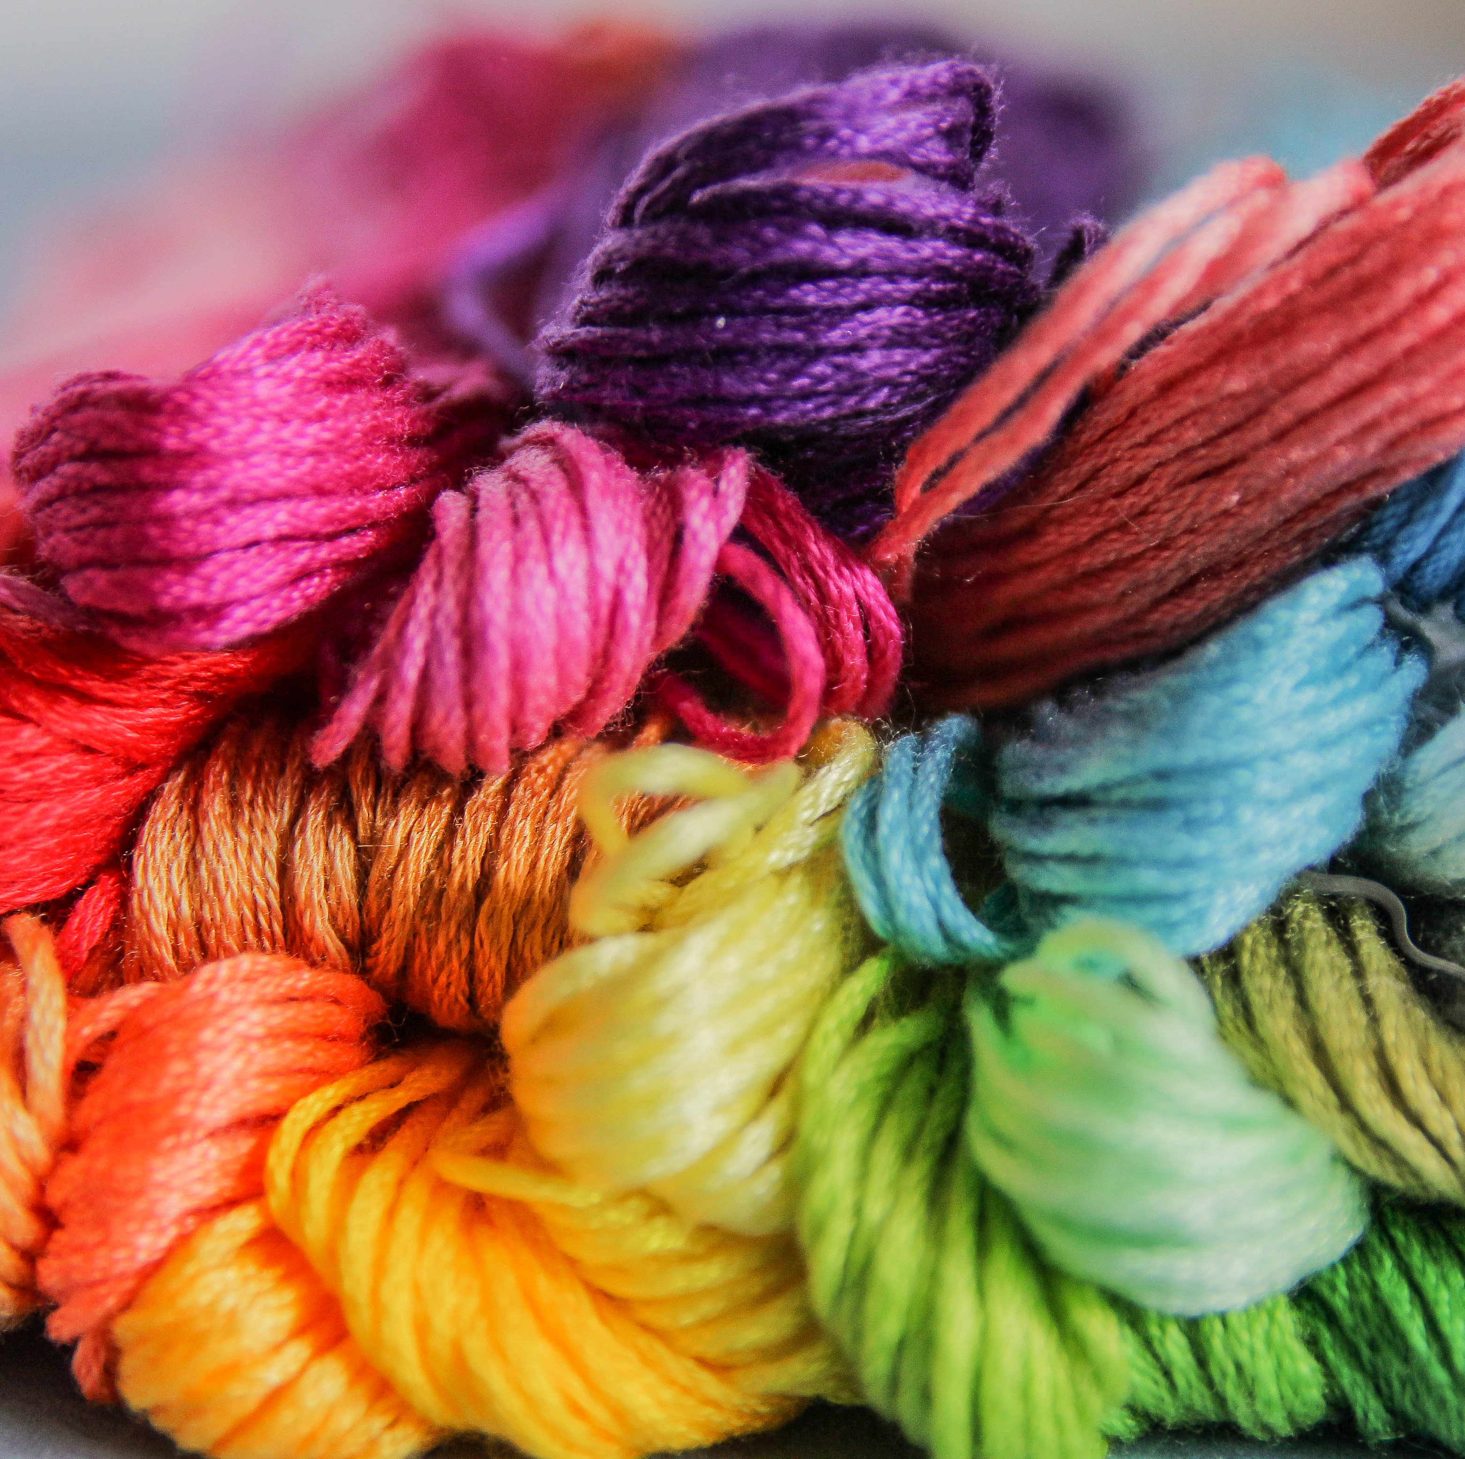

Review
How do you consider accessibility and inclusivity within your artistic practice?
In what ways can artists help advance society’s inclusivity and accessibility standards?

Slide 4
Learning Outcomes
Define adaptive performances and neurodivergent/disability communities;
Compare and contrast the elements of adaptive performances that increase accessibility and inclusivity when compared to traditional performances;
Review the current model for adaptive performances, parts 1 + 2
Update/re-imagine a traditional program to include adaptive elements

Slide 5

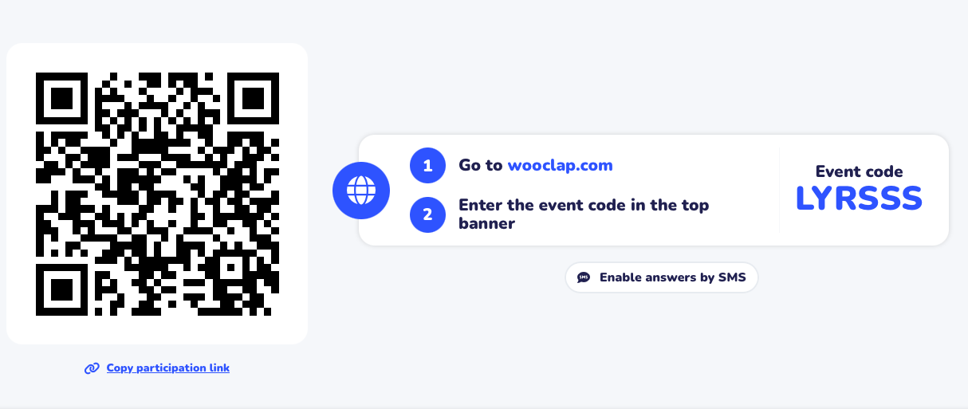

Wooclap

Slide 6

Group Discussion
Why might adaptive performances be important?

Slide 7
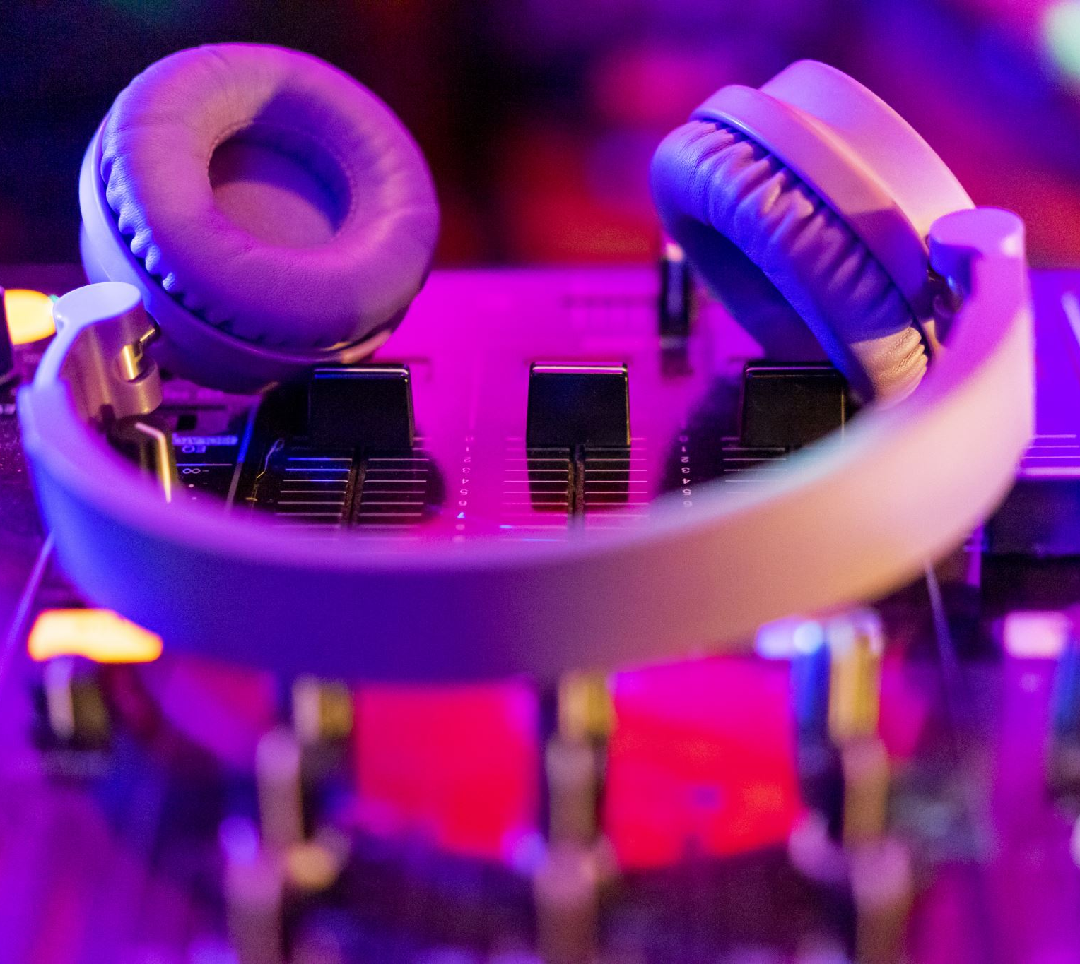
Adaptive performances - the why

Slide 8

Adaptive Performances by various names
Adaptive concerts
Sensory friendly performances
Concerts for neurodiverse groups
“Relaxed Performances”

Slide 9
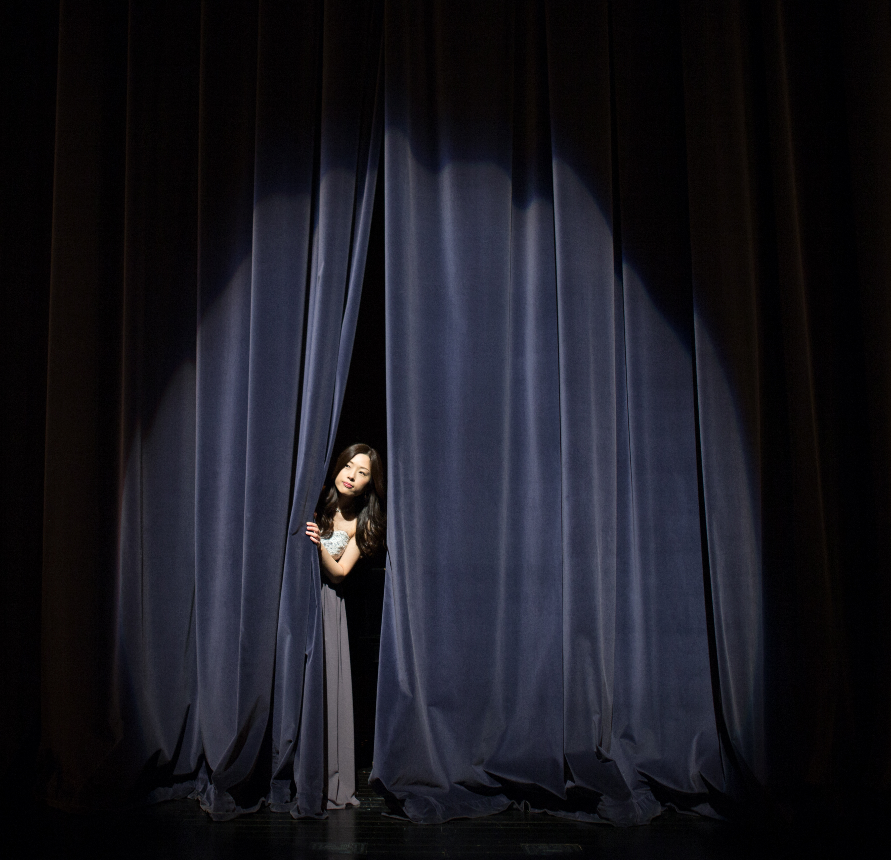
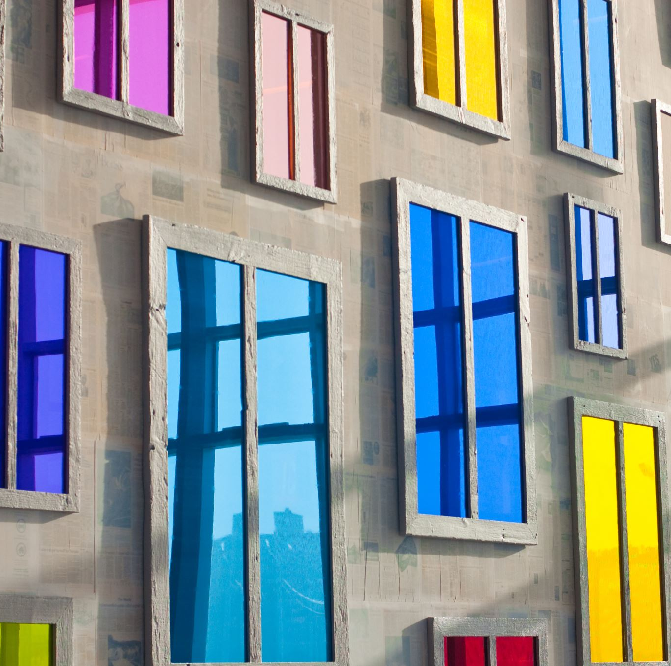

Origins of Sensory Friendly Concerts
From film, theatre, and museums in the UK in the 1990s
Came to North America around 2010s
Not much information on music at the beginning, but now it dominates the arena

Slide 10
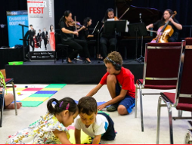
The Basics

Slide 11


Where do adaptive performances sit?

Slide 12
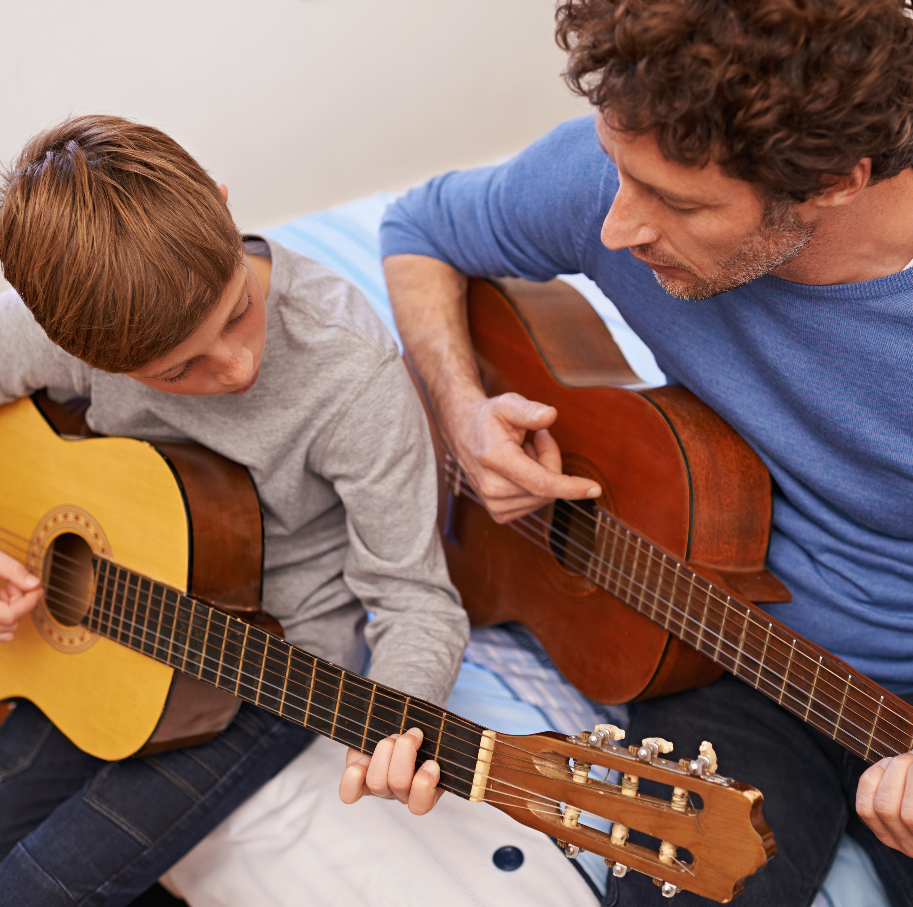
Adaptives performances are just that - performances
Music education– « learning »
Music therapy – « intervention »
Community Music – « musicking »

Slide 13

Xenia Concerts Inc.
National leader in accessibility in music performances
Probably the first to host an adaptive concert (around 2015) in Canada
Offers artist training
Addresses a gap in performance, offering performances for
https://www.youtube.com/watch?v=O86lUjIbS7s

Slide 14
Quick review of audience members who might attend adaptive performances
People with:
Autism Fetal Alcohol Syndrome Disorder (FASD) ADHD Intellectual disabilities Down Syndrome Dementia Alzheimer’s ‘Developmental delay' or ‘Global development delay’ | Sensory sensitivities Physical disabilities Germaphobia OCD Neurotypical, neurodivergent, able-bodied, or disabled family and/or friends and/or assistants …and many many more people!

Slide 15
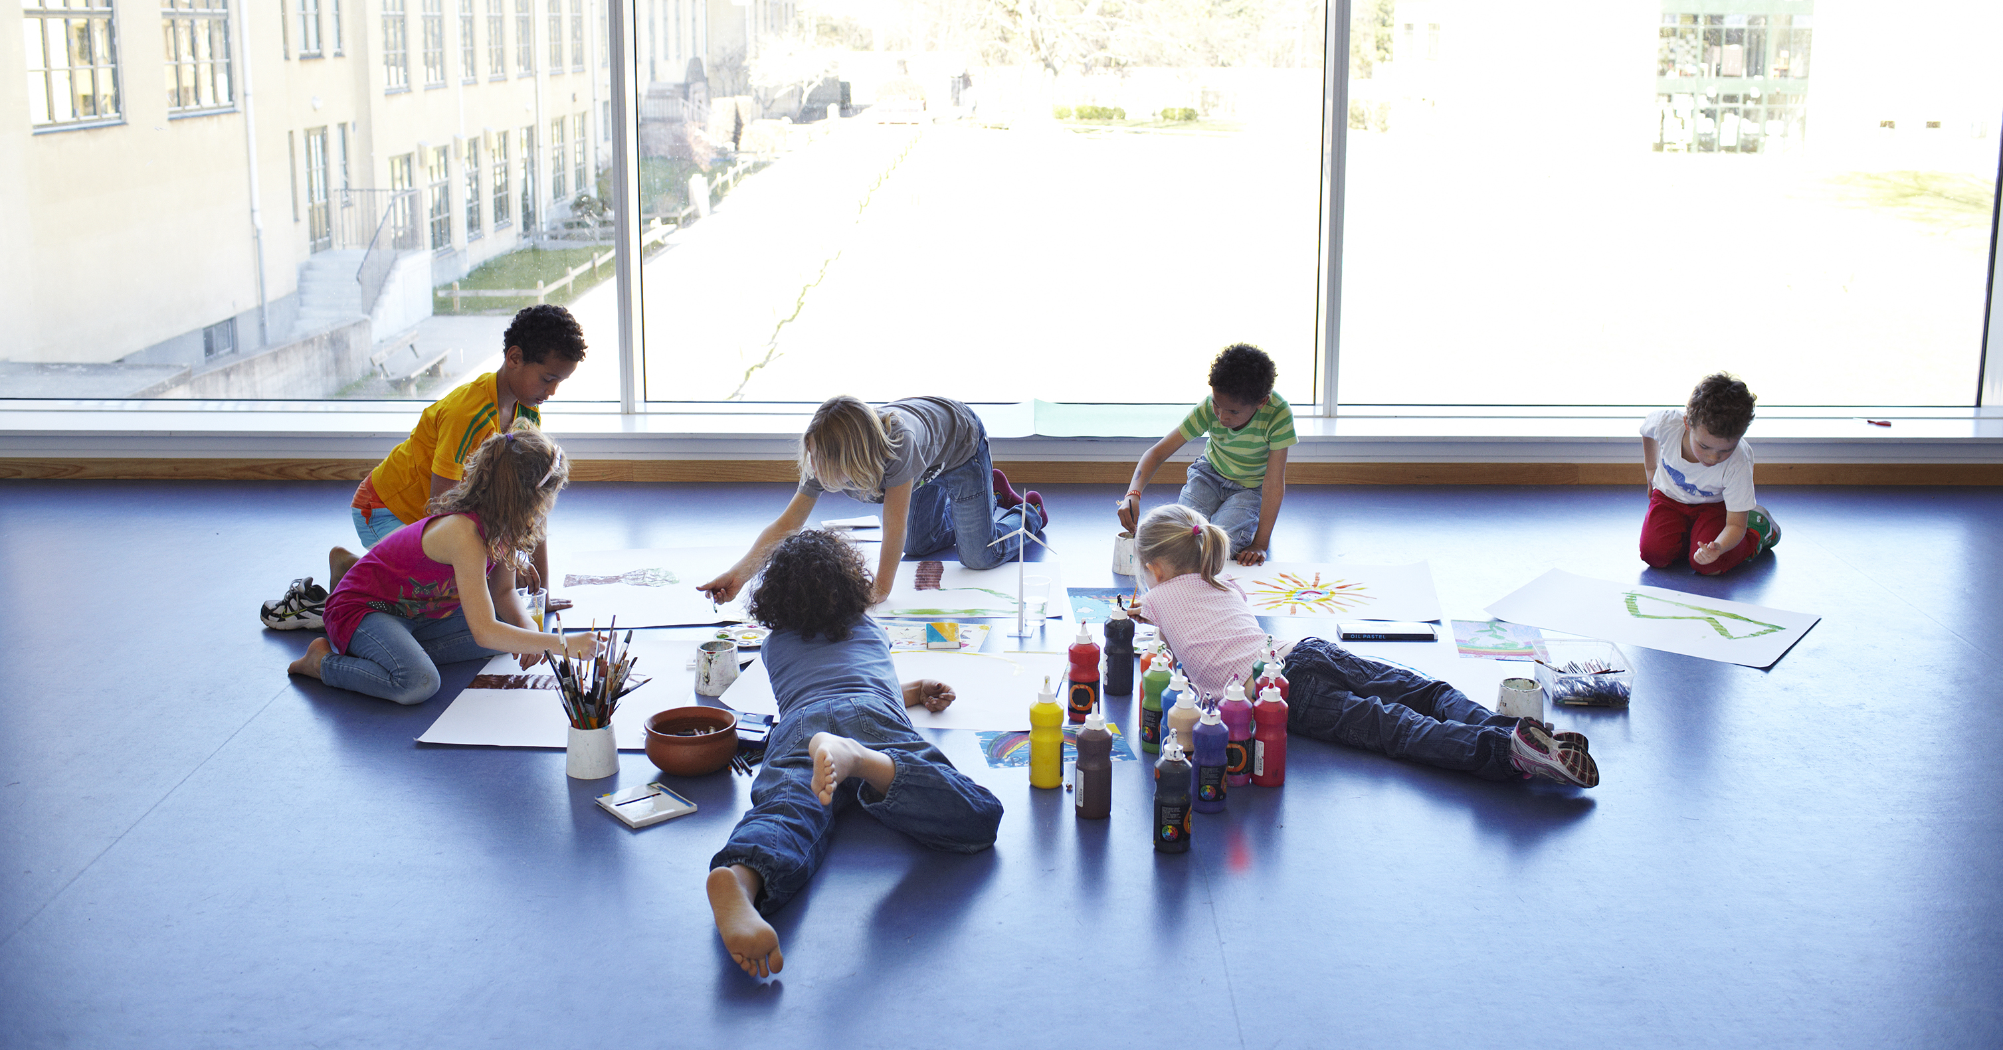
Image of children playing

Slide 16
What might be different between traditional performances?

Slide 17

Group discussion

Slide 18
Four categories of adaptation
Preshow work
Environmental Audit
Extra-musical aids
Programming adjustments

Slide 19

Category 1:
Preshow work
Visual Story
  Venue guide
  Step by step guide
  Images
  Use simple (first-person) language
  Send it before or make it available online/by request

Slide 20
Visual Story
Direct link to Chamberfest Venue Guide PDF

Slide 21
Pre-show work continued
Second document created for before, during, or after performance
  Activities like crosswords, drawing prompts, or acting scenes
  Include links
  Instruments, pieces or composer highlights/add-ons

Slide 22
Programming guide example
Direct link to programming guide PDF from Kennedy Center

Slide 23
Pre-show work
Artist, staff and volunteer training

Slide 24
Pre-show work
State the “rules”

Slide 25
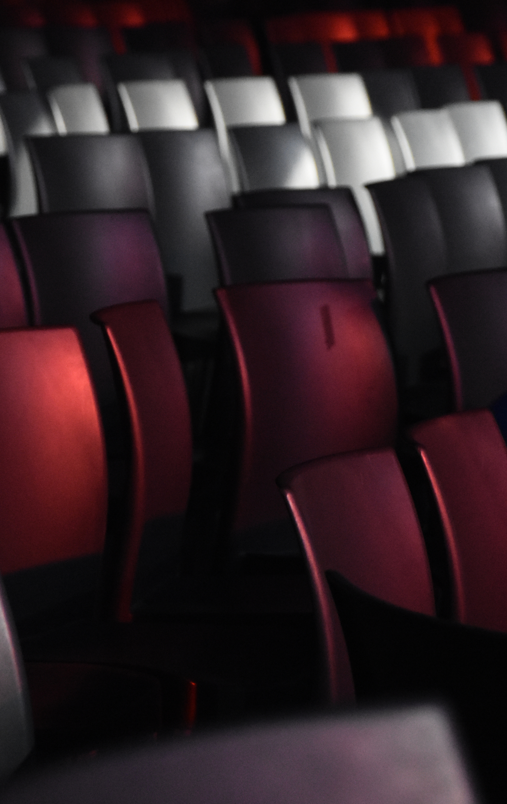
Category 2:
Environmental Audit
Clear signage
Quiet room separate from performance space
Various seating options

Slide 26
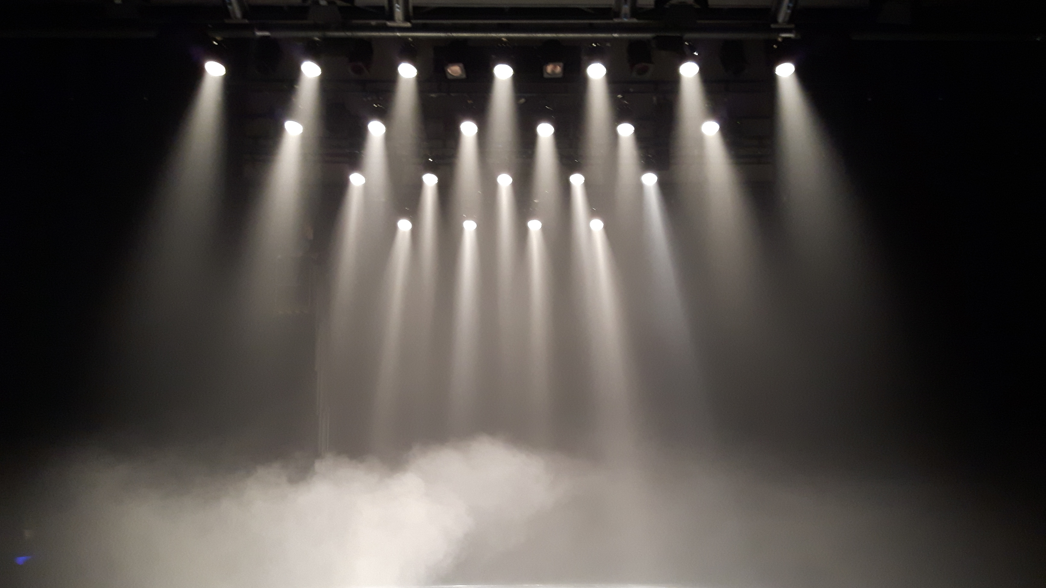
Environmental Audit continued
Lighting adjustments
Spaces for sensory items
Ability to enter and exit

Slide 27

Review
What are some pre-show elements?
What are some Environmental Audit elements?

Slide 28
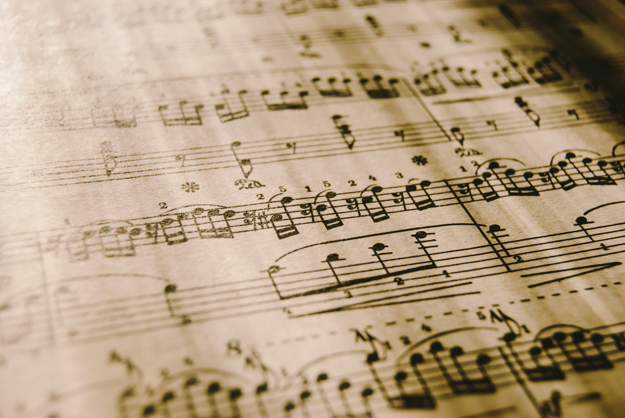
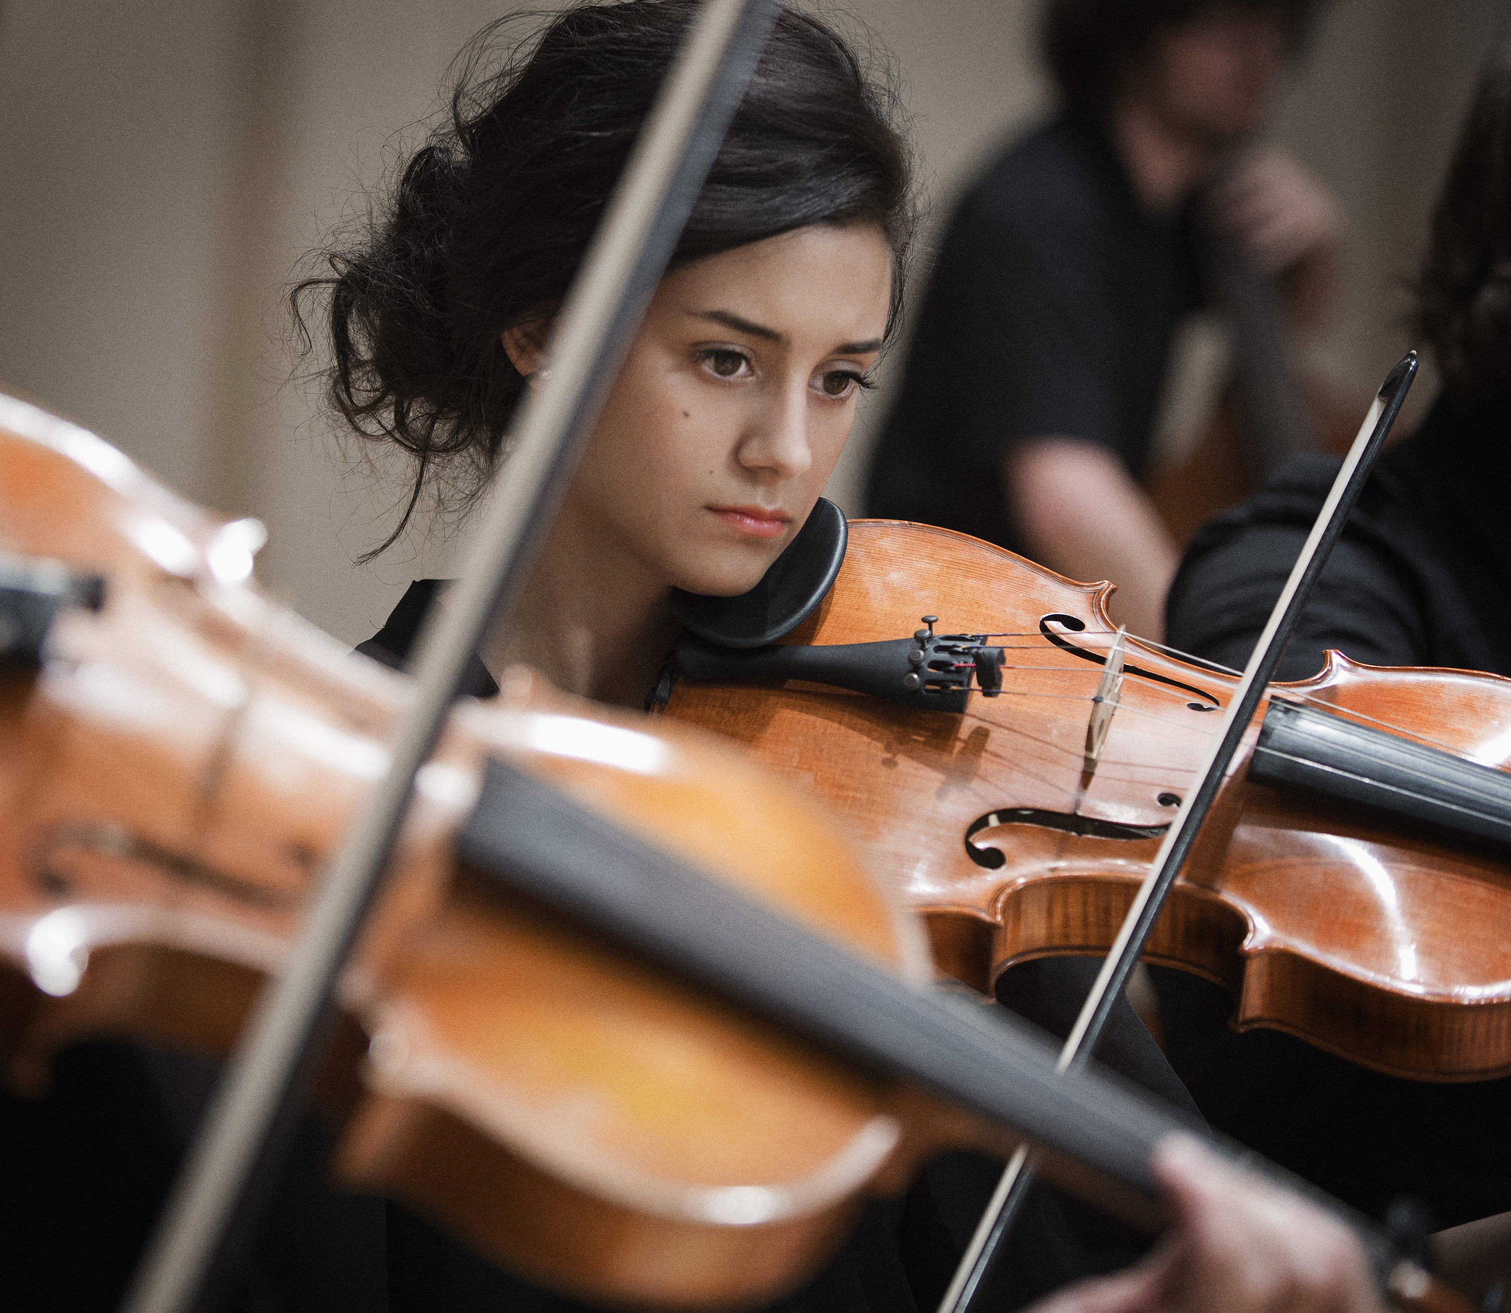
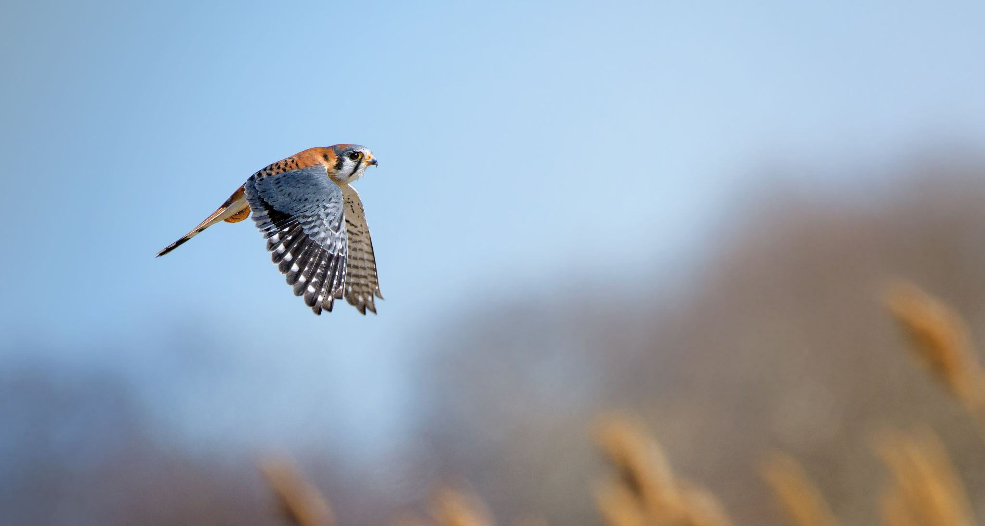
Activity
Symphony No. 40 | Wolfgang Amadeus Mozart
The Lark Ascending for violin and orchestra | R. Vaughan Williams
Intermission
Symphony No. 5 | D. Shostakovich

Slide 29

Discussion
What did you produce as adaptations (pre-show and environment) for this traditional program?

Slide 30
Next Class
Adaptive Performances Part II (3rd & 4th parts of the model)
Review of Previous Modules
Practical Activities

Slide 31
Reflection
How should we be training performance students for the various environments they will perform in when they finish school?
Does high-level performance belong exclusively on “stages”, or are other paradigms available to artists who seek advanced competency and employment as specialists in high-level interpretation?
Have you seen or heard of adaptive performances being presented in your region?

Slide 32
Assignment
Write a reflection in the discussion forum and respond to at least one colleague’s reflection

Slide 33
Additional Content
Link to the Xenia videos
Visual Story from Ottawa Chamberfest
Programming Guide from Kennedy Center
Required reading resources
Further reading resources
Website/social links for a few organizations with adaptive performances
Summary sheet for adaptive performances (includes full model)

Slide 34
Bibliography
Ansdell, Gary. “Being Who You Aren’t; Doing What You Can’t: Community Music Therapy & The Paradoxes of Performance.” Voices: A World Forum for Music Therapy 5, no. 3 (2005).
Ayres, Jean. Improving academic scores through sensory integration. Journal of Learning Disabilities 5, (1972): 338-343.
Bakan, Michael. “Neurodiversity and the Ethnomusicology of Autism.” College Music Symposium 54, (2014).
Fletcher-Watson, Ben. “Relaxed Performance: Audiences with Autism in Mainstream Theatre.” The Scottish Journal of Performance 2 (June, 2015): 61-89.
Fletcher-Watson, Ben and Shaun May. “Enhancing Relaxed Performance: Evaluating the Autism Arts Festival.” The Journal of Applied Theatre and Performance 23, no.3 (May, 2018): 406-420.
LaMarre, Andrea, Carla Rice, and Kayla Besse. “Relaxed performance: Exploring accessibility in the Canadian Theatre Landscape.” British Council and Bodies in Translation: Activist Art, Technology & Access to Life, 2019.
May-Benson, Teresa, and Roseann Schaaf. “Ayres Sensory Integration® Intervention.” In International Handbook of Occupational Therapy Interventions, edited by Söderback I, 633-644. Cham: Spring International Publishing, 2015.
Mold, James and Mark Gregory. “Best Practices Research.” Journal of Practice Management 35, no. 2 (2003): 131-134.
Muskett, Ashley, Sarah Radtke, Susan White and Thomas Ollendick. “Autism Spectrum Disorder and Specific Phobia: the Role of Sensory Sensitivity.” Review Journal of Autism and Development Disorders 6 (February 2019): 289-293.

Slide 35
Bibliography continued
Oosthuizen, Fouché. “Collaborative Work: Negotiations Between Music Therapists and Community Musicians in the Development of a South African Community Music Therapy Project.” Voices : A World Forum for Music Therapy 7, no. 3 (November 1, 2007).
Shiloh, C.J. and Blythe LaGasse. “Sensory Friendly Concerts: A Community Music Therapy Initiative to Promote Neurodiversity.” International Journal of Community Music 7, no. 1 (May, 2014): 113-128.
Silverman, Fern, and Andrea Carr Tyszka. "Supporting Participation for Children with Sensory Processing Needs and Their Families: Community-Based Action Research." American Journal of Occupational Therapy 71, no. 4 (2017): 1-9.
Stige, Brynjulf. “Community Music Therapy: Culture, Care and Welfare.” In Community Music Therapy edited by Mercedes Pavlicevic and Gary Ansdell, 91-113. London: Jessica Kingsley, 2004.
Thompson, Grace, Melissa Raine, Susan Hayward, and Hannah Kilpatrick. “Gathering Community Perspectives to Inform the Design of Autism-friendly Music-making Workshops for Wellbeing.” International Journal of Wellbeing 10, no. 5 (2020): 117-143.
Umeda, Caroline, and Tracy Jirikowic. "Cultural Arts Access for Children with Disabilities via Sensory-Friendly Theater: Parent and Organization Experiences and Impacts." American Journal of Occupational Therapy 73, no. 1 (2019).
Vesely, Arnost. “Theory and Methodology of Best Practice Research: A Critical Review.” Central European Journal of Public Policy 5, no. 2 (December 2011): 98-117.
Vize, Anne. "Sensory-friendly Films: Catering for Children with Autism." Screen Education, no. 73 (2014): 60-63.

