Slide 1

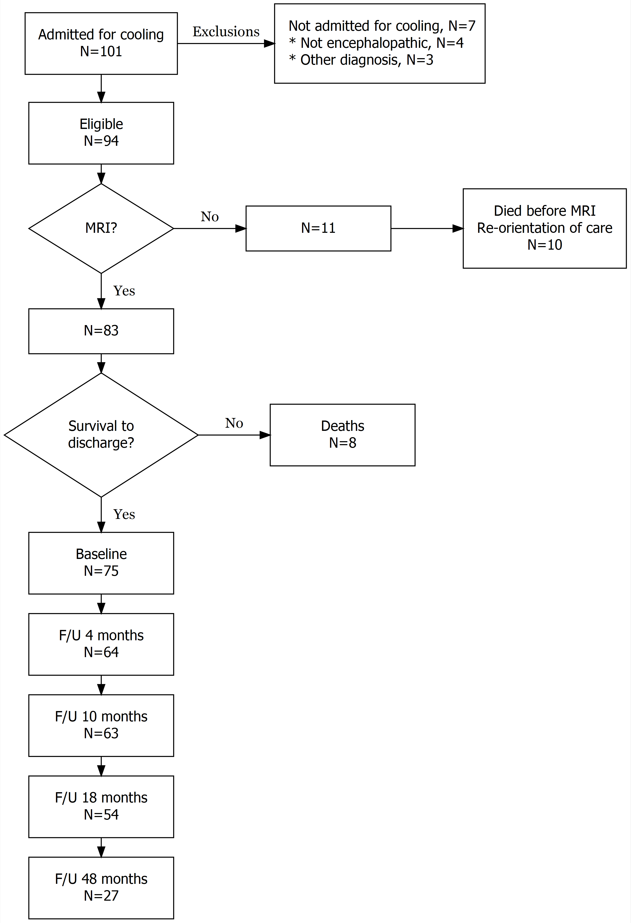
Influence of the timing of initiation of THERAPEUTIC HYPOTHERMIA on brain injury on MRI AND OUTCOME in newborns with neonatal encephalopathy
M. Philippe¹, M. Guillot², E. Miller³, J. Davila³, N. Barrowman⁴, MA Harrison⁴, N. Ben Fadel², S. Redpath², B Lemyre²
¹University of Ottawa, Faculty of Medicine; ²Division of Neonatology, Children’s Hospital of Eastern Ontario; ³ Department of Radiology, Children’s Hospital of Eastern Ontario, ⁴Clinical Research Unit, CHEO Research Institute
BACKGROUND
RESULTS
Canadian Pediatric Society recommends only tertiary care centers treat infants with therapeutic hypothermia (TH), despite challenges with transport in large areas
  Very early (<3h of life) cooling may lead to better outcomes at 18-20 months (Thoresen 2013)
  Severity and pattern of brain injury on MRI can predict adverse neurodevelopmental outcomes (Bonifacio, 2010) (Shankaran, 2015)
Figure 1: Patient Flowchart
Table 1: Cohort demographics
Table 2: Relationship between MRI findings and timing of cooling
 | Cohort n=94 | Early cooling (≤ 180 minutes) n (%) = 55 (58.5%) | Late cooling (> 180 minutes) n (%) = 39 (41.5%) | P value
Maternal Variables
Intrapartum complications
Placental abruption, n (%) | 15 (16.0) | 6 (10.9) | 9 (23.1) | 0.15
Cord prolapse, n (%) | 5 (5.3) | 4 (7.3) | 1 (2.6) | 0.40
Uterine rupture, n (%) | 8 (8.5) | 6 (10.9) | 2 (5.1) | 0.46
Vasa previa, n (%) | 1 (1.1) | 1 (1.8) | 0 (0.0) | 1.00
Shoulder dystocia, n (%) | 8 (8.5) | 5 (9.1) | 3 (7.7) | 1.00
Signs of fetal distress, n (%) | 71 (75.5) | 42 (76.4) | 29 (74.4) | 1.00
Caesarean delivery, n (%) | 54 (57.4) | 36 (65.5) | 18 (46.2) | 0.09
Infant variables
Male sex, n (%) | 56 (59.6) | 32 (58.2) | 24 (61.5) | 0.83
Median Gestational age (weeks) | 39.0 (38.0, 40.0) | 39.0 (38.0, 40.0) | 39.0 (38.0, 40.0) | 0.93
Median Birth weight (kgs) | 3.3 (3.0, 3.7) | 3.3 (3.0, 3.7) | 3.3 (3.0, 3.6) | 0.60
Resuscitation
Bag-mask positive pressure ventilation, n (%) | 29 (30.9) | 10 (18.2) | 19 (48.7) | 0.003
Endotracheal intubation with positive pressure ventilation, n (%) | 26 (27.7) | 18 (32.7) | 8 (20.5) | 0.24
Endotracheal intubation with positive pressure ventilation and CPR or medication, n (%) | 38 (40.4) | 26 (47.3) | 12 (30.8) | 0.14
Apgar score at 10 minutes (≤), n (%) | 70 (75.3) | 44 (80.0) | 26 (68.4) | 0.23
Median cord blood pH | 6.9 (6.8, 7.0) | 6.9 (6.8, 7.0) | 6.9 (6.8, 7.1) | 0.32
Cooling
Median time to initiation of cooling (hours) | 2.4 (1.2, 4.1) | 1.4 (0.6, 2.0) | 4.4 (4.0, 6.1) | <0.001
Median time to target temperature (hours) | 6.0 (4.1, 8.1) | 4.2 (3.2, 6.5) | 7.4 (6.2, 8.9) | <0.001
NICU Course
Neurologic exam with 12h of admission
Normal, n (%) | 2 (2.1) | 2 (3.6) | 0 (0.0) | 0.51
Sarnat 1, n (%) | 24 (25.5) | 12 (21.8) | 12 (30.8) | 0.35
Sarnat 2, n (%) | 46 (48.9) | 23 (41.8) | 23 (59.0) | 0.14
Sarnat 3, n (%) | 22 (23.4) | 18 (32.7) | 4 (10.3) | 0.01
aEEG with normal or discontinuous voltage, n (%) | 69 (73.4) | 38 (69.1) | 31 (79.5) | 0.47
aEEG with one of burst suppression, low voltage or isoelectric, n (%) | 25 (26.6) | 17 (30.9) | 8 (20.5) | 0.34
Seizures, n (%) | 51 (54.3) | 30 (54.5) | 21 (53.8) | 1.00
Inotropic support during cooling, n (%) | 28 (29.8) | 21 (38.2) | 7 (17.9) | 0.04
 | Early cooling (≤ 180 minutes) n = 47 (%) | Late cooling (> 180 minutes) n = 36 (%) | P value
Severity of injury according to NICHD scoring |  |  | 0.81
none to mild (score 0 or 1A or 1B) | 34 (72.3) | 27 (75.0)
moderate to severe (score ≥ 2A) | 13 (27.7) | 9 (25.0)
Severity of injury according to Barkovich scoring system
Basal Ganglia |  |  | 1.00
none to mild (score 0 or 1) | 38 (80.9) | 29 (80.6)
moderate to severe (score 2-4) | 9 (19.1) | 7 (19.4)
Watershed |  |  | 0.19
none to mild (score 0-2) | 39 (83.0) | 25 (69.4)
moderate to severe (score 3-5) | 8 (17.0) | 11 (30.6)
Predominant pattern of injury |  |  | 0.42
Normal | 27 (57.4) | 15 (41.7)
Focal-Multifocal | 6 (12.8) | 7 (19.4)
Watershed | 7 (14.9) | 10 (27.8)
Basal ganglia / thalami | 6 (12.8) | 3 (8.3)
Total brain injury | 1 (2.1) | 1 (2.8)
Moderate-severe brain injury | 11 (23.4) | 12 (33.3) | 0.33
OBJECTIVES
To examine the influence of timing of TH on the pattern and severity of brain injury on MRI
To examine the influence of timing of TH on neurodevelopmental outcomes
METHODS
Retrospective cohort study
Inclusion criteria: infants who received TH at CHEO between October 2009 and December 2016
TH criteria: ≥35 weeks, <9h of life and:
Cord pH <7.0 AND abnormal neuro exam (NICHD criteria)
    or
  Cord pH <7.15 with perinatal Hx and Apgar 10 min ≤5 or PPV x ≥10 min AND abnormal neuro exam (NICHD criteria)
Primary outcome - pattern and severity of brain injury on MRI (NICHD scoring & modified Barkovich scoring)
Secondary outcome - disability defined as: confirmed cerebral palsy, global developmental delay, deafness needing hearing aids or blindness
Variables were compared using the Fisher exact test, t-tests, Wilcoxon rank-sum test, Cochran-Armitage trend tests and/or multivariate logistic regression
DISCUSSION
Table 3: Relationship between disability and timing of cooling
Earlier initiation of therapeutic hypothermia (<3h) is not associated with statistically significant differences in pattern of injury on MRI
There is no significant difference between the two groups in regards to the severity of injury on MRI
  Trend towards more watershed(WS) injury in late cooling group
  Trend towards more moderate-severe brain injury in late cooling group despite including fewer infants with severe encephalopathy (Sarnat 3)
Patient who were cooled earlier did not have a better outcome than those cooled later
Many different confounding factors related to timing of initiation of therapeutic hypothermia
 | Early cooling (≤ 180 minutes) | Late cooling (> 180 minutes) | OR (95% CI) | P value
Severe disability or death
Yes, n = 22 | 13/22 (59.1) | 9/22 (40.9) | 0.95 (0.33, 2.71) | 0.92
No, n = 61 | 34/61 (55.7) | 27/61 (44.3)
Death
Yes, n = 8 | 6/8 (75.0) | 2/8 (25.0) | 1.36 (0.23, 10.68) | 0.74
No, n = 75 | 41/75 (54.7) | 34/75 (45.3)
Authors would like to acknowledge H. Moore and J. Ponnuthurai for their assistance in data collection

