Slide 1

Conducting a Program Evaluation of an OER Initiative
Benefits and Challenges
MÉLANIE BRUNET

Slide 2


Conducting a Program Evaluation of an OER Initiative
Benefits and Challenges
Mélanie Brunet, Ph.D., M.I., M.Ed.
Copyright and Affordable Learning Librarian
Unless otherwise specified, the contents of this presentation are made available under a Creative Commons Attribution 4.0 International license
Notes:
Introduction:
I'm Mélanie Brunet, Copyright and Affordable Learning Librarian at the University of Ottawa. Thank you for joining this session on the benefits and challenges of conducting a program evaluation of an OER initiative. I’m joining you from Ottawa, which is the traditional unceded territory of the Algonquin Anishnaabeg People.
Session description:
Launched in 2020, the University of Ottawa Library OER Program aimed to raise awareness among faculty members about the costs of commercial course materials to encourage them to choose free, open-access resources to lighten the financial burden on students. Given the persistent lack of French-language resources adapted to minority contexts in Canada, the program was also meant to encourage the production of OER in this language. In its final year, a program evaluation was conducted to determine if the human and financial resources invested have led to the desired immediate and intermediate outcomes and to propose improvements for other potential OER initiatives at the University. This presentation will focus on the questions, indicators, and methods used to assess this OER initiative through an adaptable utilization-focused evaluation, as well as the benefits and challenges of using a program evaluation approach to measure and communicate impact.
Attendees of this session will be able to:
Identify questions, indicators, and methods to plan for the evaluation of an OER initiative.
Recognize the benefits and challenges of using a program evaluation approach to assess an OER initiative.
Recognize the importance of measuring the impact of an OER program following a systematic approach to advocate for institutional support.

Slide 3

Brunet, M. (2025). The University of Ottawa Library OER Program: Evaluation Report. University of Ottawa Library, CC BY-NC 4.0
http://hdl.handle.net/10393/50336
Notes:
The full evaluation report is linked in the presentation description
This presentation is not so much about the results of this particular evaluation but rather about how you can conduct a program evaluation.

Slide 4
Target population: faculty members and part-time instructors
Beneficiaries: students
Components:
  Tools (OER by Discipline Guide, web pages)
  Services (support and consultations)
  Digital solutions (Pressbooks, H5P)
  Grant
Period evaluated: 2020-2024
About the uOttawa Library’s OER Program
May 2020 – April 2025
Notes:
Some details about the OER initiative that was evaluated and is at the centre of this presentation. Launched in May 2020, it officially ended on April 30, 2025. The target population of the Library’s OER Program were faculty members and part-time instructors at uOttawa, who by participating in program activities created and used OER. Students then benefitted from the outputs of these activities.
The Program was composed of tools, services, digital solutions, and a grant + training sessions and community of practice (that were not part of the evaluation).
Period evaluated was the first four years of the program (before it ended)

Slide 5
Needs at the University of Ottawa
For affordable course materials:
Average cost for required course materials, per course, by language of instruction
For course materials in French:
Use of resources in English in courses taught in French
Use of resources from France or Québec that are culturally or linguistically disconnected
Difficulty for students to get their hands on French-language materials that exist
Professors creating their own notes in isolation in the absence of a commercial textbook
 | Courses in English | Courses in French
2019-2020 | $148.22 | $96.73
2020-2021 | $150.36 | $90.73
2021-2022 | $138.37 | $103.53
2022-2023 | $155.77 | $113.07
2023-2024 | $145.68 | $121.69
Source: Brunet, M. (2024). uOttawa Textbook Price of Record – Reporting Student Savings [Document]. Note: Amounts are in CAD.
Notes:
Why was the program established in the first place? To address two needs that correspond to the anticipated long term results for the program. uOttawa itself is a public research university offering courses, resources and services in both English and French and has about 48,000 students

Slide 6






Demonstrate impact
Inform decision making
Notes:
Why do a program evaluation?
Ideally, it’s to demonstrate impact and to inform decision making. Like most OER initiatives, the uOttawa OER program was supported with public funds. So this evaluation was for transparency and accountability. And to keep receiving funding, it’s important to get an idea of the return on investment.
For example:
Savings for students, but it’s not just about money
Number of resources created
Usage as number of views or downloads
Level or type of student engagement with co-creation projects
Retention and completion rates
Indications of inclusion, diversity, equity, social justice

Slide 7
Program evaluation
The systematic process of applying judgment criteria to data in order to determine the merit, value, worth, and significance of a program or intervention
Program or intervention
A coherent, organized, and structured set of objectives, activities, and staff
Quoted and translated from: Bourgeois, I., Buetti, D.. & Maltais, S. (2023). Fondements et pratiques contemporaines en évaluation de programmes. Université d’Ottawa. CC BY 4.0. Chapitre 1. Introduction à l’évaluation de programmes: https://ecampusontario.pressbooks.pub/evaluation/chapter/chapitre-1-introduction-a-levaluation-de-programmes/ and Chapitre 2. La démarche évaluative et l’implication des parties prenantes: https://ecampusontario.pressbooks.pub/evaluation/chapter/chapter-2-la-demarche-evaluative/
Notes:
In the library world and in education, we often talk about « assessment » but not so much about « program evaluation » or perphaps we mean to use them interchangeably, but let’s start with two definitions.

Slide 8
Dimensions
Relevance
Effectiveness
Efficiency
Needs the program attempts to address; alignment between the program and the organization’s priorities
Achievement of anticipated results; changes observed in the target population
Sound management of the program’s human and financial resources; relationship between the results achieved and the resources used to achieve them
Translated from: Chapitre 5. Les questions d’évaluation et leurs indicateurs dans Bourgeois, I., Buetti, D., & Maltais, S. (2023). Fondements et pratiques contemporaines en évaluation de programmes. Université d’Ottawa. CC BY 4.0 https://ecampusontario.pressbooks.pub/evaluation/chapter/chapitre-5-les-questions-evaluatives-et-indicateurs/
Notes:
Three dimensions are examined in a program evaluation and will guide the evaluation questions.

Slide 9
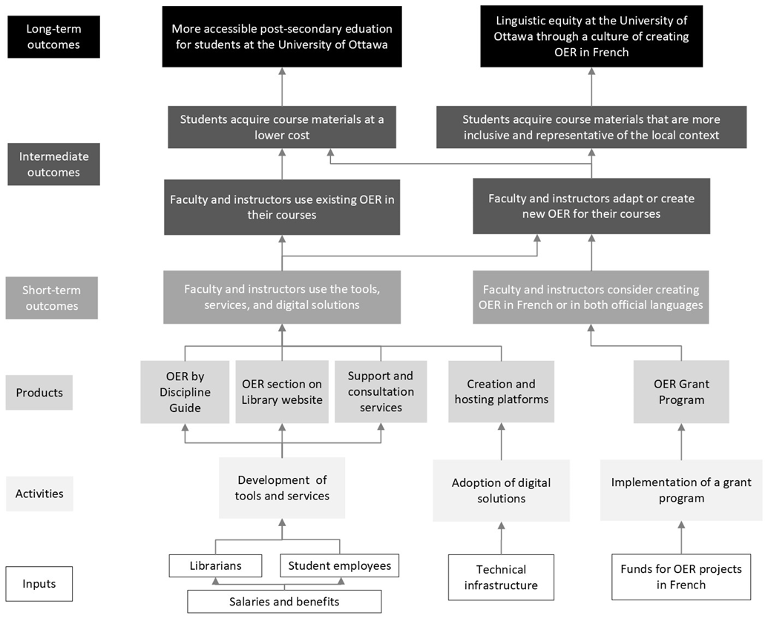
OER Program
Logic Model
Notes:
This logic model is a visual representation of the OER program, its components and activities and how they related to the program’s objectives or outcomes, short term to long term. Spoiler alert: the program did not achieve its long-term goals, at least not on an institutional scale.
I think we reached the first level of intermediate outcomes.

Slide 10
Utilization-Focused Evaluation
(UFE)
Objective:
Provide useful and usable information that is reliable and timely
Flexible Approach:
Mixed methods
Scope
Formative and summative
See: Patton, M.Q. (2012). Essentials of utilization-focused evaluation. SAGE.
Source: Chapitre 4. Les cadres théoriques et approches évaluatives dans Bourgeois, I., Buetti, D., & Maltais, S. (2023). Fondements et pratiques contemporaines en évaluation de programmes. Université d’Ottawa. CC BY 4.0 https://ecampusontario.pressbooks.pub/evaluation/chapter/chapitre-4-les-cadres-theoriques-et-approches-evaluatives/
Notes:
There are several approaches to program evaluation. The one I followed is called « utlization-focused evaluation ». The goal is to provide useful, reliable and timely information to encourage the use of the evaluation results and optimize the implementation of recommendations. We want to limit the chances of the evaluation report being shelved.
This is a flexible approach because it prioritizes the expected users of the evaluation report (decision-making bodies); mixed methods, the scope of the evaluation (its components, the period); and can be both formative (to improve the program in real time) and summative (to assess the overall effectiveness at the end of a program).

Slide 11
Evaluation Matrix
Evaluation Questions | Specific research questions to be addressed by the evaluation
Indicators | Concrete elements that will be measured to answer evaluation questions
Success thresholds / Judgement criteria | Standards or targets to be achieved
Data sources | (Examples) Administrative data, secondary data, public documents, computer data, financial data, program participants
Methods | (Examples) Secondary data analysis, literature review, survey, semi-structured interviews
See p. 24-27 of Evaluation Report: http://hdl.handle.net/10393/50336
Source: Chapitre 5. Les questions d’évaluation et leurs indicateurs dans Bourgeois, I., Buetti, D., & Maltais, S. (2023). Fondements et pratiques contemporaines en évaluation de programmes. Université d’Ottawa. CC BY 4.0 https://ecampusontario.pressbooks.pub/evaluation/chapter/chapitre-5-les-questions-evaluatives-et-indicateurs/
Notes:
To perform a program evaluation, you need to develop an evaluation matrix during the process of defining the scope of the evaluation, based on the program’s logic model, and serves as an plan.
It includes the following elements: evaluation questions, indicators, thresholds for success or judgement criteria, data sources, and methods. There may be multiple indicators per question and mutliple criteria per indicator, and a variety of data sources and methods.

Slide 12
Evaluation Questions
Relevance
2. What are the needs of University of Ottawa students for affordable course materials, and how have these needs changed since the OER Program was first implemented?
Effectiveness
8. Among faculty and instructors who have interacted with the OER Program, to what extent has there been a change in behaviour regarding the use of OER?
Efficiency
9. To what extent does the OER Program have the necessary resources to carry out its planned activities?
Notes:
Questions that you are not going to answer with a simple yes or no. Starting with « to what extent » may be helpful. Here’s a sample for each dimension.
I had a total of nine questions, 3 about relevance, 5 about effectiveness, and 1 about efficiency.
No set number of questions, but it will depend on access or even existence of data (so may need to reduce the scope), time available to perform the evaluation, and if you have a team to perform the evaluation or if it’s just you. So focus on what you think is absolutely necessary to know for those who have the power to make decisions about the program’s future.

Slide 13
Indicators and Thresholds / Criteria
Evaluation Question
8. Among faculty and instructors who have interacted with the OER Program, to what extent has there been a change in behaviour regarding the use of OER?
Indicators
Perceptions of faculty and instructors of OER in university teaching (Perceptions) Number of existing OER used in courses taught by faculty and instructors (Usage) Number of OER adapted or created for courses taught by faculty and instructors (Usage)
Success Thresholds / Judgement Criteria
Faculty and instructors report a positive opinion of OER since their interaction with the Program Faculty and instructors report using an existing OER in at least one course Faculty and instructors report that they have adapted or created OER themselves, or are in the process of doing so for one of their courses
Open Education Group. (2021). The COUP Framework – Open Education Group. Open Education Group. https://web.archive.org/web/20210629193340/https://openedgroup.org/coup
Open Education Group. (2024). The SCOPE Framework. Open Education Group. https://openedgroup.org/the-scope-framework/
Notes:
Example using one question
Indicators: COUP and SCOPE frameworks were very helpful in identifying indicators and making sense of them. But how do you decide thresholds or criteria? You don’t want to set yourself up for failure with unrealistic targets but what does success look like considering all you know about the intitiative and its context? Was this discussed in the original project plan? But you don’t want to have criteria that give a false sense of success either. It can also be the case that the thresholds or criteria have already been provided by the institution or entity who is interested in the evaluation results.
These thresholds and criteria can be a predetermined number, percentage or proportion, or finding out an average, a total, the presence or absence of something, an increase, a decrease, positive perceptions.

Slide 14
Sources and Methods
Program documentation and data: financial data, project proposals and reports, textbook costs and student spending
Program participants (127)
Reports on postsecondary education in Francophone minority contexts
Documentary analysis
Secondary data analysis
Online survey (28)
Semi-structured interviews (5)
Notes:
Program participants – grant applicants and recipients, email/consultations, reporting OER adoption, active Pressbooks users = eliminated duplicates

Slide 15
Benefits
Systematic approach
Language of leadership
Informed decision-making
Integration of disciplinary theoretical frameworks
Notes:
1. To be taken seriously, it is preferable to have a scientific, objective, rigourous approach that leadership and decision-making bodies are more inclined to consider. Program evaluation is a field of expertise and a profession. There is an American Evaluation Society that holds a conference very two years and publishes two journals.
2. In program evaluation, we talk about relevance, effectiveness, efficiency, costs, savings, return on investment, performance, accountability… concepts that correspond to the vocabulary of institutional leadership and government bodies in a neoliberal context, not just a vocabulary specific to libraries or open education.
3. Promotes informed, evidence-based decision-making.
4. Because program evaluation draws on a variety of social science methods and approaches, there is flexibility to integrate disciplinary theoretical frameworks, such as the COUP and SCOPE framework in open education to determine indicators. For example, in this evaluation, I relied on social justice, costs, use, perceptions and engagement.

Slide 16
Challenges
Evaluating own program
Reverse engineering
Return on investment
Voluntary data reporting
complicates
Changes in behavior
Changing circumstances
Keeping it manageable
(scope vs time)
Notes:
1. Evaluating your own program: I completed the evaluation as part of a master’s degree in education at the University of Ottawa and I was the coordinator of the OER Program. It was difficult to remain objective, but I also had knowledge of the program that an external evaluator would not have. I had very high expectations but my thesis supervisor helped me strike a balance.
2. When deciding to evaluate a program well after its implementation, making it a bit of an afterthought, it’s necessary to do some reverse engineering, i.e. logic model, needs, objectives, identifying available data sources. Ideally, a logic model should be part of the planning and implementation of a program.
3. In the world of OER, voluntary reporting mechanisms are common, and it has a significant impact on the availability and quality of the data I could access. There is no obligation to report the use of OER at my institution or at the provincial level.
4. This complicates calculating the return on investment. Also, most OER created with the Library’s grant did not replace commercial textbooks, and there is a lack of data on OER adoption, making it difficult to get an accurate picture of the savings achieved and the ROI, which is what decision-makers want to know. The same problem applies to evaluating the extent of behavioral changes among the target population. How can these gaps be filled? By talking directly to participants using surveys, interviews, focus groups. Finding substitutes or proxies.
5. Ever-changing circumstances: as I was preparing for this evaluation, library management decided to end the program due to budget cuts by the central administration, which wiped out the library’s surplus, which was used to pay for my salary as full-time open education librarian and the grant. During my academic leave to complete this evaluation, the grant was not offered and since January 2025, there has been no one working full-time to support the Library’s OER activities. I went from evaluating a program with the aim of improving it to evaluating a program that was winding down. But during that period, the Ministry of Colleges and Universities in Ontario issued a directive for all publicly-funded postsecondary institutions in the province requiring that the price of all course materials be indicated in the course outlines and encouraging educators to use OER. It renewed interest in affordability and by extension OER as a way to address it.
6. Scope and time management: limited time and resources available to complete a program evaluation, not necessarily part of the organizational culture, we want a quick turnaround, so choices must be made, including not consulting with all stakeholders, not evaluating all components of the program (ex. Community of practice and training, for which meaningful data were not available).
It’s important to be transparent about these limits

Slide 17
Obtain an external perspective if possible
Be strategic in recommendations and take advantage of developments during evaluation
Make evaluation report publicly available
Have talking points ready based on main findings
Some final thoughts
Notes:
1. Get an outside perspective if you are evaluating your own program; in my case it was my thesis advisor, but it could be a colleague who has some experience in evaluation or research methods – can help validate your data collection instruments, your logic model and your evaluation matrix.
2. Be strategic in your recommendations and take advantage of developments during the evaluation or that you can foresee; in this case, there’s been increased interest on the part of university leadership in the production of and access to knowledge in French; the Ontario Ministry of Colleges and University’s directive about costs of course materials; and an increased interest from the Office of the Provost and Vice-President of Academic Affairs in retention and affordability.
3. Share your evaluation report publicly and widely, for transparency and accountability, but also to possibly serve as a model for comparable initiatives in higher education. The first person to receive it was the head of my division so she could officially submit it to the University Librarian and the rest of the library executive, but I also asked her to send it to the Associate Vice-President of Francophone Affairs and the Provost and VP of Academic Affairs, considering their current concerns… While I was asked to present my findings and recommendations on various occasions, it is the Office of Associate Vice-President of Francophone Affairs that has been the most responsive so far and I’m now working with their grant manager to create a collaborative initiative around a new OER grant for the creation of French-language resources.
4. Be prepared to talk about the main findings and recommendations at every opportunity, so have a some talking points ready or your elevator speech. Ex. For each $1 invested, students saved X.

Slide 18


Thank you!
melanie.brunet@uottawa.ca
https://orcid.org/0000-0002-6912-340X

