Slide 1



An Examination of the Social-Emotional Development of Young Children in Care: The Ages and Stages Questionnaire: Minorities and the ASQ:SE
Barbara Greenbergª, Meagan Millerª,
Erik Michaelª, Robert Flynn^{a,b}
ªCentre for Research on Educational and Community Services, University of Ottawa (Canada)
^{b}School of Psychology, University of Ottawa (Canada)
bgreenbe@uottawa.ca

Slide 2

Outline
Geographic Context
Ontario Looking After Children
Purpose of current study
Samples & measures
Results
Implications

Slide 3
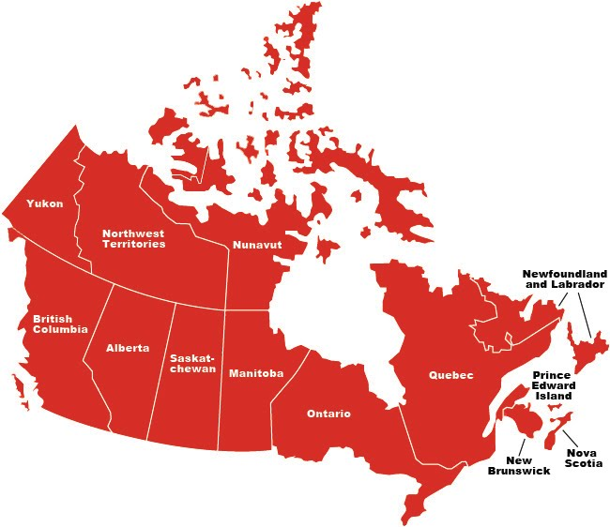
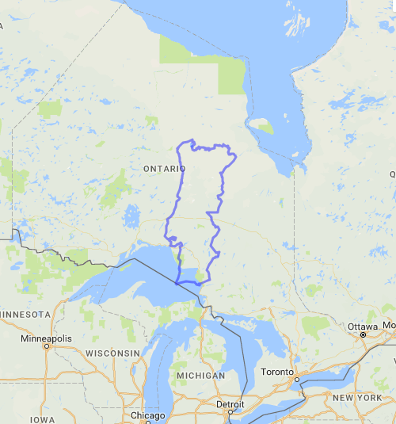
Ontario, Canada

Slide 4

Ontario Looking After Children (OnLAC)
Uses Second Canadian Adaptation of Assessment and Action Record (AAR-C2-2016)
Mandated in Ontario to assess service needs & developmental outcomes of children & young people in care

Slide 5

Purpose of current exploratory study
To determine the effect of demographic, risk, and protective factors on the social-emotional development of children in care, as measured by the Ages & Stages Questionnaires®: Social-Emotional (ASQ®:SE)

Slide 6

Sample
Cross-sectional sample OnLAC 2016-2017
N = 1,022 children
ages 8 months to 5 years (mean 2.2 yrs)
51.8% male, 48.2% female

Slide 7
Sample: Ethnicity

Slide 8
Sample: Placement type

Slide 9
Ages & Stages Questionnaires®: Social-Emotional: dependent variable
Caregiver-completed screening tool for infants and children
aged 3 to 65 months (5 years)
Addresses 7 social-emotional behavioural areas
Higher score = greater social-emotional difficulty
    Empirically-derived cut-off scores for each questionnaire
Self-regulation | Compliance
Affect | Communication
Adaptive functioning | Autonomy
Interaction with people

Slide 10
Independent Variables
Sex
Age
Black
(African, Caribbean)
ethnicity
Developmental delay
Neglect
as primary reason for entry into care
Age at entry into care
Number of changes in caregiver since birth
Positive parenting practices
Ages &
Stages-3
Skills
Gross motor
Communication
Problem solving
Fine motor
Personal-social
development

Slide 11
Social-emotional logistic regression results
 | Model 1 |  | Model 2 |  | Model 3
Predictors | B | Odds Ratio | B | Odds Ratio | B | Odds Ratio
Sex (1 = Female; 0 = Male) | -.53^{c} | .59 | -.36 | .70 | -.36 | .70
Age (in years) | .58^{c} | 1.78 | .39^{c} | 1.48 | .44^{c} | 1.56
Black (African/Caribbean descent) | .36 | 1.43 | .51 | 1.67 | .67ª | 1.96
Developmental delay |  |  | 2.08^{c} | 7.98 | .81^{c} | 2.26
Neglect |  |  | .30 | 1.35 | .18 | 1.19
Age at first entry into care |  |  | .20ª | 1.22 | .17 | 1.18
Number of caregiver changes |  |  | .19^{b} | 1.21 | .29^{c} | 1.34
Positive parenting |  |  |  |  | -.10^{b} | .90
ASQ-3 Communication |  |  |  |  | -.21^{b} | .81
ASQ-3 Gross Motor |  |  |  |  | -.08 | .92
ASQ-3 Fine Motor |  |  |  |  | -.11 | .90
ASQ-3 Problem Solving |  |  |  |  | -.15ª | .86
ASQ-3 Personal-Social |  |  |  |  | -.17^{b} | .84
Nagelkerke R Square | .17 |  | .35 |  | .48
 | χ²(3) = 113.9, p < .001 |  | χ²(7) = 248.3, p < .001 |  | χ²(14) = 361.9, p < .001
Notes: ª p < .05 (2-tailed); ^{b} p < .01 (2-tailed); ^{c} p < .001 (2-tailed)

Slide 12
Significant risk & protective factors
Sex
Age
Black
(African, Caribbean)
Ethnicity
Developmental delay
Neglect
as primary reason for entry into care
Age at entry into care
Number of changes in caregiver since birth
Positive parenting practices
Ages &
Stages-3
Skills
Gross motor
Communication
Problem solving
Fine motor
Personal-social development

Slide 13
Implications for workers & caregivers
Positive parenting practices
Do you praise the child?
Do you play together for at least 10 mins during the day?
Do you laugh together?
Stability = correlated with more successful development
Frequent moves can cause disruptions and distrust
Promotion of placement stability

Slide 14
Implications for workers & caregivers
Black children are 2Xs more likely to be investigated than White children
Black families are 33% more likely to be transferred to ongoing services than White children
Minority children in care: disproportion & disparity
Placement matching?
Population distribution and access to services?
Associations between ethnicity and misdiagnosis

Slide 15
Contact
Dr. Barbara Greenberg bgreenbe@uottawa.ca
Ontario Looking After Children Research Assistant
Meagan Miller mmiller@uottawa.ca
Ontario Looking After Children Research Associate
Centre for Research on Educational and Community Services https://ruor.uottawa.ca/handle/10393/37837
University of Ottawa, Ottawa, Canada

Slide 16
Acknowledgements
The collaboration and financial support of the Ontario Ministry of Children and Youth Services and the Ontario Association of Children’s Aid Societies are gratefully acknowledged.
Thanks also to the numerous young people in care, caregivers, lead hands, practitioners, supervisors, quality-assurance staff, executive personnel, and OnLAC research assistants who have contributed much to the OnLAC project since the beginning.

