Slide 1
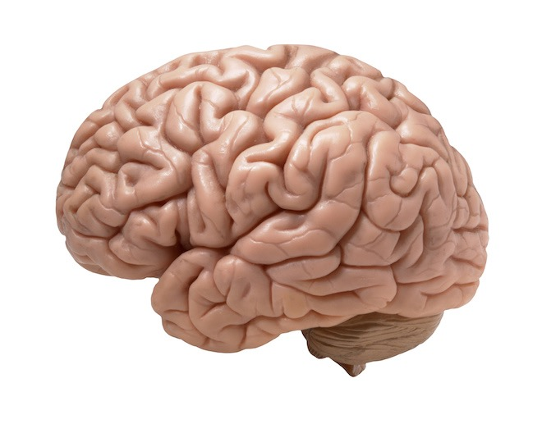

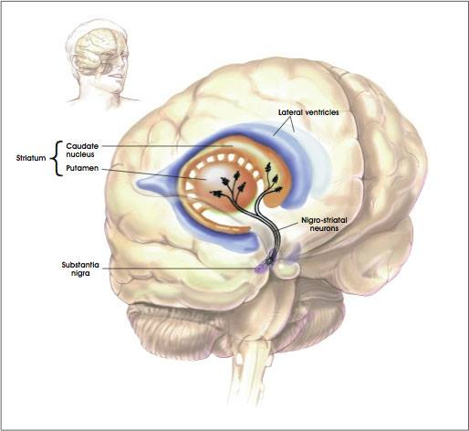
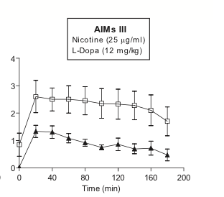
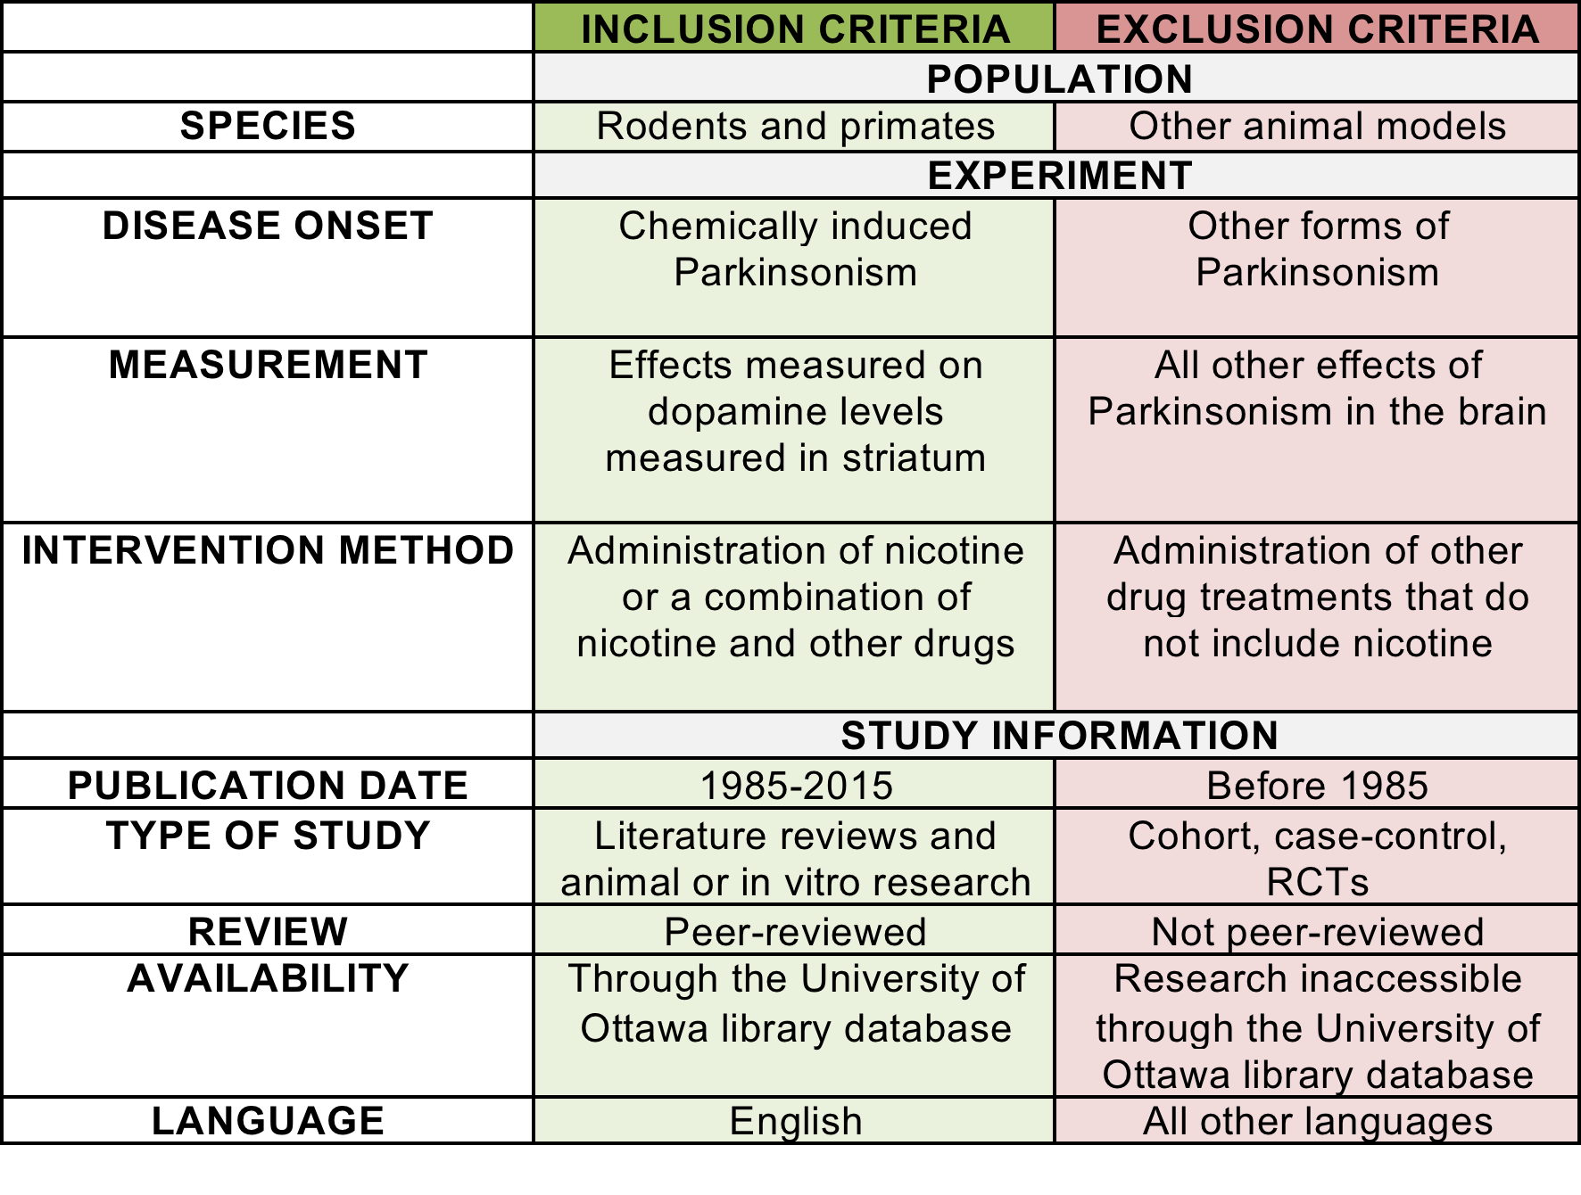
ANALYZING THE NEUROPROTECTIVE POTENTIAL OF NICOTINE IN PARKINSON’S DISEASE (PD) AND ITS EFFECT ON DOPAMINE LEVELS IN RODENTS AND PRIMATES
Interdisciplinary School of Health Sciences
Lucas Buffone, Jessica Colbourne, Daniella Lock, and Vithurry Sivaloganathan
ABSTRACT
Parkinson’s Disease (PD) is the second most common neurodegenerative disease. While there is no cure to PD, there are multiple speculated environmental factors that predispose an individual. Recent research suggests that nicotine can serve as a neuroprotective factor in Parkinson’s disease. The aim of this literature review is to determine whether the literature indicates a relationship between the use of nicotine and PD. Keywords "(parkinson’s*) AND (neuroprotection) OR (rats) OR (nicotine) OR (mouse) OR (dopamine)", were searched through University of Ottawa Search+ database.
RESEARCH QUESTION
Does nicotine serve as a neuroprotective agent and increase dopamine levels in rodent and primate subjects who experience chemically-induced Parkinson’s Disease (PD)?
RESULTS
DISCUSSION
Limitations
- Extensive literature examining the effects of cigarette smoking in PD within humans exists, however, promoting cigarette use is unfavourable due to its multitude of detrimental health effects. As a result, studies that included cigarette smoking were excluded from our literature review thus limiting the scope of information to strictly animal models.
- Non-human animal models used in the studies serve as a limitation. Post-mortem research is imperative in investigating the effects of nicotine on dopamine levels in the brain; therefore, research in this area is limited to studies performed on non-human animal models to stay in accordance with ethical guidelines. Because animal models are being used, it is not possible to achieve models that precisely mimic the pathogenesis of PD etiology, as it exists in human subjects.
- Methodology limitations also exist. The articles obtained in this structured literature review were limited to only those that are accessible through the University of Ottawa Search+ database. Additionally, only studies published in English were found therefore articles were limited as relevant studies in other languages were unobtainable.
- The publication date ranged from 1985-2015, thus providing a 30-year span. This creates a limitation because data published before this time period was rejected. On the other hand, a wide range of time creates potential for data that is outdated which also can serve as a limitation within the review.
Recommendations
- More research on non-motor symptoms of Parkinsonism and how these symptoms may also benefit from nicotine treatment.
- The safety profile of nicotine needs to be further examined. Many studies found that chronic and/or high doses of nicotine are not beneficial and potentially detrimental, therefore additional research should be conducted to investigate the ways in which these issues can be eliminated or avoided before researchers begin conducting clinical trials.
- Further research is required to examine the role of nicotine in other dopamine related neurodegenerative disorders. Because of its highly beneficial role in preventing dopamine degeneration, it is likely that these effects can be generalized to other dopamine-related conditions.
- Studies examining cigarette smoking should highlight the fact that nicotine can be administered in healthier ways for humans in the case that the findings of this study are disseminated.
AUTHOR | STUDY | OUTCOME
 |  | Neuropro-tective | Increase Dopamine
Bordia et al. (2008) | Animal Study | X
Janhunen et al. (2005) | Animal Study | X | X
Janson et al. (1992) | Animal Study | X
Maggio et al. (1998) | Animal Study | X | X
Munoz et al. (2012) | Animal Study | X
Quik et al. (2009) | Animal Study | X
Quik et al. (2012) | Literature Review | X
Sershen et al. (1987) | Literature Review | X
Singh et al. (2008) | Animal Study | X
Thiriez et al. (2011) | Literature Review | X | X
METHODS
The following "(parkinson’s*) AND (neuroprotection) OR (rats) OR (nicotine) OR (mouse) OR (dopamine)", were searched through University of Ottawa Search+ database. These keywords were used in various combinations to create a selection pool in which the most relevant and appropriate results could be obtained. Results were then further filtered to display only peer-reviewed work. A combined total of 442 articles were found in the preliminary search, of which 432 were eliminated based on article title, abstract, language, and date of publication. Of the remaining articles, 10 were deemed most relevant pertaining to the research question.
BACKGROUND
Parkinson’s Disease is a significant neurodegenerative condition to research due to its high prevalence in Canada. According to Statistics Canada in 2010/2011, 55,000 Canadian adults in private households reported being diagnosed with PD; 79% of these adults aged 65 and older. Additionally, 12,500 Canadians in long-term institutions reported a PD diagnosis; 97% of these residents aged 65 and older. As a result, according to this data, approximately 67,500 Canadians were afflicted with Parkinson’s Disease. Given that the population of Canada in 2011 was approximately 30.34 million (World Bank), PD had a prevalence of 0.22.
Dopamine (DA), a critical neurotransmitter, is a target of treatment for PD patients. Upon post-mortem analysis of the brain of patients afflicted with Parkinson’s, dopamine is below normal thresholds. Levodopa (L-dopa), is a commonly prescribed pharmaceutical that acts as a dopamine replacement, however, L-Dopa treatment is associated with motor dysfunction in patients (Movement Disorders, 2002).
Table 2: Selected Study Outcomes
Of the 10 peer-reviewed research studies analyzed, all were animal studies that concluded a negative association between nicotine and PD. Most studies concluded nicotine did not increase dopaminergic measures when administered to animals with preexisting nigrostriatal damage, however were a successful neuroprotective factor by protecting against ongoing degeneration. Yet, 3 studies (Janhunen et al. (2005), Maggio et al. (1998), Thiriez et al. (2011)) claimed that nicotine did act by increasing the dopamine levels in the striatum.
In addition, 3 studies (Bordia et al. (2008), Quik et al. (2012), Singh et al. (2008)) discovered that the way in which nicotine is administered influences its role as a neuroprotective factor. These studies found that acute intermittent nicotine treatment worked as a neuroprotective factor while chronic nicotine treatment did not have any beneficial effects in regards to Parkinsonism.
All 10 studies indicate that the neuroprotective actions of nicotine treat only the motor symptoms associated with PD such as abnormal involuntary movement (AIMs). It has been suggested by 1 study (Quik et al. (2012) that non-motor symptoms such as decreased cognition, depression and memory loss may also be treated with nicotine, however more research must be conducted in this area to provide concrete evidence.
Figure 2: Nicotine and L-Dopa Levels. Obtained from Bordia et al. (2008), observed the significant decrease in L-Dopa-induced Abnormal Involuntary Movements (AIMs) (the common motor symptom seen in PD) with the use of intermittent nicotine treatment.
Figure 1. Dopamine Striatal pathway affected in PD
CONCLUSION
In conclusion, within animal studies nicotine is successful in serving as a neuroprotective role in Parkinson’s Disease. While we discovered it was a neuroprotective factor, the mechanism by which nicotine acts has differing conclusions. Most of our studies demonstrated that nicotine worked by protecting the dopamine within the striatum from further dopamine loss. Thus, the damage caused by PD is irreversible however nicotine administration can prevent further loss of dopamine.
References
Bordia, T., Campos, C., Huang, L., & Quik, M. (2008). Continuous and intermittent nicotine treatment reduces L-3,4-dihydroxyphenylalanine (L-DOPA)-induced dyskinesias in a rat model of Parkinson's disease. Journal Of Pharmacology And Experimental Therapeutics, 327(1), 239-247.
Janhunen, S. K., Mielikäinen, P., Paldánius, P., Tuominen, R., Ahtee, L., & Kaakkola, S. (2005). The effect of nicotine in combination with various dopaminergic drugs on nigrostriatal dopamine in rats. Naunyn-Schmiedeberg's Archives of Pharmacology, 371(6), 480-491.
Janson, A., Fuxe, M., & Goldstein, K. (1992). Differential effects of acute and chronic nicotine treatment on MPTP-(1-methyl-4-phenyl-1,2,3,6-tetrahydropyridine) induced degeneration of nigrostriatal dopamine neurons in the black mouse. The Clinical Investigator, 70(3), 232-238.
Maggio, R., Riva, M., Vaglini, F., Fornai, F., Molteni, R., Armogida, M., . . . Corsini, G. (1998). Nicotine Prevents Experimental Parkinsonism in Rodents and Induces Striatal Increase of Neurotrophic Factors. Journal of Neurochemistry, 71(6),2439-2446.
Movement Disorder Society, (2002). Levodopa. Movement Disorders, 17, S23-S37.
Muñoz, P., Huenchuguala, S., Paris, I., Cuevas, C., Villa, M., Caviedes, P., . . . Tizabi, Y. (2012). Protective Effects of Nicotine Against Aminochrome-Induced Toxicity In Substantia Nigra Derived Cells: Implications for Parkinson’s Disease. Neurotoxicity Research, 22(2), 177-180.
Parkinson’s disease: Prevalence, diagnosis, and impacts (2011). Retrieved April 9, 2015 from http://www.statcan.gc.ca/pub/82-003-x/2014011/article/14112-eng.htm
Quik, M. A., Perez, X., & Bordia, T. (2012). Nicotine as a potential neuroprotective agent for Parkinson's disease. Movement Disorders, 27(8), 947-957.
Quik, M., Huang, L. Z., Parameswaran, N., Bordia, T., Campos, C., & Perez, X.A. (2009). Multiple roles for nicotine in Parkinson's disease. Biochemical Pharmacology, 78(7), 677-685.
Sershen, H., Hashim, A., & Lajtha, A. (1987). Behavioral and biochemical effects of nicotine in an MPTP-induced mouse model of Parkinson's disease. Pharmacology, Biochemistry and Behavior, 28(2), 299-303.
Singh, S., Singh, K., Patel, S., Patel, DK, Singh, C., Nath, C., & Singh, M.P. (2008). Nicotine and caffeine-mediated modulation in the expression of toxicant responsive genes and vesicular monoamine transporter-2 in 1-methyl 4-phenyl 1,2,3,6-tetrahydropyridine-induced Parkinson's disease phenotype in mouse. Brain Research, 1207, 193-206.
Thiriez, C., Villafane, G., Grapin, F., Fenelon, G., Remy, P., & Cesaro, P. (2011). Can nicotine be used medicinally in Parkinson'a[euro][TM]s disease? Expert Review of Clinical Pharmacology, 4(4), 429.

