Slide 1


Open Access to Knowledge Part 2: Sharing Your Research Data
Mélanie Brunet
Jeanette Hatherill
Chantal Ripp
University of Ottawa Library
Unless otherwise specified, the contents of this presentation are made available under a Creative Commons Attribution 4.0 International licence.
Image by mohamed_hassan from Pixabay, Pixabay Licence

Slide 2
By the end of this webinar you will:
Be familiar with copyright and data ownership
Plan to share your research data
Make your data and supporting documentation available in a recognized repository
Understand how to apply open licences to your data

Slide 3
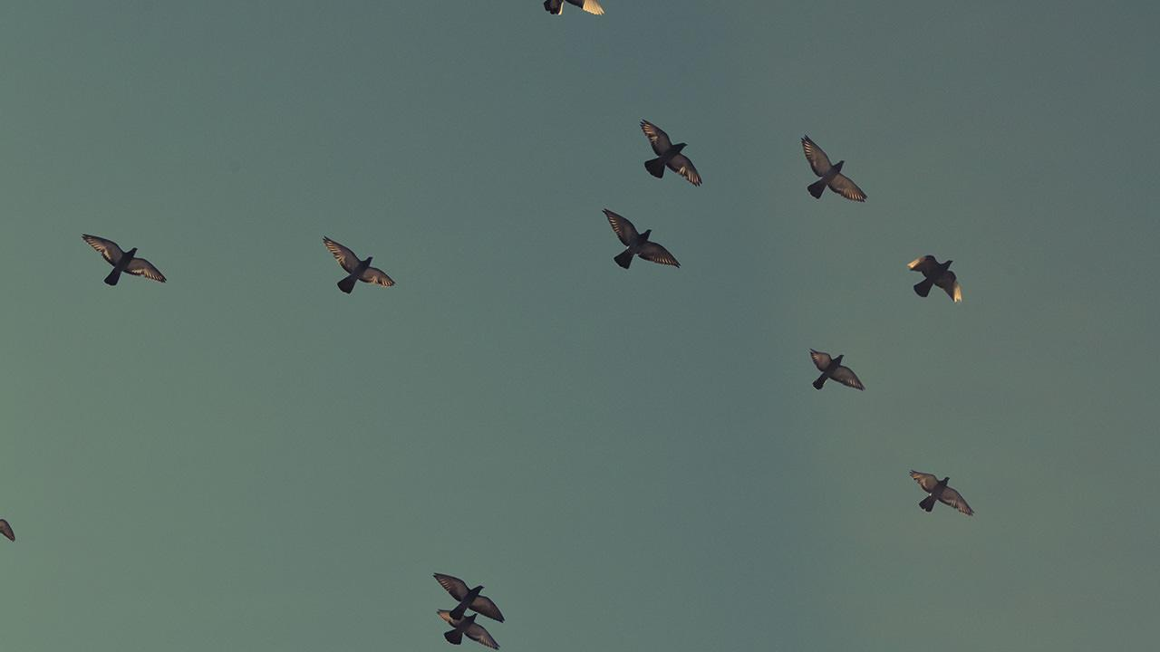
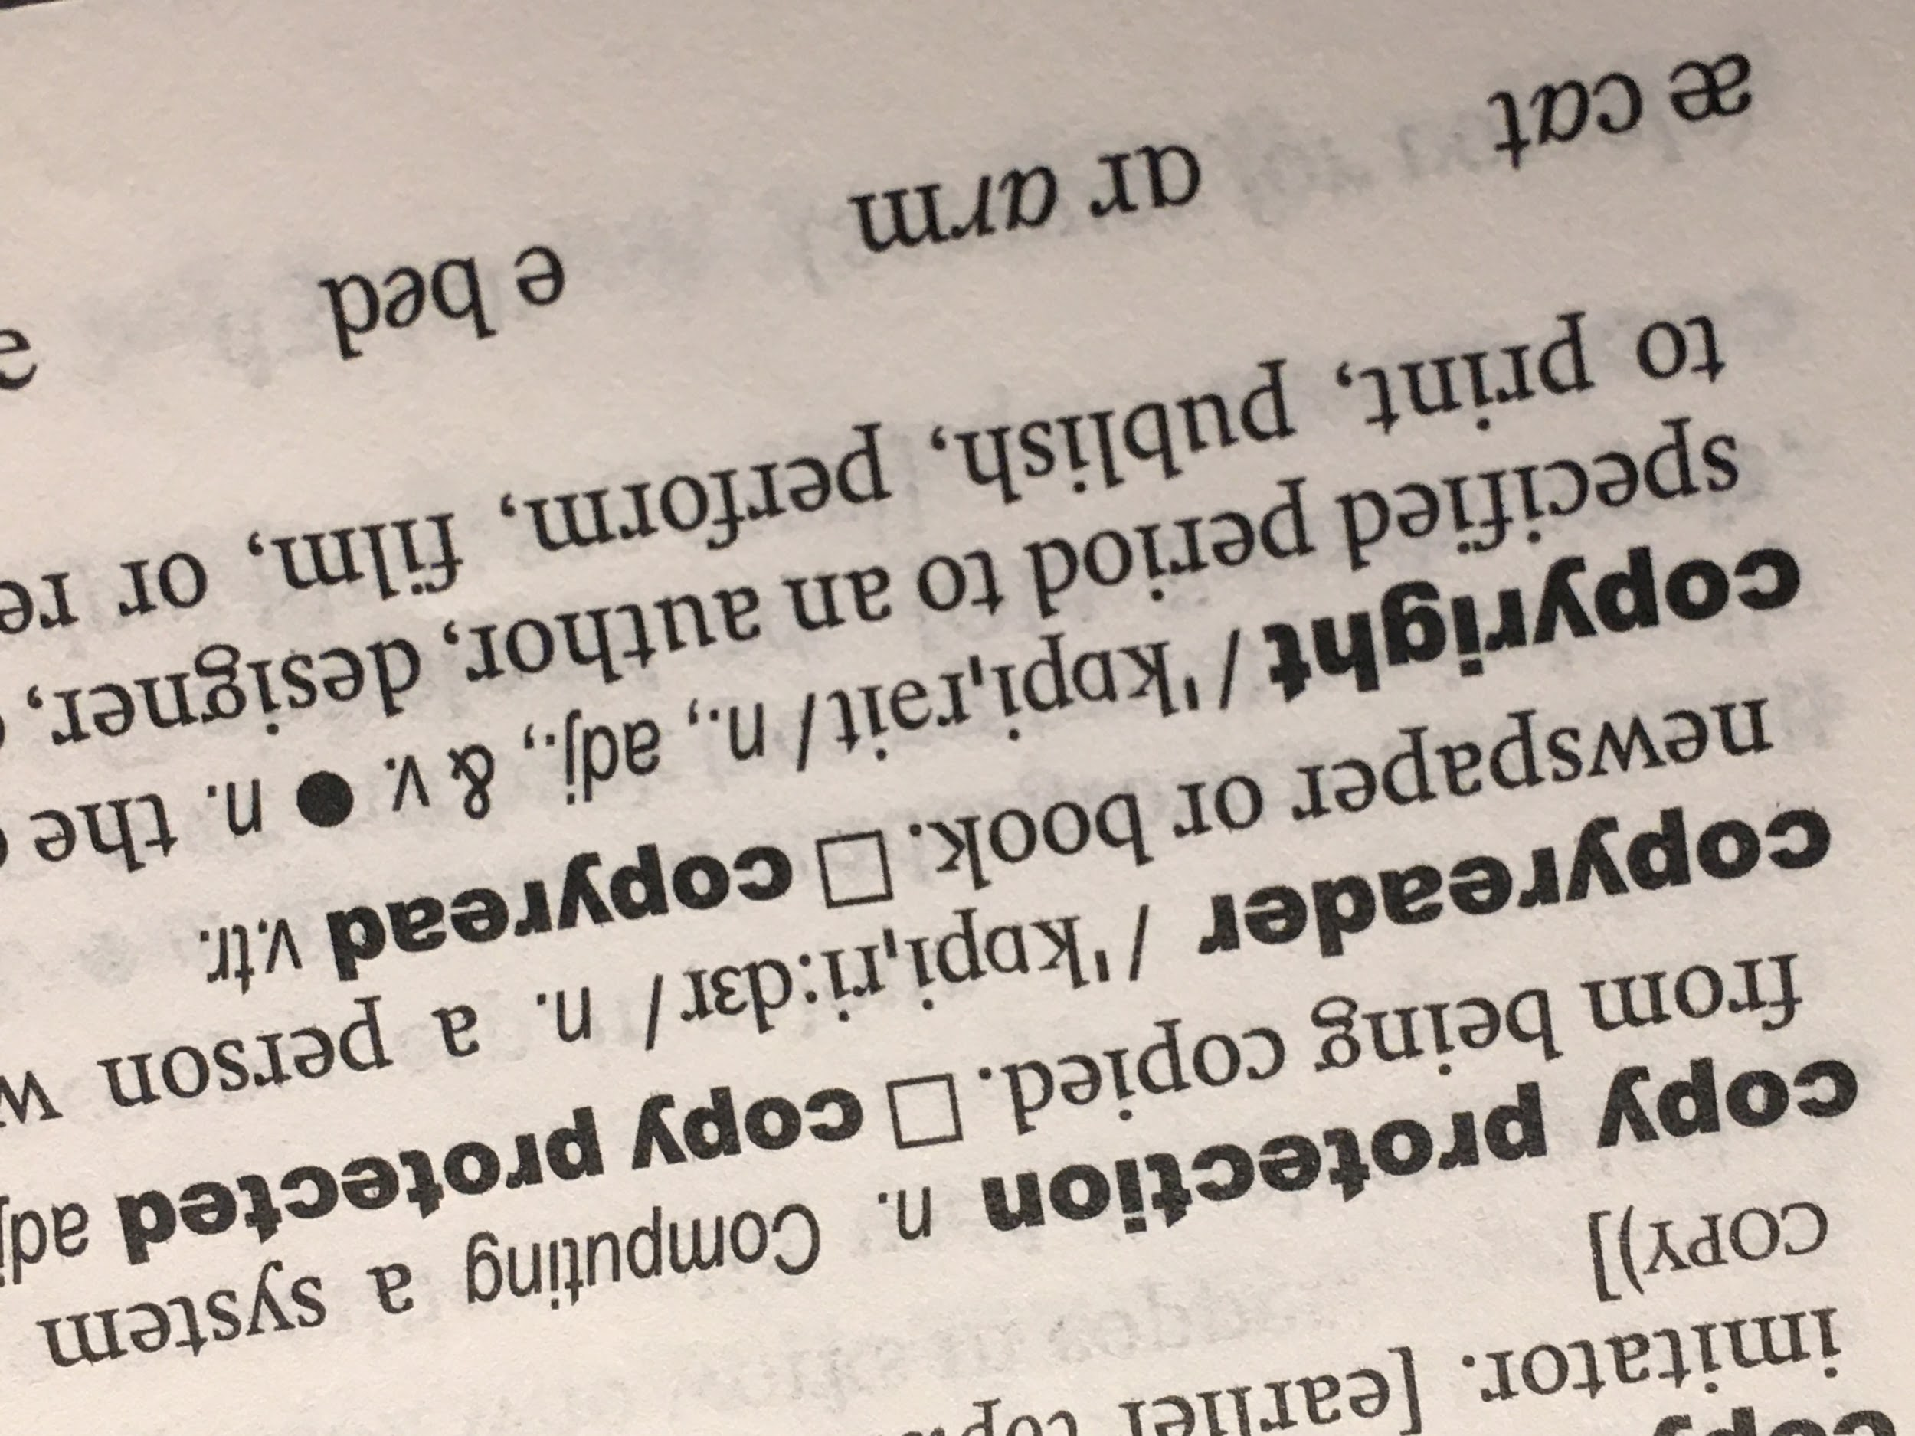
1.
Copyright
Photo by Mélanie Brunet, CC0

Slide 4

Copyright Basics
Copyright...
protects the original expression of ideas or facts fixed in a tangible medium
is automatic upon fixation
raw/factual data vs. compilation of data

Slide 5

Is data protected by copyright?
It could!
Not protected by © | Could be protected by ©
Datum/raw data (ex. a number, a measurement) | Data representations (ex. tables and graphs)
 | Data sets
 | Purchased data (with licence terms)
 | Datum that by itself is a literary, musical, dramatic or artistic work

Slide 6

Is there copyright protection and who owns it?
Determine if data protected by copyright
If yes, who owns it? Don’t assume it’s you:
  Employment contracts and institutional policies
  Disciplinary conventions and practices in attributing authorship
  Policies of funding agency or organisation
  Licensing conditions of purchased data
➽ Decision to share data and level of openness will depend on answers to these questions.
➽ If there is copyright but you do not own it, data cannot be made more open without permission of copyright owner.

Slide 7

Copyright and sharing data as supplementary materials to a publication
In subscription-based journals...
Supplementary materials require copyright transfer:
May not have authority to transfer © on data
Data will remain behind paywall and therefore not available openly
➽ Choose data repositories instead

Slide 8

2.
Begin with the end in mind
Analyse - Colour by Pixel True Studio from pixeltrue, pixeltrue license

Slide 9
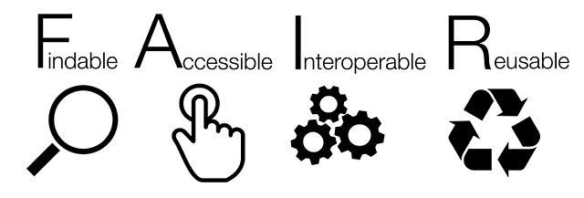
Jones, Sarah, & Grootveld, Marjan. (2017, November). How FAIR are your data?
FAIR data principles by SangyaPundir, Wikimedia Commons, CC BY-SA 4.0

Slide 10
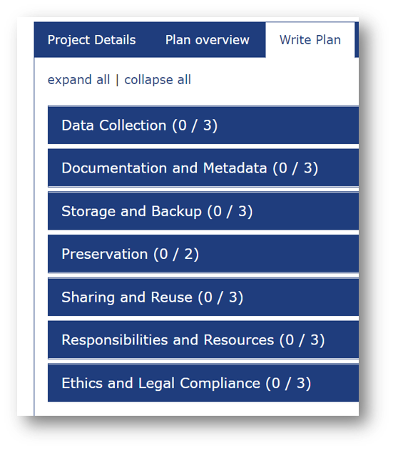

Plan to share your research data
Data Management Plan (DMP) is a document that assist researchers in determining the costs, benefits and challenges of managing data.​
➽ Create at the beginning of a project and update it as project evolves.

Slide 11
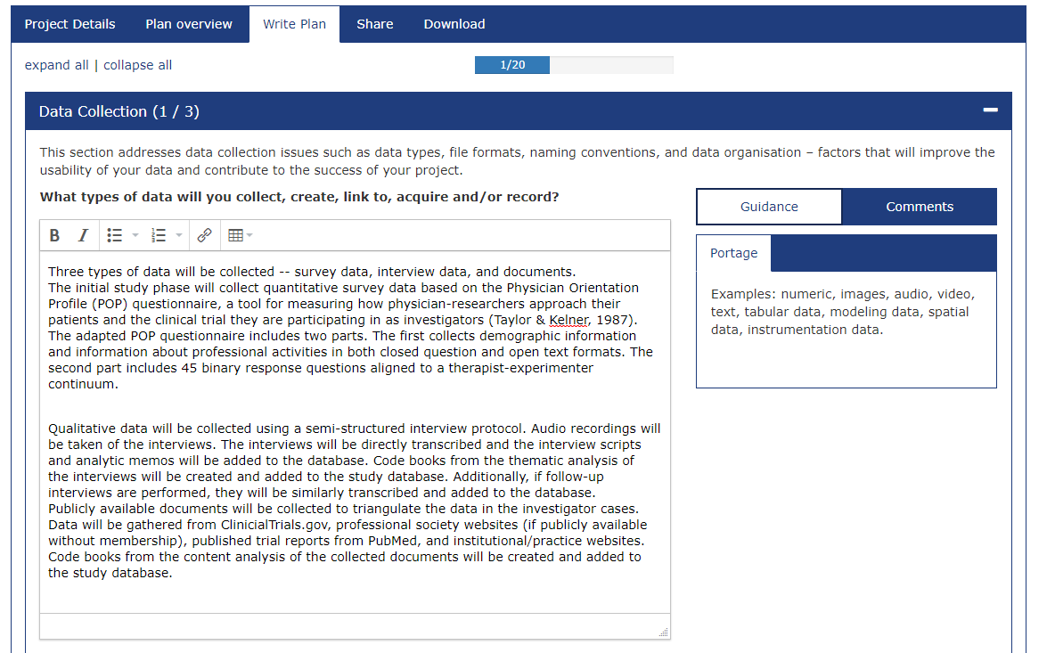
DMP Assistant
Use a template - Portage’s DMP Assistant

Slide 12
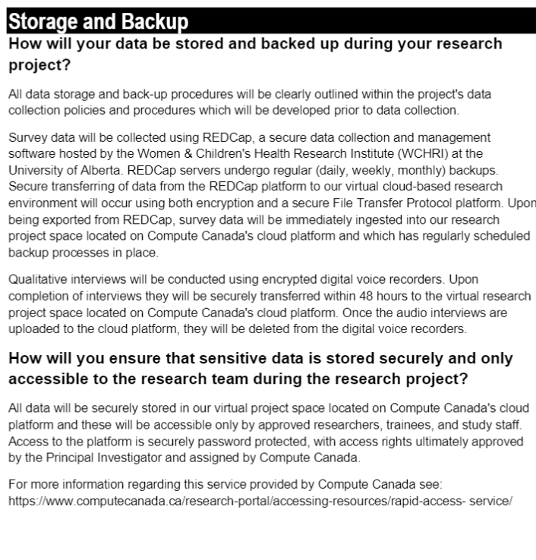
DMP Examples
Look at other DMPs as models
➽ Portage Network Exemplar DMPs
➽ Digital Curation Centre - Example DMPs and Guidance
Doiron, James. (2020, September 8). Data Management Plan Exemplar #3: Mixed Methods Fictional Exemplar. Zenodo. http://doi.org/10.5281/zenodo.4019563

Slide 13

Sensitive Data Toolkit for Researchers
Access to individual participant data and trial documents should be as open as possible and as closed as necessary
Understand the risk level for human participant research data to make decisions with respect to its management, deposit, and appropriate access/future use.
Toolkit:
Part 1: a Glossary of Terms for Sensitive Data used for Research Purposes
Part 2: a Human Participant Research Data Risk Matrix
Part 3: and a document providing samples of Research Data Management Language for Informed Consent.

Slide 14
Anonymize personal information
Minimize disclosure risk when sharing data collected from human participants by applying de-identification practices
➽ Consult Portage's De-identification Guidance
Fee-based services for de-identification
d-wise (American & European offices)
  Offering free anonymization services to researchers who deposit individual participant-level data from COVID-19 clinical trials in Vivli.
Inter-university Consortium for Political and Social Research(ICPSR)(Archive headquartered at University of Michigan
  Purchase the Professional Curation package, see Deposit Data with ICPSR
Privacy Analytics (Ottawa-based company)
  Preview datasets as part of their Data Privacy Validation Services.

Slide 15

File formats
When choosing a format for your data you need to consider later lifecycle activities​
Proprietary Format | Preferred Format
Excel (.xls, .xlsx), SPSS | Comma Separated Values (.cvs or .tsv) ASCII
Word (.doc, .docx) | plain text (.txt), XML or if formatting is needed, PDF/A (.pdf)
PowerPoint (.ppt, .pptx) | PDF/A (.pdf)
Photoshop (.psd) | TIFF (.tif, .tiff)
Quicktime (.mov) | MPEG-4 (.mp4)
➽ Not sure about a file format? Check OpenAIRE's Data formats for preservation guide ​
and Library and Archives Canada’s Advice on the digital file formats to be used when transferring information ​
​

Slide 16
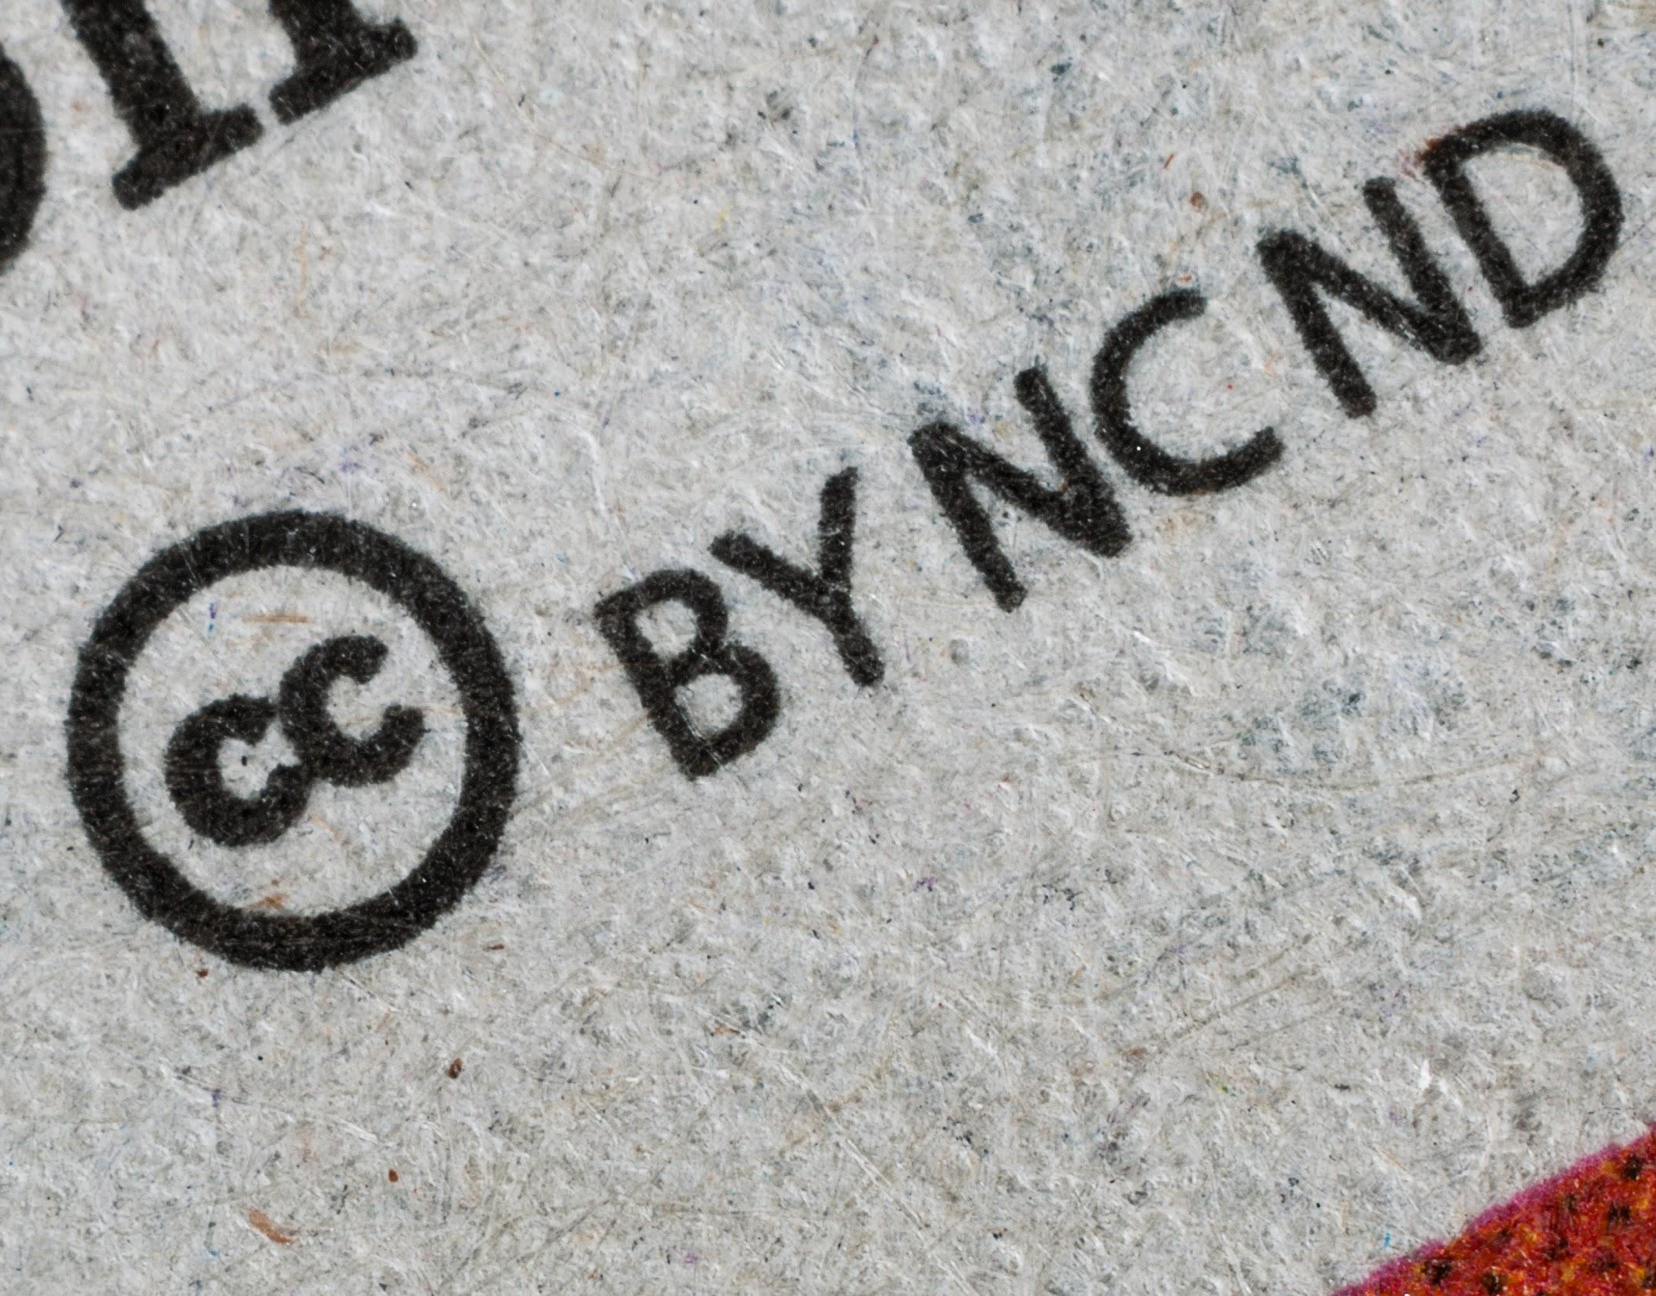
3.
Open Licences
Photo by Umberto on Unsplash, Unsplash Licence

Slide 17
What is a licence?
“A licence allows someone else to use a work for certain purposes and under certain conditions.
The copyright owner still retains ownership.”
Quoted from: A Guide to Copyright (Assignments and Licences), Canadian Intellectual Property Office (CIPO)

Slide 18
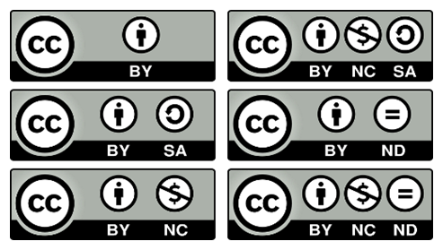

Licences
*
Creative Commons Attribution 4.0 International Licence
CC BY 4.0
About the licences: https://creativecommons.org/licenses/?lang=en
Creative Commons Icons and Logo, Creative Commons, CC BY 4.0

Slide 19




Creative Commons licences conditions
*
Attribution (BY)
ShareAlike (SA)
NonCommercial (NC)
NoDerivatives (ND)
Creative Commons icons, Creative Commons, CC BY 4.0

Slide 20


CC0 - Public Domain Dedication
CC0
Instrument used by creators to waive their rights and dedicate their work to the public domain right away
More about CC0:
https://creativecommons.org/share-your-work/public-domain/cc0/
Creative Commons CC0 Icons, Creative Commons, CC BY 4.0

Slide 21



Software licences
MIT License
GNU General Public License 3.0
Apache License 2.0
MIT logo, Wikimedia Commons, public domain, GPL logo, Wikimedia Commons, public domain,
Apache logo, Wikimedia Commons, Apache License 2.0

Slide 22
Licence comparison chart
Licence | Distribution | Modification | Sublicensing | Attribution
CC BY | Allowed | Allowed | Allowed | Required
CC0 | Allowed | Allowed | Not allowed | Not required
MIT | Allowed | Allowed | Allowed | Required
GNU GPL | Allowed | Allowed | Allowed | Required
Apache | Allowed | Allowed | Allowed | Required
All 5 licences allow for commercial use
Sublicensing = derivatives can be shared under different licence
Table licensed CC BY-SA 4.0, based on Comparison of free and open-source software licences, Wikipedia, CC BY-SA 3.0

Slide 23

4.
4 Easy Steps to Share Research Data
Image de Memed_Nurrhomd, Pixabay. Licence Pixabay
Analyse - Colour by Pixel True Studio from pixeltrue, pixeltrue license

Slide 24

Why a data repository?
Repositories provide :
Technical infrastructure
Visibility of your research data (collected in discovery platforms such as OpenAIRE COVID-19 Guideway)
Permanent identifier (DOI) and citation of your data
Access controls

Slide 25

Step 1: Identify a disciplinary or generalist repository
Look for:
Recommendations or requirements in funder guidelines (e.g. CIHR Open Access Policy: Annex)
Recommended repositories maintained by journals/publishers (e.g. Scientific Data and PLOS ONE)
FAIRsharing or re3data.org to consult a a list of certified data repositories
Consult library’s RDM website for supported repositories, including uOttawa Dataverse and Federated Research Data Repository (FRDR)​

Slide 26




Disciplinary repositories examples
GenBank
NDEx v2.5.0
ImmPort
COVID-19 Data Repository OpenICPSR
Portage COVID-19 Working Group, Roger Reka, Minglu Wang, Erin Clary, Beth Knazook, Qian Zhang, … Melanie Parlette-Stewart. (2020, September 21). Recommended Repositories for COVID-19 Research Data (Version 2). Zenodo. http://doi.org/10.5281/zenodo.4270545, CC BY 4.0

Slide 27





Generalist repositories examples
Zenodo
Scholars Portal Dataverse
Federated Research Data Repository (FRDR)
Open Science Framework
Figshare
Portage COVID-19 Working Group, Roger Reka, Minglu Wang, Erin Clary, Beth Knazook, Qian Zhang, … Melanie Parlette-Stewart. (2020, September 21). Recommended Repositories for COVID-19 Research Data (Version 2). Zenodo. http://doi.org/10.5281/zenodo.4270545, CC BY 4.0

Slide 28
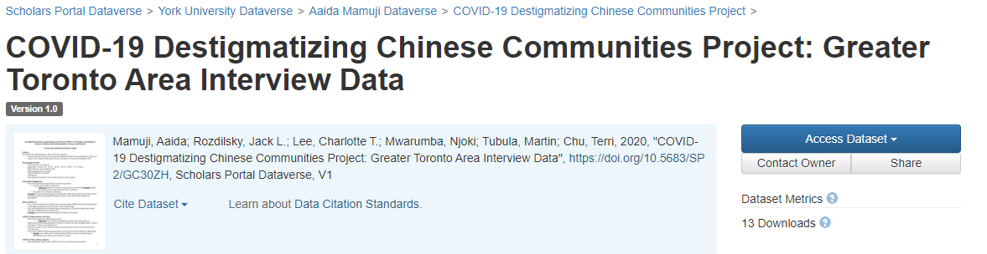
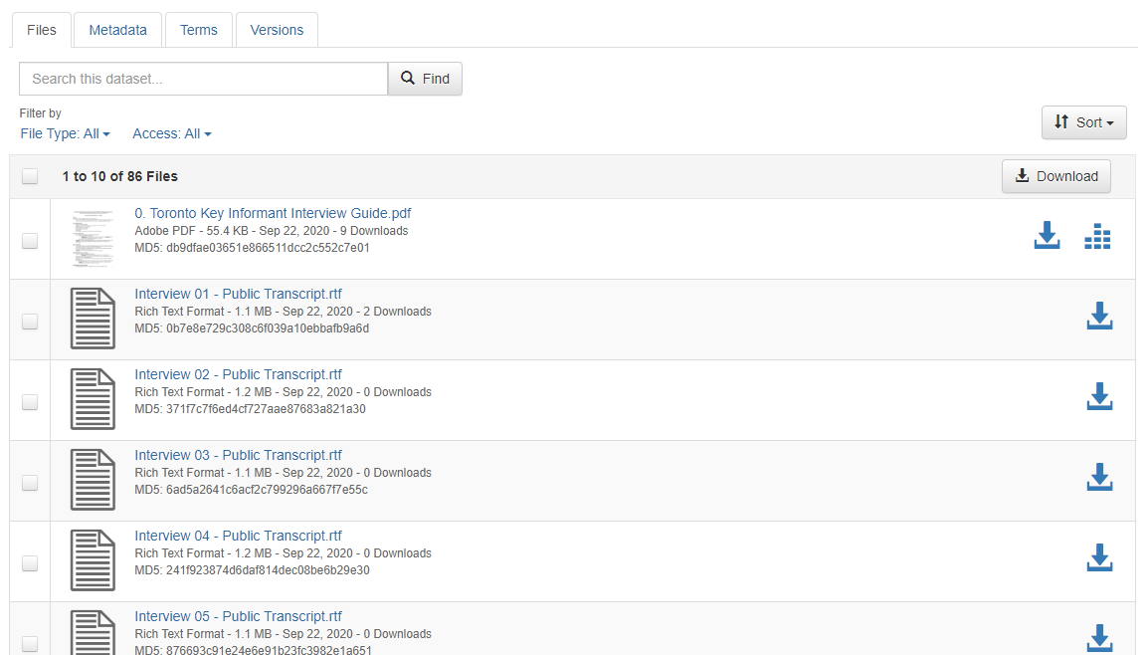

Step 2:
Deposit dataset(s) and documentation
Data file(s)
Provide documentation and supporting information
(e.g. codebook and/or Readme file; methodologies; data provenance).
Portage’s Documentation and Supporting Material Required for Deposit

Slide 29
Step 3:
Add descriptive metadata
Make your research outputs richer, connected and reusable with robust metadata
Recommended metadata fields:
*ORCID iD
Dataset Name | Author(s)* | Description
Keywords | Date Published | Date Modified
Licence | Funder and Grant # | DOI
Related identifiers (e.g. to publication or code if in another repository like Github)

Slide 30
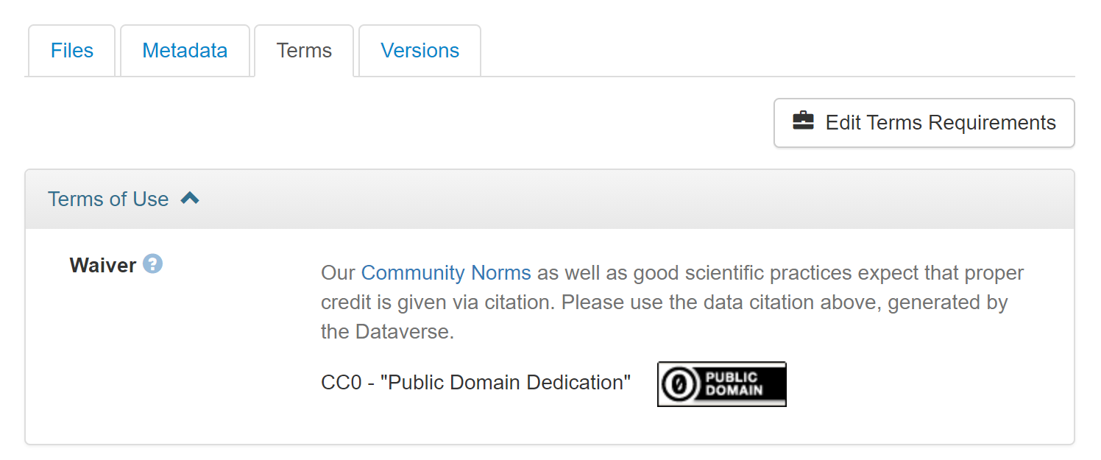
Step 4: Apply
Open Licences to Your Data
Ex.
Scholars Portal Dataverse
Default is CC0
Want to apply an open licence? Click “Edit Terms Requirements”

Slide 31
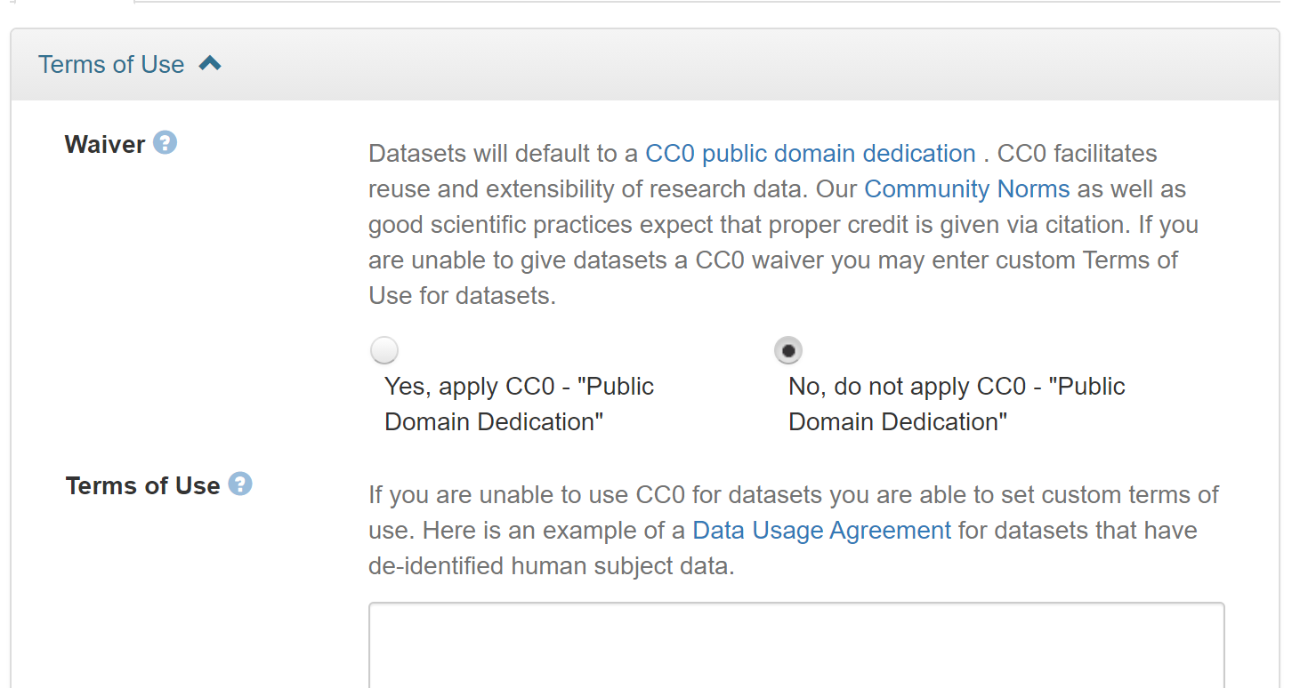
Step 4: Apply
Open Licences to Your Data
Ex.
Scholars Portal Dataverse
1. Click “No, do not apply CC0”
2. Add another open licence under “Terms of Use”

Slide 32
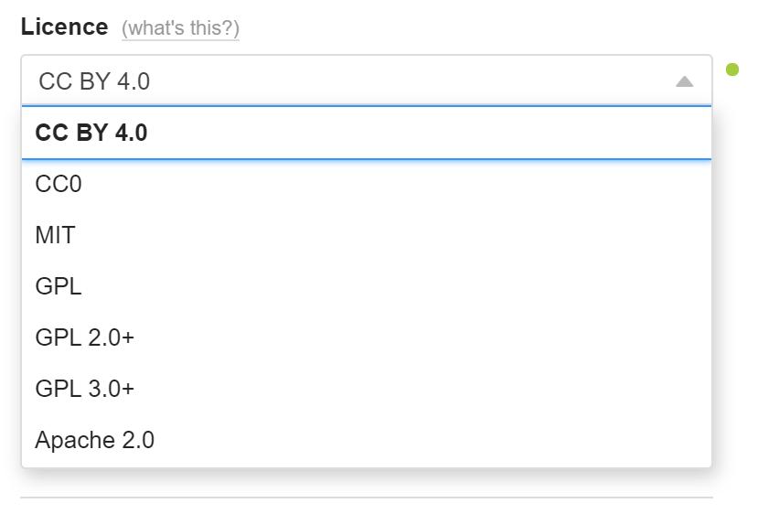
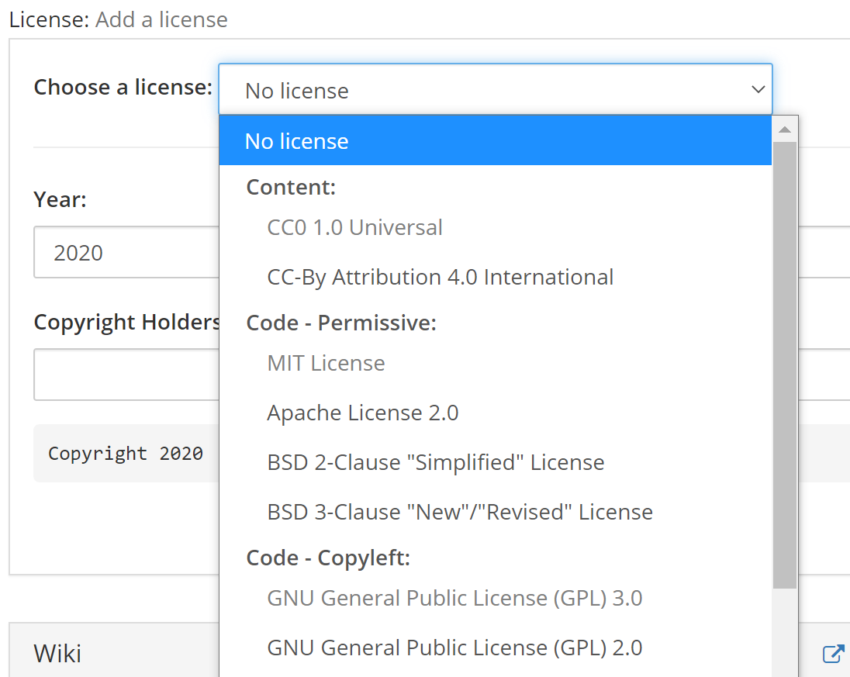
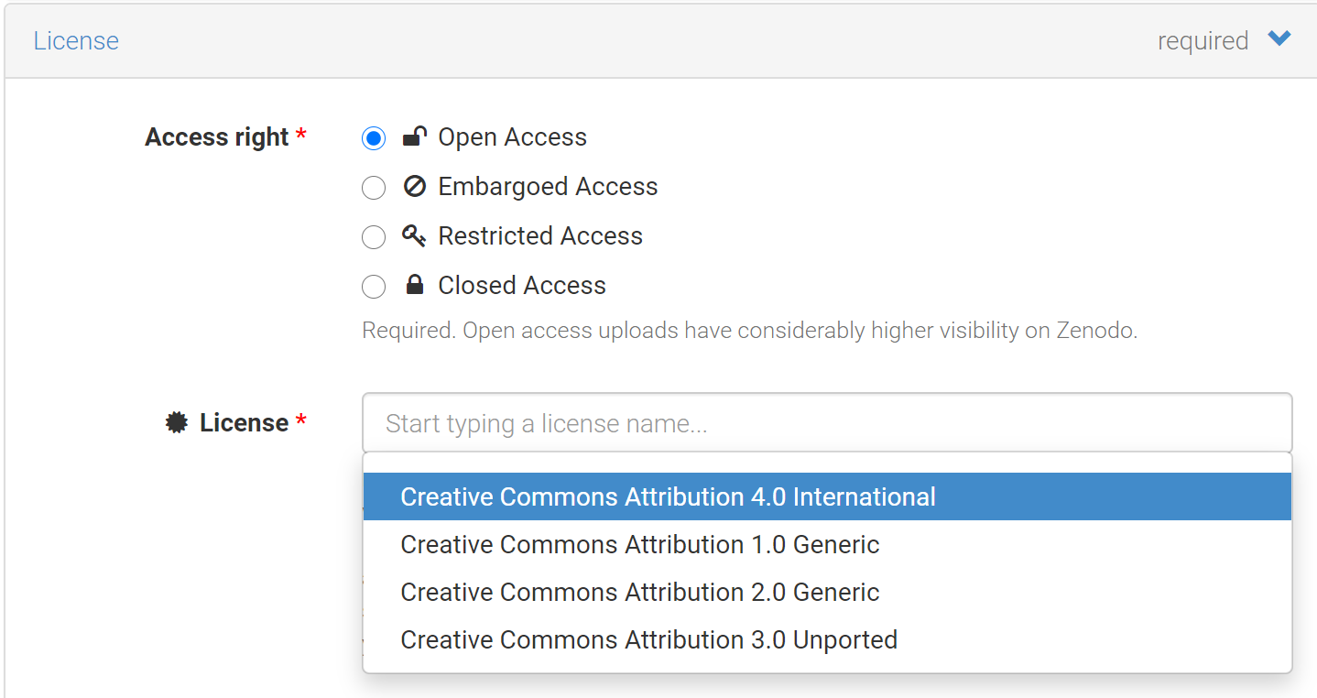
Figshare
OSF
Zenodo

Slide 33
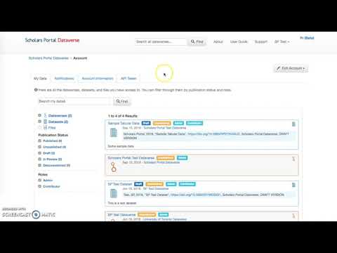
Publishing datasets in Scholars Portal Dataverse

Slide 34
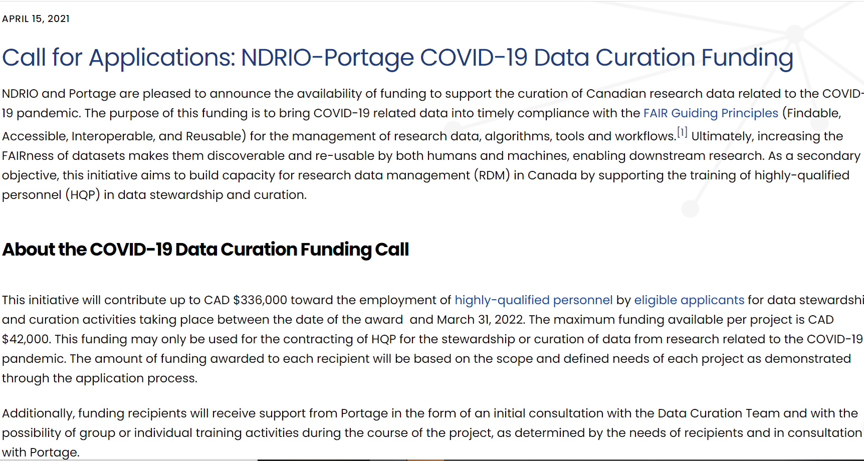
https://portagenetwork.ca/news/call-for-applications-ndrio-portage-covid-19-data-curation-funding/

Slide 35
Key Takeways
Ensure you have the authority to share the data
Choose a disciplinary or generalist repository
Add descriptive metadata
Share your data under an open licence such as Creative Commons
Cite your data

Slide 36
Thank you!
Questions?
Mélanie Brunet, Copyright Services Librarian
melanie.brunet@uottawa.ca
Jeanette Hatherill, Scholarly Communication Librarian
jeanette.hatherill@uottawa.ca
Chantal Ripp, Research Data Management Librarian (Interim)
chantal.ripp@uottawa.ca
Credits:
Ulysses presentation template by SlidesCarnival, CC BY 4.0
Unless otherwise noted, icons used in this presentation are from the Noun Project, used with permission through a NounPro for Education royalty-free licence

Slide 37
Additional Resources
FAQ: COVID-19 Rapid Response Data Sharing and Deposit Support, version 1.1, April 2020, Felicity Tayler and Chantal Ripp, uOttawa, CC BY 4.0
Portage COVID-19 Working Group (2020, September 21). Guide to COVID-19 Rapid Response Data Sharing and Deposit for Canadian Researchers (Version 2). Zenodo. http://doi.org/10.5281/zenodo.4270501, CC BY 4.0
RDA COVID-19 Working Group (2020). Recommendations and Guidelines on data sharing. Research Data Alliance, https://doi.org/10.15497/rda00052
Teresa Scassa (2018). Data Ownership. CIGI Papers No. 187, CC BY-NC-ND 3.0

Slide 38
Additional Resources
Sensitive Data Expert Group. (2020, October 1). Sensitive Data Toolkit for Researchers Part 3: Research Data Management Language for Informed Consent. Zenodo. http://doi.org/10.5281/zenodo.4107178, CC BY-NC 4.0
ARDC (2018). FAIR Self Assessment Tool, Australian Research Data Commons
Jones, Sarah, & Grootveld, Marjan. (2017, November). How FAIR are your data? Zenodo. http://doi.org/10.5281/zenodo.1065991, CC BY 4.0

Slide 39
Copyright ownership and data categories
Primary data:
Data collected for your own purposes from experiment or research you have conducted
  If copyright exists, you would likely be the owner (verify agreement or contract related to your research project to confirm)
Secondary data:
Data collected for other purposes from experiment or research conducted by others
  If copyright exists, it is owned by others
Tertiary data:
Synthesis of data from experiment or research conducted by others
  Articles, reports, etc. written by others over which you do not own the copyright

Slide 40
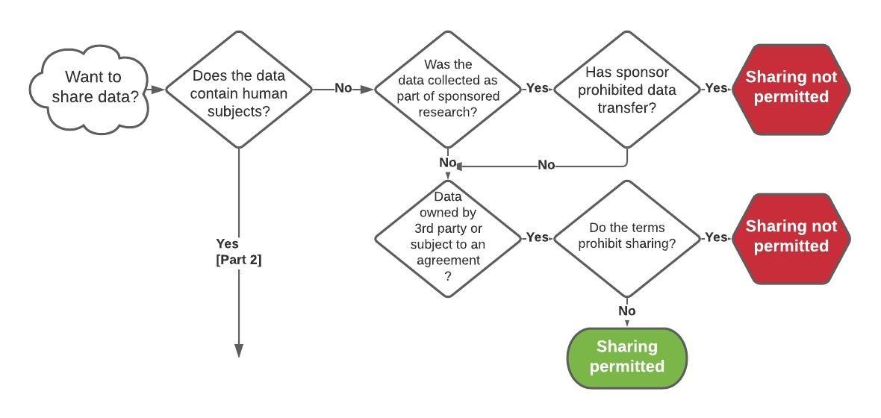
Part 1 - Decision Tree: Can I share my data?
Adapted from: University of New Mexico, Data Sharing Permitted Decision Tree.

Slide 41
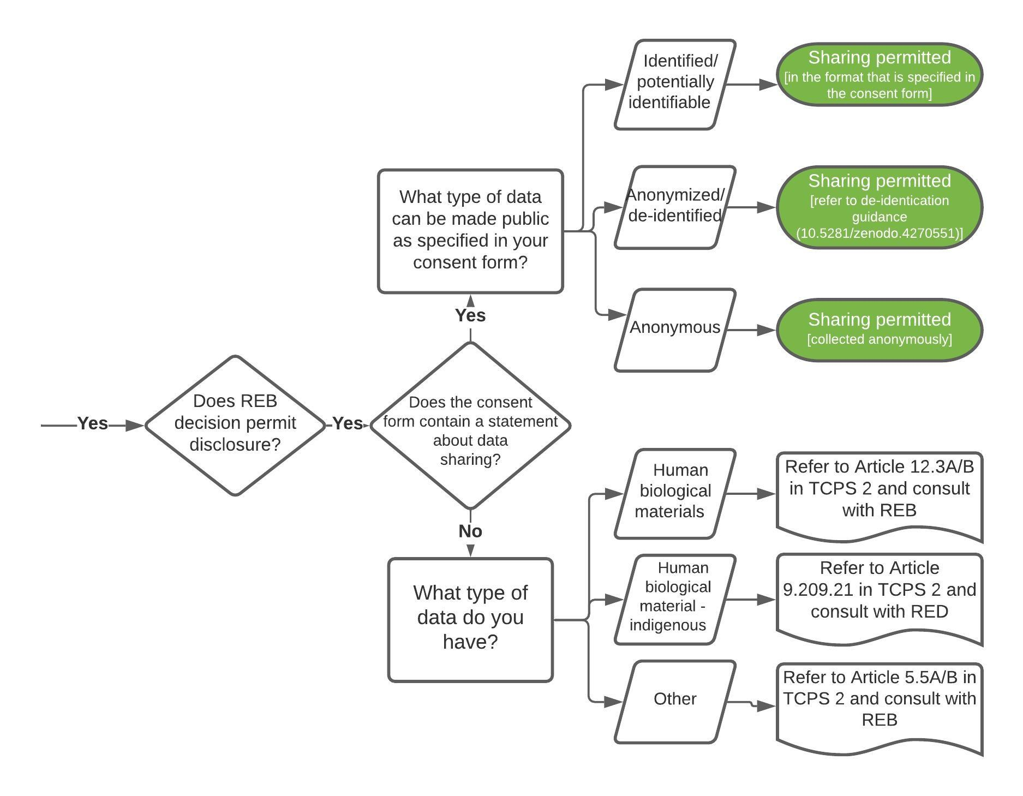
Part 2 - Decision Tree: Can I share my data?
Adapted from: Portage COVID-19 Working Group, Can I Share My Data? (Version 2)

