Slide 1



Pick a Path OER Game: Helping Students Find Affordable Course Materials
Open Education Conference 2023
Mélanie Brunet, Savannah Gorbahn, and Tyler Stephens
University of Ottawa Library
Unless otherwise specified, the contents of this presentation are made available under a Creative Commons Attribution 4.0 International licence
Notes:
[Mélanie] – Hello and welcome to our presentation on the “Pick a Path OER Game,” an activity meant to help students find affordable course materials.

Slide 2
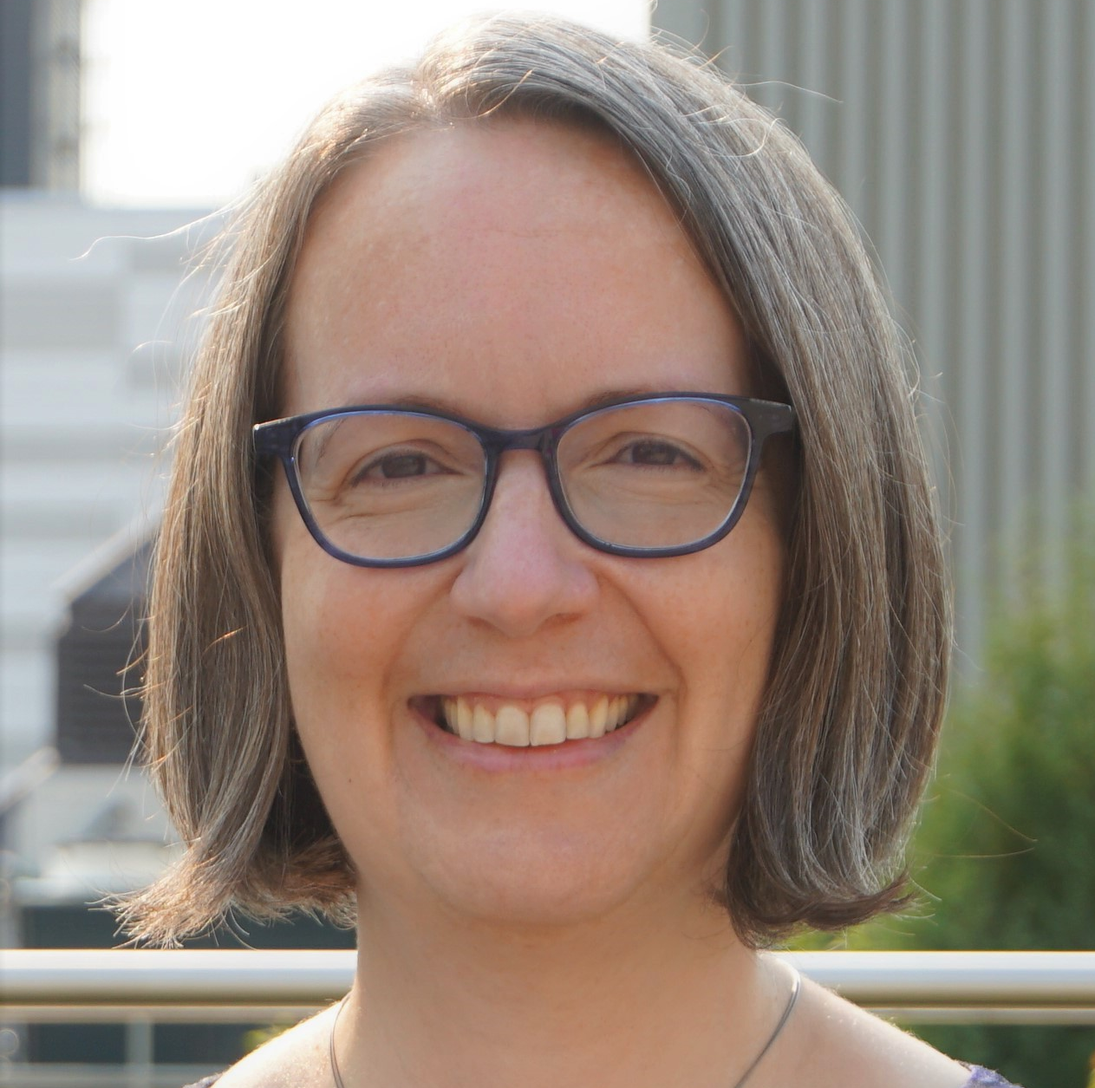
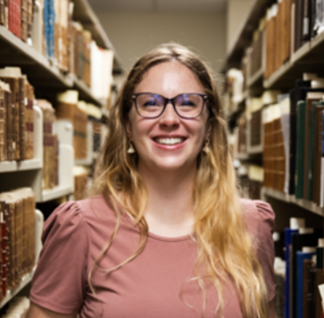

Presenters
Mélanie Brunet
Savannah Gorbahn
Tyler Stephens
Open Education Librarian
Open Education Assistant (Fall 2022) – Graduate student in Information Studies
Open Education Assistant (Winter 2023) – Undergraduate student in English
Photo credit: © Jennifer Gratton
Photo credit: © Bonnie Findley
Photo credit: © Tyler Stephens
Notes:
[Mélanie]
I’m Mélanie Brunet, the Open Education Librarian at the University of Ottawa.
And I’m joined by Savannah Gorbahn and Tyler Stephens, both former coop students at the uOttawa Library and the brains behind the game.

Slide 3

1.
Context at the University of Ottawa
Notes:
[Mélanie] - First, some context about the University of Ottawa.

Slide 4
University of Ottawa
Bilingual (English-French)
public research university in Canada
Notes:
[Mélanie] It is a bilingual (English-French) public research university located on the unceded territory of the Algonquin people in Canada’s national capital.

Slide 5
University of Ottawa
Bilingual (English-French)
public research university in Canada
Over 550 programs
Notes:
[Mélanie] It offers over 550 undergraduate, master’s, doctoral and professional programs.

Slide 6
University of Ottawa
Bilingual (English-French)
public research university in Canada
Over 550 programs
48,000
students
Notes:
[Mélanie] As of September 2023, there are about 48,000 students at the University of Ottawa.

Slide 7
University of Ottawa
Bilingual (English-French)
public research university in Canada
Over 550 programs
48,000
students
Language of study:
70% English
30% French
Notes:
[Mélanie] Roughly 70% of those students study in English while 30% study in French.

Slide 8

2.
Textbook affordability at uOttawa
Notes:
[Mélanie] The cost of textbooks has been on the Library’s radar since 2018.

Slide 9
Textbook costs and reported spending in 2022-2023*
Expected spending
French
English
Average expected spending per course $86
Average expected spending per course
$124
*All amounts in Canadian dollars
CampusStore prices for first-year course sequence in highest enrolment undergraduate programs. ​M. Brunet, “uOttawa Price of Record, 2022-2023,” University of Ottawa Library.
Notes:
[Mélanie] – In 2022-2023, students were expected to spend between $86 and $124 per course on textbooks in undergraduate programs.

Slide 10
Textbook costs and reported spending in 2022-2023*
Expected spending
French
English
Average expected spending per course $86
Average expected spending per course
$124
Potential annual cost
$860
Potential annual cost
$1,240
*All amounts in Canadian dollars
CampusStore prices for first-year course sequence in highest enrolment undergraduate programs. ​M. Brunet, “uOttawa Price of Record, 2022-2023,” University of Ottawa Library.
Notes:
[Mélanie] – This represents between $860 (for French programs) and $1,240 (for English programs) per year for a full course load.

Slide 11
Textbook costs and reported spending in 2022-2023*
Expected spending
Reported spending
French
English
Fall 2022
Winter 2023
Average expected spending per course $86
Average expected spending per course
$124
Average spending per student
$288
Average spending per student
$235
Potential annual cost
$860
Potential annual cost
$1,240
Total for 2022-2023
$523
*All amounts in Canadian dollars
CampusStore prices for first-year course sequence in highest enrolment undergraduate programs. ​M. Brunet, “uOttawa Price of Record, 2022-2023,” University of Ottawa Library.
uOttawa Textbook Broke campaigns, Fall 2022 (https://www.uottawa.ca/library/textbookbroke) and Winter 2023 (https://www.uottawa.ca/library/news-all/textbook-broke-winter-2023)
Notes:
[Mélanie] But what students have reported spending, while still a substantial amount of money, is lower. For the same period, students reported spending on average about $523 in the Library’s Textbook Broke campaign.

Slide 12
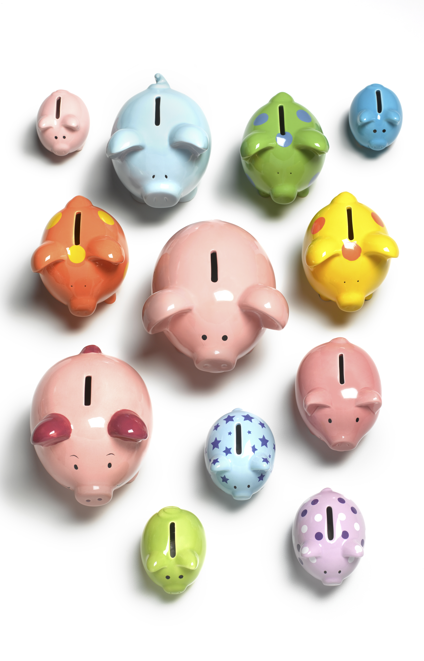

At least 60% of students do not purchase required textbooks at some point during their studies due to cost
60%
Sources: Inclusive Access and SPARC, History of College Textbook Prices: Examining Past Practices and Emerging Models (May 27, 2022); Florida Virtual Campus, 2016 Student Textbook and Course Materials Survey: Results and Findings (October 7, 2016); Accessible Course Content and Open Educational Resources Task Force, University of Guelph Student Textbook Survey (October 18, 2017); Yvonne Kim, “Study: 65% of college students skip textbook purchases during pandemic,” The Cap Times (March 3, 2021).
12
Notes:
[Mélanie] Many surveys show that at least 60% of students do not purchase required textbooks at some point during their studies due to cost. The difference between expected and reported spending at uOttawa reflects this trend. Short of going without required textbooks and risking their academic success, what can students do?

Slide 13
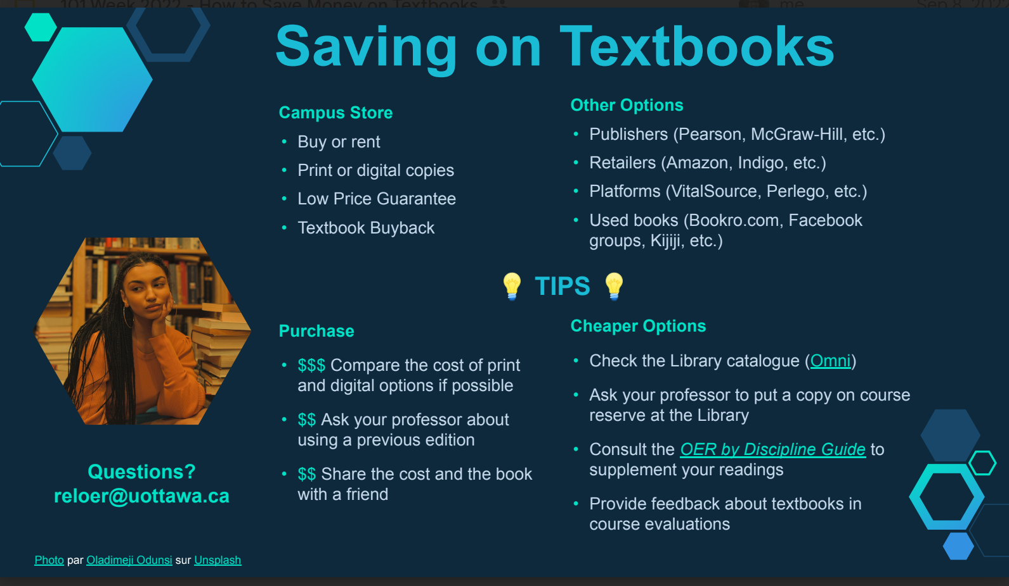
How to save on textbooks
Student union orientation week and Library workshop
Fall 2022, in person and online
Poorly attended
Notes:
[Mélanie] The Library held workshops on how to save on textbooks (legally) in the fall of 2022, online and in person. We discussed a variety of cheaper options, including purchasing directly from the publisher, using previous editions, sharing the cost with a friend, turning to the Library and asking the prof to put a copy on course reserve, and consulting the OER by discipline guide for free and open alternatives. These were poorly attended, but inspired the game that Savannah will discuss next.

Slide 14

3.
Origins of the in-person game
Notes:
[Savannah] As the Open Education Assistant at the time, I helped Mélanie with these workshops by creating the “Saving on textbooks” handout pictured on the previous slide. As a separate task, she also asked me to brainstorm ideas for an in-person game that could raise awareness of OER and Library resources with students.

Slide 15

How it came about
Interactive activity during Open Education Week
To provide information to students about navigating textbook purchasing
Notes:
[Savannah] Inspired by the workshop topic, I created the game to be run in-person during Open Education Week as an interactive activity to inform students about their options when navigating textbook purchasing.

Slide 16
How it came about
Designed to be customizable, in-person or virtual
Loosely modeled after Escape Rooms and Choose Your Own Adventure-style novels
Notes:
[Savannah] It is loosely modeled after Escape Rooms and Choose Your Own Adventure novels. Students progress through different “locations” and scenarios in a large room to gather information and make choices that affect their adventure in textbook purchasing.

Slide 17
Premise of the game
You’re a student starting a new semester.
You’ve received a list with all your required textbooks.
You’re living on a tight budget and are hoping to save some money on textbooks.
Your choices will help you discover ways to lower your textbook costs.
Notes:
[Savannah] The premise of the game is « You’re a student starting a new semester. You’ve received a list with all your required textbooks. You’re living on a tight budget and are hoping to save some money on textbooks. Your choices will help you discover ways to lower your textbook costs. »

Slide 18
Scenarios and locations
Inspired by student experiences
Library
Used bookstore
CampusStore
Websites
Notes:
[Savannah]
Using mine and fellow students’ experiences, I created scenarios or “locations” that players can visit. New students go for a walk with a fourth-year student who would tell them about illegal websites, co-purchasing textbooks with other students, used bookstores in Ottawa, or used uOttawa textbook groups on Facebook.
At each location, including the Library, the CampusStore and websites, they learn about an aspect of the textbook market.

Slide 19
Scenarios examples
Sharing textbooks, using Library’s copy
Finding used copies
Purchasing from CampusStore
Finding an OER
Notes:
[Savannah]
For each scenario, possible positive and negative consequences are discussed.
If they share textbooks with other students or use the Library’s copy, they may not have the book when they need it, but they could create a study group. If they look for used copies, they might spend lots of precious time searching. If they purchase from the CampusStore, they will spend a lot more money but could have the books promptly. If they found OER, they could also have access to a lot of supplementary information and extra quizzes to help them study.

Slide 20
Ultimate goal
Funneling players towards scenarios that teach them about OER and meet the Open Education Librarian
Notes:
[Savannah] The game was designed to funnel players towards scenarios teaching them about OER. Ultimately, all choices lead them to meet with the Open Education Librarian.

Slide 21
4.
Designing the online version with Twine
Notes:
[Tyler] When I took over as Open Education Assistant the following term, Mélanie asked me to create an online version of Savannah’s in-person game using Twine.

Slide 22
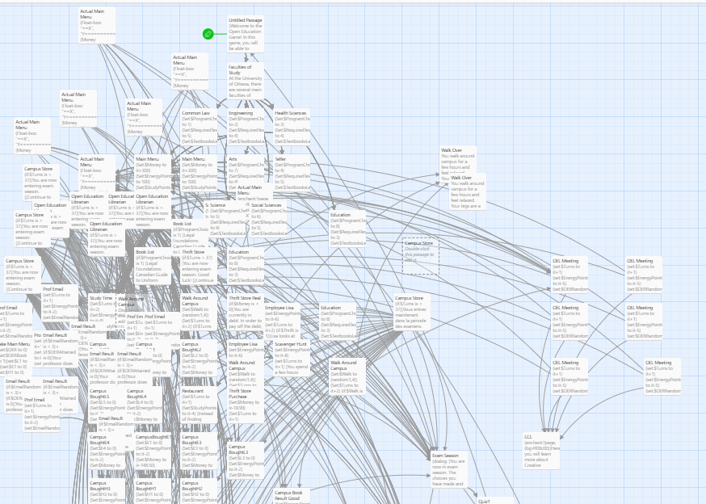
What is Twine?
“Open-source tool for telling interactive, non-linear stories” with variables and conditional logic
Backend of
Pick an Path OER game in Twine
Notes:
[Tyler] Twine is an open-source tool for telling interactive non-linear stories with variables and conditional logic. The backend of a game looks like a web of interrelated choices.

Slide 23
What is Twine?
Games are published in HTML
Desktop app or browser
Notes:
[Tyler] Games are published in HTML and Twine is available as a desktop app or can be used in a browser.

Slide 24
What is Twine?
Games are published in HTML
Desktop app or browser
https://twinery.org
Notes:
[Tyler] Twine is available at twinery[dot]org

Slide 25
From in-person to online game
Twine coding used to maximize amount of possible “paths,” allowing players to customize experience based on field of study
Notes:
[Tyler] Twine coding was used to maximize the amount of possible “paths,” allowing players to customize their experience based on their field of study in eight faculties at uOttawa.

Slide 26
From in-person to online game
Integrated locations and scenarios
Money available and energy status
Notes:
[Tyler] I integrated the locations and scenarios from the in-person game, added a budget and energy level because shopping for textbooks costs money, but looking for bargains and alternatives also takes time and effort.

Slide 27

5.
Game preview
Notes:
[Tyler] While the Pick at Path OER Game is not officially available yet while I fix some coding errors and work on the French version, here is a preview.

Slide 28
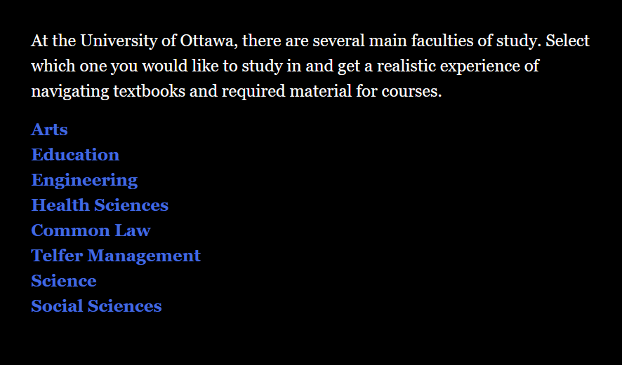
Choosing a faculty of study
Player chooses from eight faculties at the University of Ottawa
Notes:
[Tyler] Players choose in which field they want to study. Each faculty presents different challenges, variables, and textbooks which students in those disciplines would recognize. The situational aspect was designed to be as realistic as possible, using actual required textbooks and cost data at uOttawa.

Slide 29
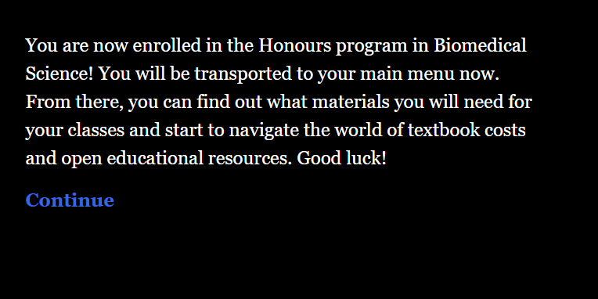
Enrolling in a program
Player chose the Faculty of Science and is now enrolled in the Honours program in Biomedical Science
Notes:
[Tyler] Once players choose a faculty, their adventure begins. In this case, they chose Science and are now enrolled in the Honours program in Biomedical Science.

Slide 30
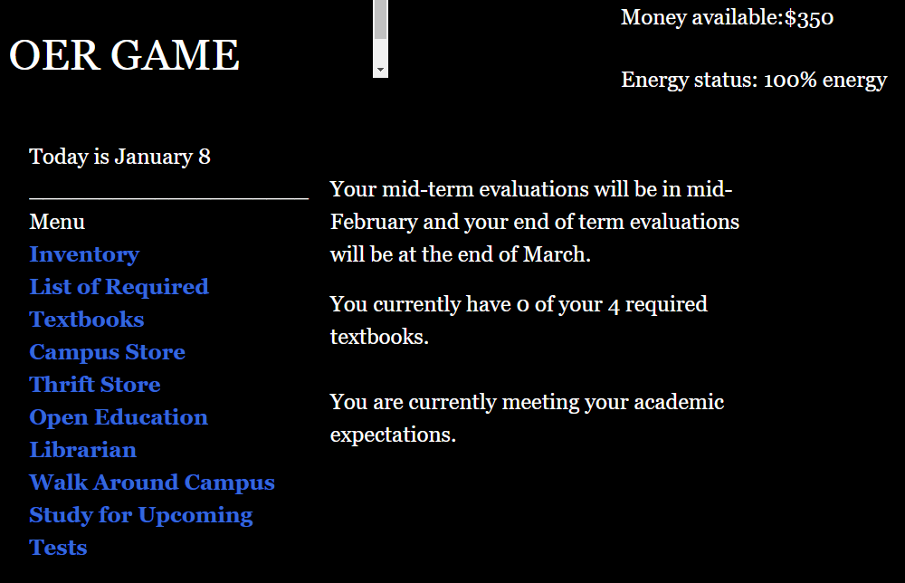
Starting the game
Student starts with $350 and 100% energy, and has four textbooks to acquire
Notes:
[Tyler] This student has a budget of $350 and starts with 100% of their energy. They have four required textbooks to acquire.

Slide 31
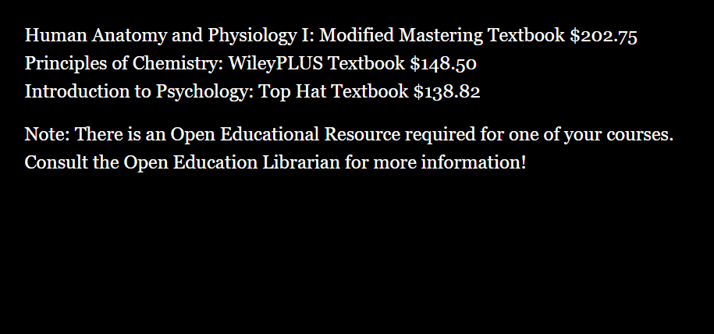
List of required textbooks
One of the four required textbooks is an OER!
Notes:
[Tyler] Of the four textbooks, one is an OER and the student is invited to consult with the Open Education Librarian to learn more.

Slide 32
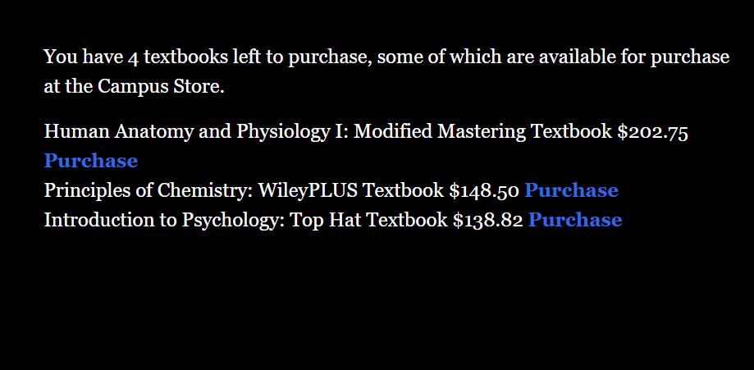
Purchasing textbooks at the CampusStore
At the CampusStore, the student can choose to purchase all, some or none of the textbooks
Notes:
[Tyler] At the CampusStore, the student can buy all, some or none of the texbooks. In this case, they decide to purchase the least expensive one.

Slide 33
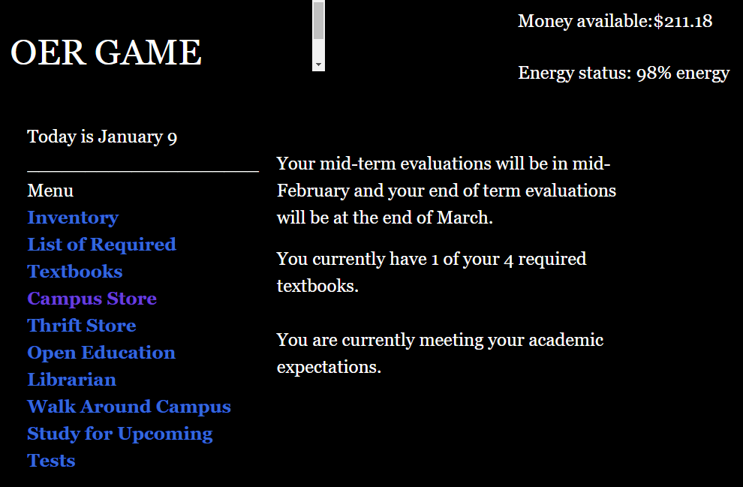
After purchasing a textbook
Less money and less energy but still meeting academic expectations
Notes:
[Tyler] Back on the homepage, the student now has a bit less energy, has spent more than a third of their budget on one book, but is still meeting academic expectations.

Slide 34
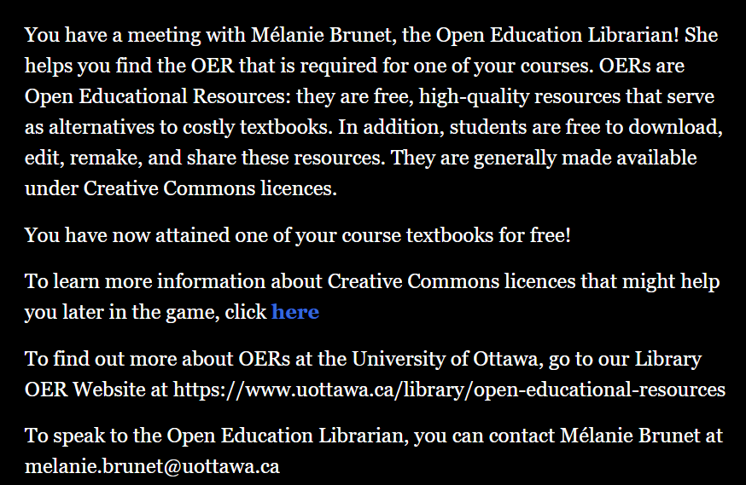
Meeting with the Open Education Librarian
Student learns about OER and Creative Commons licences
Notes:
[Tyler] Meeting with the Open Education Librarian allows the student to learn about OER…

Slide 35
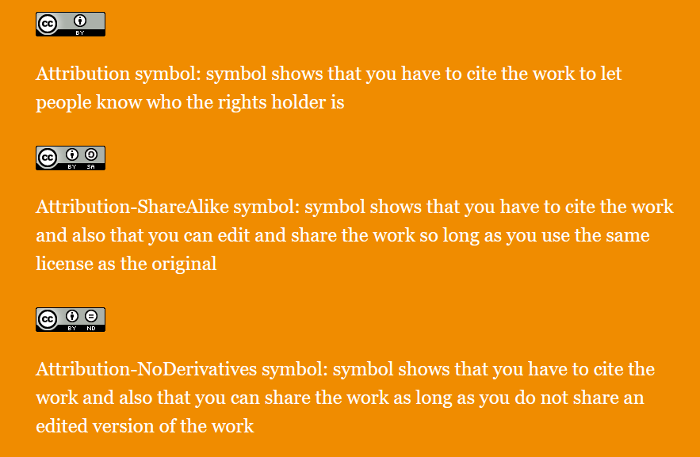
Meeting with the Open Education Librarian
Student learns about OER and Creative Commons licences
Notes:
[Tyler] … and Creative Commons licences.

Slide 36
Other game plays
Studying for an upcoming test
Going for a walk
Going into debt
Working to pay textbook debt
Searching for used copy at the Thrift Store
Going to the restaurant
Presentation Title
Notes:
[Tyler] Other game plays include:
Studying for an upcoming test
Going for a walk
Going into debt
Working to pay the textbook debt
Searching for a used copy of a textbook at the Thrift Store
Going to the restaurant

Slide 37
What’s next?
February 2024
May 2024 +
Add both versions to Borogove.io
Track use and feedback
January 2024
Finish French version and testing
March 2024
April 2024
Launch game officially for Open Education Week 2024
Index game for greater discovery
Notes:
[Mélanie] At the time of recording this talk, the English version is undergoing some bug fixing. Tyler is also working on completing the French version. We are aiming to make them public next February and launch the game for Open Education Week 2024. Then it will be indexed on various sites for greater discovery and track its use and feedback.

Slide 38



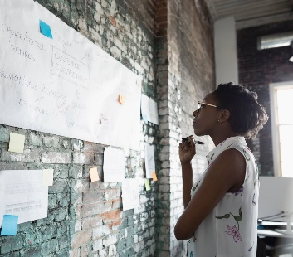
Thank you!
Questions?
melanie.brunet@uottawa.ca
PowerPoint Hexagon presentation light template
Unless otherwise indicated, photos are PowerPoint stock images
Notes:
[Mélanie] Thank you for viewing our presentation!

