Slide 1

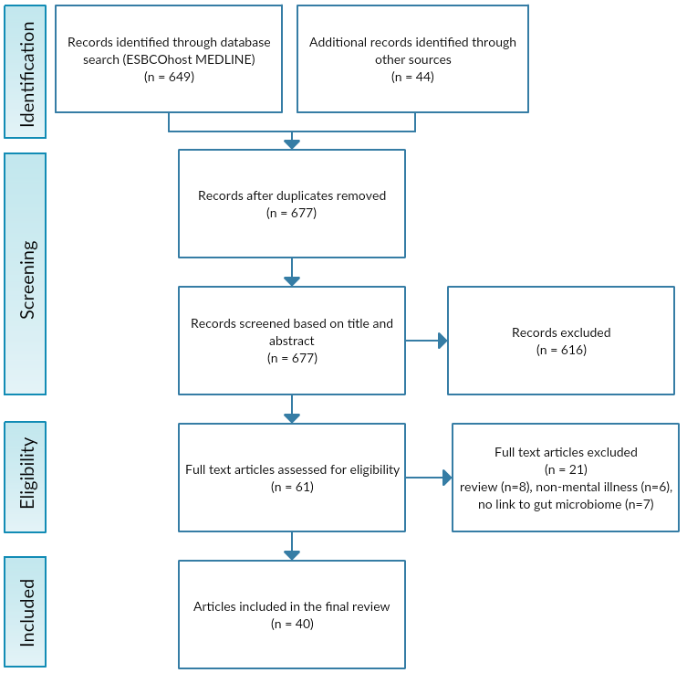
ROLE OF THE GUT-BRAIN AXIS IN MENTAL ILLNESS
Aldaqqaq Z¹, Spettigue W, MD¹⁻³ , Norris M.L, MD^{1-2. 4}, Isserlin L, MD¹⁻³, Valois D.D, MA¹, Obeid N, PhD¹
¹ Children’s Hospital of Eastern Ontario Research Institute; ² Faculty of Medicine, University of Ottawa; ³ Department of Psychiatry, University of Ottawa; ⁴ Department of Pediatrics, University of Ottawa
BACKGROUND
There is increasing research on the link between the gut microbiome and the brain: a relationship known as the gut-brain axis. This study is a literature review of all primary research reports examining the interaction between the gut microbiome and mental illness.
OBJECTIVES
To summarize current literature on the relationship between the gut microbiome and mental illnesses.
To examine trends in gut microbial composition with respect to each mental illness and to determine which, if any, interventions affecting the microbiome were successful in either reverting gut dysbiosis or treating mental illness.
To demonstrate the need for further exploration of the gut microbiome as a target of innovative treatments for mental illnesses.
METHODS
This review was conducted using a thorough database search of ESBCOhost MEDLINE electronic database. The search strategy included MeSH and keyword terms relevant to any aspects of the gut microbiome in relation to various mental illnesses (e.g. mental disorders, mental health, mental processes, gut n2 brain, probiotics, synbiotics, gastrointestinal microbio*). There were no limitations placed on the date of report publication, however the eligibility criteria included only peer-reviewed full text English language articles with an abstract. All reports were screened against the following eligibility criteria.
RESULTS
Each of the 40 included reports were categorized under one of the following mental illnesses: Autism Spectrum Disorder (ASD), Attention Deficit Hyperactivity Disorder (ADHD), Anxiety, Depression, Anxiety AND Depression, Obsessive Compulsive Disorder (OCD), Post Traumatic Stress Disorder (PTSD), Anorexia Nervosa (AN), Bipolar Disorder (BD) or Schizophrenia.
A wide variety of original research reports were reviewed. The 40 included studies contained a combination of randomized clinical trials, open-label studies, double-blind placebo-controlled trials, and many tests of microbial variance such as Shannon diversity, observed species, the Chao1 index, Illumina sequencing of the 16SrRNA gene, and analysis of molecular variance (AMOVA) to name a few.
Of the 40 included studies, 39 reported significant gut dysbiosis in those with mental illness compared to controls, with many finding a positive correlation between severity of symptoms and degree of gut dysbiosis. All 16 studies using probiotic intervention reported either improvement in symptoms, correction of gut dysbiosis, or both.
RESULTS
CONCLUSION
The broad range of microbiota analyses, interventions and trials point to a relationship between the gut microbiota and mental illness, and provide evidence towards a potential causative mechanism.
Symptoms of mental illness were successfully treated using probiotics, supporting a promising innovative therapeutic use of prebiotics/probiotics in treating these illnesses.
Evidence remains limited but promising for the association between the gut microbiome and schizophrenia, bipolar disorder, PTSD, OCD, and ADHD.
There is more evidence for a link between the gut microbiome and anxiety and anorexia nervosa, and quite strong evidence for an association between the microbiome and depression and the microbiome and autism.
This literature review encourages further research into the relationship between mental illness and the gut microbiome, to treat mental illness by manipulating the gut microbiome.
Mental Illness (# of Reports) | Total number of participants | Outcome measure(s) | Intervention/analysis | Primary outcomes
Autism Spectrum Disorder (11) | n=664 | Gut microbial diversity^{[3-13]}, Autism Diagnostic Interview^{[4]}, Childhood Autism Rating Scale^{[5,8,10]}, Autism Treatment Evaluation Checklist^{[6]}, Autism Behavior Checklist and Social Responsiveness Scale^{[10]} | Stool analysis^{[3-11, 13]}, Probiotic supplementation ^{[4,6,7]}, Vitamin A supplementation ^{[10]}, Duodenal biopsy ^{[12]} | Gut dysbiosis in ASD population^{[3-11,13]}, Improved scores on autism severity scales following probiotic intervention^{[4,6]}, strong relationship between autism severity and degree of gut dysbiosis^{[4,6,13]}
ADHD (3) | n=189 | Gut microbial diversity^{[14-16]} | Stool analysis^{[14-16]}, Probiotic supplementation | Elevated Bacteroidaceae and Neisseria in ADHD^{[14]}, Decreased fractional representation of Faecalibacterium in ADHD^{[15]}, Probiotic cohort remained ADHD free compared to 17.1% of the placebo group diagnosed with ADHD ^{[16]}
Anxiety AND Depression (2) | n=471 | Gut microbial diversity^{[17-18]}, Beck Depression Inventory (BDI)^{[17-18]}, Beck Anxiety Inventory (BAI)^{[17-18]}, Eating Disorder Examination Questionnaire^{[18]} | Probiotic supplementation^{[17]}, Stool analysis^{[17-18]} | Significantly lower (improved) BDI and BAI scores in probiotic group^{[17]}; no significant relationship between gut composition and any of the measures^{[18]}
Anxiety (3) | n=732 + murine subjects | Stress response (cortisol output)^{[19]}, Elevated plus maze task^{[20]}, Social Phobia and Anxiety Inventory^{[21]} | Cold pressor test to simulate stress response ^{[19]}, Probiotic supplementation^{[19-21]} | Within the probiotic groups: less cortisol output when exposed to stressor^{[19]}, Improved anxiety-like behavior^{[20]}, fewer symptoms of social anxiety^{[21]}
Depression (11) | n=19,828 | Gut microbial diversity^{[22,24-25,29-31]}, Hamilton depression rating scale (HAM-D)^{[23,29]}, BDI^{[23,26-27]}, Patient Health Questionnaire^{[28]}, Leiden Index of Depression Sensitivity (LEIDS)^{[32]} | Fecal microbiota transplantation^{[22]}, Stool analysis^{[22,24-25,29-31]}, Probiotic supplementation^{[23,26-27,32]}, Magnesium Orotate^{[27]}, NHANES (dietary intake survey)^{[28]} | Microbiota depleted rats show depressive symptoms upon fecal microbiota transplant^{[22]}. Significant improvements in BDI scores^{[23,26-27]} and HAM-D scores^{[23,29]} following probiotic intervention. (Faecalibacterium, Coprococcus, Dialister groups)^{[24]} and (Bifidobacterium, Lactobacillus groups)^{[25]} depleted in depression. Lower rates of depression in probiotic group (unadjusted analysis)^{[28]}. Lower fecal sIgA in infants born to mothers with depressive symptoms^{[31]}. Improved LEIDS score in Probiotic group^{[32]}
Anorexia Nervosa (4) | n=278 | Gut microbial diversity^{[33-36]}, BDI, BAI, Eating Disorder Examination-Questionnaire^{[33]} | Stool analysis^{[33-36]} | Gut dysbiosis in Anorexia Nervosa group (low microbial alpha diversity)^{[33-36]}, depression, anxiety, and eating disorder psychopathology related to poor gut microbial diversity^{[33]}.
Bipolar Disorder (2) | n=296 | Gut microbial diversity^{[37-38]}, Altman Mania Rating Scale, Patient Health Questionnaire, Short Form Health Survey, and Generalized Anxiety Disorder Scale ^{[37]} | Stool analysis^{[37-38]} | Decreased fractional representation of Faecalibacterium associated with improvements in all scales used for illness severity^{[37]}. Decreased alpha diversity in females treated with atypical antipsychotics^{[38]}.
Post Traumatic Stress Disorder (1) | n=330 | Gut microbial diversity, Clinician Administered Posttraumatic Stress Disorder Scale for DSM-5 (CAPS-5)^{[39]} | Stool analysis | Low levels of Actinobacteria, Lentisphaerae, and Verrucomicrobia associated with higher (worse) CAPS-5 scores
Schizophrenia (2) | n=198 | Gut microbial diversity^{[40-41]}, Hospital Anxiety and Depression Scale (HADS), Positive and Negative Syndrome Scale (PANSS)^{[40]}, Choline levels^{[41]} | Stool analysis^{[40-41]}, Probiotic supplementation^{[40]} | Improved HADS and PANNS scores in schizophrenic population following probiotic supplementation ^{[40]}. Elevated choline levels and gut dysbiosis in schizophrenic group^{[41]}.
Obsessive Compulsive Disorder (1) | BALB/cJ house mice | Locomotor behavior, marble burying behavior, inter-male aggression, ultrasonic vocalizations^{[42]} | Probiotic supplementation (L. rhamnosus) ^{[42]} | Attenuated OCD-like behaviors in mice following 2 and 4 weeks of pre-treatment with L. rhamnosus^{[42]}
Study Parameters | Inclusion | Exclusion
Population | Human or murine Existing gut dysbiosis or mental illness Experimental and control groups | Non-human non-murine subjects No experimental or control group
Study type | Studies published in English Primary research Studies published in a Peer-reviewed journal | Studies not published in English Literature reviews, non-peer-reviewed journals, editorials, hypotheses Unpublished theses/dissertations
Methodology | Any measured manipulation of the gut-brain axis Probiotic or prebiotic supplementation Fecal bacterial composition analysis | No link to gut microbiome or mental illness No manipulation or analysis of gut microbiota
Outcomes | Measured changes in mental illness qualities (e.g. BDI, BAI) Measured levels of specific bacteria pre and post-intervention Levels of inflammatory markers | Any outcome not relating the gut microbiome to one or more mental illnesses No objective measures of outcomes
Table 1: Eligibility criteria [1]: Inclusion and exclusion criteria for study selection in the literature review process, based on recommendations from the Cochrane Handbook for Systematic Review of Interventions.
Table 2: Significant clinical study results: Reports containing primary research which demonstrate statistically significant relationships between the gut microbiota and mental illness, categorized by mental illness, outcome measures, the intervention or analysis of each study, and the primary outcomes.
Figure 1: PRISMA flowchart [2]: Outline of search strategy using MEDLINE, EMBASE, PSYCINFO and PubMed and breakdown of study selection process using inclusion and exclusion criteria.

