Slide 1

Beyond Safety and Decency:
Intellectual Property Considerations in Makerspaces
True North Science Boot Camp 2019
Mélanie Brunet, Ph.D., Copyright Services Librarian
Unless otherwise noted, the content of this presentation is licensed under a Creative Commons Attribution 4.0 International licence.

Slide 2

The information provided in this session does not constitute legal advice.

Slide 3
Outline
Types of intellectual property
Legal exceptions (copyright)
Examples of potential issues
Reducing risks
Raising awareness

Slide 4


Common Makerspace Equipment…
3D scanners and printers
Laser cutters
Electronics, robotics and hand tools
Video, sound and photography equipment and software
VR and augmented reality equipment
Button makers, sewing machines, Legos
And more!
… Common Concerns
Safety
Ethical Use
Notes:
Examples of equipment in Makerspaces: mix of low-tech and high-tech tools
A quick read of makerspace guidelines, policies or user agreements will show concerns about safety (for the user and others) and ethical use (obsene, indecent or dangerous objects) … but intellectual property is not mentioned consistently, if mentioned at all.
Yet, a number of makerspace technologies, like book printing machines or digital conversion tools, reproduce copyright issues of other technologies found in a library (photocopier, scanner). And in the case of the reproduction of 3D objects, copyright may be involved but also patents, trademarks and industrial designs.

Slide 5




Types of Intellectual Property
Copyright
Protects original creative works in a fixed form
Automatic upon fixation
In general, life of the creator + 50 years
Patent
Protects new technology or improvements to existing products or to processes
Requires application
20 years from date of issue (no renewal)
Trademark
Protects unique combination of words, letters, sounds or images to distinguish product or service from others
Usually requires registration
15 years + renewals
Industrial
Design
Protects look of product with distinctive and unique appearance
Requires registration
Up to 15 years
Source: University of Ottawa, Copyright Office, "Other forms of intellectual property," https://copyright.uottawa.ca/other-forms-intellectual-property
Notes:
There are four types of intellectual property in Canada, each subject to their own law.
Only copyright is automatic upon fixation (and protection may extends to other countries under their national copyright law through international treaties such as the Berne Convention).
Others types of IP require application or registration, may or may not be renewable, and are only applicable in Canada. To have protection in other countries, one would have to apply for it there.

Slide 6

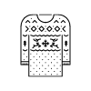

Examples of IP Protection Overlap
Logo
Invention
Pattern
Protected by copyright as artistic work and by trademark if registered
Technology protected by patent and technical drawings in patent document are protected by copyright
Protected by copyright as artistic work and could qualify for protection as industrial design if 50 or more are produced
Notes:
More than one type of intellectual property may be present in the same object. Here are some examples of how copyright, trademarks, industrial designs and patents can overlap.

Slide 7


3D Printing: File vs Object
Code could be protected by copyright as literary work
Object could be protected by copyright as artistic work (unless functional)
Notes:
There could be two levels of copyright.
Object: for example, if the object is a chair, the chair itself would not be protected by copyright as a useful/functional object, but if there was an engraving on it, that engraving could be protected as an original artistic work.

Slide 8
Exceptions for Use of Third-Party Content
Some copyright exceptions (user rights) could apply depending on purpose and other factors:
  Fair dealing
  User Generated Content (“YouTube exception”)
No exceptions for patents, trademarks and industrial designs
Personal vs commercial use:
  Personal use does not mean no IP infringement but generally lower risk
  Commercial use carries more risk = competes on market for original

Slide 9
Copyright Exceptions: Fair Dealing
Education, research and private study are considered “fair” purposes under Copyright law, but entertainment and commercial use are not
Research can be for personal interest
Other factors:
  Amount – small portion of the original or the entire work?
  Character – one copy or multiple copies of the original work?
  Nature – is the original work published or unpublished?
  Alternatives – is there an equivalent not protected by copyright?
  Effect – will it cut into the market for the original?
Notes:
With fair dealing, Canadian copyright law allows reproduction without asking for permission from copryight owner under certains conditions for education, research and private study (among others purpsoses - those are the most relevant in educational setting), but generally not for entertainment or commercial use

Slide 10
Copyright Exceptions: User Generated Content (UGC)
Individual can use existing work publicly available to create new work if:
  Use and dissemination is for non-commercial purposes
  Source of existing work is mentioned
  Existing work does not infringe on copyright
  Use and dissemination of new work does not have substantial adverse effect (financial or otherwise) on market of existing work
Notes:
Like fair dealing, permission not required from the copyright owner if these conditions are met:
Non commercial User-generated content clause from the Canadian Copyright Act might apply.

Slide 11
Overuse/Misuse of Education and Library Exceptions
Education exceptions are sometimes overused…
  Only apply to copyright (not other types of IP); non-profit educational reproduction of patented parts may be allowed = untested
  Fair dealing: purpose is only one of six factors to consider
  Making reproduction or new work available publicly may not qualify as “education”
Photocopiers available without making educational institutional or library liable for infringement committed by users
  3D printers fall under that exception = untested

Slide 12



Potential IP Issues in Makerspaces
Example of 3D Printing
Creating own design using CAD to print 3D object
  User will have © over own file, no infringement when printing
Scanning object to print in 3D
  Possible infringement; fair dealing exception may apply
Scanning object, modifying it and printing in 3D
  Possible infringement; UGC exception may apply
Using 3D model from repository
  Possible infringement if no licence or terms of licence are not followed
Using 3D model of unknown origin
  Copy of file itself could be an infringement
Source: Mallory Austin, Michael B. McNally, and Samuel E. Trosow, “Intellectual Property, Makerspaces and 3D Printing,” Presentation for 2015 Ontario Library Association Super Conference, Toronto (January 29, 2015), https://doi.org/10.7939/R3B853Q46 (CC BY 3.0)
Notes:
Example of 3D printing but could substitute photograph, video, sound recording
User creating own design using CAD (computer aided design) to print 3D object: will have copyright over own file, no infringement when printing
User scanning object to print in 3D : possible copyright infringement depending on the kind of object, design; May be fair dealing exceptions
User scanning object, modifying it and print in 3D: same as above, but there could be UGC exceptions
Using 3D model from repository: could be copyright infrigement if licence is absent from that site or use does not follow terms of licence (ex. modifying not allowed, commercial purpose).
Using 3D model of unknown origin: on a USB key: could be a problem; copy of file itself could be an infringement.
List not meant to be comprehensive… other situations.
Note: even if object was purchased by user, there can be issues because property rights do not eliminate intellectual property rights that may exist in the object
Of course, other questions would be: it there a patent on this? Is there a trademark attached to this?

Slide 13
Reducing Risks
Include IP in guideline, policy, user agreement, waiver
  Part of what users have to read and sign before using equipment/space
Does it prevent infringement?
Transfer risk to users by making them liable (common but limited approach)
Examples…
Notes:
Here, we are talking about using third-party content, adapting or copying it.
Could « clear » every file or object, but doubt anyone has time and resources to do this, not to mention the serious IP chill that would create, going against the entire rationale of a makerspace.
Does it prevent infringement? Somes cases perhaps. More about managing risk and making institution/organization not liable if infringement does occur. Also, keep in mind that a waiver is between the user and the makerspace when the real threat of a lawsuit for infringement, if there was one, would be from the third-party who holds the intellectual property that was used without their permission. In that sense, waivers are a very imperfect tool.
But if this is the preferred approach, you will see in the following examples that it does not have to be complicated language. If you have access to an IP specialist at your institution, ask for feedback.

Slide 14
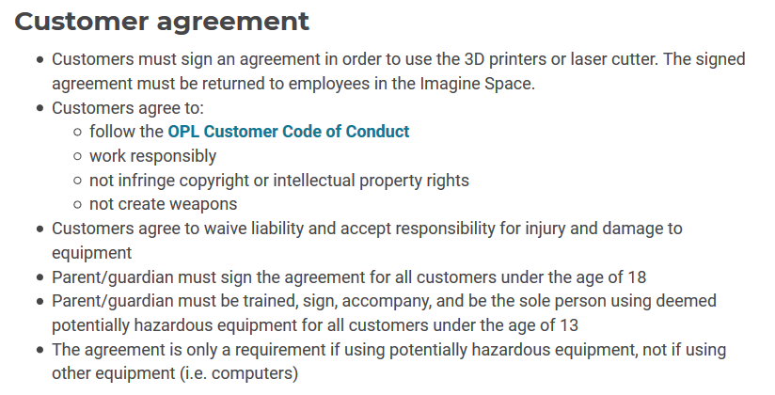
Ottawa Public Library Imagine Space and Labs
Customer agreement (for use of 3D printers or laser cutter) (website)
Source: https://biblioottawalibrary.ca/en/using-the-equipment

Slide 15
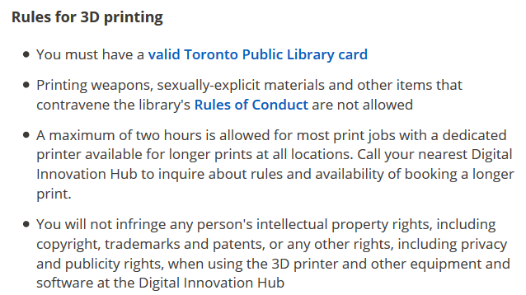
Toronto Public Library Digital Innovation Hubs
3D Design & Printing (website)
Source: https://www.torontopubliclibrary.ca/using-the-library/computer-services/innovation-spaces/3D-design-print.jsp

Slide 16
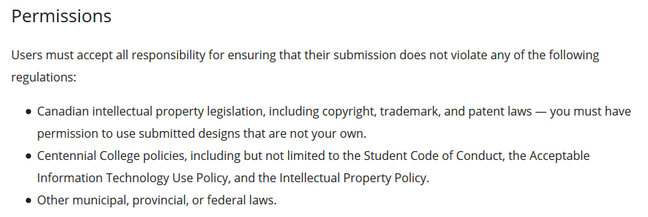
Centennial College Libraries Makerspace
3D Printing Policy (website)
Source: https://library.centennialcollege.ca/about-the-library/policies/3d-printing-policy/

Slide 17
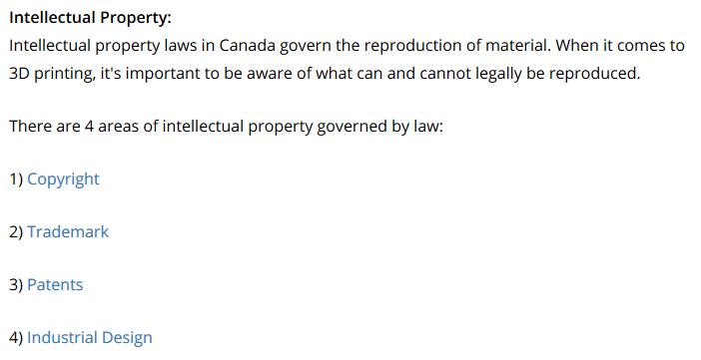
University of Toronto Scarborough Library
Makerspace Access & Policies (website)
Source: https://utsc.library.utoronto.ca/utsc-library-makerspace-access
Notes:
Those links direct to the corresponding sections on the Canadian Intellectual Property Office website

Slide 18
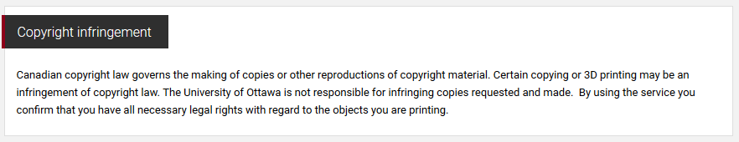
University of Ottawa Health Sciences Library
3D Printing at the Health Sciences Library (Research Guide)
Source: http://uottawa.libguides.com/c.php?g=436695&p=2976893

Slide 19
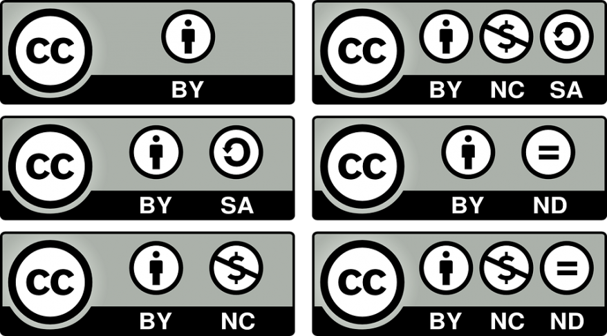




Copyright: Creative Commons Licences
Attribution (BY)
ShareAlike (SA)
NonCommercial (NC)
NoDerivatives (ND)
Creative Commons Attribution 4.0 International Licence
CC BY NC SA 4.0
About the licences: https://creativecommons.org/licenses/?lang=en
Icons and buttons from: Creative Commons Icons, Creative Commons, CC BY 4.0
Notes:
Between reducing risk and raising awareness, I’d like to talk about Creative Commons Licences.
CC licences – open licences – not a way around copyright or an alternative – they work with copyright (and with copyright only, not with other types of IP) – applied by creators/copyright owners to indicate to potential users of their work what they can do without having to ask for permission, essentially creators are communicating that they are waiving some of their exclusive rights.

Slide 20


Copyright: Public Domain
Copyright has expired
OR
Creator/copyright owner waived their rights and placed creation directly in the public domain using CC tool:
CC0
Icon and button from: Creative Commons Icons, Creative Commons, CC BY 4.0

Slide 21
Open Content: Suggested Platforms
Jamendo Music
https://www.jamendo.com/
Audio
Under various CC licences
Free Music Archive
http://freemusicarchive.org
Audio
Under various CC licences
Freesound
http://freesound.org/
Audio
Under various CC licences
SoundCloud
https://soundcloud.com/
Audio
Search for Creative Commons
Internet Archive
https://archive.org/
Multimedia
Under various CC licences
Vimeo
https://vimeo.com/
Videos
Search and then filter by licence under “More filters” -- “License”
Creative Commons (CC) Search
https://ccsearch.creativecommons.org/ Images
Pulls CC-licensed content from various independent platforms
Wikimedia Commons
https://commons.wikimedia.org
Multimedia
Under various CC licences
(click on item for more details)
YouTube
https://www.youtube.com/
Videos
Look under “Show More” for licence;
search and then filter by Creative Commons under “Filters”

Slide 22
Open Content: Suggested Platforms
Google Images
https://images.google.com/
Images
Search and then filter by licence under “Tools” -- “Usage rights”
Flickr
https://www.flickr.com/
Images
Search and then filter by licence under “Any license”
Pixabay
https://pixabay.com/
Images
Under Pixabay licence
(similar to CC0 public domain)
Pexels
https://www.pexels.com/
Images
Under Pexel licence
(similar to CC0 public domain)
Visual Hunt
https://visualhunt.com/
Images
Under various CC licences
Search and then filter by licence type
Unsplash
https://unsplash.com/
Images
Under Unsplash licence
(similar to CC0 public domain)
Thingiverse
https://www.thingiverse.com/
3D models
Search and refine by “License Type”
Sketchfab
https://sketchfab.com/
3D models
Search and look for “License” information in the model’s description
YouMagine
https://www.youmagine.com/
3D models
Search and look for “License” information in the model’s description
NIH 3D Print Exchange
https://3dprint.nih.gov/discover
Science-related 3D models
Search by “License”

Slide 23
Raising Awareness
Waiver transferring liability is not a teachable moment
Educating and informing without being “IP police”
  Focus on makerspace users’ own rights
  Successful copyright (IP) instruction focuses on users as creators, not just or primarily their risk of infringement:
    1) who owns IP over what is created in makerspace
    2) information on how to apply for IP protection beyond copyright
    3) information about Creative Commons licences
Do you have a copyright officer, librarian, specialist or other IP advisor on campus? Talk to them about policy, consultations, instruction
Notes:
Tone: focus on the positive - focus on what can be done first rather than what cannot be done, focus on opportunities, not just limitations/prohibitive aspects. Not about intimidating users, assuming they are breaking the law (that’s part of the reason waivers are so imperfect).
Make own creations open: Continue to encourage them to be open (copyright-wise) with their own design so more of it will be open in the future, truly democratizing makerspaces using Creative Commons licences

Slide 24

“Don’t default to assuming that there is an IP problem with makerspace technologies, but there are some concerns.”
-Austin, McNally and Trosow (2015)
“While often libraries are preoccupied with preventing infringement of intellectual property, makerspace users are creating novel items everyday which may be eligible for protection under a patent, trademark, copyright, or Creative Commons license.”
-Radniecki (2018)
Notes:
It’s a matter of balance! You are not expected to become an IP expert! You can be aware of the risks, but think about this more positively and be aware of the possibilities for makerspace users as creators, not just as reusers of third-party content. If your institution/organization has a copyright guide, at least direct users to it if you don’t feel comfortable or just don’t have time to take this on. Have a idea of where you can send users for more information (whether that’s a person or some documentation).

Slide 25

Thank you!
Mélanie Brunet
Copyright Services Librarian
melanie.brunet@uottawa.ca
@MelanieBrunet
Copyright at uOttawa
copyright.uottawa.ca

Slide 26
Suggested Readings
Mallory Austin, Michael B. McNally, and Samuel E. Trosow (2015), “Intellectual Property, Makerspaces and 3D Printing,” Presentation for 2015 Ontario Library Association Super Conference, Toronto (January 29, 2015), https://doi.org/10.7939/R3B853Q46 (CC BY 3.0) [includes scenarios]
Jennifer Horton (2017), “A Content Analysis of 3D Printing Policies at Academic Libraries,” Journal of Library Administration, 57:3, 267-281, DOI: 10.1080/01930826.2016.1258876 [US context]
Tara Radniecki (2018), “Intellectual Property in the Makerspace,” Journal of Library Administration, 58:6, 545-560, DOI: 10.1080/01930826.2018.1491178 [US context]
Michael Weinberg (2014), “US Legal Lessons from Canada’s First SLT IP Infringement Case,” Make: Magazine, https://makezine.com/2014/06/25/us-legal-lessons-from-canadas-first-stl-ip-infringement-case/ [US context inspired by Canadian case]

Slide 27
Suggested Resources
Opening Up Copyright Instructional Modules (University of Alberta): https://sites.library.ualberta.ca/copyright/
Makerspaces and Copyright
Other Types of IP
Including Third Party Content in Your Work
Canadian Intellectual Property Office guides:
A guide to copyright: http://www.ic.gc.ca/eic/site/cipointernet-internetopic.nsf/eng/h_wr02281.html?Open&wt_src=cipo-cpyrght-main&wt_cxt=learn
A guide to patents: http://www.ic.gc.ca/eic/site/cipointernet-internetopic.nsf/eng/h_wr03652.html
A guide to trademarks: http://www.ic.gc.ca/eic/site/cipointernet-internetopic.nsf/eng/h_wr02360.html?Open&wt_src=cipo-tm-main&wt_cxt=learn
A guide to industrial designs: http://www.ic.gc.ca/eic/site/cipointernet-internetopic.nsf/eng/h_wr02300.html?Open&wt_src=cipo-id-main&wt_cxt=learn
Canadian laws:
Copyright Act: https://laws-lois.justice.gc.ca/eng/acts/C-42/Index.html
Trade-marks Act: https://laws-lois.justice.gc.ca/eng/acts/t-13/
Industrial Design Act: https://laws-lois.justice.gc.ca/eng/acts/i-9/index.html
Patent Act: https://laws-lois.justice.gc.ca/eng/acts/p-4/index.html

Slide 28
Icon Credits
Icons from the Noun Project, NounPro royalty-free licence:
Slide 2 – Alert by Kevin
Slide 4 – Safety by nauraicon and ethic by priyanka
Slides 5 and 6 – Copyright by Stefan Parnarov, trademark by Vectorstall, Patent by Andrew Nolte and Chair by Joris Hoogendoorn
Slide 6 – Logo by Rafina Andra, rollerblades by Sergey Demushkin and Sweater by lastspark
Slide 7 – File by Kokota and 3D by Smalllike
Slide 12 – yes by David, maybe by Kristin Hogan and wrong by Rose Alice Design
Slide 24 – Balance by Delta
Slide 25 – Question by Angelo Troiano

