Slide 1
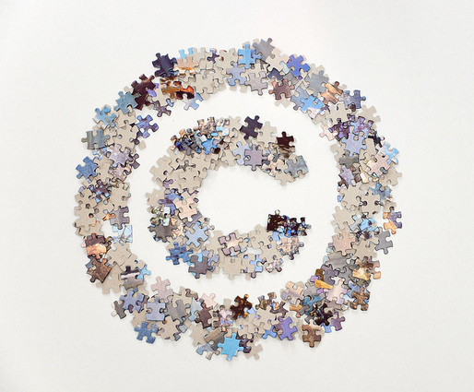

Copyright Aware:
What You Need to Know
Copyright sign made with puzzle pieces by Horia Varlan CC BY 2.0
Unless otherwise indicated, the contents of this presentation are licensed under a Creative Commons Attribution-NonCommercial 4.0 International licence.

Slide 2

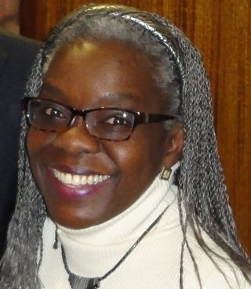
Your instructors
Mélanie Brunet
Obianuju Mollel

Slide 3
Schedule
9:00-9:10 (10 minutes) – introductions and housekeeping
9:10-9:15 (5 minutes) – self-assessment quiz to be completed individually
9:15-9:40 (25 minutes) – presentation: copyright basics, including alternatives to copyright and open licensing
9:40-9:55 (15 minutes) – questions
9:55-10:10 (15 minutes) – presentation of scenarios, analytical method and creation of groups
10:10-10:35 (25 minutes) – small group discussion to analyze assigned scenarios
10:35-10:50 (15 minutes) – break
10:50-11:30 (40 minutes) – groups presenting their scenario, analysis and recommendations
11:30-12:00 (30 minutes) – questions, including participants’ own scenarios
12:00-12:15 (15 minutes) – review of the self-assessment quiz
12:15-12:25 (10 minutes) – conclusion and completing workshop evaluation form
Notes:
Mélanie

Slide 4

The information provided in this session does not constitute legal advice.
Notes:
Mélanie – today, we are talking about the Canadian Copyright Act, because we are in Canada – generally speaking, the applicable law is the one where the use is being made, not necessarily where the work originated or the nationality of the creator

Slide 5
Presentation Overview
Copyright defined
Copyright ownership
Exceptions and limits of copyright
Open licensing (e.g. Creative Commons)
Licence agreements & terms of use
Notes:
Mélanie

Slide 6
What is Copyright?
1
Notes:
Mélanie

Slide 7
Copyright is:
“The sole right to produce or reproduce a work or substantial part of it in any form.”
A Guide to Copyright (Copyright Defined),
Canadian Intellectual Property Office (CIPO)
Notes:
Mélanie

Slide 8
What is protected by copyright?
A work that is ORIGINAL and tangibly FIXED
IDEAS and FACTS are NOT protected
A work does not need to be registered or have the © to be protected
Notes:
Mélanie
-Original does not mean unique or had never been done before; original means that judgement and skill have been applied in the creation of the work
-tangibly fixed, it can in a physical or digital medium
Examples of what copyright protects:
books, pamphlets, computer programs and other works consisting of text
motion picture films, plays, screenplays and scripts
musical compositions with or without words
paintings, drawings, maps, photographs, sculptures and plans
performances, sound recordings and communication signals such as radio waves

Slide 9
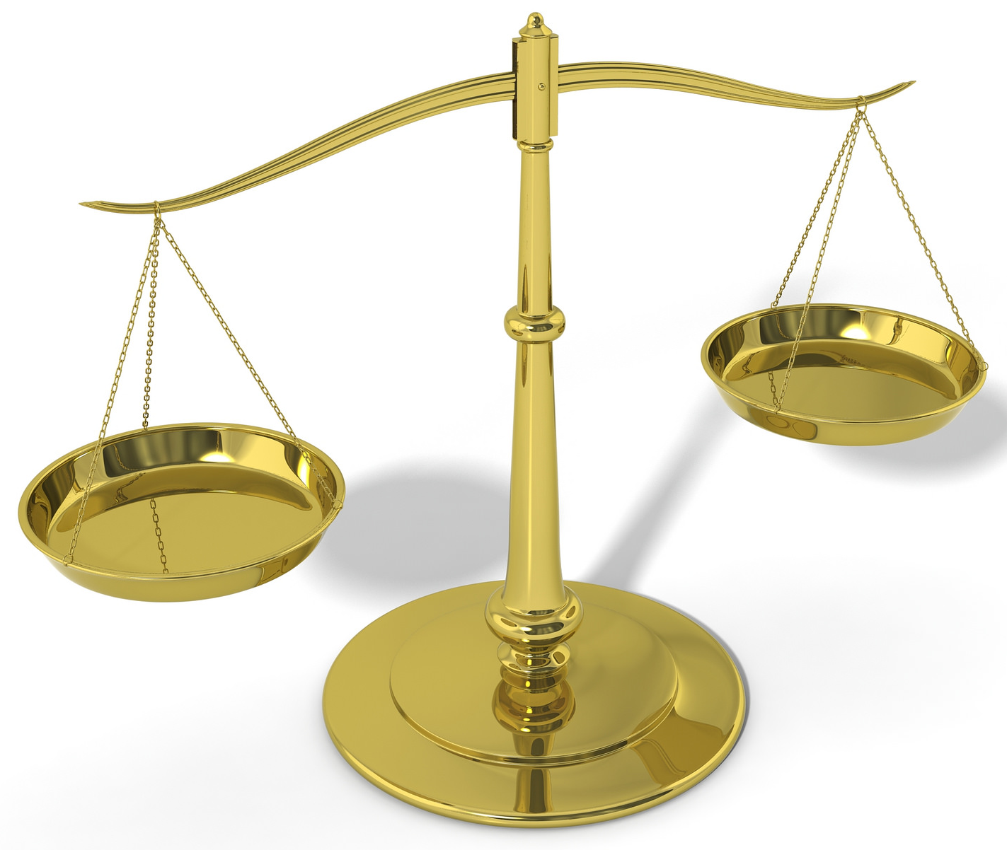
Why Copyright?
To protect owners while promoting the orderly exchange of ideas
3D Scales of justice by Chris Potter CC BY 2.0
Notes:
Mélanie
Copyright is a balance
-incentive for creators to create
-making these creations available to others to foster other creations

Slide 10
Duration of Copyright
Generally, life of the creator + 50 years
Notable exception: Sound recordings
  70 years after the release of the sound recording
When copyright term ends, work is no longer protected and enters the public domain
Notes:
Mélanie

Slide 11
Copyright Ownership
2
Notes:
Uju

Slide 12
Who is the copyright owner?
The creator(s) of the work
  e.g. author, illustrator, photographer
An employer, entity or organization
As stated in a collective agreement or employment contract
Notes:
Uju

Slide 13
Who is the copyright owner?
A publisher
Any other person/entity that has been assigned or transferred the copyright
Notes:
Uju

Slide 14
Rights of a Copyright Owner
Economic Rights | Moral Rights
Reproduce/make copies | Integrity
Publication/distribution | Paternity
Performance/display | Association
Make derivatives/translation
► Transferable | ► Non-transferable
Notes:
Mélanie
Economic rights:
-Reproduction in whole or in part/make copies
-publication (first publication)/distribution (for profit or for free)
-performance (as in a play or music)/display (as in a museum or a gallery)
-make derivatives, including translation of the original
Can be transfered to another party, exclusively or non-exclusively, through licences, with or without compensation
Moral rights:
-integrity: right to not see one’s work modified, mutilated or distorted or undergo any derogatory action that could harm reputation of author
-paternity: right to attribution, to be recognized as the author
-association: right to not see one’s work used in conjunction to a cause, product or service that author would find prejudicial and harms their reputation or honour
These cannot be transfered to another party

Slide 15
Exceptions and Limits
(“User Rights”)
3
Notes:
Mélanie
Copyright does not last forever and it is not absolute

Slide 16


Public Domain
Copyright term has expired
When a work is not entitled to copyright protection in the first place
  E.g. titles, names, slogans, ideas, facts, data, list of content/ingredients (but trademark or patent law may apply)
OR
Creator waived their rights and dedicated their work to the public domain
CC0
Notes:
Mélanie
Free to use for any purpose (remember to cite/give attribution)

Slide 17
Determining Public Domain in Canada
Copyright Term and Canada’s Public Domain (flowchart) – Copyright Office, University of Alberta
  https://cloudfront.ualberta.ca/-/media/ualberta/faculty-and-staff/copyright-office/public-domain-chart-v11-revised.pdf
Public Domain – Copyright Educational Resources Guide, Library, University of British Columbia
  http://guides.library.ubc.ca/c.php?g=698822&p=4961440
Notes:
Mélanie

Slide 18
Fair Dealing Analysis
Nature of the Dealing | More Fair | Less Fair
Purpose | Education/training | Commercial/for profit
Character | Single copy; limited distribution | Multiple copies; wide distribution
Amount | Least amount | Entire work/significant excerpt
Nature | Published; in the public interest | Unpublished; confidential
Available alternatives | No suitable alternative work | Suitable non-copyrighted work available
Effect | No detrimental effect on original work | Competing with original work; negative impact
Notes:
Mélanie
Fair dealing defined:
An exception in Canadian Copyright Act which allows for limited copying of materials without having to ask permission from the copyright owner under certain conditions
Need to cite works used under fair dealing
Purposes in the law are education, research, private study, critcism, review, news reporting, parody and satire (education, parody and satire were added in 2012)
Educational institutions often have guidelines that complement the law and 2004 Supreme Court decision in CCH Canadian Ltd v. Law Society of Upper Canada; other types of organizations may also have guidelines/policies

Slide 19
Other Exceptions and Limits
Linking
Insubstantial use
Notes:
Mélanie

Slide 20
Open Licensing
4
Notes:
Uju

Slide 21
What is a licence?
“A licence allows someone else to use a work for certain purposes and under certain conditions.
The copyright owner still retains ownership.”
A Guide to Copyright (Assignments and Licences),
Canadian Intellectual Property Office (CIPO)
Notes:
Uju

Slide 22
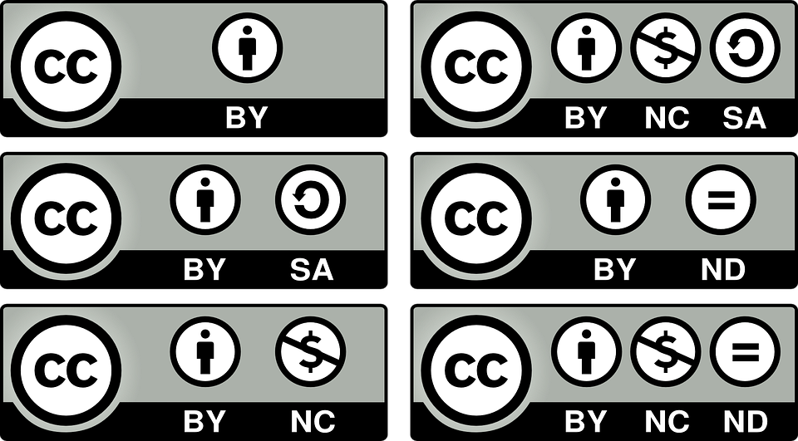
Creative Commons
Licences
Notes:
Uju

Slide 23
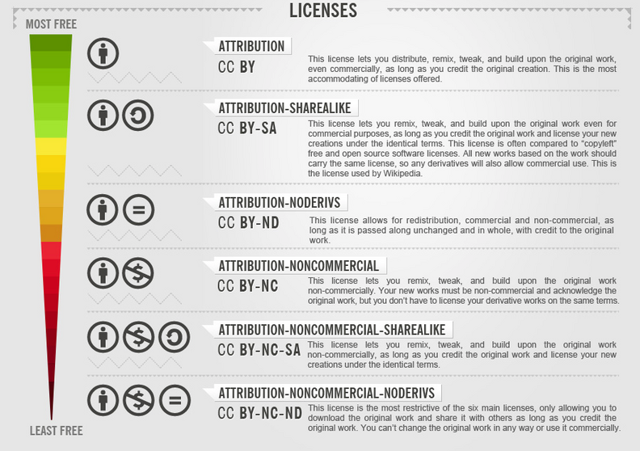
What are CC licences?
Choice of 6 free legal licences for copyright owners to use to share their content
No registration required
Compatible with copyright laws
Used by major platforms (e.g. Flickr, Youtube, Wikipedia, Internet Archive) and open access publishers (e.g. PLOS, BioMed Central)
CC license freedom scale chart by Foter CC BY-SA 3.0 via Wikimedia Commons
Notes:
Uju
Copyright owners retain their copyright
Chose from 6 licences according to permissions they want to give to others
Label content in advance so others know that they may share, reproduce or adapt the copyrighted content

Slide 24

CC Licence Icons – Attribution (BY)
Must cite (i.e. give credit) to the creator of the work (if supplied) and link to licence (or state URL if linking is not possible)
Required for all CC licences
Notes:
Uju

Slide 25

CC Licence Icons – ShareAlike (SA)
If re-users adapt the original content, they must share their modified work under the same CC licence or a licence with similar/compatible terms
Notes:
Uju

Slide 26

CC Licence Icons – NonCommercial (NC)
Material cannot be used for commercial purposes.
“Commercial use refers to primarily intended for commercial advantage or monetary compensation” https://creativecommons.org/licenses/by-nc/4.0/legalcode
Notes:
Uju
Recuperating costs of printing is acceptable, but reproduction or adaptation cannot be sold for profit.

Slide 27

CC Licence Icons – NoDerivatives (ND)
If re-users adapt the original works, they can use that adaptation privately, but they are not permitted to distribute the modified work publicly
Notes:
Uju

Slide 28
Other types of open licences
Open source licences for software
  GNU General Public License (GLP)
  More examples: https://opensource.org/licenses
Open Data Commons Licenses https://opendatacommons.org/licenses/index.html
Open Government Licence
  Government of Canada, Statistics Canada Open Licence
  Government of Ontario, Alberta Government
  UK Government (for public sector information)
Notes:
Uju

Slide 29





Selected Sources of Open Content
https://open.bccampus.ca
under “Health Related”
https://openstax.org/
Subjects – Science
https://www.merlot.org/merlot/
Browse by Discipline – Science and Technology
https://open.umn.edu/opentextbooks
Browse subjects – Medicine
https://www.oercommons.org/oer
Subject Areas – Life Sciences
Notes:
Uju
Note: These are broad subject categories used on these sites. « Medicine » actually includes nursing and other health-related books.

Slide 30
Suggested Sources of Open Images
MedPix: Images and case materials curated by the U.S. National Library of Medicine, for personal use and local teaching at your institution (permission required for other uses)
Open-i: Biomedical images curated by the U.S. National Library of Medicine, various levels of openness, can filter by “License Type”
Public Health Image Library (PHIL): Images provided by the Centers for Disease Control and Prevention, most are royalty-free and available for personal, professional and educational use, with appropriate citation (CDC and individual photographer when name given)
National Cancer Institute Visuals Online: Most images are in the public domain, should acknowledge NCI and its website as the source; if image marked as copyright-protected, copyright holder must be contacted for permission
Notes:
Uju
The U.S. federal goverment puts its information in the public domain right away, so many of these suggested sites are administered by the National Institutes of Health in the U.S. Note that while they offer open images, only some uses are permitted so make sure to check each source for terms and conditions.

Slide 31
Suggested Sources of Open Images
NIH Digital Collections: Images (and more) from the U.S. National Library of Medicine; to limit to open images, refine by Formats → Still image and then by Copyright → Public domain; should be credited with “Courtesy of the National Library of Science”
PMC (PubMed Central): free full-text archive of biomedical and life sciences journal literature and associated images at the U.S. National Library of Medicine. Use the tag [capt] to search for a specific term in the image captions (ex. pityriasis [capt]). Click on “Copyright and License information” for the image (or for the article if there is not one for the image) to see the conditions of use.
Bassett Collection of Stereoscopic Images of the Human Anatomy: (from the Lane Medical Library at Stanford University) Choose “Images” and search for keywords; results will be displayed in four tabs, from more open (public domain) to least open (all rights reserved, requiring permission)
Hardin Library, University of Iowa Image Bank of Diseases: Archived subset of public domain images hosted on the Hardin MD site
Notes:
Uju
The U.S. federal goverment puts its information in the public domain right away, so many of these suggested sites are administered by the National Institutes of Health in the U.S. Note that while they offer open images, only some uses are permitted so make sure to check each source for terms and conditions.

Slide 32
Suggested Sources of Open Images
Health Education Assets Library (HEAL): Collection of freely available digital materials housed at the University of Utah; can browse or search the entire HEAL collection or specific sub-collections
National Center for Complementary and Integrative Health (NCCIH): Free images available for non-commercial scientific and educational use, acknowledgment required (photographer or illustrator, copyright holder, institution and NCCIH); other uses require permission
National Institutes of Health (NIH) Image Gallery: Flickr gallery with over 1,000 images, all in the public domain or under a Creative Commons licence, free to use with credit, but not intended for commercial use
National Institute of Diabetes and Digestive and Kidney Diseases (NIDDK) Image Gallery: Original full-colour and black-and-white illustrations available copyright free
Notes:
Uju
The U.S. federal goverment puts its information in the public domain right away, so many of these suggested sites are administered by the National Institutes of Health in the U.S. Note that while they offer open images, only some uses are permitted so make sure to check each source for terms and conditions.

Slide 33
Licence Agreements
& Terms of Use
5
Notes:
Mélanie

Slide 34
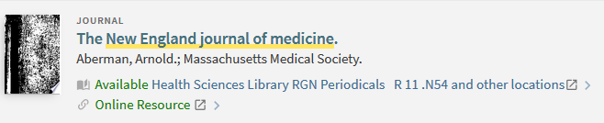
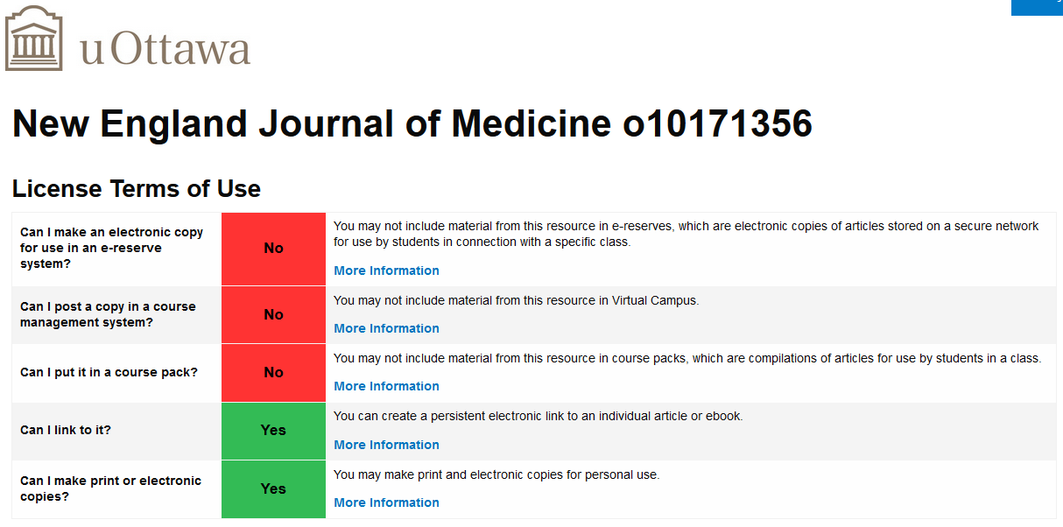
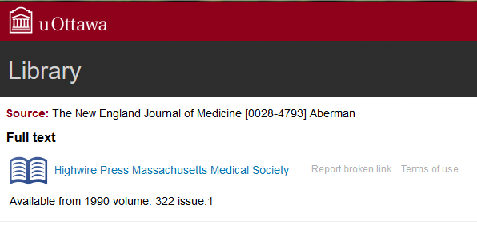
Licence terms for subscription-based resources
Example: Institutional subscription (University of Ottawa Library)
Notes:
Mélanie
Note: Use and reproduction are not the same thing, permission to use through a subscription does not automatically mean permission to reproduce/make copies – have to read the fine print
How to you find that information? In this example, the licence terms of use are easy to find because the catalogue connects to a database of licences and what is displayed is a summary or « human readable » version of the licence, focusing on the most common uses
If your library or information service does not have access to such a feature, you should know where you can find the actual agreements (they should be filed somewhere by acquisitions, collections team, procurement…) so you can check those terms when needed

Slide 35
Licence terms for subscription-based resources
Examples: Individual/personal subscriptions
Electronic Nutrition Care Process Terminology (eNCPT) – Academy of Nutrition and Dietetics
“The Individual Subscription is a single-user subscription and is intended for just that—the individual.”
https://www.ncpro.org/subscription-categories-explained
Netflix Terms of Use
“… any content viewed through the service are for your personal and non-commercial use only and may not be shared with individuals beyond your household.”
https://help.netflix.com/legal/termsofuse
Notes:
Mélanie
Use and reproduction are not the same thing, permission to use through a subscription does not automatically mean permission to reproduce
It might be tempting to copy or stream something from an individual/personal subscription, but two issues arise:
1) The amount of the copying may not be legal under copyright law
2) It is likely a breach of the contract (user agreement) the individual has with the provider of the product or service; those terms usually refer to « personal use » only. So it’s important to read those conditions. If an individual uses a personal subscription in a way to violates the terms of their agreement, they are the ones taking the risk

Slide 36
Websites and platforms
Look for “Terms/Conditions of Use”
World Health Organization
https://www.who.int/about/who-we-are/frequently-asked-questions
Mayo Clinic
https://www.mayoclinic.org/about-this-site/terms-conditions-use-policy
YouTube – Terms
5. Your Use of Content
“You shall not copy, reproduce, distribute, transmit, broadcast, display, sell, license, or otherwise exploit any Content for any other purposes without the prior written consent of YouTube or the respective licensors of the Content.” https://www.youtube.com/t/terms
-Use videos under CC licence (Search – Filter – “Creative Commons” under “Features”)
-Check whether video was posted legally
Notes:
Mélanie
Terms and conditions, rights and permissions, permissions and licensing, copyright, intellectual property, Frequently Asked Questions

Slide 37
Thanks!
Questions ?
Contact us at:
melanie.brunet@uottawa.ca
obianuju.mollel@ahs.ca

Slide 38
Credits (other than specified on slides)
Slide 2: Photos courtesy of instructors
Slide 4: Icon from The Noun Project, NounPro royalty-free licence
Slides 16, 22, 24-27: Creative Commons buttons and icons, CC BY 4.0
Slide 29: BCcampus logo, CC BY 4.0; Merlot logo, CC BY NC SA 4.0; Open Textbook Library logo, CC BY 4.0; OpenStax logo, © Rice University; OER Commons logo, CC BY NC SA 3.0
Slide 34: screen captures of University of Ottawa Library catalogue
Viola slide template from SlidesCarnival, CC BY 4.0

Slide 39
Scenarios

Slide 40
Scenario 1:
The health promotions department creates consumer health handouts. The material they produce is adapted from patient handouts created by other organizations/institutions. Does this infringe copyright?
Notes:
Uju

Slide 41
Scenario 2:
A clinician takes photos during a patient interaction and consult. They want to use the pictures for a continuing education presentation to colleagues. What are important considerations to keep in mind and who owns the copyright to the photos?
Notes:
Uju

Slide 42
Scenario 3:
Stephanie and Paul are health librarians in an academic library. They would like to put a Creative Commons licence on the research guide they created on systematic reviews.
Notes:
Mélanie

Slide 43
Scenario 4:
Tawny co-authored an article with her thesis supervisor. It is now available in the current issue of the Canadian Journal of Diabetes. She wants to add the PDF that she downloaded using the library’s subscription to her ResearchGate profile.
Notes:
Mélanie

Slide 44
Additional Scenarios

Slide 45
Scenario 5:
A published article has several authors. Some are university faculty and others are employees of a health organization. The lead author, a university faculty member, wants to grant a copyright licence so that the article can be reproduced and uploaded to an organization’s website. Do all the authors have to also give their approval? Or is only the lead author’s approval required?
Notes:
Uju

Slide 46
Scenario 6:
When Pedro was a lecturer in human kinetics at a university, in his lectures he used the slides and images provided by the publisher of the textbook he adopted for his course, Fundamentals of Athletic Training (published by Human Kinetics). He now wants to use these slides for a presentation he is giving at coaching clinic at his local arena.
Notes:
Mélanie

