Slide 1
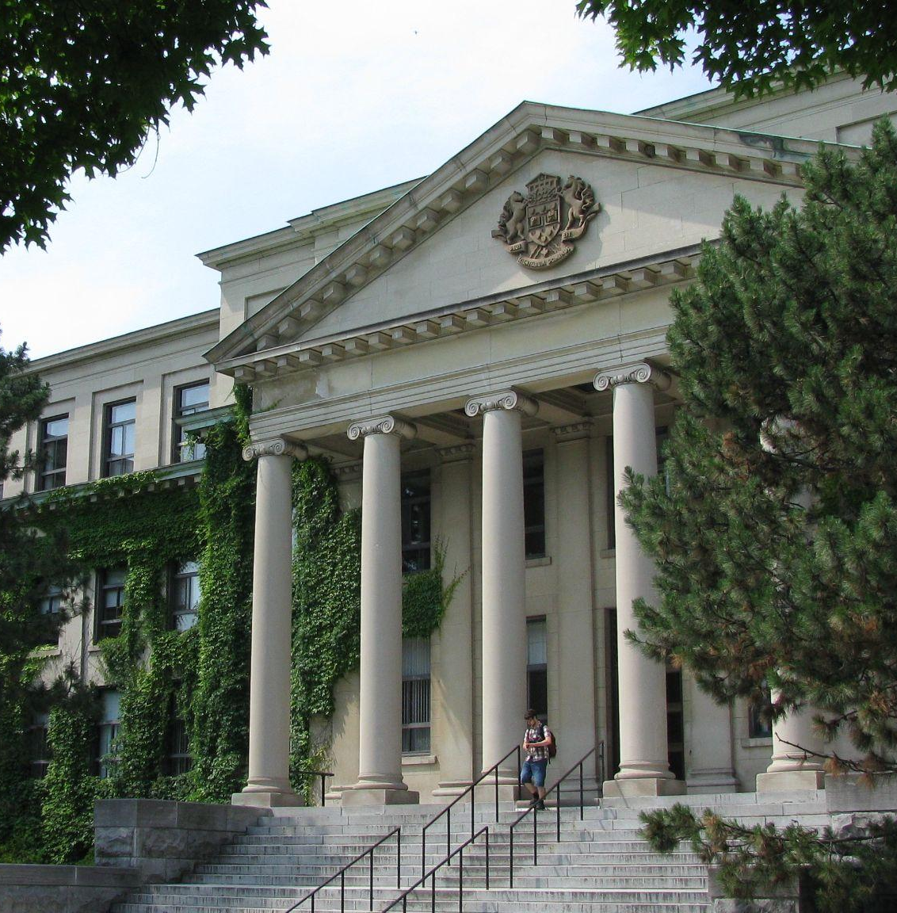

OER and the Challenges and Opportunities of Linguistic Equity at a Bilingual Canadian University
OERcamp.global 2021
Mélanie Brunet and Michelle Brown
University of Ottawa Library
Unless otherwise specified, the contents of the presentation are made available under a Creative Commons Attribution 4.0 International licence.
Tabaret Hall, Bytown Museum, CC BY-NC 2.0
Notes:
Intro do session in plenary hall
About ourselves: Michelle Brown and Mélanie Brunet and were are both librarians at the University of Ottawa in Canada.
About the session: We will talk about the linguistic equity challenges that currently exist at our university around OER but also the opportunities OER represents to address these challenges. We look forward to hearing about your thoughts and about your own experiences with equity gaps in OER.
[MICHELLE]
Hello everyone and welcome to our presentation on OER and the Challenges and Opportunities of Linguistic Equity at a bilingual Canadian University.
Please note that this session is being recorded.
My name is Michelle Brown and I am the Head - Learning & Student Success and I am joined today by my co-presenter Mélanie Brunet who is the Open Education Librarian. We both work at the University of Ottawa Library.

Slide 2
1.
Context: The University of Ottawa
Notes:
[MICHELLE]
First we will provide some context about our institution. Founded in 1848, the University of Ottawa is located on the unceded ancestral land of the Algonquin people in the heart of Canada’s capital city, Ottawa, Ontario. The largest bilingual (English-French) university in the world, uOttawa is a public research university that offers 550 undergraduate, master’s, doctoral and professional programs. It provides courses, resources and services in both English and French, but it is not in equal proportion.

Slide 3
42,000
70%
30%
students
English
French
Sources: University of Ottawa, “About us,” https://www2.uottawa.ca/about-us/ and “Quick Facts 2020,” https://www.uottawa.ca/institutional-research-planning/resources/facts-figures/quick-facts
Notes:
[MICHELLE]
There are about 42,000 students at the University of Ottawa. 70% of those students study in English while only 30% of students study in French.
Because of the relatively low number of Francophone students at the University, they are a linguistic minority within its walls as well as in most areas of Canada. This poses a challenge for the University which is officially bilingual and has a mandate to promote and strengthen both the French language and the Francophone culture at both the national and international levels. As much as possible, it is required to provide the same services and resources in both English and in French. However, French-language teaching and research resources like textbooks and databases are often more difficult to find, more expensive, and in some disciplines, non-existent.

Slide 4
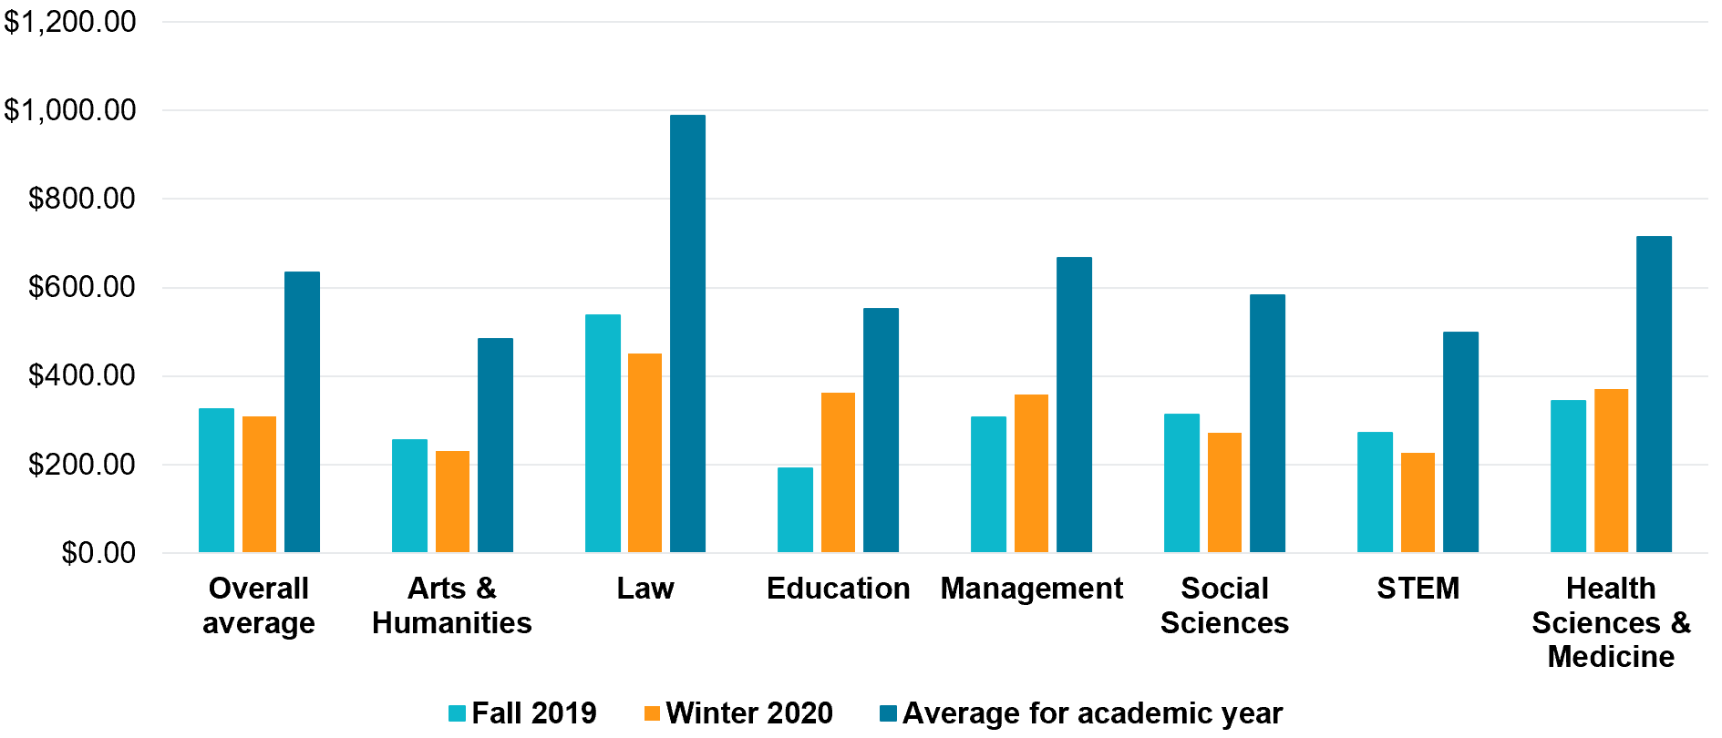
Average Reported Spending on Course Materials in 2019-2020 at uOttawa (in CAD)
Source: University of Ottawa Library #TextbookBroke campaign, Fall 2019 and Winter 2020
Notes:
[MICHELLE]
Since January 2018, the uOttawa Library has been tracking textbook spending and costs.
Before the pandemic, the Library held Textbook Broke campaigns to bring attention to the cost of textbooks and the impact on students. Indeed, our initial interest in OER was from an affordability perspective.
The campaign was held the third week of January and September, with
-posters in five library locations on which students could add a post-it note
-Focus on what students said they spent on course materials (amounts and comments)
In 2019-2020, the overall average was a bit more than $630 $ year, both languages included. Law was in the lead with average reported spending of almost $1,000 per year.
-----------------------------------------------------
Additional data:
Overall average: 634,97 $
Arts and humanities : 484,72 $
Law : 989,15 $ *
Education : 552,50 $
Management : 666,20 $
Social sciences : $583.62 $
STEM : 497,92 $
Health sciences and medicine : 714,34 $

Slide 5
Textbook Costs at uOttawa, 2019-2020
Highest enrollment undergraduate programs (in CAD)
 | English | French
Juris Doctor | $2,086.75 | $558.69
Biomedical Sciences | $1,938.00 | $655.91
Psychology | $1,530.45 | $756.37
Nursing | $1,037.82 | $839.25
Electrical Engineering | $984.75 | $728.25
Communication | $941.70 | $257.87
Commerce | $821.00 | $584.68
Education | $130.67 | $214.40
Civil Law (L.LL.) | ---- | $699,52
Source: M. Brunet (2020). Textbook Costs and Affordable Alternatives at the University of Ottawa [presentation].
Open Education Week 2020, Ottawa, CC BY-SA 4.0, http://hdl.handle.net/10393/40237
Notes:
[MICHELLE]
In 2019-2020, we also tracked the cost of textbooks assigned in the first year of the highest enrolment undergraduate programs in each faculty at uOttawa. In English, the most expensive program was common law at over $2,000 while in French it was Nursing at over $800, if students purchased all required course materials without compromising on their preferred format and access.
For all programs, it looks like it is more expensive to study in English than in French, but this is an oversimplification: the textbook market is much smaller in French, new editions don’t come out as frequently (for example, Campbell’s Biology is updated every two years in English, but every four years in French). And professors in French courses will turn to other options like print course packs, the Library’s digital course reserve or the learning management system to bring together parts of various resources instead of assigning a textbook that may not exist. It is also known that a portion of these assigned resources, even if they don’t involve an extra cost for students in French courses, are in English. And that’s when a course is even offered in French. Indeed some programs cannot be completed only in French. As stated in a recent report from the Office of the Vice-President, International and Francophonie, “this leads to the creation of two categories of students who simply do not have the same rights” (https://www.uottawa.ca/sites/www.uottawa.ca/files/towards_a_revewed_francophonie.pdf, p. 7)
You will also notice that there is a significant difference between what students reported spending and the actual cost of the required textbooks provided by the CampusStore and other local bookstores used by professors.
The expected costs are much higher. In Law (Common Law programme in English), it is over $2,000 per year for the same period, 2019-2020, whereas for the Civil law program in French only it was almost $700. It is clear that students do not purchase all the required materials, which is not unique to uOttawa. They find other ways to access the materials, sometimes illegally, or they go without, at the risk of compromising their success.

Slide 6
2.
Gap in Availability of OER in French
Notes:
[MICHELLE]
We will now speak to the gap in the availability of French language OER.

Slide 7
English Dominance in OER
Dominance in Internet infrastructure, use and content
Internet World Stats (March 31, 2020)
 | English | French
Internet Users | 25.9% | 3.3%
Internet Penetration | 77.5% | 35.2%
Source: Miniwatts Marketing Group, “Internet World Users by Language: Top 10 Languages,” Internet World Stats: Usage and Population Statistics, https://www.internetworldstats.com/stats7.htm
Notes:
[MÉLANIE]
Although OER as a concept has been around since 2002, it is still a movement dominated by the English language, in Canada and elsewhere. In Canada, the provinces of Ontario and Quebec have invested in the creation of French-language OER over the past few years, but a wide gap remains.
We’d like to take a moment here to acknowledge the irony of holding this session in English. In an effort to make this presentation and ensuing discussion more accessible (and appealing) to an international audience, we are reinforcing the idea of English as a lingua franca.
The infrastructure of the Internet on which OER rely for creation, hosting, dissemination and use, is English-dominated. As of March 31, 2020, according to the Internet World Stats, while English dominated with 25.9% of Internet users, French accounted only for 3.3%. And the Internet penetration by language is 77.5% for English while only 35.2% for French.

Slide 8
English Dominance in OER
Dominance in scientific/academic publishing, including in research about OER
Google Scholar Search in Title (December 10, 2021)
“open educational resources” | ≈ 4,200 results
“ressources éducatives libres” | ≈ 34 results
Source: Advanced searches performed by M. Brunet using https://scholar.google.com/
Notes:
[MÉLANIE]
The uneven language distribution in OER also follows the trend in scientific and academic publishing in general, where English is still the dominant language, in large part because university rankings take into account the number of articles published in the most prestigious journals and most of these are in English, perpetuating the imperative of publishing in English for one’s research to be read and cited widely, i.e. have an ‘impact’.
The research about OER is still mostly published in English. A quick search in Google Scholar today for “open educational resources” in the title returned 4,200 results while a search for its equivalent in French, “ressources éducatives libres,” returned 34 results. We ran that search in September for another presentation and while the results in English increased by 100, there are no changes in French.

Slide 9
Comparison with Commercial Textbooks
Small commercial publishing market for French-language resources
Francophone population
Ontario (2016) | 622,415 | 4.7%
Canada (2016) | 7,914,498 | 22.8%
World (2018) | 253,000,000 | 3.1%
Sources: Government of Ontario, https://www.ontario.ca/page/profile-francophone-population-ontario-2016, Canadian Heritage, Government of Canada, https://www.canada.ca/en/canadian-heritage/services/official-languages-bilingualism/publications/facts-canadian-francophonie.html,
and OIF, La langue française dans le monde, https://www.francophonie.org/node/305.
Notes:
[MÉLANIE]
The lack of OER in French also reflects the imbalance that exists in commercial publishing. The market for French-language learning resources is small compared to English, even when including individuals in French immersion programs.
In the province of Ontario where uOttawa is located, francophones represented 4.7% of the population in 2016 while they represented 22.8% of the Canadian population. Internationally, the Organisation internationale de la francophonie estimated in 2018 that about 3.1% of the world population used French on a daily basis.
Small markets usually mean smaller print runs, less investment in digital formats on the part of publishers, and a more higher cost for items. Therefore, not only fewer francophone resources make it to publication in Canada, those that do often rely on financial support from the federal and provincial governments, especially in Québec, Ontario, and New Brunswick, the three Canadian provinces with the largest francophone populations.

Slide 10
Comparison with Commercial Textbooks
Unique cultural and linguistic Franco-Ontarian context
Own dialect
Own history of struggles and evolving relationship with dominant English society
Not reflected in textbooks from Quebec or France
Notes:
[MÉLANIE]
There is also a unique cultural and linguistic context for Francophones in Ontario, which continues to be underrepresented in the already small market for French-language resources in Canada.
Franco-Ontarians have their own dialect (which varies across the province) and own history of struggles and evolving relationship with the dominant English society to preserve their language and culture, which are not reflected in textbooks from Quebec or France.

Slide 11
Comparison with Commercial Textbooks
Lost in translation and amplification of biases
Ontario elementary and secondary school textbooks distributed by Quebec authors
  Direct translation of English textbooks
  Written in French by Quebec authors
Notes:
[MÉLANIE]
While some English textbooks are translated into French, a translation does not necessarily capture the cultural and linguistic context of Francophones in Ontario. Which is true for translations in general - the content becomes accessible but not necessarily representative.
For example, commercial textbooks in French used in Ontario elementary and secondary schools are often direct translations of English textbooks or written in French by Québec authors, and in both cases they are distributed by Quebec publishers.
We are at a similar stage with French-language OER in Canada at the moment.

Slide 12
Why Fewer OER in French?
University tuition costs in Francophone countries and regions?
Tuition fees in France, full-time European students, licence, per year (2021-2022) (in Euro) | €170 (≅ $255 CAD) (real cost without government subsidy ≅ €10,000 or $15,000 CAD)
Tuition fees in Canada, full-time domestic students, undergraduate programs in arts and humanities, per year (2020-2021) (in CAD)
Quebec | $2,623 - $8,186
Ontario | $5,398 - $11,420
British Columbia | $4,267 - $14,646
Sources: Campus France, Tuition Fees in France, https://www.campusfrance.org/en/tuition-fees-France and Universities Canada, Tuition fees by university [from Statistics Canada], https://www.univcan.ca/universities/facts-and-stats/tuition-fees-by-university/
Notes:
[MÉLANIE]
So why are there fewer OER in French? Is it just reproducing the commercial market?
Tuition fees may be a factor in the use and development of OER in a country or region.
For instance, tuition fees are low in France where the government heavily subsidizes higher education in public institutions. For European students tuition at the licence (or bachelor level) is currently at 170 euros per year or around $255 CAD. The real cost without the government subsidy would be around $15,000 CAD.
In Canada, Quebec has been lagging behind in OER use and production compared to the provinces of Ontario and British Columbia. Québec also has some of the lowest tuition fees in the country, starting at around $2,600 CAD per year compared to $5,400 in Ontario and $4,300 in British Columbia.

Slide 13
Why Fewer OER in French?
More protective view of copyright (“droit d’auteur”)
Right of the author vs right to copy
No fair use/fair dealing provisions in Civil Law
Knowledge cultures resistant to “open”?
Resistance to digital to limit illegal reproduction
Copibec and Access Copyright
Notes:
[MÉLANIE]
Approaches to copyright could also have an impact. French-speaking countries can have a more protective view of copyright, which in French is called “droit d’auteur”. The word itself focuses on the right of the author, not the right to copy.
Also, civil law is the legal tradition in most French-speaking regions, a tradition that does not have the copyright exception of fair use or fair dealing (it’s more of a common law tradition).
It sets the stage for knowledge cultures that are resistant to open or may know see open as a necessity.
French-language textbook publishers have also been known to resist digital formats to limit illegal reproduction, which is noted as being especially widespread in educational publishing in Quebec. Source: Sharon Hackett and François Dallaire, (2016), Étude sur l’avenir du livre numérique et des ressources documentaires en ligne en formation à distance au Canada francophone, Montréal: Réseau d’enseignement francophone à distance du Canada (REFAD): https://www.refad.ca/documents/Etude%20sur%20lavenir%20du%20livre%20numerique%20en%20FAD%20au%20Canada%20francophone.pdf, p. 62 and 72.
There is also a difference in Canada between how schools in Quebec and schools in the rest of the country manage copyright (even though they all fall under the same Copyright Act). In Québec, post-secondary institutions have a licence with the copyright collective Copibec that allow for reproduction in the context of education in exchange at a fixed rate (with the royalties redistributed to copyright owners), while in the rest of Canada, the relationship with Access Copyright (the copyright collective that operates outside of Quebec) has been strained and often non existent and reproduction for education is handled internally following fair dealing guidelines that have come under scrutiny all the way to the Supreme Court of Canada. So perhaps there is not as much of a need for OER as an alternative to “all rights reserved” materials in Québec compared to elsewhere in the country.

Slide 14
3.
Equity Challenges
Notes:
[MICHELLE]
All of these factors could contribute to the gap in available French-language OER. And this gap should be viewed as a equity issue for bilingual PSE institutions like the University of Ottawa but also for any school, region or country who claims to support more than one language. We will now explore these challenges.

Slide 15
uOttawa Examples of Language Inequity
Academic Writing Help Centre - Writing manual
English version
free and under CC BY 4.0 since 2016
French version (“Outils de rédaction”)
not under CC license but now free
required purchase ($20) for French academic writing courses until 2020
Notes:
[MICHELLE]
Until recently at uOttawa, the English version of a popular academic writing manual was available under a CC BY license on the writing centre’s website. However, students taking writing courses in French were required to purchase the French version of the manual for $20. While it is now free, it is still not under a Creative Commons licence.

Slide 16
uOttawa Examples of Language Inequity
Introduction to Linear Algebra
MAT 1341 (English) uses “Vector Spaces First” by T. Giordano, B. Jessup and M. Nevins since 2015
Not OER but free
1,300 students annually
MAT 1741 (French) uses “Algèbre linéaire et applications” by D. Lay
$120.50 (published by Pearson at uOttawa Campus Store)
630 students annually
Notes:
[MICHELLE]
In this second example, the English course for linear algebra has had a free textbook since 2015 assigned to about 1,300 students every year. The same course taught in French has required about 630 students annually to purchase a 120$ textbook.

Slide 17
Consequences of equity gaps
Human rights issues
Assimilation into the dominant culture/loss of culture
Cost considerations
Undermine achievement of SDGs
Notes:
[MICHELLE]
The consequences of this inequity can be profound and far reaching. The U.N and other prominent international governing bodies have declared the right to speak and learn in one’s mother tongue a universal human right. Local languages, especially minority languages, transmit cultures, values and traditional knowledge, thus playing an important role in promoting sustainable futures. In this way, French language OER play a critical role in maintaining equitable access to education, culture and knowledge for those who wish to learn in French.
A lack of access to French language learning resources puts increased pressure on Francophone learners to fall back on making do with English textbooks and other learning materials. This may further contribute to the assimilation of a linguistic minority group into the dominant culture and language.
There is also the cost of learning to consider. Although some regions of the French speaking world have low tuition costs (such as Quebec in Canada and some countries in Europe), as we have mentioned, this isn’t the case in Ontario. French speaking Canadian students are required to pay the same tuitions costs as English speaking Canadian students, yet they have less access to free or low-cost OER and can end up paying more to purchase learning materials. So comparatively speaking it can cost more to study in French than in English at uOttawa and elsewhere.
OER (and open educational practices) can be in service to a number of Sustainable Development Goals, including SDG4 (quality education), SDG10 (reduced inequalities) and SDG12 (responsible consumption and production) but this ongoing gap in the availability of OER in languages other than English undermines the achievement of those goals.

Slide 18
4.
Opportunities
Notes:
[MICHELLE]
Despite the many challenges faced at our institution surrounding OER, there are also opportunities to promote awareness, adoption and creation of OER.

Slide 19
University of Ottawa Strategy
Transformation 2030
  Promote and reward the development of affordable learning materials
  Develop Open Educational Resources in French
University of Ottawa. (2019). Transformation 2030: Building the University of Tomorrow, https://transformation2030.uottawa.ca/
Notes:
[MÉLANIE]
In its strategic plan released in late 2019, uOttawa committed to promoting and rewarding the development of affordable learning materials and developing OER in French.

Slide 20
University of Ottawa Strategy
2019 Action Plan for the Francophonie
2021 Consultations on the Francophonie and resulting report
  Provide resources to create a French-language textbook publishing program in collaboration with French-language publishers including the University of Ottawa Press
  Provide faculty with publishing tools to publish in the other official language and fund open access rights to French-language publications
Linda Cardinal. (2019). A Shared Responsibility: An Action Plan for the Francophonie at the University of Ottawa. https://www.uottawa.ca/president/sites/www.uottawa.ca.president/files/francophonie_action_plan_-_january_30_2019.pdf and Office of the Vice-President, International and Francophonie. (2021). Towards a renewed Francophonie at the University of Ottawa: A Shared Responsibility [Summary Report]. https://www.uottawa.ca/sites/www.uottawa.ca/files/towards_a_revewed_francophonie.pdf
Notes:
[MÉLANIE]
uOttawa also endorsed an action plan for the Francophonie that clearly identified the gap in French-language textbook availability and open access publications. While OER were not mentioned in the action plan, they were presented as a promising solution during the consultations are mentioned in the resulting report.

Slide 21
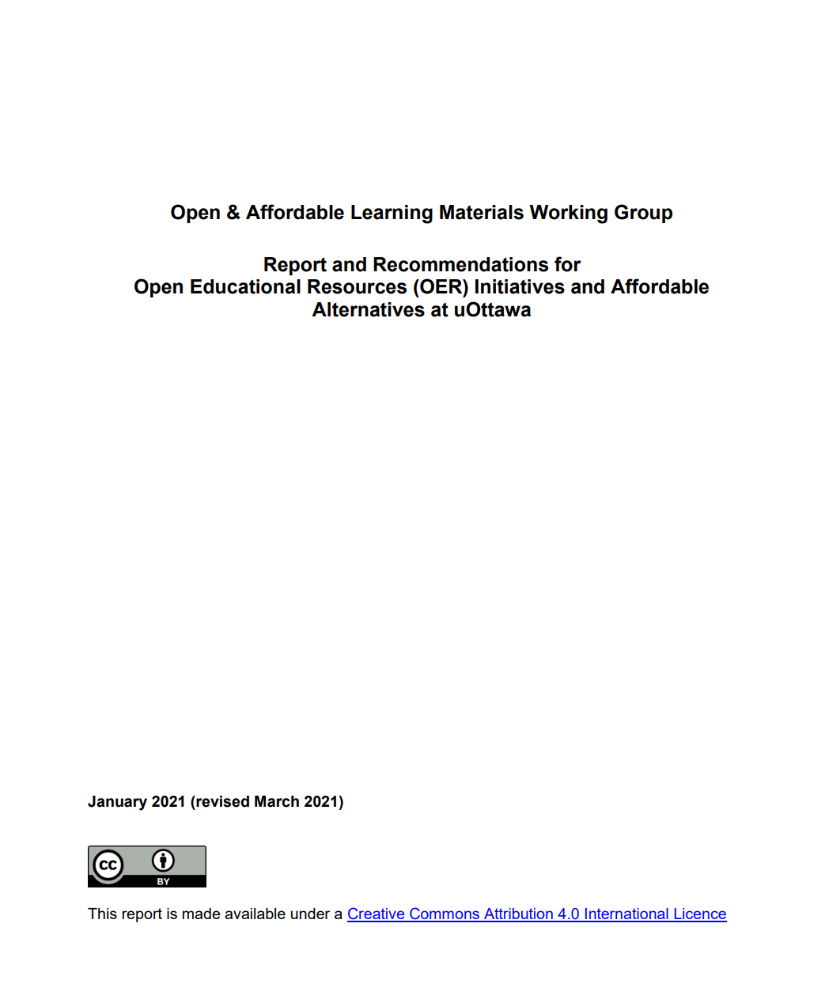
Open & Affordable Learning Materials Working Group Report
Need for dedicated funding and initiative for OER in French
Open & Affordable Learning Materials Working Group. (2021). Report and Recommendations for Open Educational Resources (OER) Initiatives and Affordable Alternatives at uOttawa. Ottawa: University of Ottawa. CC BY 4.0. http://hdl.handle.net/10393/42580
Notes:
[MÉLANIE]
Earlier in 2021, the Open and Affordable Learning Materials Working Group released its reports and recommendations, pointing to the need for for dedicated funding and initiatives for OER in French, not just translating what exists in English. Also without a specific French-language OER initiative, English will more likely be chosen as language of creation and adoption. Even at uOttawa, creating bilingual resources results in adding to the availability of English OER instead of focusing on equity in the overall availability of OER in French.

Slide 22
Open and Affordable Learning Materials Working Group
Mandate:
To develop awareness and promote the use of affordable course content;
To explore and recommend strategies to establish an environment at uOttawa in which the creation and adoption of OER is encouraged and rewarded;
To coordinate efforts among key campus stakeholders who lead and support open education initiatives on campus.
Notes:
[MÉLANIE]
Created at the end of 2019 and sponsored by the University Librarian, the Vice-Provost for Academic Affairs and the Associate Vice-President for Student Affairs. With representatives from the Library, faculty, students, teaching and learning support service
Mandate (see slide)

Slide 23
Recommendations by Category
Raise awareness of OER and open education
Support the use of existing OER
Foster the creation of new OER by uOttawa faculty
Encourage the use of other affordable alternatives
Notes:
[MÉLANIE]
1.Raise awareness of OER and open education:
-training and workshops, including for new professors, teaching assistants, graduate students and library employees. Possibility of an open education certificate.
-promotional campaign with all departments about benefits of OER and using open and affordable content
-Community of practice to meeting regularly
2.Support the use of existing OER:
-discovery and visibility - examine hosting platforms at uOttawa and invest in the maintenance of the selected platform(s)
-translation and adaptation - encourage translation AND adaptation in French of existing OER to start filling cap in French, esp. in Canadian context
-financially support maintenance and update of uOttawa OER to keep them relevant
-support grant recipients with timely assistance and training on copyright, licences, accessibility, hosting and other relevant topics
3.Foster the creation of new OER by uOttawa faculty
-Develop Pressbooks and H5P expertise and support:
-Increase OER grant funding to encourage creation of French-language (or bilingual) OER
-Develop workflows for adoption and production of OER, adapted to uOttawa context
-Recognize the work of professors who use OER or create them and investigate other incentives as part of tenure and promotion process
-new positions, including open education librarian
4.Encourage the use of other affordable alternatives
-increase use of the Library’s course reserve service to leverage resources students can already access and reduce reliance on expensive textbooks
-work with registrar to identify in course timetable courses that do not require the purchase of materials
-adapt and promote a voluntary faculty pledge supporting affordable course materials

Slide 24
University of Ottawa Library
Strategic Plan 2025
  Maximize opportunities for participation in the open scholarship movement (focus on French)
University of Ottawa Library (2020). Strategic Plan 2025, https://biblio.uottawa.ca/en/strategic-plan-2025
Notes:
[MÉLANIE]
The Library’s own strategic plan includes an objective to maximize opportunities for participation in the open scholarship movement, with a focus on French language open scholarship.

Slide 25
uOttawa Library OER Grant
2020 - 3 grants = $15,000
2021 - 4 grants = $20,000
2022 - 8 grants = $40,000
Current call: https://copyright.uottawa.ca/open-educational-resources-oer-grant-program-winter-2022
Notes:
[MÉLANIE]
Since 2020, the uOttawa Library has awarded a total of $35,000 to 7 projects, including the following, meant to support the creation of OER, especially in French, to start addressing that gap.
For the call that was launched a few weeks ago for 2022, we have $40,000 available and we are confident that this level will be maintained or increased in 2023 and 2024

Slide 26
uOttawa Library OER Grant (2020)
Translating for Canada, eh? https://ecampusontario.pressbooks.pub/translatingforcanada/
Vous traduisez pour le Canada?
https://ecampusontario.pressbooks.pub/voustraduisezpourlecanada/
Open textbook in both French and English introducing the concepts of translation and localization, term banks, bilingual concordancers, tools for comparing language varieties, machine translation tools and language portals.
Notes:
[MÉLANIE]
The Grant supported the creation of an open textbook in both French and English on translation and localization in a Canadian context.

Slide 27
uOttawa Library OER Grant (2021)
Introduction to Legal Analysis by Anne Levesque
Series of podcasts in French to introduce first-year students in the French common law program to legal analysis.
Note
Common law is taught in French only at two universities in Canada: University of Ottawa (Ontario) and Université de Moncton (New Brunswick)
Notes:
[MÉLANIE]
The grant also supported a series of French-language podcasts currently under development on legal analysis specifically for the French common law program at uOttawa, one of only two universities in Canada to teach common law in that language.

Slide 28
OER Community of Practice
Taking over from working group
First meeting October 20, 2021
Open to all at uOttawa
Share experiences, ask questions, guide and inform OER activities and support
Networking and outreach promotion
Notes:
[MÉLANIE]

Slide 29
Opportunities for uOttawa and Beyond
Bypassing limited commercial market for French-language resources
  Representative of French-speaking minorities in Canada
  Potential of co-creation with students
Notes:
[MÉLANIE]
Why are OER in French an opportunity to address existing equity gaps?
Focusing on the creation of OER in French makes it possible to bypass the challenging conditions dictated by a limited commercial market for French-language educational material.
We can hope that the resulting OERs would be more representative of French-speaking minorities in Canada, especially if they are co-created with students.

Slide 30
Opportunities for uOttawa and Beyond
Beyond uncritical translation of English OER or using “as is”
Dimension | Injustices | Ameliorative (affirmative) response Remedial reforms | Transformative response Addressing root causes
Cultural | Misrecognition: • Using OER “as is” (copying) • Translating OER uncritically | Recognition: • Locating and incorporating • OER used “as is” within local epistemological and cultural contexts • Translation OER into local languages prudently | Re-acculturation: • Re-mixing OER critically to engage with and challenge hegemonic perspectives • Sharing remixed teaching and learning materials publicly • Creation of OER
Cultural dimension from Table 2: OER, OEP and Social Justice Framework by Hodgkinson-Williams, C. A., & Trotter, H. (2018). A Social Justice Framework for Understanding Open Educational Resources and Practices in the Global South. Journal of Learning for Development, 5(3), https://jl4d.org/index.php/ejl4d/article/view/312, CC BY-SA 4.0.
Notes:
[MÉLANIE]
This co-creation with students taking courses in French would contribute to going beyond an uncritical translation of an existing English OER or using it “as is”. As outlined by Hodgkinson-Williams and Trotter in the context of OER and open educational practices in the Global South, addressing cultural and linguistic injustices in a transformative way means remixing critically in a manner that engages with and challenges hegemonic perspectives and creating our own OER.
But is also an opportunity for OER in French at uOttawa to be more inclusive as well when students are involved. Franco-Ontarian perspectives are often underrepresented in the learning materials assigned to them, but the idea of who is deemed to belong to that community also needs to be more inclusive and broadened. While uOttawa has a mandate to protect and promote the Francophonie especially in Ontario and Canada, our Francophone and Francophile students are diverse.

Slide 31
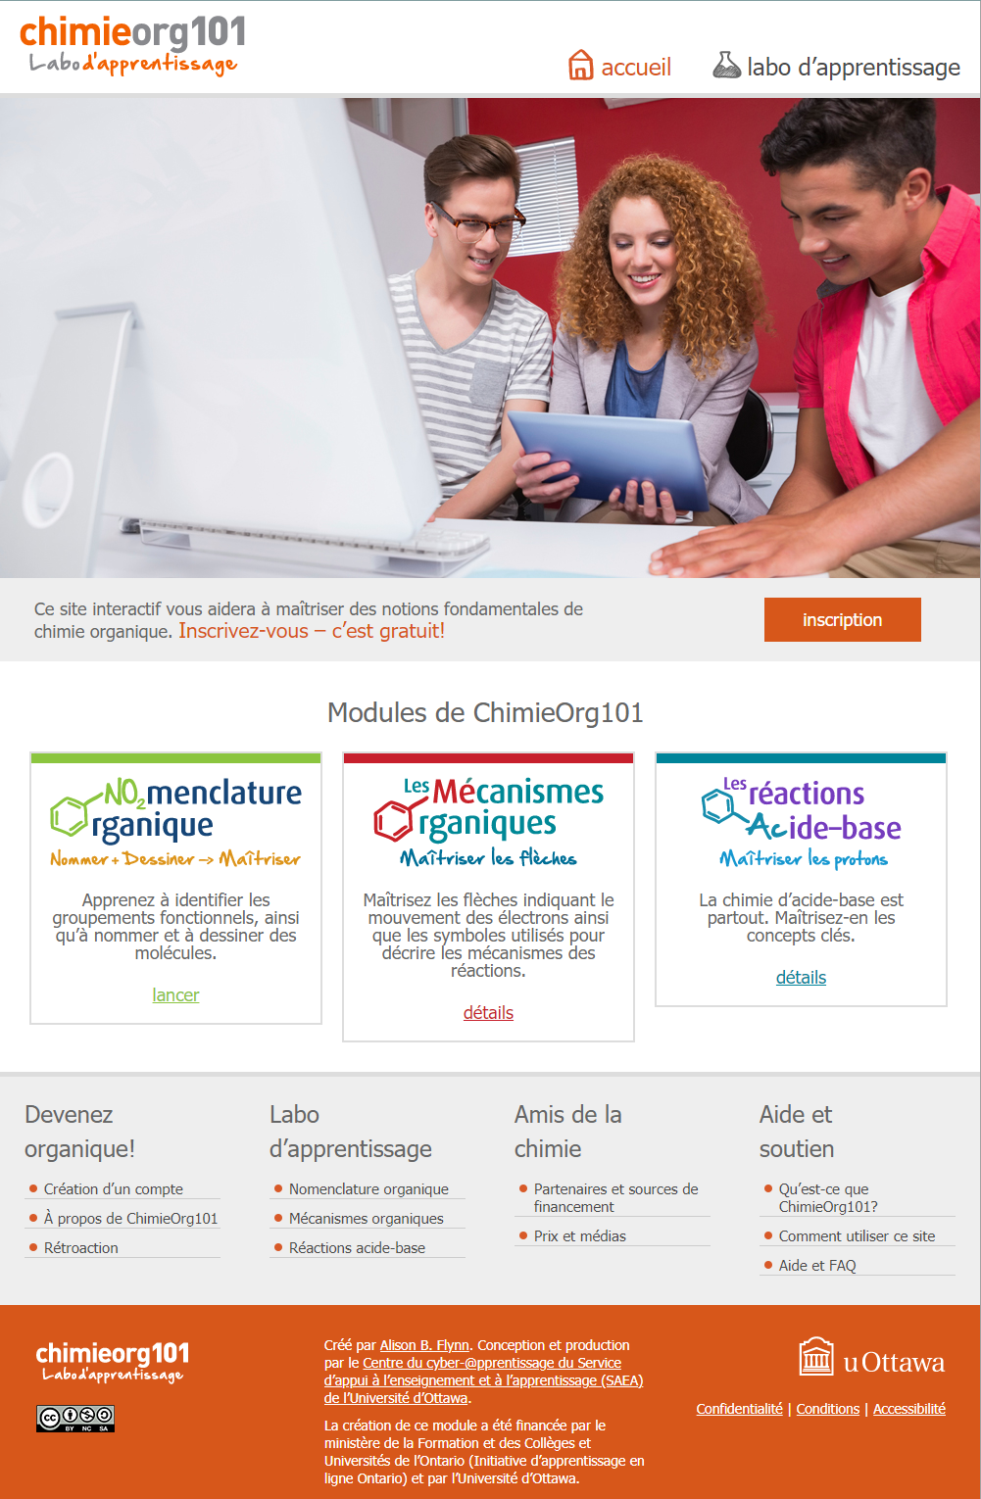
Examples of bilingual uOttawa OER
ChimieOrg101 Labo d’apprentissage
https://orgchem101.com/index_fr.php
OrgChem101 Learning Lab
https://orgchem101.com/index.php
Notes:
[MICHELLE]

Slide 32
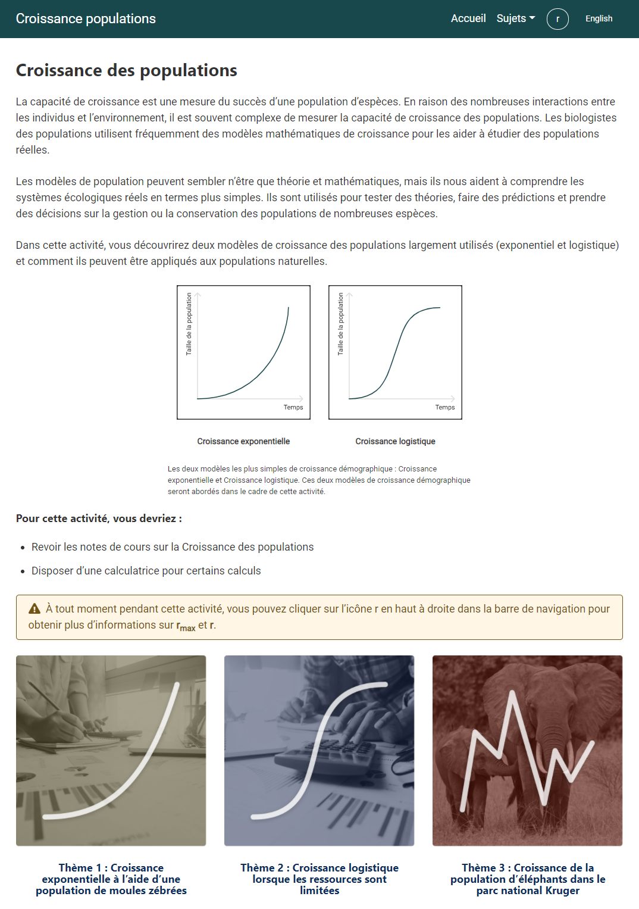
Examples of bilingual uOttawa OER
Croissance des populations
https://ecosystem-project.com/fr/
Ecology: Population Growth
https://ecosystem-project.com/
Notes:
[MICHELLE]

Slide 33
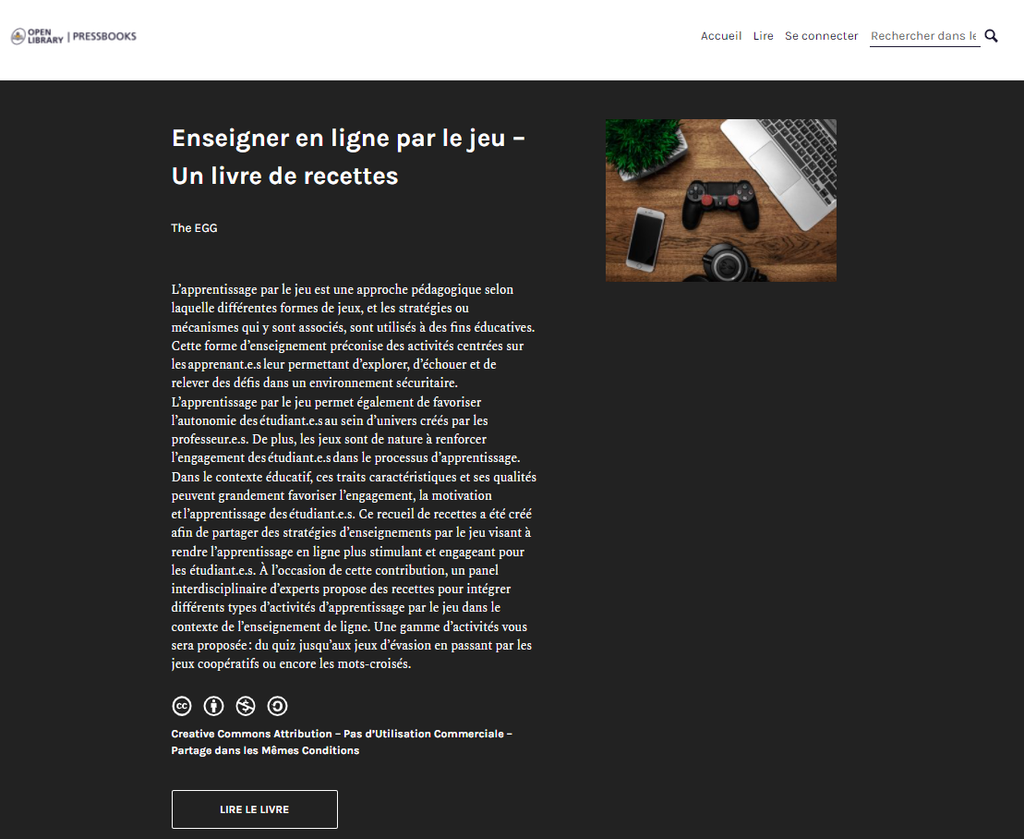
Examples of bilingual uOttawa OER
Enseigner en ligne par le jeu - un livre de recettes
https://ecampusontario.pressbooks.pub/apprentissageparlejeu/
Using Game-Based Learning Online - Cookbook of Recipes
https://ecampusontario.pressbooks.pub/gamebasedlearning/
Notes:
[MICHELLE]

Slide 34

Examples of bilingual uOttawa OER
La chimie générale pour les Gee-Gees
https://ecampusontario.pressbooks.pub/genchempourlesgeegees/
General Chemistry for Gee-Gees
https://ecampusontario.pressbooks.pub/genchemforgeegees/
Notes:
[MICHELLE]

Slide 35
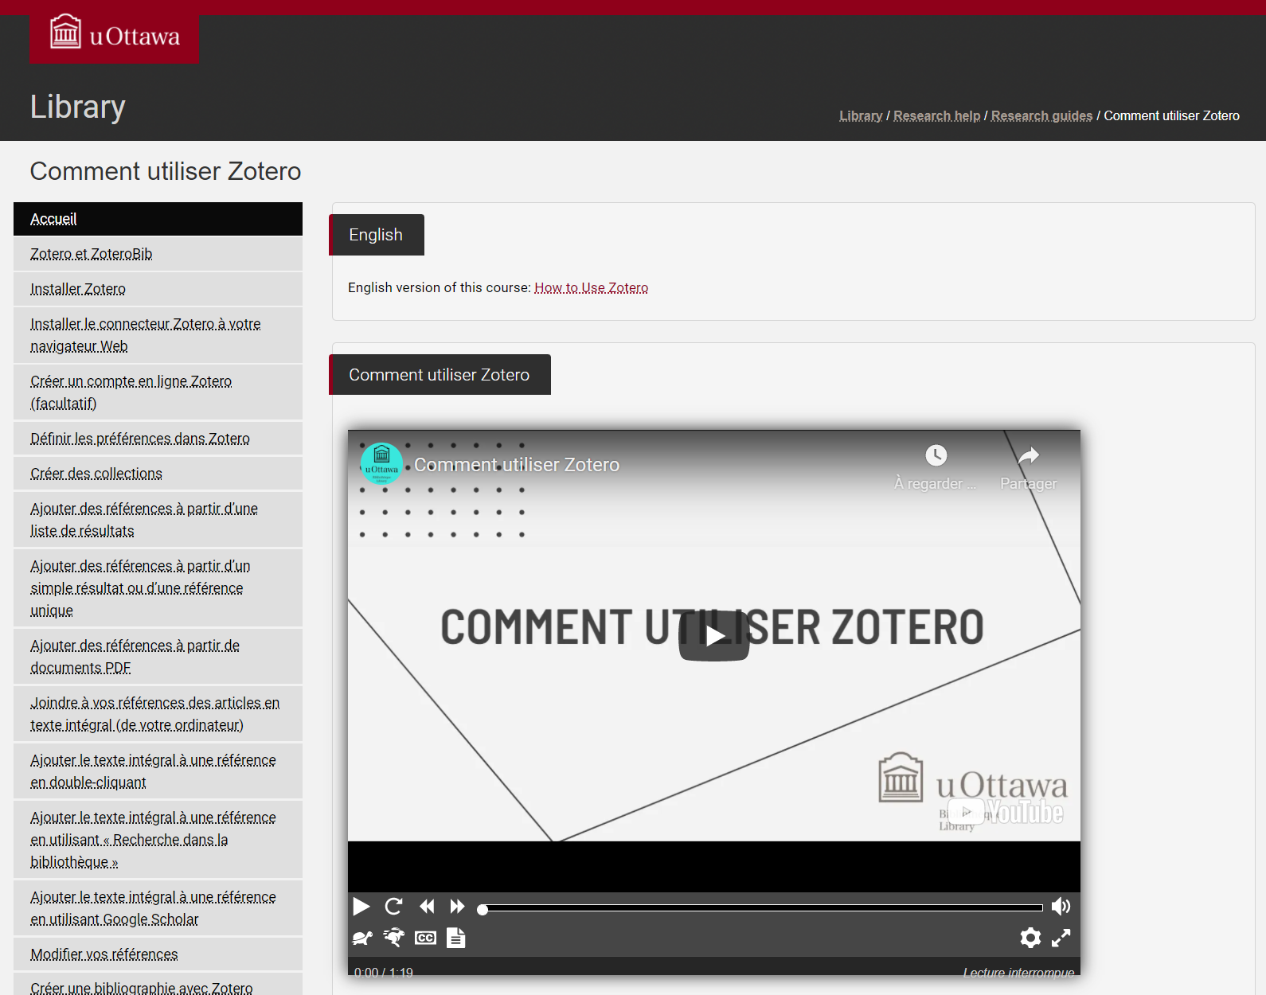
Examples of bilingual uOttawa OER
Comment utiliser Zotero
https://uottawa.libguides.com/c.php?g=710437&p=5061952
How to Use Zotero
https://uottawa.libguides.com/how_to_use_zotero

Slide 36
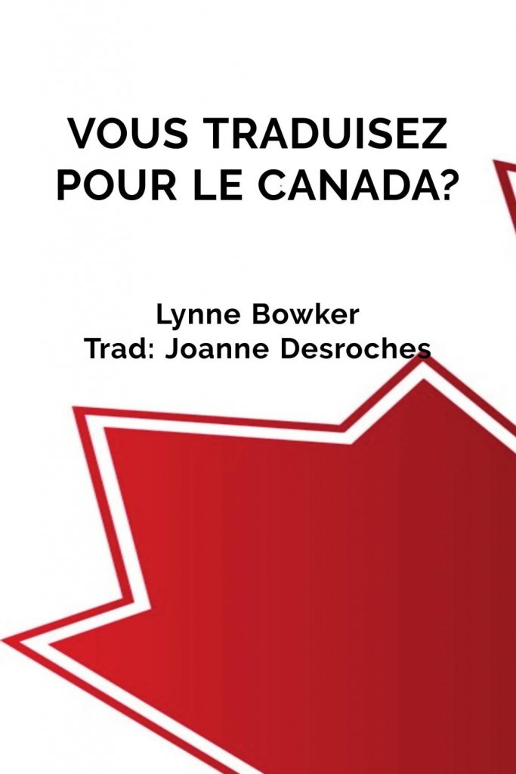
Examples of bilingual uOttawa OER
Vous traduisez pour le Canada?
https://ecampusontario.pressbooks.pub/voustraduisezpourlecanada/
Translating for Canada, eh?
https://ecampusontario.pressbooks.pub/translatingforcanada/
Notes:
[MICHELLE]

Slide 37
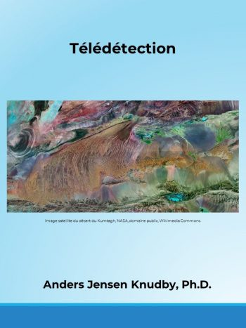
Examples of bilingual uOttawa OER
Télédétection
https://ecampusontario.pressbooks.pub/teledetection/
Remote Sensing
https://ecampusontario.pressbooks.pub/remotesensing/
Notes:
[MICHELLE]

Slide 38
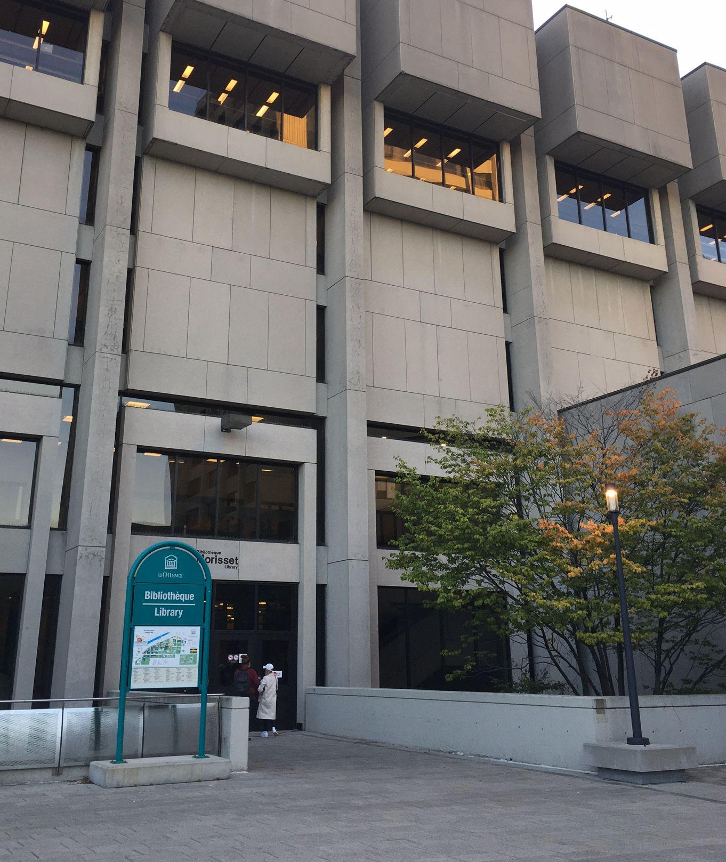
Thank you!
Questions?
melanie.brunet@uottawa.ca
@MelanieBrunet
michelle.brown@uottawa.ca @LibraryGurrl
Geometric Corporate template by Jimena Catalina for SlidesCarnival, CC BY 4.0
This presentation is based on the following:
Brunet, M. et Godon, D. (2021). Établir un environnement favorable aux REL dans une université canadienne bilingue. OE Global 2021 Online Conference. CC BY 4.0. http://hdl.handle.net/10393/42754
Brunet, M. & Brown, M. (2021). Challenges and Opportunities of OER at a Bilingual Canadian University. Open Education Conference 2021, CC BY 4.0. http://hdl.handle.net/10393/42821
Morisset Library by Mélanie Brunet, CC BY 4.0
Notes:
[MICHELLE]

Slide 39
Discussion Prompts
Why are there so few OER in French and languages other than English?
What are your thoughts and experiences about equity gaps in OER?
What are your thoughts or experiences with translation and localization when adapting existing OER?
Notes:
[MELANIE]

