Slide 1

Textbook Costs and Affordable Alternatives at the University of Ottawa
Mélanie Brunet, Ph.D.
Copyright Services Librarian
University of Ottawa Library
Unless otherwise specified, the content of this presentation is made available under a Creative Commons Attribution-ShareAlike 4.0 International licence.

Slide 2
1.
TEXTBOOK COSTS
uOttawa and the larger context

Slide 3




Commercial Textbook Trends
Textbook costs since 2000 + tariff on imported books
146%
Mergers and concentration
Digital textbooks, access codes, « value added » features
N.S. Baron, “Textbook merger could create more problems than just higher prices,” The Conversation (September 19, 2019), https://theconversation.com/textbook-merger-could-create-more-problems-than-just-higher-prices-123120 and R. Jhangiani & S. Jhangiani, “Investigating the Perceptions , Use, and Impact of Open Textbooks: A survey of Post-Secondary Students in British Columbia,” International Review of Research in Open and Distributed Learning 18.4 (June 2017), http://www.irrodl.org/index.php/irrodl/article/view/3012/4214.
Notes:
Increase in textbook costs greatly outpaced general inflation over the same period; print textbooks from US and overseas also have at 10 to 15% tariff under the Book Importation Regulations (doesn’t apply to ebooks)
Mergers - Cengage and McGraw-Hill recently announced merger, both to focus on digital options, rentals and inclusive access (not selling directly to individuals); Less pressure to keep prices low; Main education publishers in English Canada (most often subsidiaries of American or British companies): McGraw Hill, Nelson, Pearson, OUP
Education publishers moving away from print textbooks (reducing used textbook market) to favor digital textbooks with “value added” features (assessments, image banks and slides for instructors, tutors, etc.), often through an access code and for a limited time (may be less expensive up front, but comes with costs, i.e. access to materials for limited time, need for stable and reliable access to internet and device, cannot be resold…
… versions that cannot be purchased by libraries – are meant to be purchased by individuals)

Slide 4
University of Guelph Student Textbook Survey
(Fall 2016 – 4,240 responses from undergraduates)
72 %
spent less than $500 for their textbooks
but…
57 %
chose not to purchase at least one textbook
H. Martin, « Students, textbooks, and the inevitability of open », OER Panel – ABC Copyright Conference (June 29, 2017), http://hdl.handle.net/1974/15953 and Accessible Course Content and Open Educational Resources Task Force, University of Guelph Student Textbook Survey (October 18, 2017), https://www.lib.uoguelph.ca/sites/default/files/uofg_student_textbooksurvey_report.pdf.
Notes:
Survey conducted by the University of Guelph Library with undergraduate students, 4,240 responses (21%), fall 2016
Numbers comparable to a survey conducted in 2015 with post-secondary students in BC (see Jhangiani and Jhangiani): http://www.irrodl.org/index.php/irrodl/article/view/3012/4214

Slide 5
University of Guelph Student Textbook Survey
What are students doing if they are not purchasing the textbook?
27 %
Use a copy from the Library
17 %
Use a friend’s copy
22 %
Download a copy
6 %
Other strategy
28 %
Don’t use the textbook at all
H. Martin, « Students, textbooks, and the inevitability of open », OER Panel – ABC Copyright Conference (June 29, 2017), http://hdl.handle.net/1974/15953 and Accessible Course Content and Open Educational Resources Task Force, University of Guelph Student Textbook Survey (October 18, 2017), https://www.lib.uoguelph.ca/sites/default/files/uofg_student_textbooksurvey_report.pdf.
Notes:
Download a copy – probably not legally
Other strategy, including using an older edition even if the pages don’t match, visiting public library, googling information, purchasing copy from Amazon (making notes and then returning for refund), combination of options.
Comments showed that alternative options were less than satisfactory – students would have preferred to own a copy of the required textbook

Slide 6
University of Guelph Student Textbook Survey
Downside of not purchasing the textbook
“It’s a sacrifice of around 15% off my final grade but sometimes it’s worth it.”
Accessible Course Content and Open Educational Resources Task Force, University of Guelph Student Textbook Survey (October 18, 2017), https://www.lib.uoguelph.ca/sites/default/files/uofg_student_textbooksurvey_report.pdf.

Slide 7
University of Guelph Student Textbook Survey
Downside of not purchasing the textbook
“If you can’t afford to buy a textbook you have less opportunity to learn than your classmates. Your grade could be lower solely because you are not from the same socioeconomic background.”
Accessible Course Content and Open Educational Resources Task Force, University of Guelph Student Textbook Survey (October 18, 2017), https://www.lib.uoguelph.ca/sites/default/files/uofg_student_textbooksurvey_report.pdf.

Slide 8
University of Guelph Student Textbook Survey
Downside of not purchasing the textbook
“I’m facing a trade-off between getting good enough grades to impress the people who control my future and being able to meet my basic needs such as food. I have to choose food.”
Accessible Course Content and Open Educational Resources Task Force, University of Guelph Student Textbook Survey (October 18, 2017), https://www.lib.uoguelph.ca/sites/default/files/uofg_student_textbooksurvey_report.pdf.
Notes:
This is something that the Library has heard through student comments during our #textbookbroke campaigns.

Slide 9






Format vs Cost
R.S. Jhangiani, F.N. Dastur, R. Le Grand & K. Penner, « As Good or Better than Commercial Textbooks: Students’ Perceptions and Outcomes from Using Open Digital and Open Print Textbooks, » Canadian Journal for the Scholarship of Teaching and Learning 9.1 (April 2018), https://doi.org/10.5206/cjsotl-rcacea.2018.1.5.
Notes:
Studies have shown that when students are given a choice between a print and a digital textbook, they prefer the print if they can have their own copy. They want to take notes or highlight texts. But to cut on costs, they will compromise and chose digital (which does come with the advantage of being accessible anywhere anytime if one has a device and a good internet connection, and book is downloadable for later

Slide 10

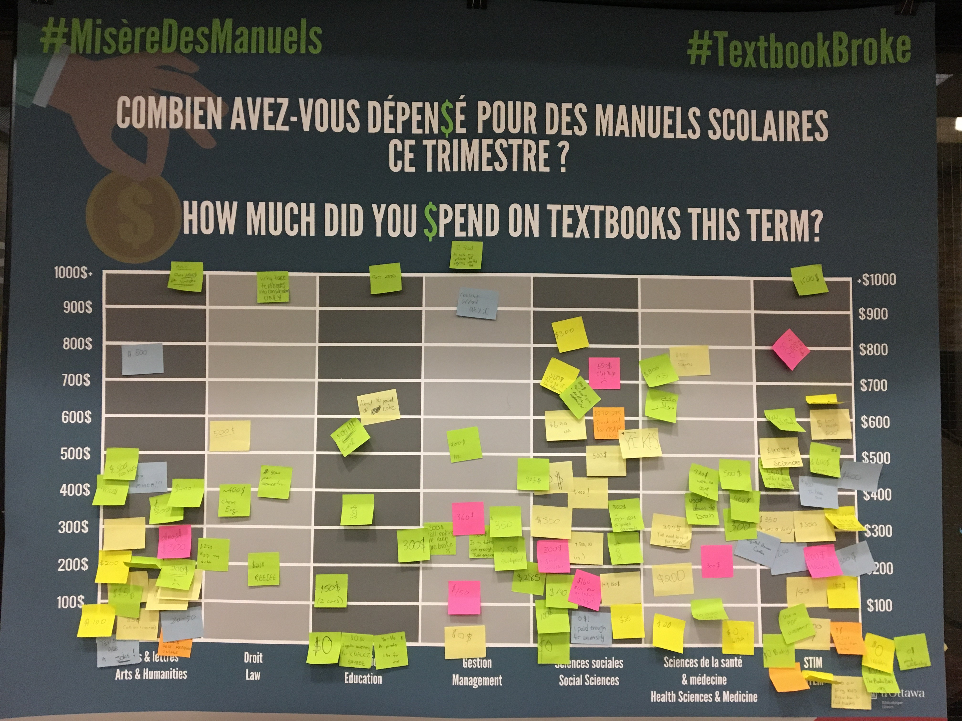
uOttawa #TextbookBroke
uOttawa Library, Twitter (January 22, 2020), https://twitter.com/uOttawaBiblio/status/1219993123671232514
Morisset Library, January 2019
Notes:
Textbook reported spending and costs at uOttawa…
#textbookbroke campaigns started in the US as early as 2014 – tweeting receipts, saying what they would have spent it on otherwise, poster like ours; in an effort to call attention to costs and impact on students; in Canada, the Ontario Undergraduate Student Alliance (OUSA) has been active in this regard (and promoting open educational resources as an alternative); libraries and student unions across country have been conducting their own campaigns.
Methodology:
3rd week of January and September
Poster in five library locations
Organized by broad subject areas/faculties:
Arts & humanities
Law
Education
Management
Social sciences
Health Sciences & Medicine
STEM
Focus: what students say they spend on course materials (amounts plus comments)
Results for 5 terms – Winter 2018 to Winter 2020

Slide 11
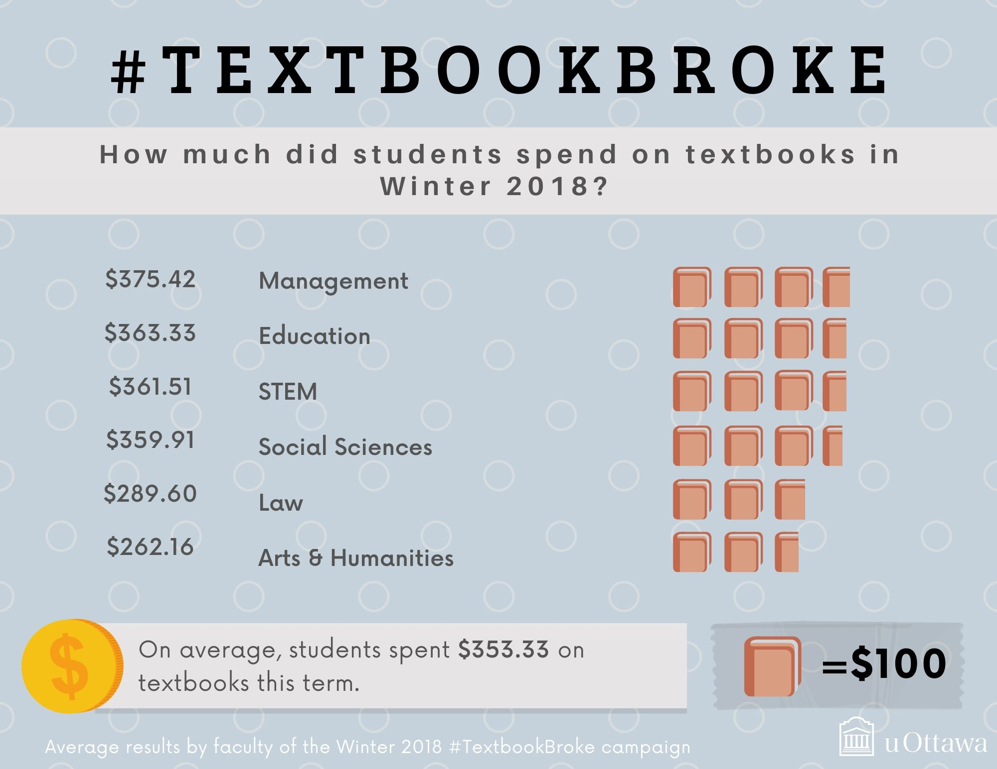
Winter 2018
Alicia Yoshino, Copyright Office, University of Ottawa
Notes:
First campaign in Winter 2018:
Average of $353.33, with Management in the lead with $375.42

Slide 12
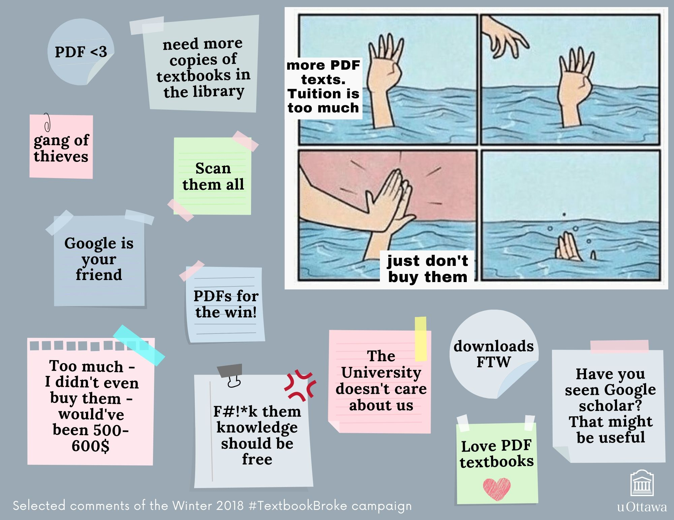
Winter 2018
Alicia Yoshino, Copyright Office, University of Ottawa

Slide 13
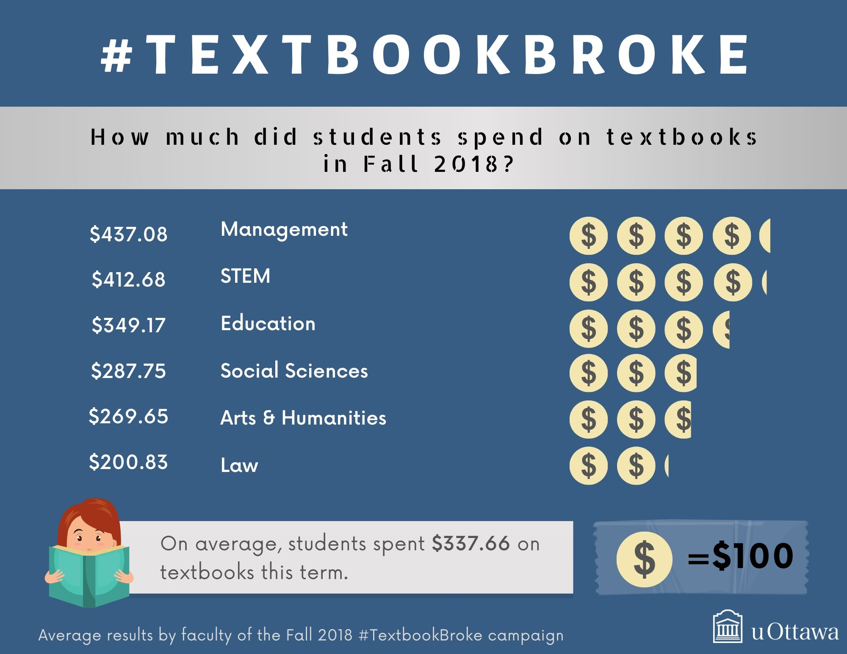
Fall
2018
Alicia Yoshino, Copyright Office, University of Ottawa
Notes:
Second campaign in Fall 2018:
Average of $337.66, with Management again in the lead with $437.08

Slide 14
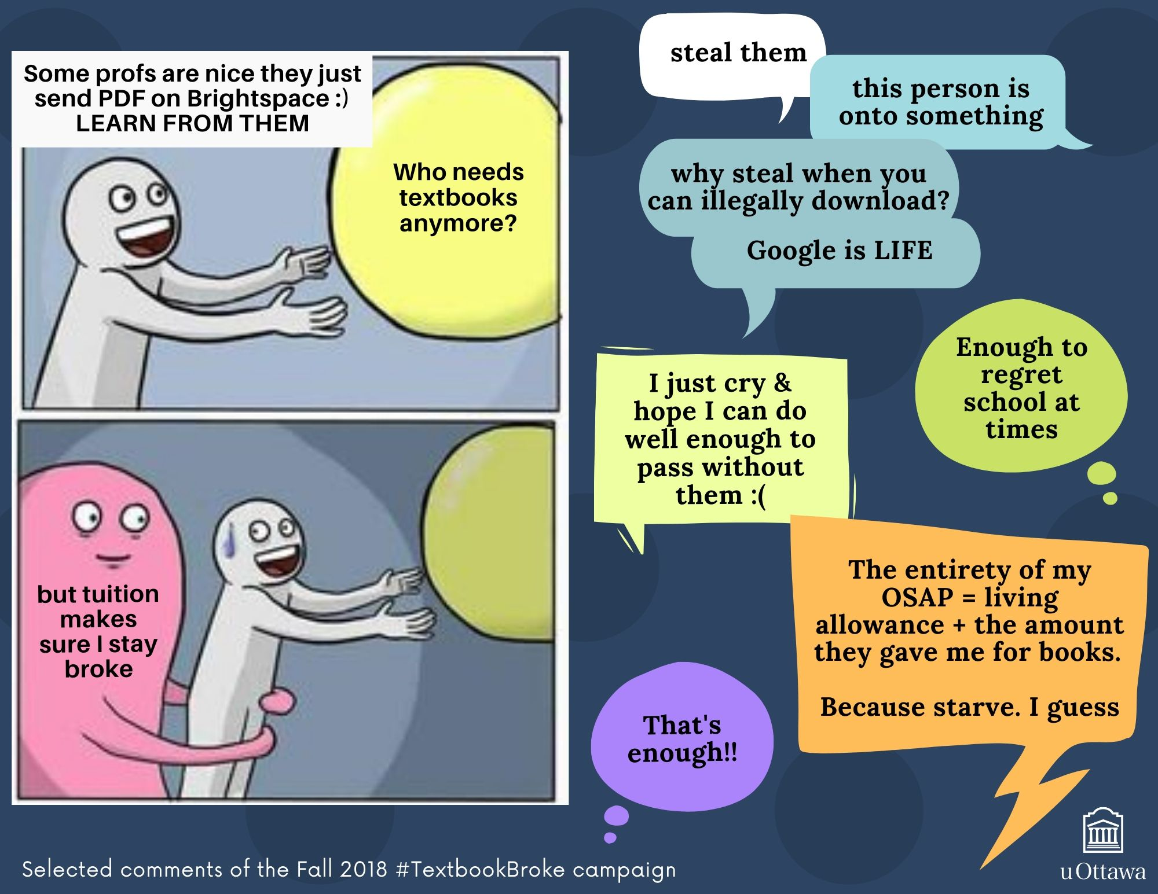
Fall
2018
Alicia Yoshino, Copyright Office, University of Ottawa

Slide 15
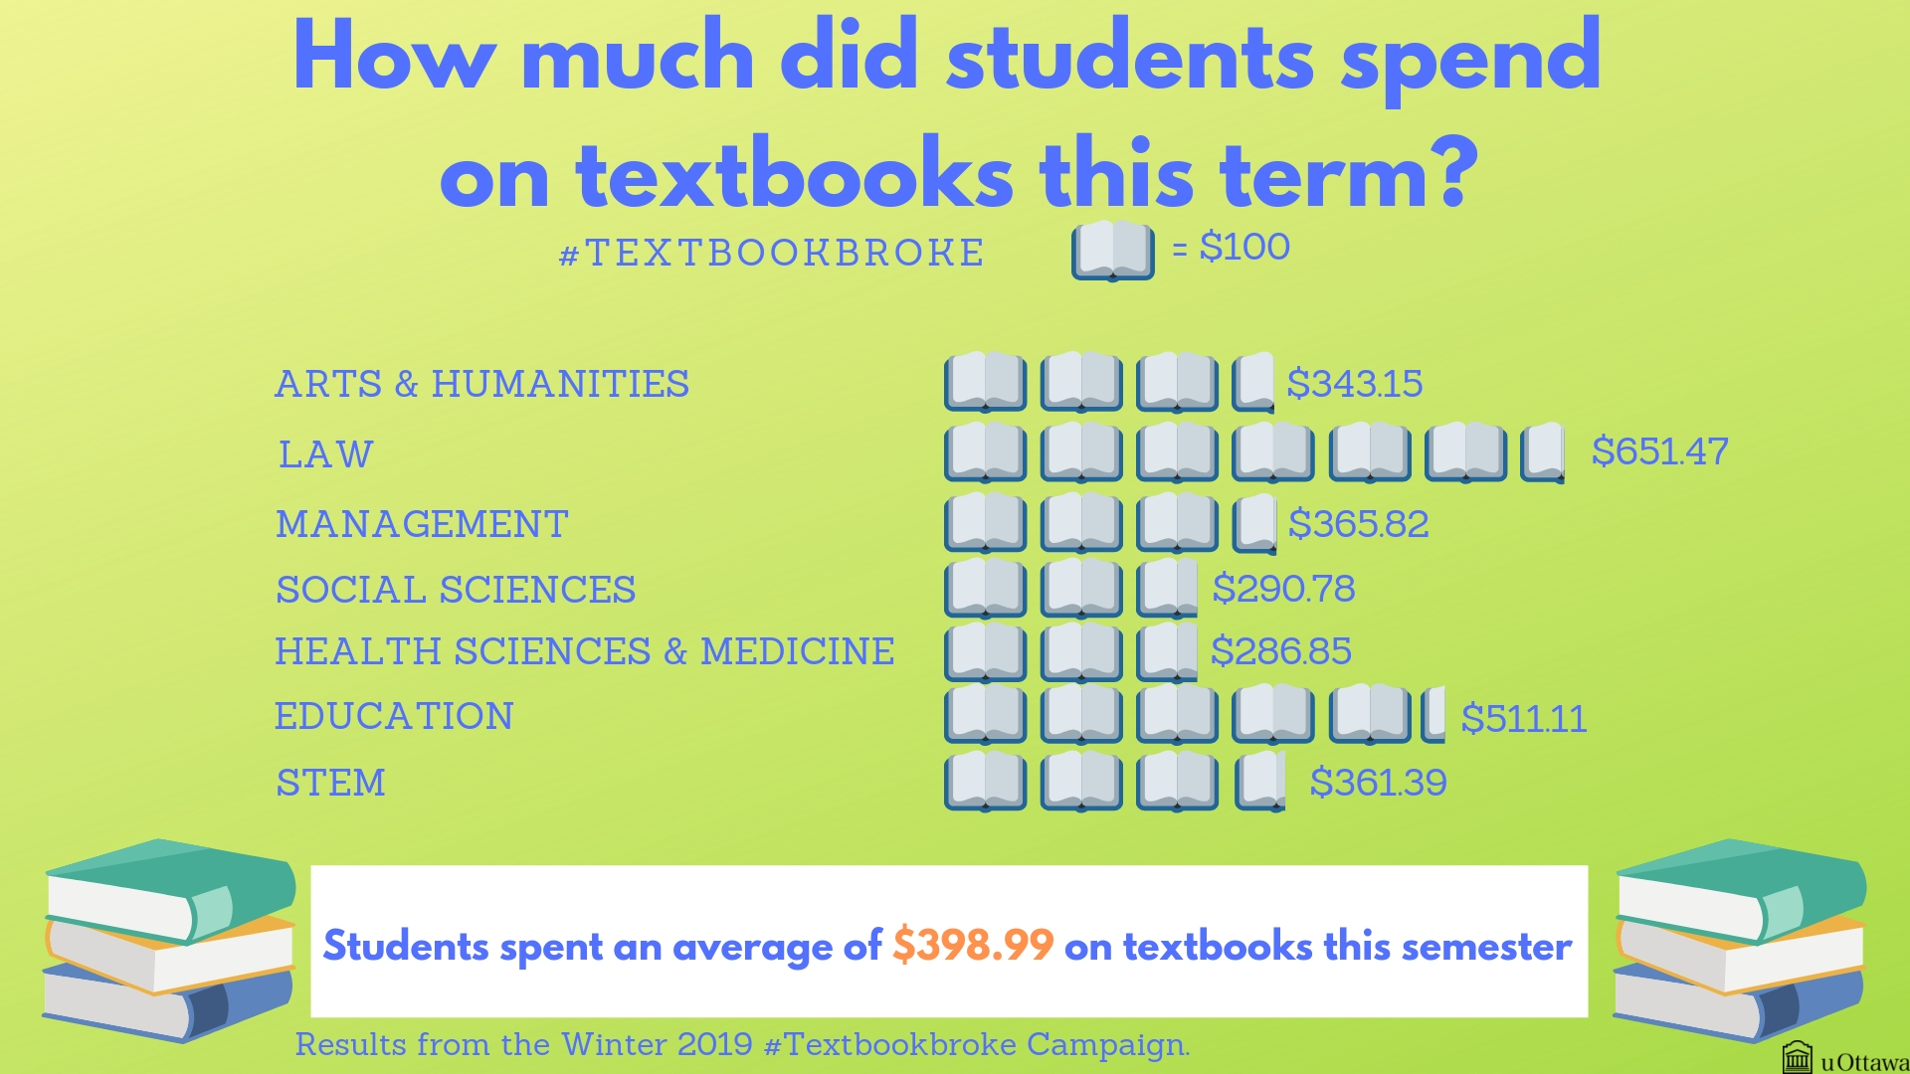
Winter 2019
Émilie Gendron, Copyright Office, University of Ottawa
Notes:
Third campaign Winter 2019
Average of $398.99, with Law leading at $651.47

Slide 16
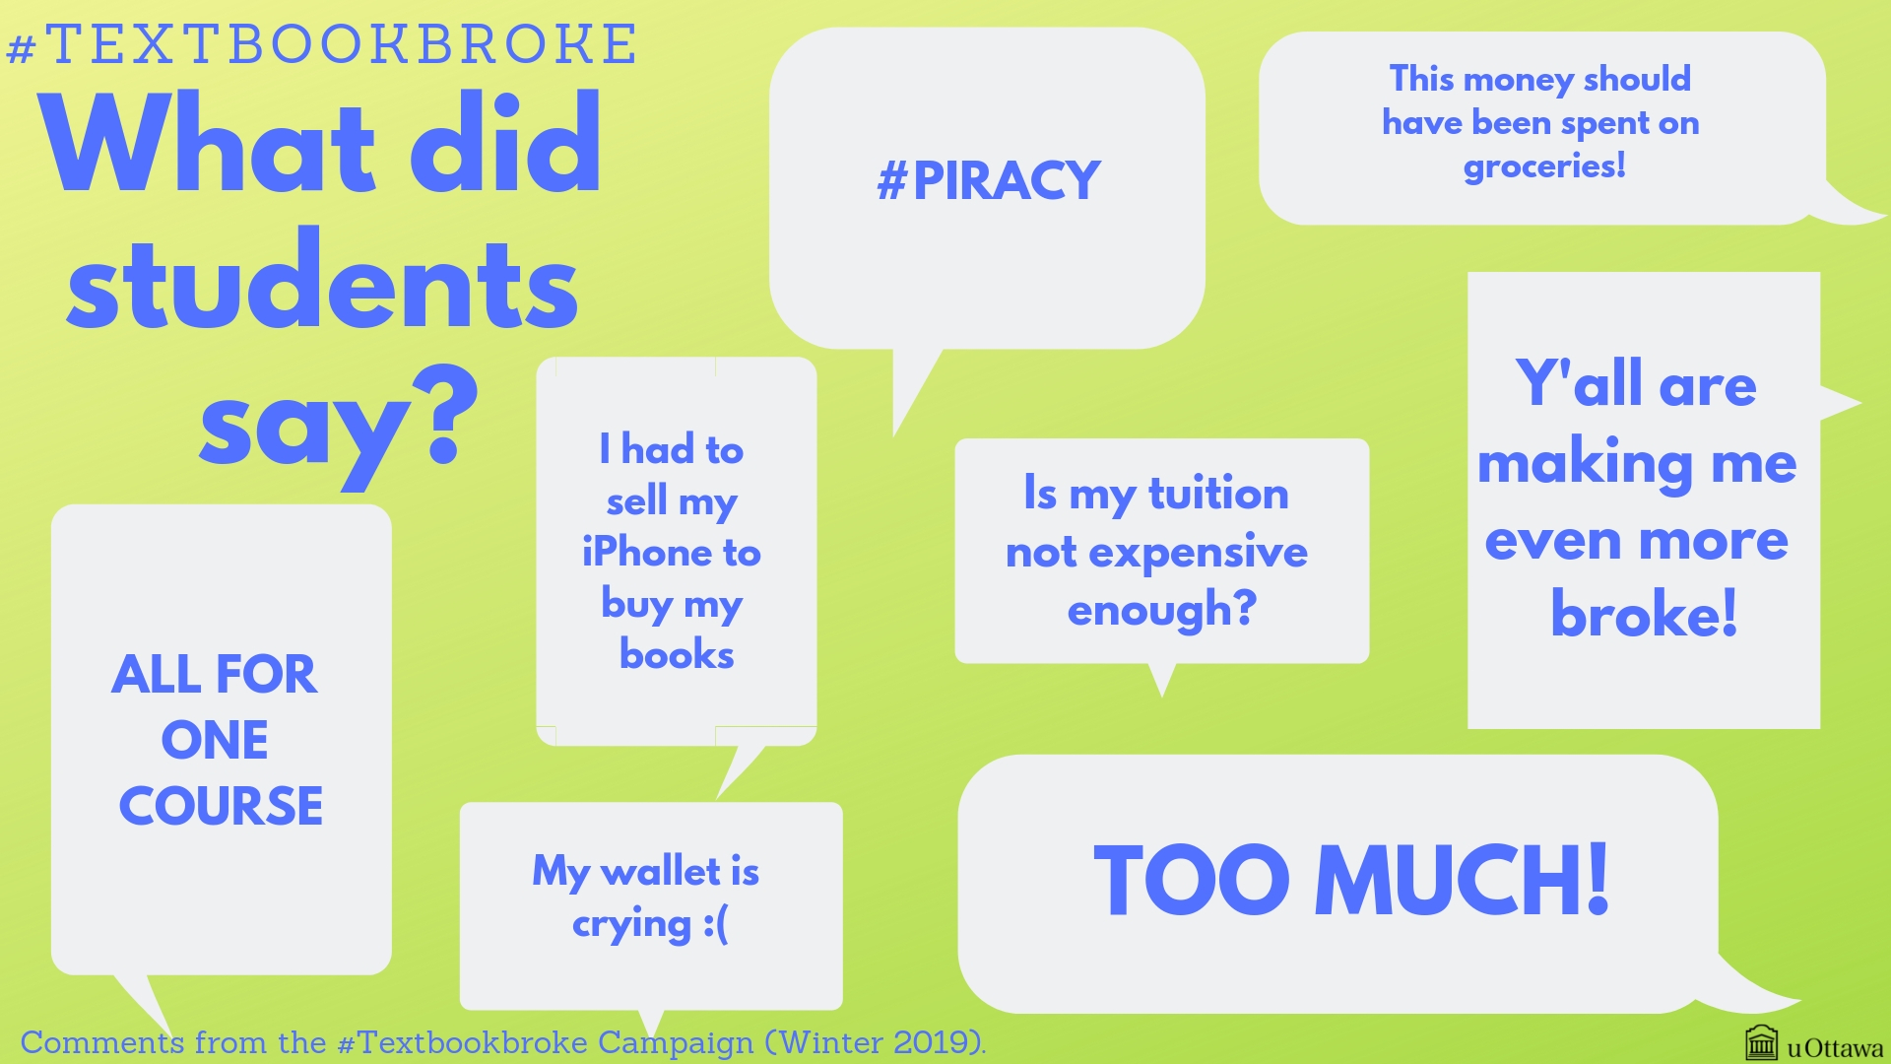
Winter 2019
Émilie Gendron, Copyright Office, University of Ottawa

Slide 17
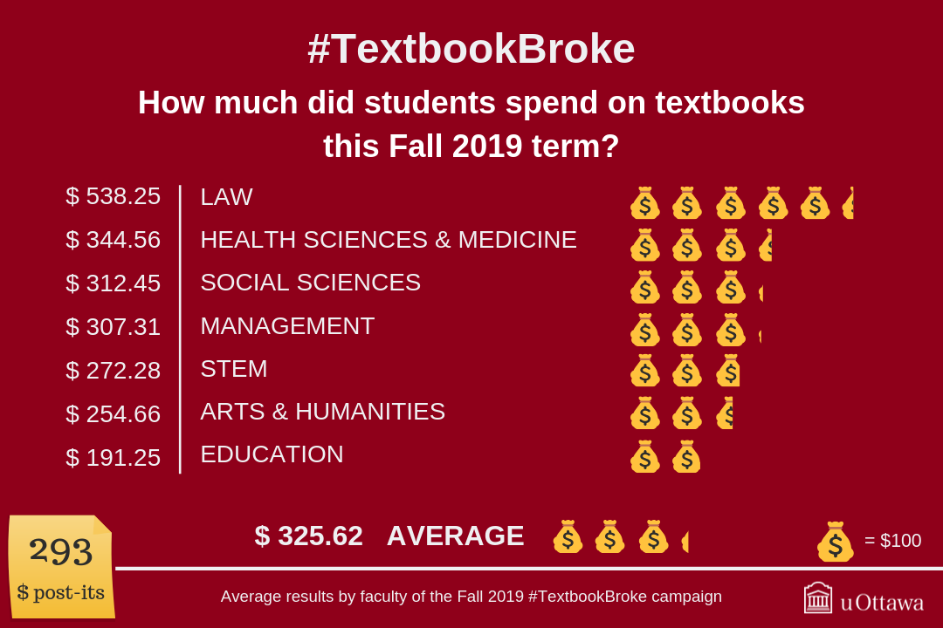
Fall
2019
Barotsz Chmura, Copyright Office, University of Ottawa
Notes:
Fourth campaign last fall:
Average of $325.62, with Law in the lead again at $539.25

Slide 18
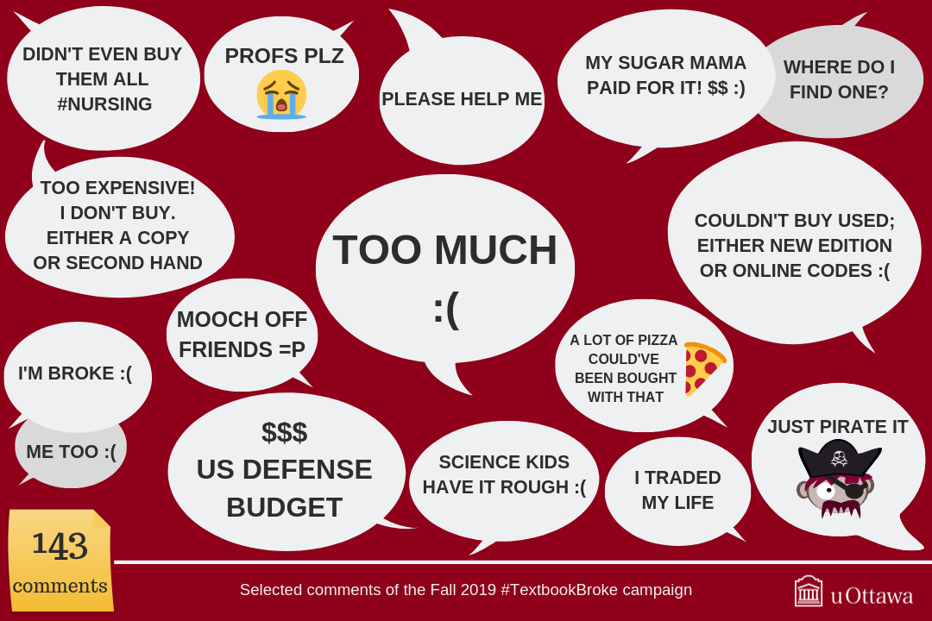
Fall
2019
Barotsz Chmura, Copyright Office, University of Ottawa

Slide 19
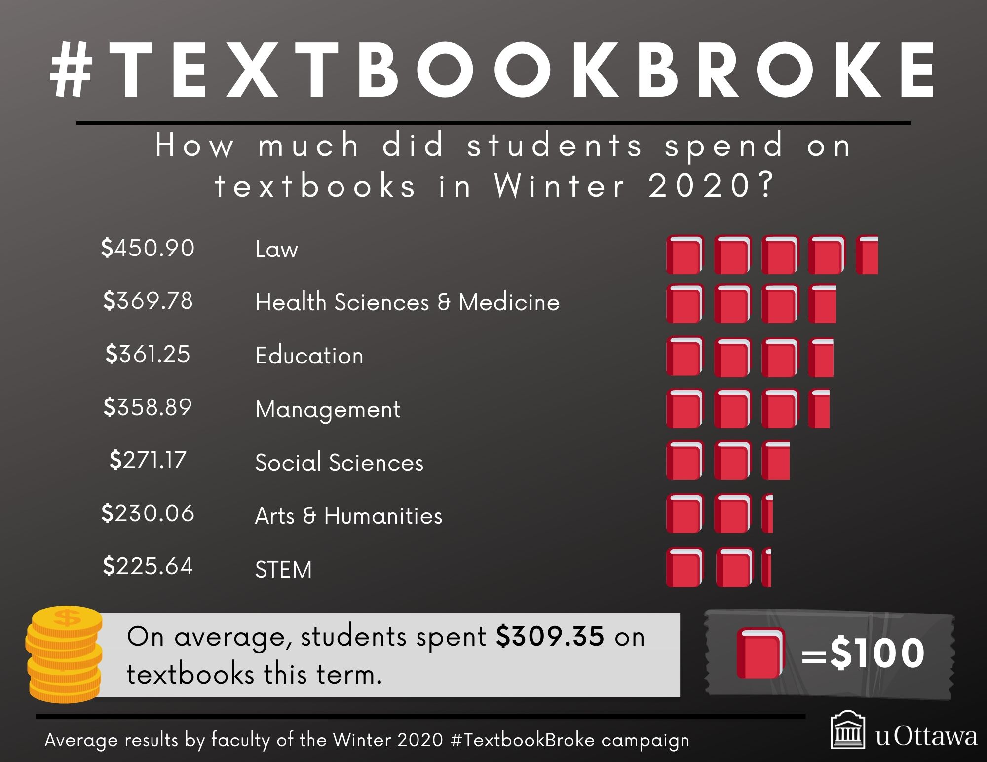
Winter 2020
Alicia Yoshino, Copyright Office, University of Ottawa
Notes:
Fifth and most recent campaign this January
Average of $309.35, again with Law in the lead at $450.90

Slide 20
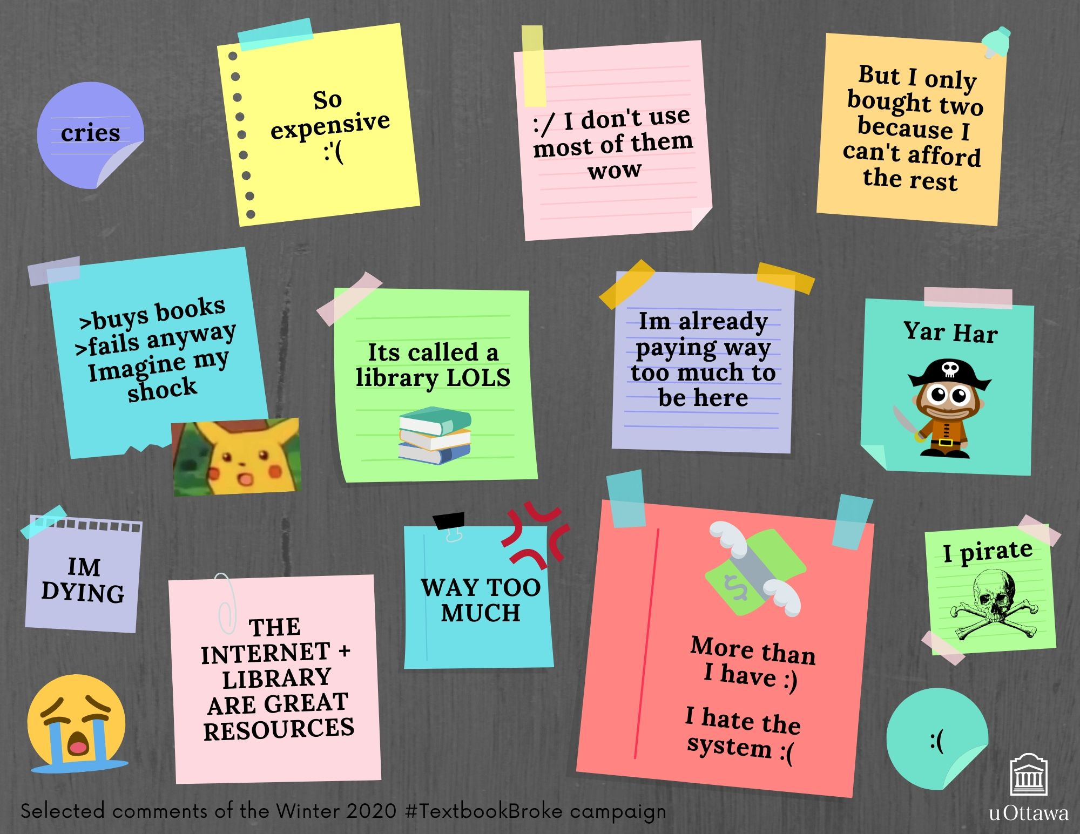
Winter 2020
Alicia Yoshino, Copyright Office, University of Ottawa

Slide 21
Notes:
Throughout those 5 terms, average reported spending has remained between $300 and $400 per term.
Law has been consistently high over the last three terms (since we’ve had a poster at the Law Library) – between $450 and $650
There’s a general decrease, but too early to say why or if it’s a continuing trend – are prices lower or are more students and professors resorting to alternatives?

Slide 22
Notes:
Reported spending for the current academic year 2019-2020:
Overall average: $634.97
Arts and Humanities: $484.72
Law $989.15 *
Education:$552.50
Management: $666.20
Social Sciences: $583.62
STEM: $497.92
Health Sciences and Medicine: $714.34

Slide 23
Notes:
During those five terms, consistently 11-12% of participants report spending $0 on course materials – through some legal means, but also through some illegal ones… Fall 2019, close to 10% of the responses referred to piracy and illegal downloads

Slide 24
uOttawa Textbook Cost Data
2018-2019 and 2019-2020
Highest enrolment undergraduate programs in each faculty
English and French
First-year course sequence
Required materials only
Campus Store
Agora (2018-2019)
docUcentre
Rytec
Librarie du Soleil
Service du livre (droit civil)
Common Law Student Society Bookstore (2018-2019)
Notes:
Collected textbook costs to determine how much students were expected to spend (vs how much they reported spending)

Slide 25
Notes:
Expected spending at its highest – most expensive option – if students didn’t shop around, could have their own copies and didn’t compromise on format

Slide 26
Notes:
Expected spending at its highest – most expensive option – if students didn’t shop around, could have their own copies and didn’t compromise on format
In both years, the JD common law program is the post expensive at a total of over $2,000 in expected spending if students were to purchase all the required course materials at the highest cost (no compromise of format).
Caution: in both years, it looks like it’s generally more expensive to study in English than in French, but that would be an oversimplification: the education textbook market is much smaller in French, new editions don’t come out as frequently (ex. Campbell’s Biology updated every 2 years in English but every 4 years in French), possible professors in French courses are turning to other options like course packs/course reserve/Brightspace to bring together parts of various resources instead of assigning a textbook that may not exist.

Slide 27
Campus Store vs Agora, 2018-2019
Average: 9.8% Median: 12.0%
 | Campus Store | Agora | Difference
Writing by Choice (ENG1100) | $96.00 | $84.55 | 11.9%
Elements of Sociology (SOC1101) | $101.50 | $89.25 | 12.1%
Engineering Problem Solving with C (GNG1106) | $214.75 | $189.13 | 11.9%
Canadian Business and Society (ADM1301) | $135.75 | $118.86 | 12.4%
Selected examples of textbooks, same format and same condition, at each store
Notes:
The only year we were able to gather textbook cost data for both bookstores (Campus Store and Agora Bookstore, which is now closed), it was found that for materials that were available in the same format and the same condition at both stores, the prices at Agora were usually lower. Here are four examples.
Note: Campus Store usually had more options for used copies or digital format
Average and median based on 107 titles

Slide 28
Differences by Section
ENG1100 – Workshop in Essay Writing (Fall 2019)
44 sections
32 sections
5 sections
4 sections
1 section
None assigned
Writing by Choice (3rd ed.) (OUP) $101.50
Norton Field Guide to Writing with Readings & Handbook (5th ed.) (Norton) $124.75
Checkmate: A Writing Reference for Canadians (3rd ed.) (Nelson) $84.25
+
Landmarks: A Process Reader for Canadian Writers (2nd ed.) (Pearson) $129.25
1 section
1 section
Checkmate: A Writing Reference for Canadians (3rd ed.) (Nelson) $84.25
Broadview Pocket Guide to Writing (4th ed.) (Broadview) $21.50
As listed on Campus Store website (September 2019)
Notes:
According to textbooks listed on Campus Store website – all new, paperback – possible that there were some docUcentre course packs assigned as well (still waiting on data for Fall 2019)
Each instructor can assign what they want, but for students selecting a section, the need to spend more is random.

Slide 29



Impact of Textbook Costs
Compromising
on format
Illegal downloads/
copies
Stress
Notes:
Using a format that is not preferred or even best to study in order to save; disadvantaging students with disabilities or students who learn better with print
Piracy, illegal dowloading, lesser quality versions
Stress – finances (food, rent, going home)/pressure of succeeding without textbook/organizing schedule around library hours for reserve copies/investing time to find alternatives, etc. – taking fewer courses, not register for a course, withdraw from a course.

Slide 30
2.
AFFORDABLE ALTERNATIVES
at uOttawa
Notes:
Students are resourceful, but what about legal alternatives

Slide 31
Promote and reward the development of affordable learning materials
Develop Open Educational Resources (OERs) in French
Transformation 2030 – More Agile – Objective 3 – Actions
https://transformation2030.uottawa.ca/en/agile
Transformation 2030 – More Connected – Objective 2 – Actions
https://transformation2030.uottawa.ca/web/connected
Notes:
There is a commitment on the part of the University to address the cost of textbooks – most recent strategic plan

Slide 32


Course Packs (print)
docUcentre
Fair dealing
Licences (library agreements with providers)
Permission from copyright owner
Median cost (Winter 2019)
Rytec
Access Copyright Licence
Median cost (Winter 2020)
$23.96
$45.50
Notes:
Course packs have often been presented as a less expensive alternatives to textbooks that allows for customization of the content.
Prices including GST (5%) in both cases.
Reproduction costs (paper, ink, labour)
Much of it is what is available at no extra cost at the library… print so students will read it… but depending on the course, 20 to 40 % of registred students do not purchase the course pack from the docUcentre – based on observations from Copyright Office (we process all course packs for copyright compliance)
Not known if that’s also the case at Rytec.

Slide 33

Course Reserve (Ares) - Library
Reading lists available in Ares or Virtual Campus
Syllabus
Leverages Library collections
Electronic and print
Open Access content
Public domain
Fair dealing
Library licences
Permissions
For more information: https://biblio.uottawa.ca/en/find/course-reserve

Slide 34
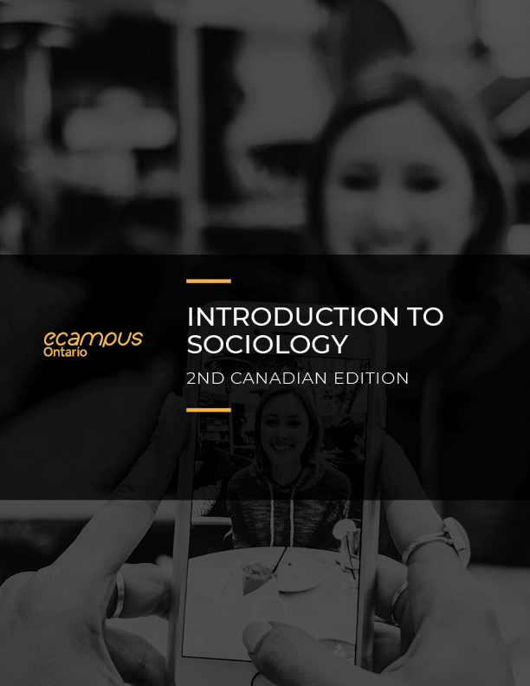
Open Educational Resources (OER)
Freely and openly available teaching and learning materials
Creatives Commons licence or public domain
5Rs – Retain, Reuse, Revise, Remix, Redistribute
More information: “Open Educational Resources,” Scholarly Communication, University of Ottawa Library, https://scholarlycommunication.uottawa.ca/open-educational-resources
W. Little (2016), Introduction to Sociology
(2nd Canadian Edition), https://ecampusontario.pressbooks.pub/introsoc2ed/, CC BY 4.0
Notes:
What are they?

Slide 35
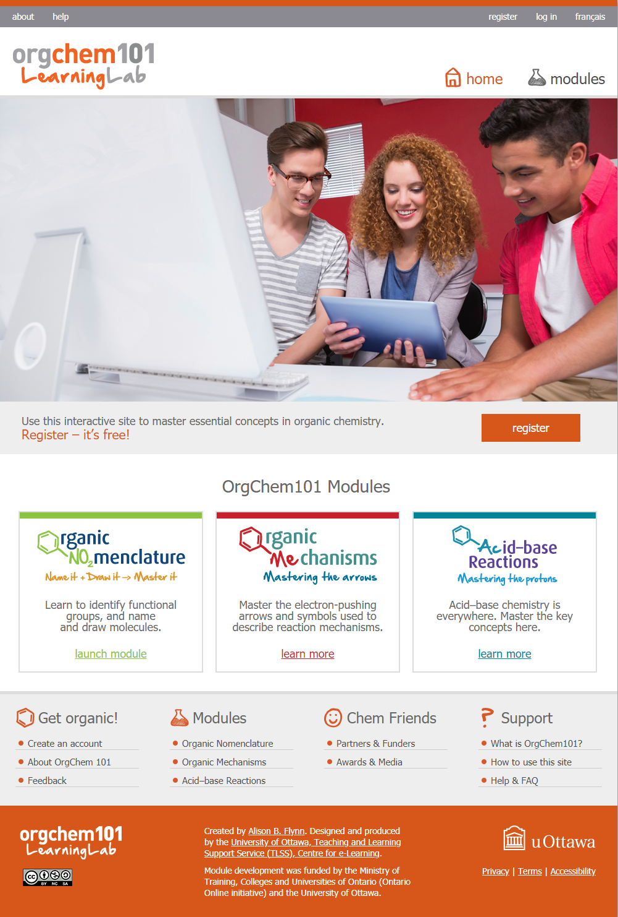
Open Educational Resources (OER)
Affordable for students
Customizable and adaptable
Fit multiple learning styles
Success and completion
Continued access
A.B. Flynn, OrgChem101, https://orgchem101.com/, CC BY-NC-SA 4.0
Notes:
Why?
Affordable for students, making education more accessible
Customizable and adaptable, providing richer teaching and learning opportunity
Benefit multiple learning styles by incorporating various content formats (text, audio, video or multimedia) and interactive elements
OER contribute to student success and completion – compared to commercial textbook, students perform same or better in exams that use an open textbook
Can keep accessing it after the course is over, part of lifelong learning

Slide 36
3.
ADVOCACY
What can we do?
Notes:
We all have a role to play in making education more affordable

Slide 37

OER Funding at uOttawa
Library OER Grant
TLSS Learning Grants Program
To consider:
Creation of OER Fund (donation)?
Student-initiated levy?
Union deduction?
Notes:
If OER are free to the user, takes time and money from somewhere to adapt or create and OER. Cost of creating an OER vary a lot depending if author is doing all of the work as part of their regular job (but common expense is research, review, translation, videography, graphic design etc.) $5,000 to over $80,000 for a high quality open textbook.
What exists already at uOttawa to fund these kinds of projects
Other options to consider to fund more grants
These OER would have an Impact beyond this university

Slide 38

Professors
Library course reserve service – leveraging collections
Consider cost (and use) of assigned materials
Recognition for tenure/promotion
Funding and course releases
Notes:
Practical level:
Using the Library’s course reserve service (electronic and print) – leverage Library collections at no extra cost to students
Cost of what is assigned and how much will it be used?
Policy level:
Recognition of OER use, adaptation, creation for tenure and promotion
Funding and course releases

Slide 39
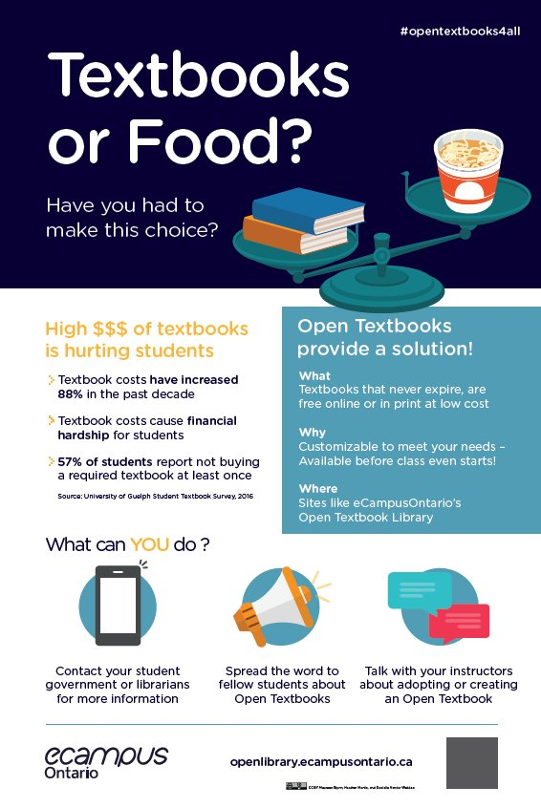
Students
Course evaluations
#Textbookbroke
Open Education Week
Create open content
Maureen Glynn, Heather Martin and Danielle Vander Wekken, CC BY 2.0
Notes:
Use course evaluations as opportunity to tell instructors that you appreciate it when they kept the costs low by using the course reserve service, putting links to readings in Virtual Campus, use open content but also pointing out what is not working and suggest alternatives
Take part in the Library’s #textbookbroke campaign or in a larger province-wide initiative through OUSA
Take part in Open Education Week events – get informed
Create open content yourself but putting it under a Creative Commons licence

Slide 40

Library
Open and Affordable Learning Materials Working Group
#textbookbroke and textbook costs
Course reserve service
Library OER Grant
Create open content
Support OER discovery
Notes:
What is the Library doing and what can it do better?
Library plays an important role in newly created OALM WG – campus-wide intiative with three librarian members on it
Conducting #textbookbroke campaigns and textbook cost data collection to track stories and trends
Course reserve service (electronic and print) since Fall 2019 that leverages the collections so you don’t have to pay again
Library OER grant (recipients to be announced March 6) – first time but hopefully not the last
Lead by example by creating open content
Support OER discovery – helping faculty, by adding OER to repositories and own catalogue, promoting uOttawa OER elsewhere

Slide 41
Acknowledgements
Bartosz Chmura
Emily Da Silva
Émilie Gendron
Jennifer Gratton
Vanessa Kraus
Myriam Lebel
Allison Smith
Alicia Yoshino

Slide 42
Thank you!
Questions or comments?
@MelanieBrunet
melanie.brunet@uottawa.ca

Slide 43
Credits (if not indicated on slides)
“Antonio” presentation template by SlidesCarnival, CC BY 4.0
Icons from Noun Project, royalty-free NounPro for Education licence

