Slide 1

Heather Morrison
Open Access Week 2013
AGL Group
University of Regina
Open Access:
recent trends & policy

Slide 2
Open access is…
Literature that is digital, online, free of charge and free of most copyright and licensing restrictions (Suber)
Heather Morrison

Slide 3
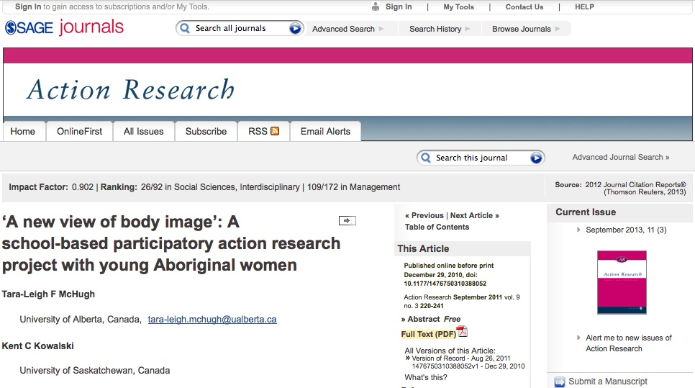
Who needs open access?
Heather Morrison

Slide 4
Sage paywall options
Purchase Short-Term Access
Pay per Article - You may purchase this article for US$25.00. You must download your purchase, which is yours to keep, within 24 hours.
Regain Access - You can regain access to a recent Pay per Article purchase if your access period has not yet expired.
Heather Morrison

Slide 5
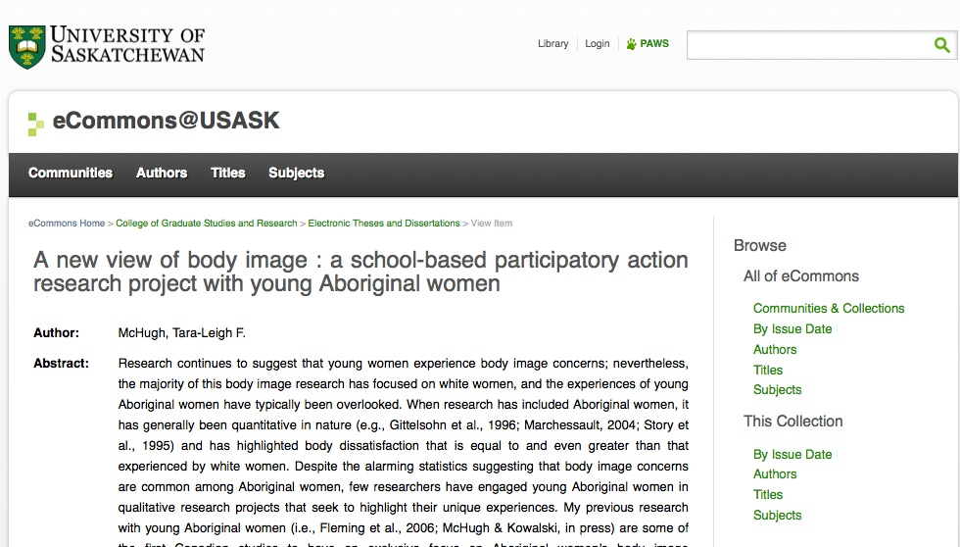
Heather Morrison

Slide 6
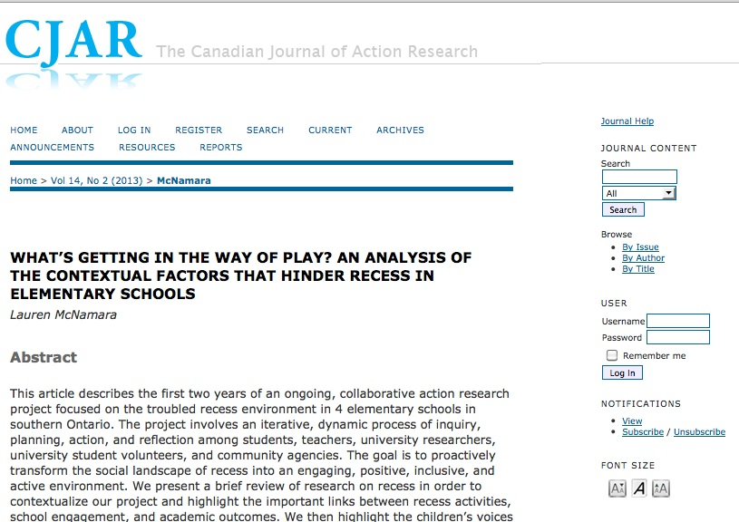
Heather Morrison

Slide 7
How is this possible?
Authors give away articles
Peer-reviewers give away services
Editors often unpaid (or honorarium)
Low cost of dissemination online
Free open source software (OJS)

Slide 8
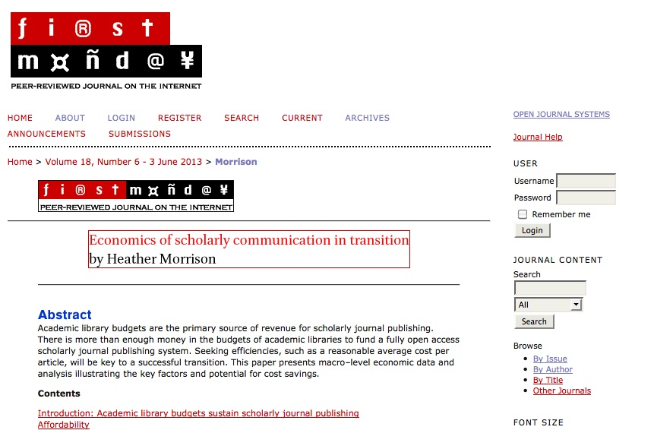
Open access publishing

Slide 9
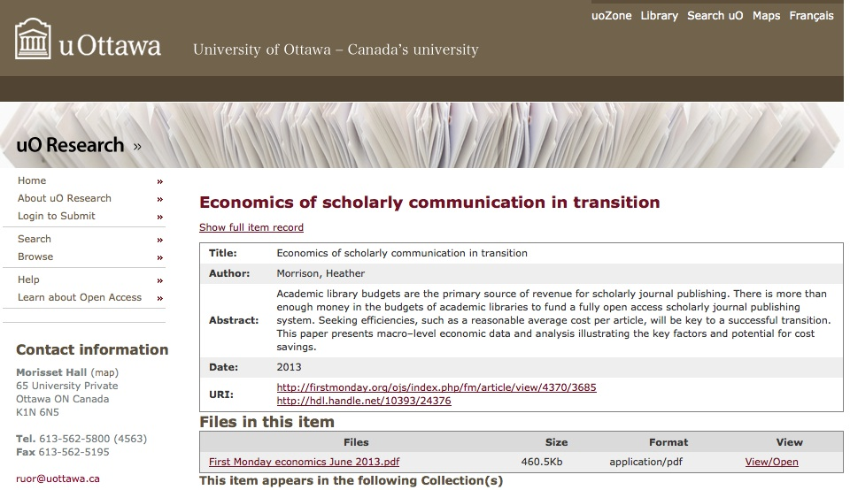
Open access archiving

Slide 10
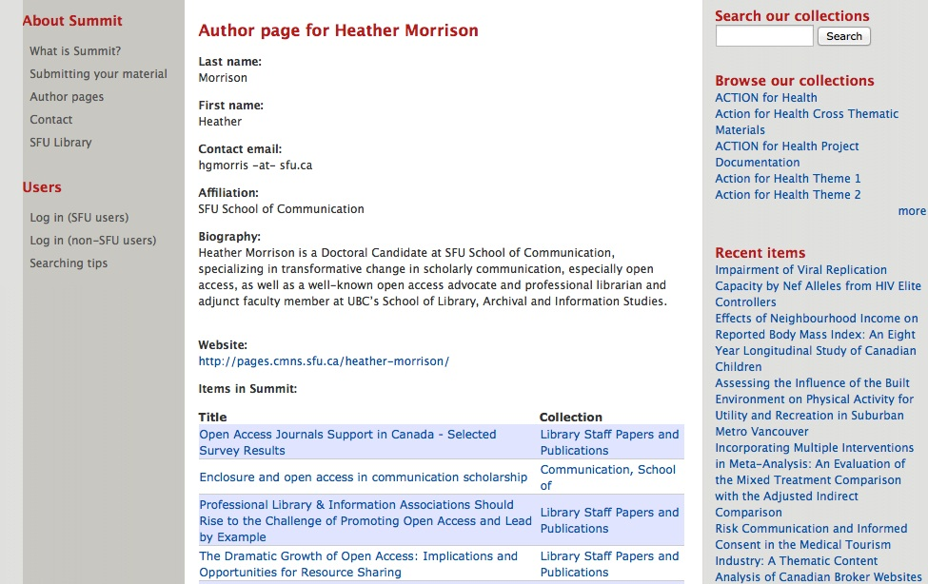
SFU SUMMIT / author’s works
Heather Morrison

Slide 11
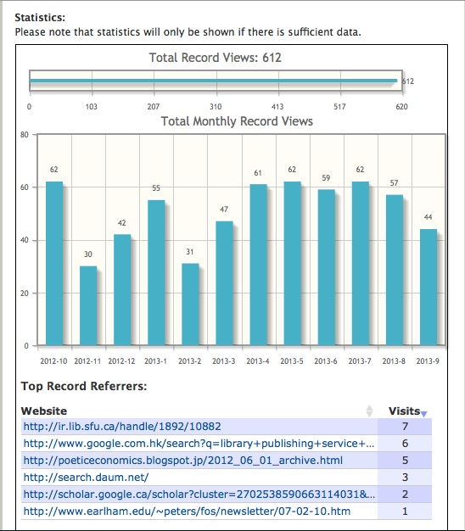
SFU SUMMIT
statistics for “Open Access journals support in Canada” – Morrison, Owen, Taylor, Vézina, Waller
Heather Morrison

Slide 12
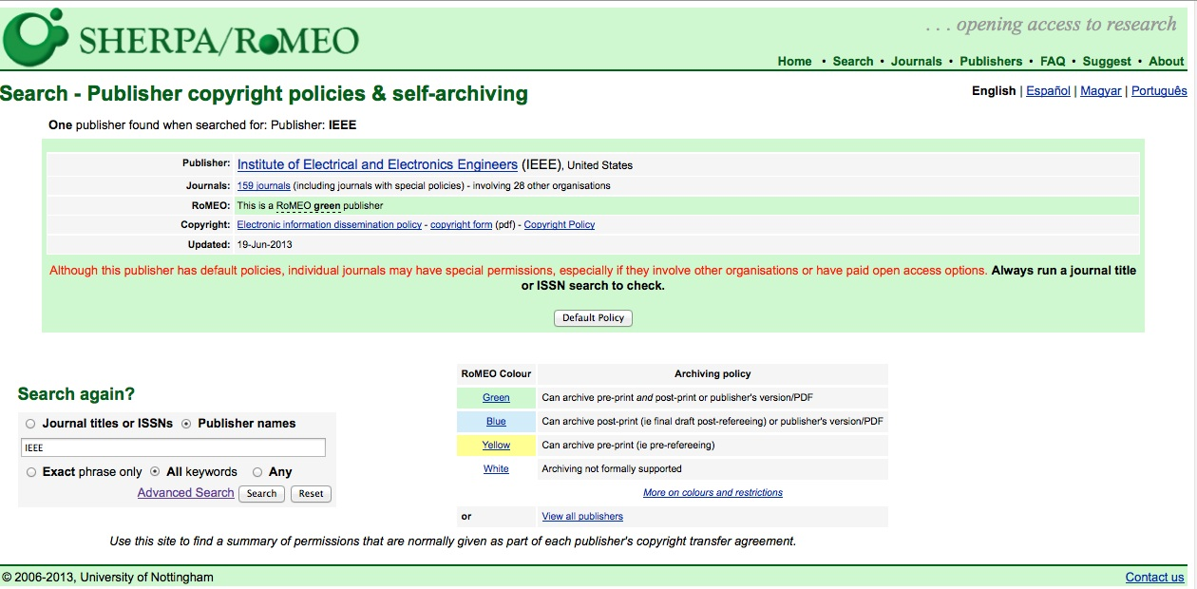

Slide 13
Heather Morrison

Slide 14
Estimated annual revenue & profit 4 largest commercial scholarly publishers
U.S. $ billions
 | Revenue (U.S. $ billions) | Profit (U.S. $ billions) | % profit | notes
Elsevier | 3 | 1 | 37% | revenue up 3%, profits up 6%
Springer | 1.4 | .5 | 35%
Wiley | .98 | .27 | 28% | revenue rose 5%; adjusted contribution to profit rose 13%
Informa (T&F) | .5 | .2 | 33%
Total | 6 | 2 | 35%
Based on Most recent financial report / scholarly pub. Section Bank of Canada currency conversion Oct. 22, 2013 Quarterly / half results multiplied
Heather Morrison

Slide 15
Potential savings (global)
Scholar-led / Open Journal Systems: 96% of current spend
PLoS ONE: 60-70% of current spend
Heather Morrison

Slide 16
Why do we need savings?
Academic jobs!
2/3 of $5.8 billion current academic library expenditures = $3.9 billion.
At average annual salary of $100,000, that 39,000 jobs!
If average RA = $6,000, that’s 650,000 RAs!
8% increase on $1 million subscription = $160,000 =1 senior or two junior faculty positions
New needs!
Research data management & preservation
Archiving scholarly blogs and websites
Heather Morrison

Slide 17
Why open access?
It’s the trend – report commissioned by the European Union estimates more than 50% of funded research is now freely available http://www.science-metrix.com/eng/news_13_08.htm

Slide 18
Prestige & impact
Get your work read. Not even Harvard subscribes to all the journals!
Minimal click
Showcase UR work in OURspace
Don’t give all UR prestige to publishers; bring it home
Drive web traffic to UR
Share UR knowledge with alumni, practitioners, the public, journalists, donors
If they understand what you do…will they support you?

Slide 19
But….what about impact factor?

Slide 20
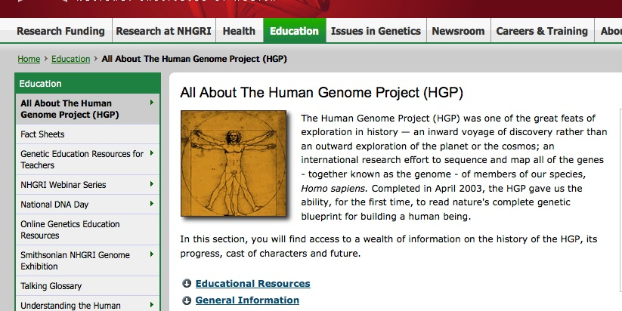
Genome.gov

Slide 21
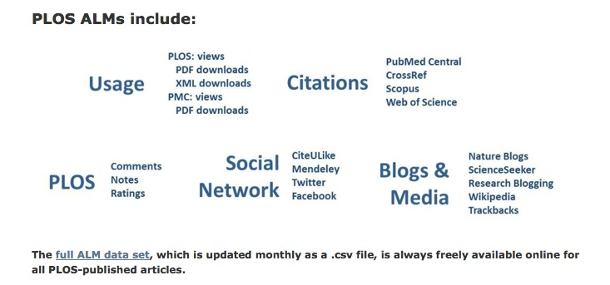
Article Level Metrics (PLoS)

Slide 22
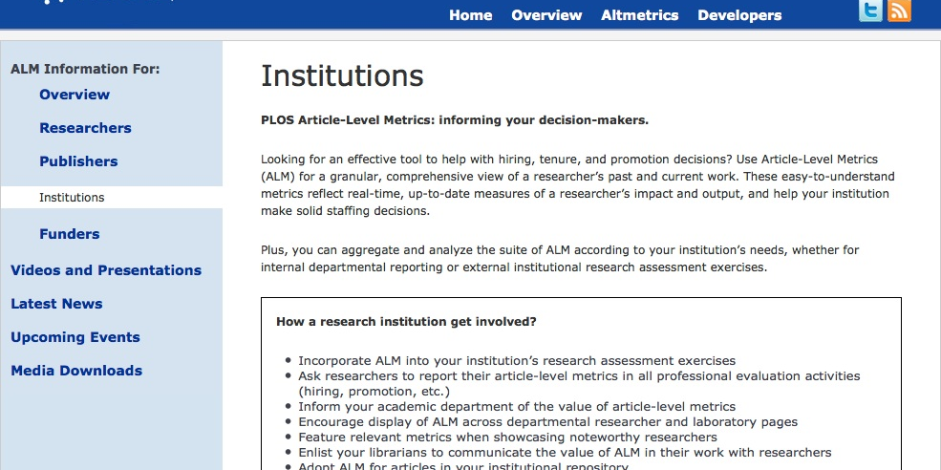
PLoS ALMs for Institutions

Slide 23
San Francisco Declaration on Research Assessment (DORA) http://am.ascb.org/dora/
“The Journal Impact Factor is frequently used as the primary parameter with which to compare the scientific output of individuals and institutions. The Journal Impact Factor, as calculated by Thomson Reuters, was originally created as a tool to help librarians identify journals to purchase, not as a measure of the scientific quality of research in an article. With that in mind, it is critical to understand that the Journal Impact Factor has a number of well-documented deficiencies as a tool for research assessment. These limitations include: A) citation distributions within journals are highly skewed [1–3]; B) the properties of the Journal Impact Factor are field-specific: it is a composite of multiple, highly diverse article types, including primary research papers and reviews [1, 4]; C) Journal Impact Factors can be manipulated (or "gamed") by editorial policy [5]; and D) data used to calculate the Journal Impact Factors are neither transparent nor openly available to the public [4, 6, 7]”.

Slide 24
DORA
General Recommendation
1. Do not use journal-based metrics, such as Journal Impact Factors, as a surrogate measure of the quality of individual research articles, to assess an individual scientist's contributions, or in hiring, promotion, or funding decisions.
Heather Morrison

Slide 25
DORA
For institutions
4. Be explicit about the criteria used to reach hiring, tenure, and promotion decisions, clearly highlighting, especially for early-stage investigators, that the scientific content of a paper is much more important than publication metrics or the identity of the journal in which it was published.
5. For the purposes of research assessment, consider the value and impact of all research outputs (including datasets and software) in addition to research publications, and consider a broad range of impact measures including qualitative indicators of research impact, such as influence on policy and practice.
Heather Morrison

Slide 26
Does your research matter to the public?
…if not, why would the public fund your research?

Slide 27
Grant funding…

Slide 28
Access to Research Results: Guiding Principles (NSERC, CIHR, SSHRC, 2011)
“Making research results as widely available and accessible as possible is an essential part of advancing scholarship, promoting intellectual inquiry and critical analysis, and applying knowledge to ensure that practical solutions are found to challenges facing Canadians”.
Heather Morrison

Slide 29
Access to Research Results: Guiding Principles (NSERC, CIHR, SSHRC, 2011)
The following principles will guide the agencies in promoting access to research results:
Advance Knowledge
The advancement of knowledge depends upon peer review to ensure excellence, as well as long-term preservation to ensure that research can be built upon by others.
Minimize Research Duplication
Broad dissemination increases the effectiveness of public investments in research by reducing the potential for unnecessary duplication.
Maximize Research Benefits
Publicly funded research should be as accessible as possible in order to maximize the economic, social, cultural and health benefits for Canadians.
Promote Research Accomplishments
Improving access to research results will better promote the accomplishments of Canadian researchers throughout the world.
Heather Morrison

Slide 30
Heather’s Insight Development Grant (forthcoming) – Knowledge Dissemination section
open research approach
data posted as soon as collected
collaborative discussion of research questions
almost all work open access
Scholarly blogging
Public talks when anyone will listen
UR scholars will be competing with people like me!
Heather Morrison

Slide 31
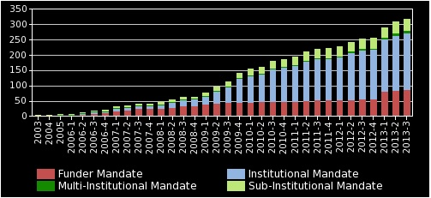
Open access policies

Slide 32
Canadian research funders with open access policies (from Sherpa JULIET) http://www.sherpa.ac.uk/juliet/index.php
Canadian Breast Cancer Research Alliance (CBCRA) Canada Canadian Cancer Society (CCS) Canada Canadian Foundation for Healthcare Improvement (CFHI) Canada Canadian Institutes of Health Research (CIHR)
International Development Reseach Centre (IDRC) Canada Conseil de recherches en sciences humaines (CRSH)
Social Sciences and Humanities Research Council (SSHRC) Canada

Slide 33
Canadian research funders with open access policies (from Sherpa JULIET) http://www.sherpa.ac.uk/juliet/index.php
Natural Sciences and Engineering Research Council of Canada (NSERC) Canada Fonds de la recherche en santé du Québec (FRSQ) Canada Genome Canada Canada Heart and Stroke Foundation of Canada (HSFMichael Smith Foundation for Health Research (MSFHR) Canada
National Research Council Canada (NRC) Canada Natural Sciences and Engineering Research Council of Canada (NSERC) Canada Ontario Institute for Cancer Research (OICR) Canada Social Sciences and Humanities Research Council (SSHRC)

Slide 34
Related
open data / open government
open education

Slide 35
Major international policy developments
UK
  2004
  Finch
  RCUK
  House of Lords
  Business, Innovation & Skills Committee
US
  NIH Public Access Policy: 2004, 2008
  FASTR
India – CGIAR
Latin America - publishing
Heather Morrison

Slide 36
Draft tri-agency open access policy (comments due Dec. 13)
Preamble:
As publicly funded organizations, the Agencies have a fundamental interest in promoting the availability of findings that result from the research they fund, including research publications, to the widest possible audience, and at the earliest possible opportunity. Societal advancement is made possible through widespread and barrier-free access to cutting-edge research and knowledge, enabling researchers, scholars, clinicians, policy-makers, private sector and not-for-profit organizations and the public to use and build on this knowledge.
CIHR already in effect – NSERC and SSHRC proposed Sept. 1, 2014
Heather Morrison

Slide 37
Draft tri-agency open access policy: principles
Committing to academic freedom, and the right to publish;
Maintaining the high standards and quality of research by committing to academic openness, integrity and ethics;
Promoting recognized research best practices and standards across disciplines, and embracing and sharing emerging practices and standards;
Advancing academic research, science and innovation;
Effective diffusion of research results; and
Aligning activities, programs and policies between Canadian and international research funding agencies.
Heather Morrison

Slide 38
Draft tri-agency open access policy: policy statement
Grant recipients are required to ensure that any peer-reviewed journal publications arising from Agency-supported research are freely accessible within 12 months of publication, either through the publisher's website (Option #1) or an online repository (Option #2).
Heather Morrison

Slide 39
Draft tri-agency open access policy: option 1
Option #1: Grant recipients submit their manuscript to a journal that offers immediate open access to published articles, or offers open access to published articles within 12 months.
The Agencies consider the cost of publishing in open access journals to be an eligible expense under the Use of Grant Funds.
Heather Morrison

Slide 40
Draft tri-agency open access policy: option 2
Option #2: Grant recipients archive the final peer-reviewed full-text manuscript in a digital archive where it will be freely accessible within 12 months (e.g., institutional repository or discipline-based repository). It is the responsibility of the grant recipient to determine which publishers allow authors to retain copyright and/or allow authors to archive journal publications in accordance with funding agency policies.
Grant recipients must acknowledge Agency contributions in all peer-reviewed publications, quoting the funding reference number.
Heather Morrison

Slide 41
Draft tri-agency open access policy: publication-related research data (CIHR only)
Recipients of CIHR funding are required to adhere with the following responsibilities: deposit bioinformatics, atomic, and molecular coordinate data into the appropriate public database (e.g. gene sequences deposited in GenBank) immediately upon publication of research results;
retain original data sets for a minimum of five years (or longer if other policies apply).
t
Heather Morrison

Slide 42
Draft tri-agency open access policy: additional information
Information on publicly available archives or repositories in which researchers can deposit journal publications is available on the following Web sites:
Canadian Institutional Repositories PubMed Central Canada (repository for health sciences) Directory of Open Access Repositories (international)
A list of funds available from Canadian universities that assist authors in making their publications open access, can be found at the Canadian Association of Research Libraries Web site.
Heather Morrison

Slide 43
Draft tri-agency open access policy: public submissions (to date)
Stevan Harnad (UQAM) http://mailman.ecs.soton.ac.uk/pipermail/goal/2013-October/002235.html
Heather Morrison http://poeticeconomics.blogspot.ca/2013/10/canadas-tricouncil-draft-open-access.html
*** update In progress: Advocates for Canadian Open Access (ACOA)
Heather Morrison

Slide 44
ACOA / APLAC draft response to tri-agency open access policy: key points
Overall: model policy
Supports transition to open access publishing
Because OA publishing is an option, not a requirement, allows market forces to operate
Supports academic freedom by not forcing authors to choose OA journals
Needs work: open access archiving in a Canadian-based repository should be required, even when authors publish open access
Embargoes overly generous, should be shortened to 6 months with view to eventual elimination
Heather Morrison

Slide 45
ACOA / APLAC – please join!
https://docs.google.com/document/d/1C4HksXi399pqUNitVy0eEcIn0cTC9hU1g5tmUYA4OQI/edit?usp=sharing
Heather Morrison

Slide 46
What to do?
Heather Morrison

Slide 47
Institutional OA policy?
UR Librarian and Archivists’ policy - congratulations!
Faculty permissions: Harvard / MIT policy
Institutional policy: University of Liège
Why policy? Help faculty succeed by:
  Making sure meet requirements of funders
  Impress with knowledge dissemination
  Help our funding agencies succeed in getting funding!
Data management template
Heather Morrison

Slide 48
MIT Faculty Open Access Policy
“Each Faculty member grants to the Massachusetts Institute of Technology nonexclusive permission to make available his or her scholarly articles and to exercise the copyright in those articles for the purpose of open dissemination. In legal terms, each Faculty member grants to MIT a nonexclusive, irrevocable, paid-up, worldwide license to exercise any and all rights under copyright relating to each of his or her scholarly articles, in any medium, provided that the articles are not sold for a profit, and to authorize others to do the same. The policy will apply to all scholarly articles written while the person is a member of the Faculty except for any articles completed before the adoption of this policy and any articles for which the Faculty member entered into an incompatible licensing or assignment agreement before the adoption of this policy. The Provost or Provost’s designate will waive application of the policy for a particular article upon written notification by the author, who informs MIT of the reason”.

Slide 49
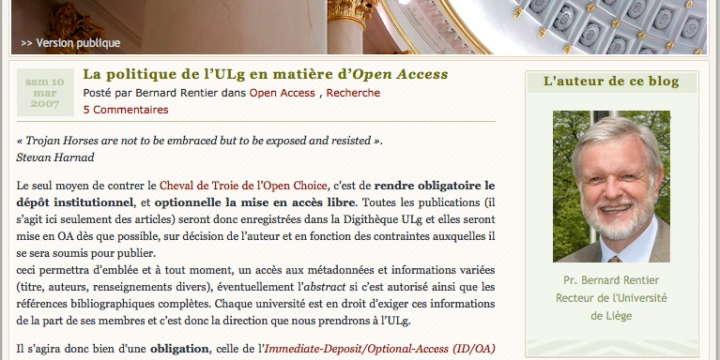
Université de Liège http://recteur.blogs.ulg.ac.be/?p=103

Slide 50
Library journal publishing
Edgar & Willinsky 2010 OJS survey (900 journals): average expenditure $188 / article
Global average library expenditure ~ $4,500 / article
= self-publishing could save up to 96% of current spend
Renaissance of scholar-led publishing
Needs further research (resource requirements, infrastructure costs)
Standard university library service (Taylor, Morrison, Owen, Vézina & Waller; Hahn)

Slide 51
Publishing advice & support for faculty and grad students
Journal start-up or transition
Funding agency policies
Data management plan / template
Beall’s list
Journal ownership
Journal article turnaround time
Author’s copyright
  Rights retention (articles and other works)
  Creative Commons options
  Negotiating royalties & rights (monographs)
  Attribution rights (encyclopedia articles)
Heather Morrison

Slide 52
Open access archives / digital repositories
Theses
Scholarly articles, books, book chapters, etc.
Research data
Heather Morrison

Slide 53
Synergies library & other departments
Meeting funding agency policies
Where to publish
Local publishing
Heather Morrison

Slide 54
Conclusions
Open Access is happening, and that’s a good thing
Research funding agencies prefer OA and increasingly require it
Institutions looking at OA policy
A lot of work needed to transition to OA
Synergies between scholars, libraries and other university departments
University of Regina
Heather Morrison

Slide 55
References
Hahn, K. (2008). Research library publishing services: new options for university publishing. Association of Research Libraries http://www.arl.org/storage/documents/publications/research-library-publishing-services-mar08.pdf
MIT Faculty Open Access Policy. http://libraries.mit.edu/scholarly/mit-open-access/open-access-at-mit/mit-open-access-policy/
San Francisco Declaration on Research Assessment. http://am.ascb.org/dora/
Science.gc.ca (2011) Access to Research Results: Guiding Principles. http://www.science.gc.ca/default.asp?Lang=En&n=9990CB6B-1
Science-Metric (2013). Open access reaches a tipping point. http://www.science-metrix.com/eng/news_13_08.htm
Suber, P. n.d. Open Access Overview http://legacy.earlham.edu/~peters/fos/overview.htm
Taylor D, Morrison H, Owen B, Vézina K, Waller A. Open Access Publishing in Canada: Current and Future Library and University Press Supports. Publications. 2013; 1(1):27-48. http://www.mdpi.com/2304-6775/1/1/27
Heather Morrison

Slide 56
Questions? Contact:
Dr. Heather Morrison
Assistant Professor
École des sciences de l'information / School of Information Studies
University of Ottawa
http://www.sis.uottawa.ca/faculty/hmorrison.html
The Imaginary Journal of Poetic Economics http://poeticeconomics.blogspot.com
Heather.Morrison@uottawa.ca
Heather Morrison

Slide 57
Heather Morrison

