Slide 1
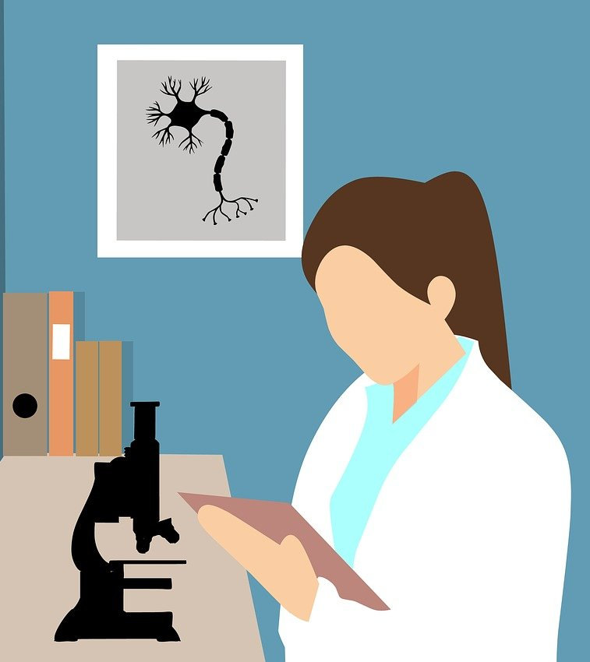

Open Access to Knowledge Part 1: Sharing Your Research Publications
Mélanie Brunet
Jeanette Hatherill
Chantal Ripp
University of Ottawa Library
Unless otherwise specified, the contents of this presentation are made available under a Creative Commons Attribution 4.0 International licence.
Image by mohamed_hassan from Pixabay, Pixabay Licence

Slide 2
By the end of this webinar you will:
Be familiar with copyright in a publishing context
Understand CDN funder requirements for sharing research outputs
Know how to make your work available in Open Access (OA)
Understand how Creative Commons (CC) licences apply to OA publications
Know what supports are available through uOttawa

Slide 3
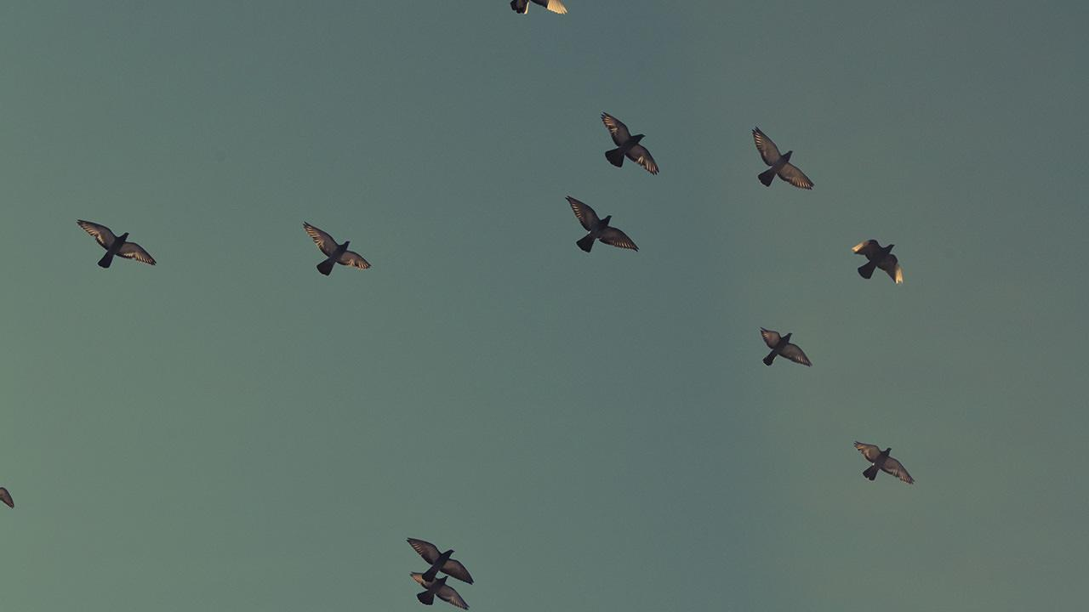
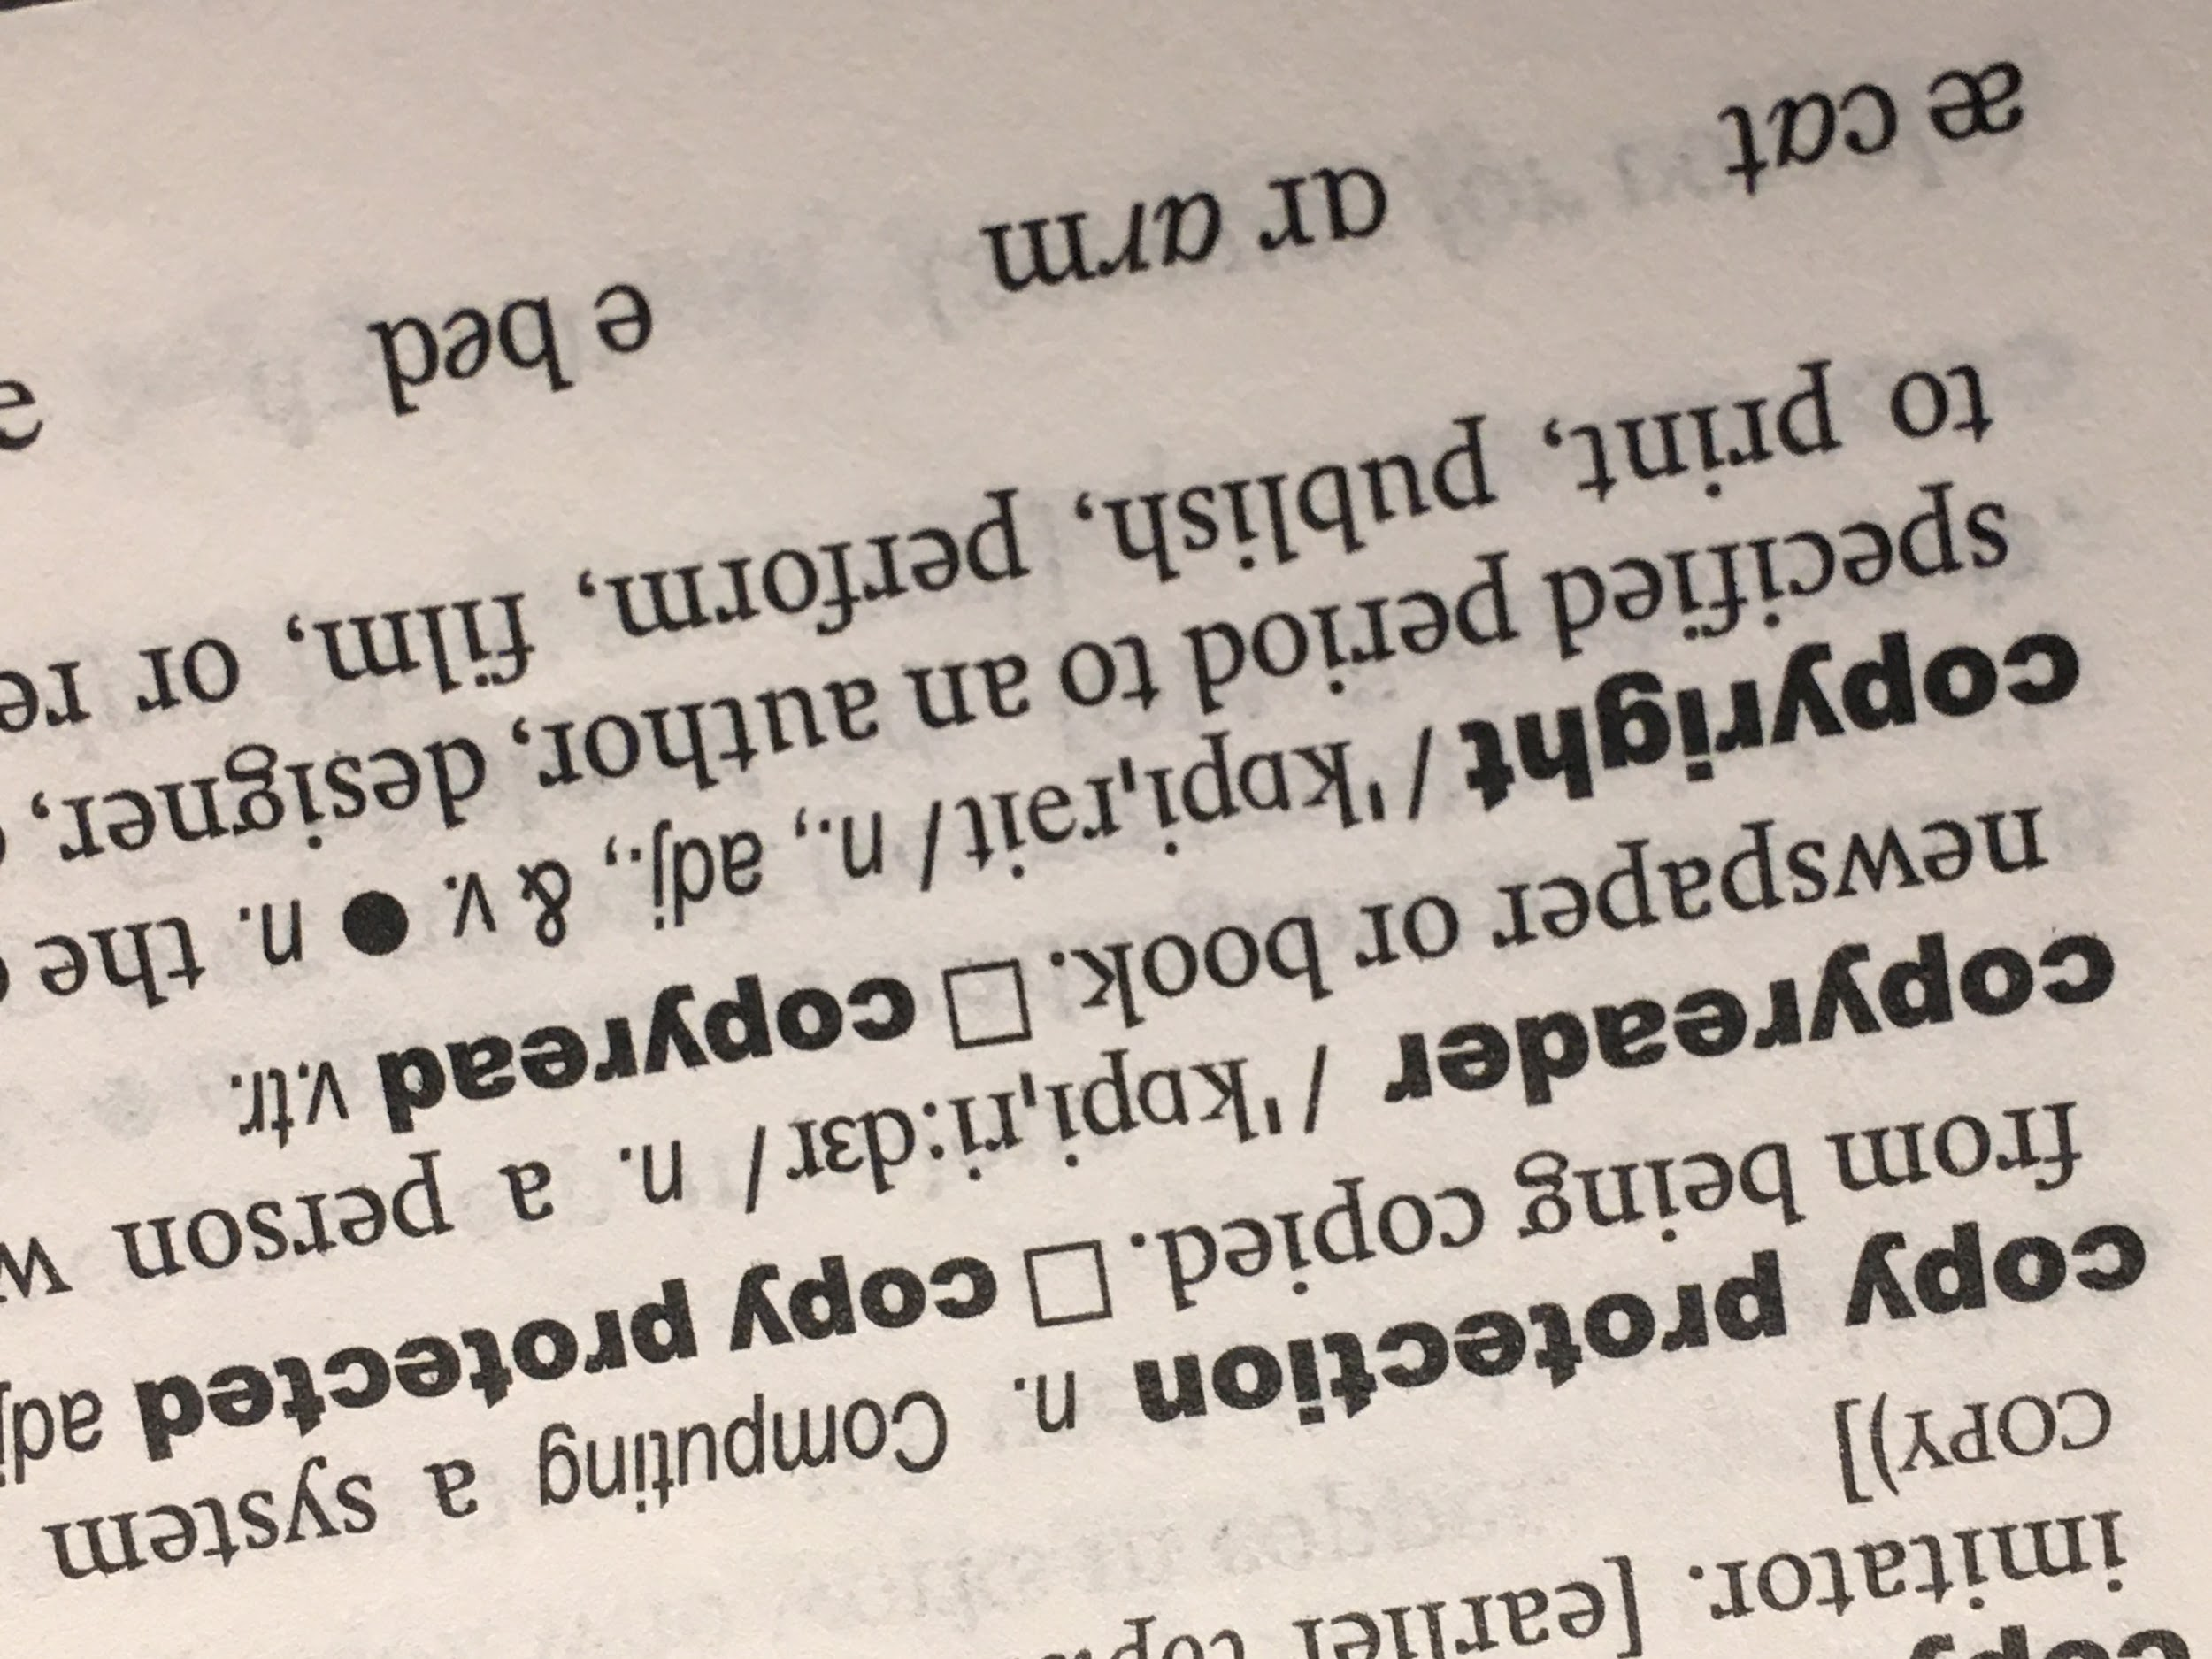
1.
Copyright
Image by Mélanie Brunet, CC0

Slide 4
Copyright Basics
Automatic upon fixation
Copyright ownership:
  APUO and APTPUO members retain copyright under respective collective agreement
  In joint authorship, each co-author owns copyright
  Clarify copyright ownership status of all authors early on (students, staff, co-authors from other institutions or organisations)

Slide 5
Copyright Transfer Agreements
Publishing and copyright transfers
Publishers often require authors to sign copyright transfer agreements (CTAs) as a condition for publication
Publishers may require editors to transfer copyright for journals using their publication platforms
Commons restrictions in CTAs:
x Posting on personal website, ResearchGate
x Reusing in other formats
x Preserving published version in a digital repository
… ability to share widely
Know which rights you want to maintain before
signing a CTA!

Slide 6
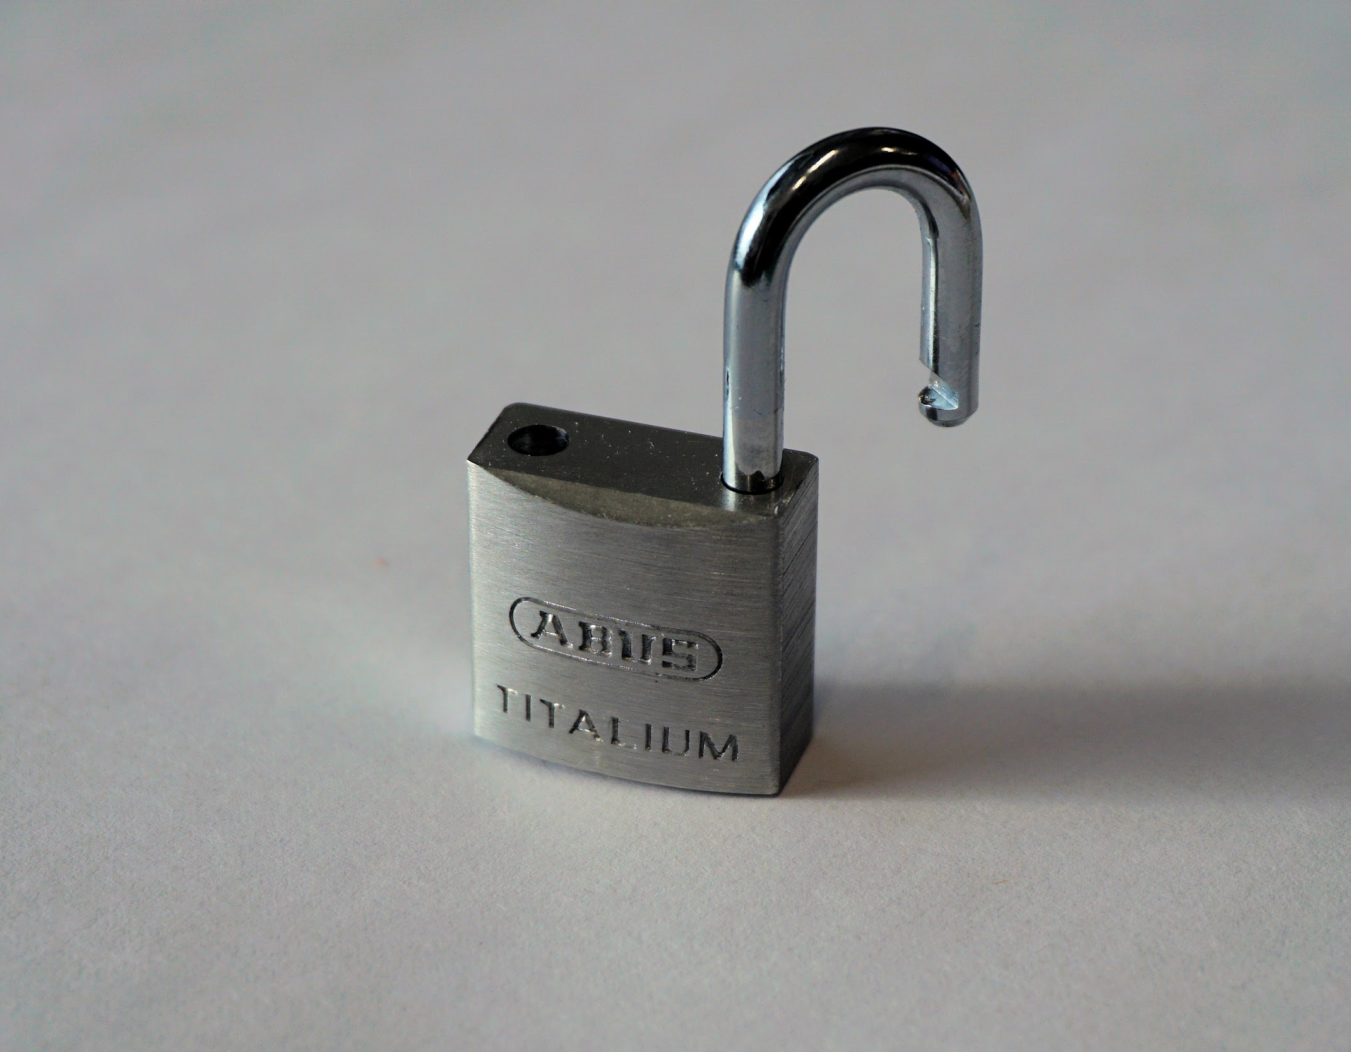
2.
Open Access
Image by Andreas Lischka from Pixabay, Pixabay Licence

Slide 7
Open Access
Open access (OA) literature is digital, online, free of charge, and free of most copyright and licensing restrictions

Slide 8
Open Access
Rationale
Increased visibility for your research
Advances research in a given discipline
Public access to publicly funded research
Ethical or moral imperative
Maintain copyright ownership of your work

Slide 9
Open Access
Rationale
Increased visibility for your research
Advances research in a given discipline
Public access to publicly funded research
Ethical or moral imperative
Maintain copyright ownership of your work
Comply with funder mandates

Slide 10
Open Access
Funder requirements
Tri-Agency Open Access Policy on Publications
Principles on sharing research data and findings relevant to the novel coronavirus (nCoV)

Slide 11
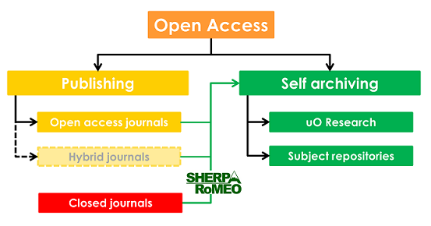
Open Access
GOLD
Publishing directly in open access. In other words, the publisher is responsible for making final published version of the article openly available online.

Slide 12
Open Access
GOLD
Publishing directly in open access. In other words, the publisher is responsible for making final published version of the article openly available online.
GREEN
The author takes the initiative to make their paywalled article openly available by placing a version of it online in an open repository, often referred to as self-archiving.

Slide 13
Open Access
Open access (OA) literature is digital, online, free of charge, and free of most copyright and licensing restrictions

Slide 14
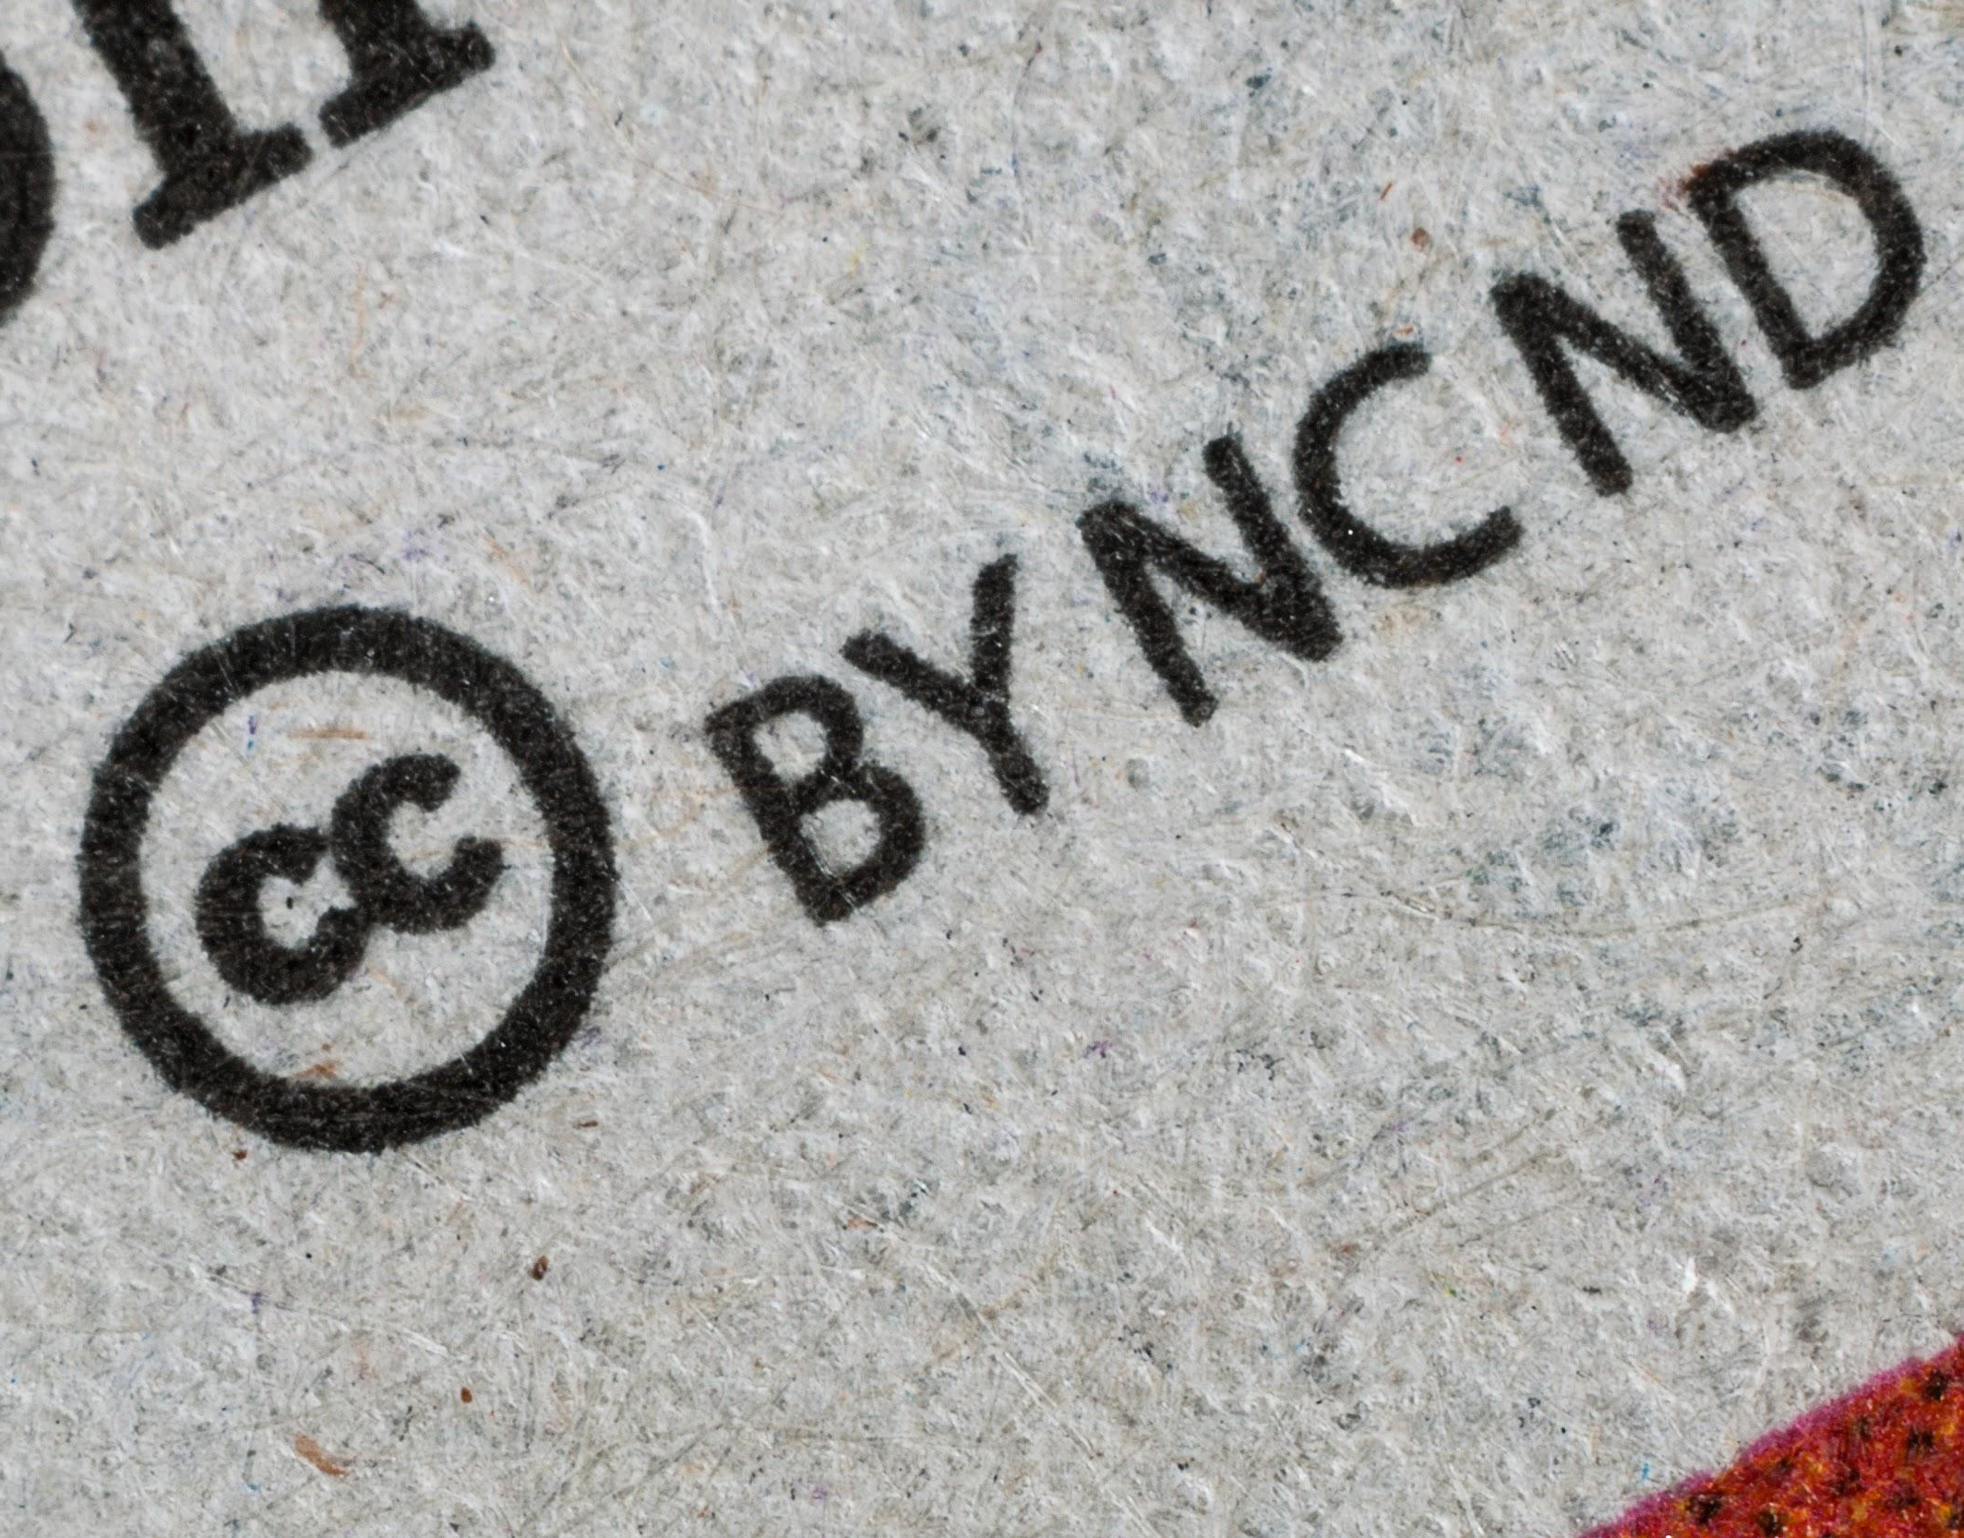
3.
Creative Commons Licences
Image by Umberto from Unsplash, Unsplash Licence

Slide 15
What is a licence?
“A licence allows someone else to use a work for certain purposes and under certain conditions.
The copyright owner still retains ownership.”
Quoted from: A Guide to Copyright (Assignments and Licences), Canadian Intellectual Property Office (CIPO)

Slide 16
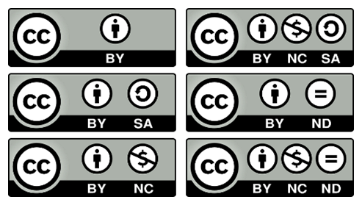

Licences
Creative Commons Attribution 4.0 International Licence
CC BY-NC-SA 4.0
About the licences: https://creativecommons.org/licenses/?lang=en
Creative Commons Icons and Logo, Creative Commons, CC BY 4.0

Slide 17

Attribution (BY)
Must give credit to the author of the work
Basic requirement for all Creative Commons licences
Creative Commons BY icon, Creative Commons, CC BY 4.0

Slide 18

ShareAlike (SA)
If the original content is adapted, the new (modified) work must be shared under the same licence (i.e. cannot be more restricted)
Creative Commons SA icon, Creative Commons, CC BY 4.0

Slide 19

Non Commercial (NC)
Content cannot be used for commercial purposes (i.e. sold for profit)
Applies to the “use” being made, not the “user”
Creative Commons NC icon, Creative Commons, CC BY 4.0

Slide 20

No Derivatives (ND)
Adaptations of the original work cannot be shared publicly (only used privately)
Creative Commons ND icon, Creative Commons, CC BY 4.0

Slide 21
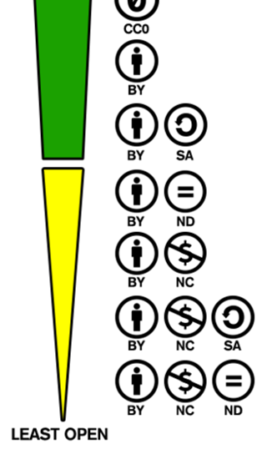

Levels of Openness
Ordering of Creative Commons licences from most to least permissive, Wikimedia Commons, CC BY-SA 4.0
(modification: removed CC0)

Slide 22
Creative Commons Licences and Publishing Agreements
As per publishing agreement:
One licence for entire journal
  ex. PLoS ONE uses CC BY only
Choice of licences
  ex. OUP Journals use CC BY, CC BY-NC and CC BY-NC-ND
Watch out for:
Journals that charge more for a less restrictive licence
Publishers who have their own open licence that sounds like Creative Commons but have additional conditions
➽ For accurate definitions of CC licences, go to: https://creativecommons.org/about/cclicenses/

Slide 23

4.
Making Your Publications Open Access
Image by 200degrees from Pixabay, Pixabay Licence

Slide 24
Finding
Open Access Journals
Directory of Open Access Journals (DOAJ)
https://doaj.org/
Open Journal Matcher
https://ojm.ocert.at/

Slide 25
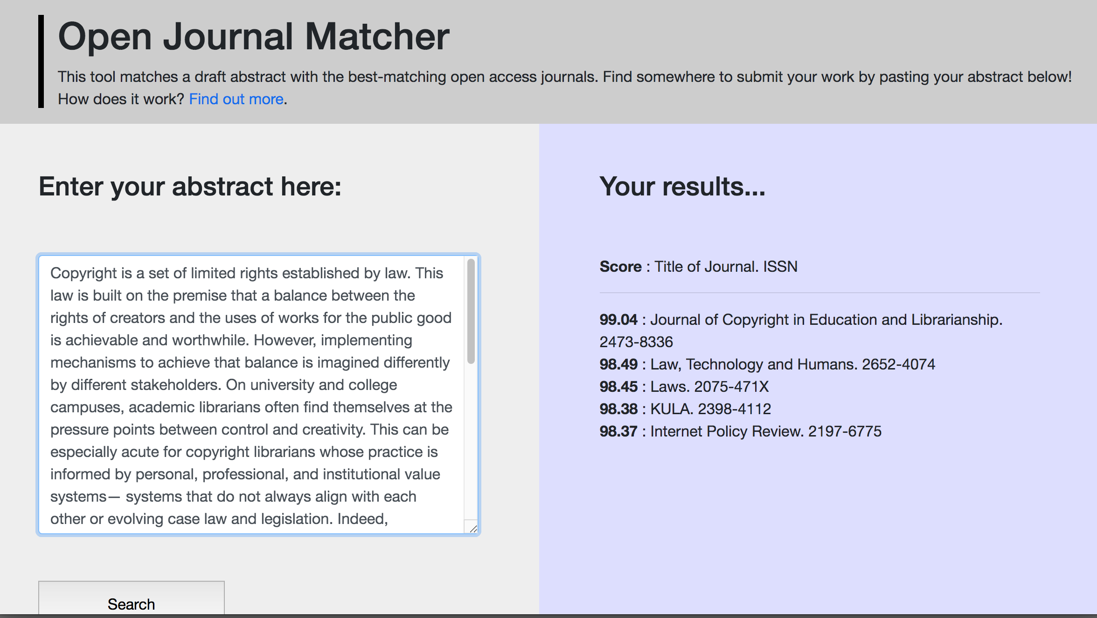
Finding
Open Access Journals

Slide 26
Open Access
Journals
Financial Support
Criteria
Faculty, employees, affiliated researchers, current grad students
Fully open access journals (no hybrid)
Part of a larger strategy of OA support
https://scholarlycommunication.uottawa.ca/
uottawa-initiatives/financial-support

Slide 27
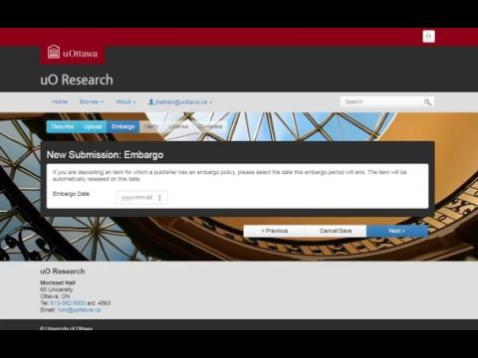
Open Access Repositories
uO Research
Demo: DOI, Sherpa/Romeo lookup & Embargo feature
https://ruor.uottawa.ca/

Slide 28
Open Access Repositories
Unpaywall
https://unpaywall.org/
Browser extension for Chrome and Firefox
Searches repositories, websites and databases for OA versions of articles
Immediately shows if an OA copy is available

Slide 29
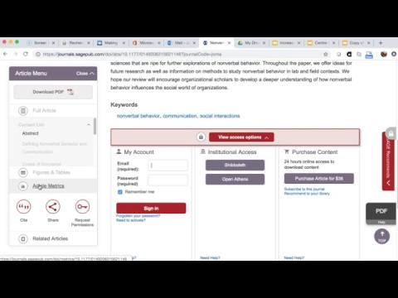

Open Access Repositories
Unpaywall
No OA version available:
OA version available:

Slide 30
Thank you!
Questions?
Mélanie Brunet, Copyright Services Librarian
melanie.brunet@uottawa.ca
Jeanette Hatherill, Scholarly Communication Librarian
jeanette.hatherill@uottawa.ca
Chantal Ripp, Research Data Management Librarian (Interim)
chantal.ripp@uottawa.ca
Ulysses presentation template by SlidesCarnival, CC BY 4.0

Slide 31
Open Access support at University of Ottawa
Practice Open Access
https://scholarlycommunication.uottawa.ca/open-access/practice-open-access
Green and Gold Route
uO Research
https://ruor.uottawa.ca
Deposit your research
Financial Support
https://scholarlycommunication.uottawa.ca/uottawa-initiatives/financial-support
Financial Support for Open Access Publishing

Slide 32
Other resources
How Open Is It?
A Guide for Evaluating the Openness of Journals
https://sparcopen.org/our-work/howopenisit/
FAQ COVID-19 Rapid Response Data Sharing and Deposit Support
https://biblio.uottawa.ca/en/services/faculty/research-data-management/faq-covid-19-rapid-response-data-sharing-and-deposit

