Slide 1



A holistic approach to child development: factors influencing overall development in children in care in Ontario, Canada
Meagan Millerª, Barbara Greenbergª,
Erik Michaelª, Robert Flynn^{a,b}
ªCentre for Research on Educational and Community Services, University of Ottawa (Canada)
^{b}School of Psychology, University of Ottawa (Canada)
mmiller@uottawa.ca

Slide 2

Outline
Ontario, Canada
Ontario Looking After Children
Purpose of the current study
Research Question I factor analysis
Research Question II overall development predictors
Conclusion/practical implications

Slide 3
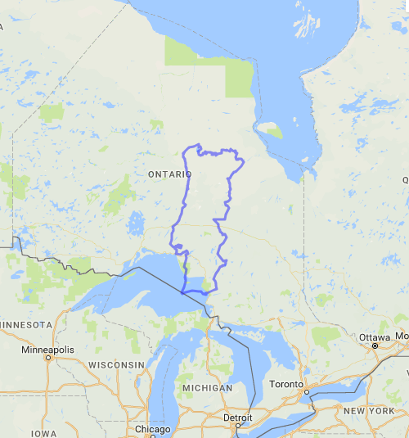
Ontario, Canada
AREA
Portugal | 91,568 km²
Spain | 505,990 km²
United Kingdom | 244,820 km²
Denmark | 44,493 km²
Belgium | 30,510 km²
Malta | 316 km²
+ | 44 km²
Ontario | 917,741 km²

Slide 4
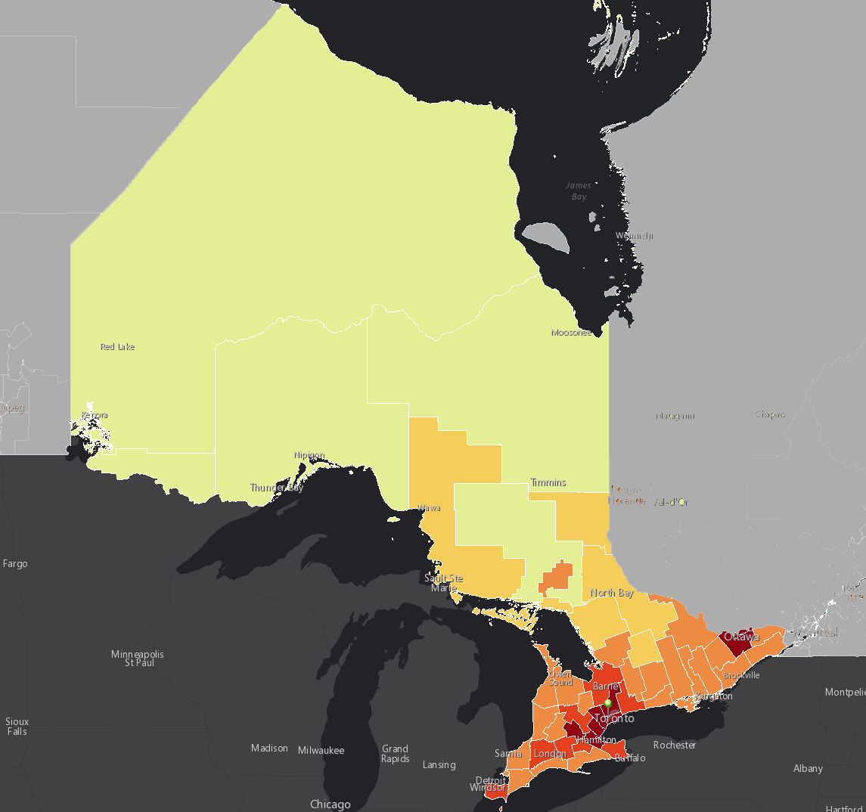
Ontario, Canada

Slide 5
OnLAC
Mandated in Ontario to assess service needs and developmental outcomes of young people in care
Uses Second Canadian Adaptation of Assessment and Action Record (AAR-C2-2016)
  Seven developmental dimensions:
    Health
    Education
    Identity
    Family & Social Relationships
    Social Presentation
    Emotional & Behavioural Development
    Motor & Social Development
18th year of data collection (2001-present)

Slide 6
Ages & Stages Questionnaires®, Third Edition (ASQ®-3)
Caregiver-completed screening tool for infants aged 1 month to children aged 66 months (5.5 years)
  21 age-interval questionnaires, 19 included in the AAR-C2-2016 (6- to 60-months)
Five developmental domain scales in each questionnaire:
Communication Fine motor Personal-social development
Gross motor Problem solving
Higher score = greater development in specific domain

Slide 7
Purpose of the current exploratory study
Phase I: to examine and explain the relationship between the five domains of development measured by the Ages & Stages Questionnaire®, Third Edition
Phase II: to provide decision-makers (practitioners, caregivers, and policy-makers) with evidence of demographic, risk, and protective factors affecting overall development for children in care.

Slide 8
Phase I: Research question
Is it possible to simplify ASQ®-3 data?
Communication
???
Personal-social
development
Gross motor
Problem solving
Fine motor

Slide 9
Phase I sample
Cross-sectional sample
OnLAC years 2016-2017
N = 1,459 children
Aged 8 months to 5 years (mean 2.3 years)
53.6% male, 46.4% female

Slide 10
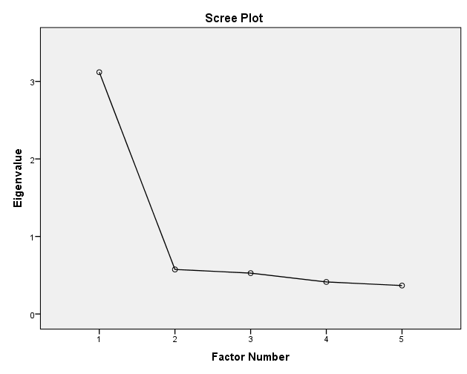
Phase I results
Exploratory factor analysis

Slide 11
Phase I results
Factor loadings
Communication .81
Problem solving .79
Fine motor .73
Gross motor .64
Personal-social dev. .67

Slide 12
Phase I results
Exploratory factor analysis
OVERALL
DEVELOPMENT
Communication
Total proportion of variance accounted for = 62.37%
Problem solving
Fine motor
Reliability
α = .85
Personal-social dev.
Gross motor
Notes:
The total proportion of variance accounted for by our superfactor is 62.37% and our new measure of overall development has a Cronbach’s alpha of .85, or very good reliability. Higher scores on our new, composite measure indicate a higher level of overall development.

Slide 13
Phase I conclusion
OVERALL
DEVELOPMENT
Communication
???
Personal-social
development
Gross motor
Problem solving
Fine motor

Slide 14
Phase II overall development sample
Cross-sectional sample OnLAC 2016-2017
N = 1,097 children, aged 1 to 5 years (mean 2.5 years)
54.1% male, 45.9% female
Placement
  Kinship 7.9%
  Foster home 86.4%
  Customary care (for Indigenous children) 3.8%
  Other 1.8%

Slide 15
Phase II overall development predictors
Sex
Age
Number of children in the home
Social-emotional difficulties
Child’s positive self-view
Kin care placement
Caregivers’ literacy-promoting activities

Slide 16
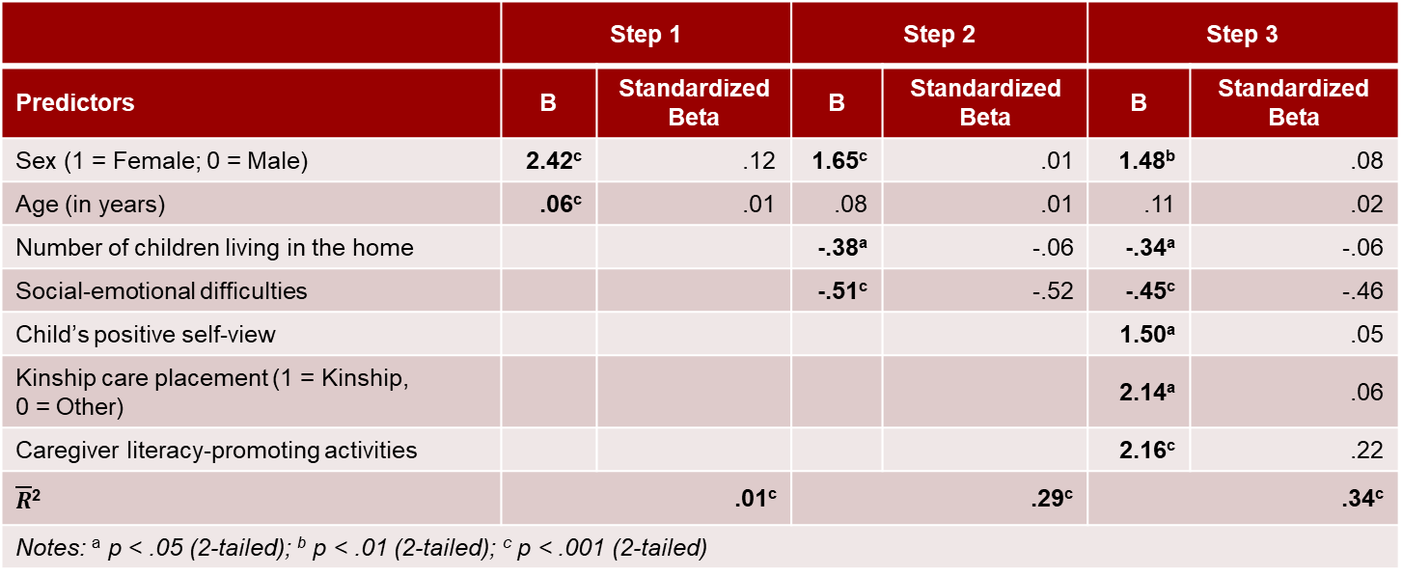
Phase II overall development regression results
Statistically significant model
  F (7, 1096) = 81.40, p < .001
 | Step 1 |  | Step 2 |  | Step 3
Predictors | B | Standardized Beta | B | Standardized Beta | B | Standardized Beta
Sex (1 = Female; 0 = Male) | 2.42^{c} | .12 | 1.65^{c} | .01 | 1.48^{b} | .08
Age (in years) | .06^{c} | .01 | .08 | .01 | .11 | .02
Number of children living in the home |  |  | -.38ª | -.06 | -.34ª | -.06
Social-emotional difficulties |  |  | -.51^{c} | -.52 | -.45^{c} | -.46
Child’s positive self-view |  |  |  |  | 1.50ª | .05
Kinship care placement (1 = Kinship, 0 = Other) |  |  |  |  | 2.14ª | .06
Caregiver literacy-promoting activities |  |  |  |  | 2.16^{c} | .22
$\overline{R}$² | .01^{c} |  | .29^{c} |  | .34^{c}
Notes: ª p < .05 (2-tailed); ^{b} p < .01 (2-tailed); ^{c} p < .001 (2-tailed)

Slide 17
Phase II summary of significant predictors of overall development
Sex
Age
Number of children in the home
Social-emotional difficulties
Child’s positive self-view
Kin care placement
Caregivers’ literacy-promoting activities

Slide 18
Implications
Gross motor
Personal-social development
Communication
Problem solving
Fine motor

Slide 19
Implications for caregivers and child welfare practitioners
Literacy promotion
OVERALL
DEVELOPMENT
Fewer children in the placement
Kin placement

Slide 20
Acknowledgements
The collaboration and financial support of the Ontario Ministry of Children, Community and Social Services and the Ontario Association of Children’s Aid Societies are gratefully acknowledged.
Thanks also to the numerous young people in care, caregivers, lead hands, practitioners, supervisors, quality-assurance staff, executive personnel, and OnLAC research assistants who have contributed much to the OnLAC project since the beginning.

Slide 21
Contact
Meagan Miller mmiller@uottawa.ca
Ontario Looking After Children Research Associate
www.linkedin.com/in/millermeagan
Centre for Research on Educational and Community Services https://ruor.uottawa.ca/handle/10393/37837
University of Ottawa, Ottawa, Canada

