Slide 1
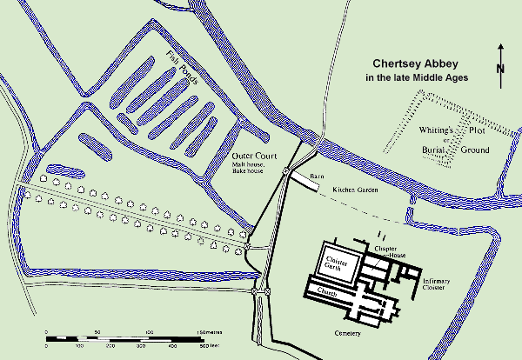
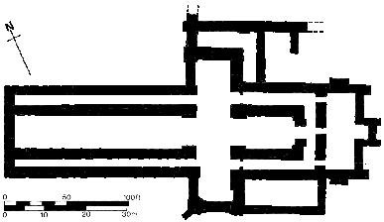
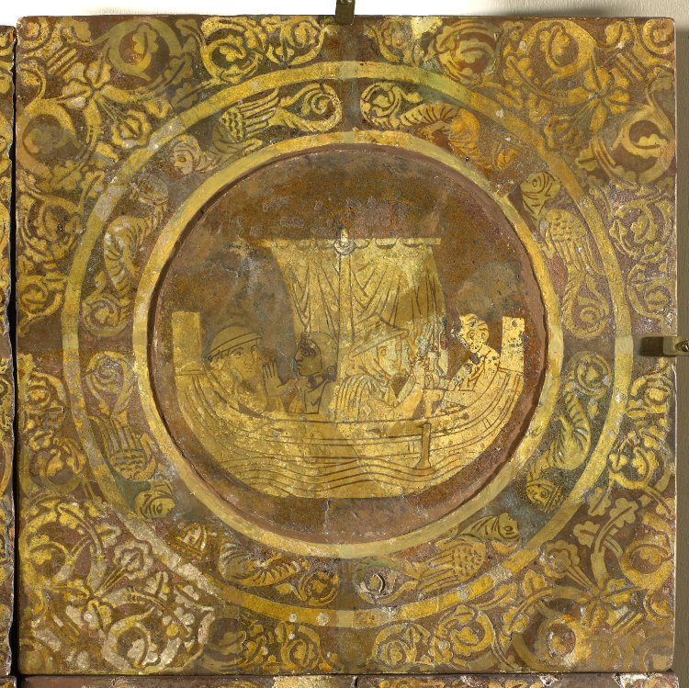
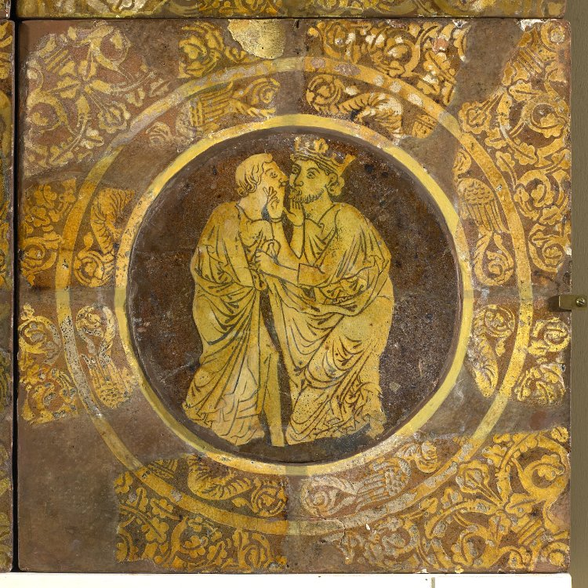
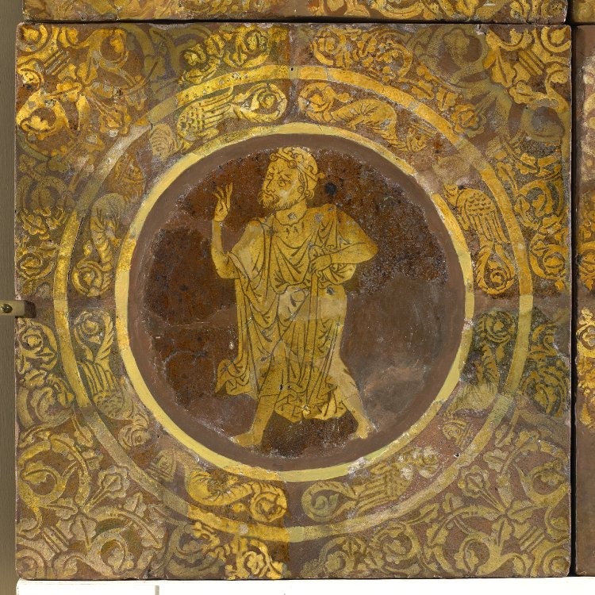
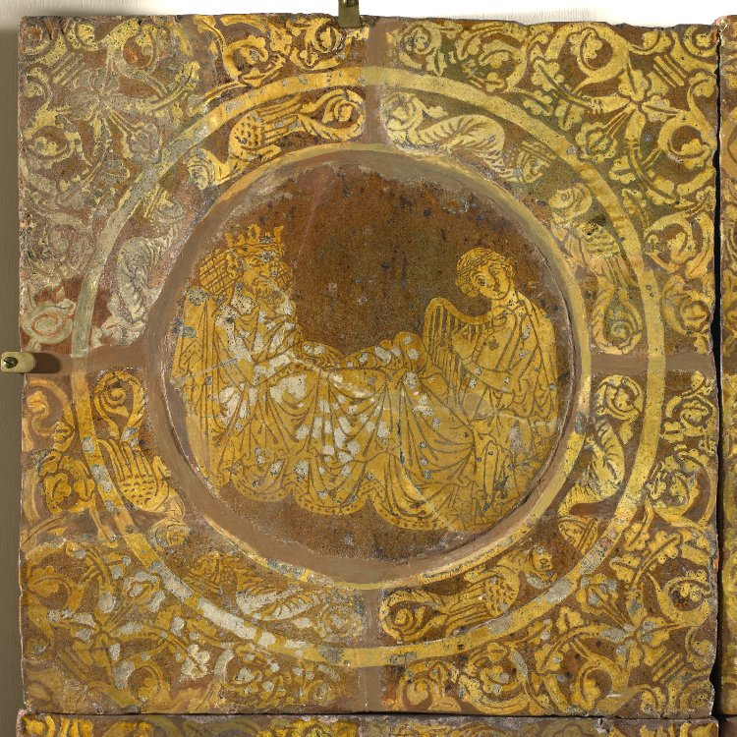
Audiences of Romance: Tristan and Iseult in Chertsey Abbey
By Charlene Chow | Supervised by Dr. Geoff Rector University of Ottawa, Department of English
Introduction
Conclusion
Chertsey Abbey, a medieval English monastic church, was decorated with a series of floor tiles depicting the romance of Tristan and Iseult, a story of courtly love with adultery, murder, dragons, and many sins against God. These tiles decorated the floor of the chapter house which is a place where monks read and pray as a community. Despite this seemingly inappropriate subject matter, the use of romance images in a monastic church is not uncommon. Closer examination of these tiles can help us ask questions about medieval reading practices and the audiences of romance as a genre. To explore these questions, I first tried to situate the tiles in their original architectural context, and then researched the uses of a monastic chapter house and its traditional decoration. Then I examined the story itself, reading several different medieval versions of the legend. Looking particularly at Melissa Furrow’s Expectations of Romance: The Reception of a Genre in Medieval England, I then tried to understand why the tiles were there in the larger context of the tradition.
The question of why the scenes of a story whose heroes commit acts of incest, adultery, treason, disloyalty, deception, attempted murder, and tricky wording which flirt with lying to God are depicted in a monastery is something scholars have tried to answer by looking at the contexts of how romances were received by readers.
Medieval writers (William of Nassington, Denis Piramus, Robert Manning, Thomas Walsingham) had varying views, but all agreed there is a factor of utility to reading romances, whether it be the story having a positive moral impact, as remembrance and record of history, as pleasure, or as a break in order “to return to their real work, refreshed” (Furrow, 41). While the latter of those views still enforces a sense of utility to reading romances, it is one of recreation instead of moral compassing. Intellectuals of the medieval church believed that studying the past and other secular works would “[enable] one to see God working in the world” (Olson, 54). Moreover, we know that some monks “enjoyed reading Virgil,” so much so that “they had guilty dreams” (Olson, 54).
In this case, the tiles are part of a programme of decoration; and the tiles, like the story, are highly regarded and valued. The monks themselves were readers of stories like Tristan and Iseult, and the chapter house, despite our assumptions, does seem to be an appropriate place. Reading here combined moral utility and refreshment, which is exactly how romances were justified. (Or, because it is a story so filled with sin, it could be a reminder of God’s remaining work in the world.) Melissa Furrow (10) has suggested that the story could have had an allegorical meaning with an ethical or spiritual impact, obvious to medieval readers, but lost to modern readers. The use of these images in this location challenges modern understandings of the borders between the sacred and the secular, and encourages us to reconsider where and how romances were read.
[Map and floor plan of Chertsey Abbey]
[Floor plan of Chertsey Abbey]
Chertsey Abbey
The Abbey at Chertsey, in Surrey, has been renovated, improved, and extended many times since it was first built in 666 AD. The Chertsey Tiles, a series of earthenware floor tiles, with inlaid slip decoration depicting scenes of aristocratic life, were installed under Abbot John de Rutherwick, sometime between 1307 and 1346 (stpeterschertsey.f2s.com). The Abbey fell into ruins after the Dissolution of the Monasteries by Henry VIII, and tiles were covered in the process.
It is unclear where exactly the tiles were located inside the abbey because they were discovered during an excavation in the early 1850s, and carelessly thrown aside (workinghistory.org). Many tiles were lost before a local architect and amateur archaeologist, Samuel Angell realised that the remaining tiles depicted the story of Tristan and Iseult. At that point he began the search for the abbey, and his work ultimately led to the first publication of the tiles, by Henry Shaw. Most of the tiles are now in the British Library.
[Iseult travelling to see Tristan in Brittany at the end of the story.]
[King Mark kissing Tristan.]
Tristan and Iseult
Monastic Context
The Romance of Tristan emerged in the 12th century, and became very popular as one of the key courtly romances, told by several authors. Major authors include Thomas of Britain, whose work is fragmentary, Béroul, and Marie de France. The story as a whole includes many recognizably distinct episodes. The main storyline features Tristan, a knight and nephew of the king, who goes to Ireland to escort Iseult, his uncle’s new wife, home to Cornwall. But on the way, the two fall in love due to the effects of a love potion. The story works through distinct episodes– the trip to Ireland, a fight with a dragon and a giant named Morhault, King Mark spying on the them from a tree, Tristan playing his harp– that all work with the same problems of love, adultery, secrecy, and court politics. The problems repeat in different contexts, but ultimately cannot be resolved. Some versions, like ‘Chevrefeuil’ of Marie de France, take up only 1 episode; others, like Béroul’s organized them all into a continuous story. The Chertsey Abbey tiles include several of these recognizable scenes, including the return from Ireland by boat, the fight with Morhaut, Tristan and Iseult kissing, and Tristan playing his harp. Interestingly, the floor-tile program also included images of Richard Coeur de Lion and his dashing, chivalric Muslim counterpart, Saladin.
Chertsey Abbey is not the only monastery with scenes of romance. For example, the church of St. Pierre in Caen has “two scenes from Arthurian romances – Lancelot crossing the Sword Bridge and Gawain on the Perilous Bed” (Lacy, 65). However, these knights “fight temptations and evil powers in the service of their ladies, take on moral implications that make them acceptable for inclusion as church decoration” (Lacy, 65).
Although the exact location remains uncertain, the evidence suggests that the tiles decorated the floor of the chapter house (Furrow, 7). Chapter houses with similarly decorated floors can be seen in abbeys at Westminster and, in particular, Canterbury. Located near to both the church and the cloister, the Chapter House is a site for the “daily [morning] gathering of the monastic community during which a chapter of the Benedictine Rule was read” (Boynton, 245). In the evening, the community gathered here again for collation, which was another moment of devotional reading, but one thought to be refreshing, recreational, and a relief from boredom and work.
Monasteries were centres of reading, writing, and learning, and worked to preserve books of all sorts, including the classics, such as Cicero, Virgil, Ovid, and Aristotle (MetMuseum.org). Reading was a very important practice in monastic culture that was not limited to religious works– nor even to books. Pope Gregory the Great (6th century) said that ‘images are the books of the unlettered,’ and from there on images were understood as subjects to be read (Kessler, 104). Thus, monasteries also celebrated the visual arts– in tiles, stained glass, sculpture and tapestries– and images could include “rulers and donors, exotic animals, humorous or even lascivious figures” as well as narratives (MetMuseum.org). In the case of Chertsey Abbey, the art depicts scenes of a popular romance. Some have speculated that the tiles could have been a royal gift to Chertsey, but because tiles were usually made on the site of installation, this theory is unlikely (Furrow, 7). Thus, donated by an abbot, these tiles were purposely installed in this place by the abbey’s own monks. However, this remains a surprise because of its romance subject and location.
[Gormon hastens to view Morhaut’s body after Tristan kills him.]
[Tristan playing the harp for the sick King Mark.]
References
Béroul. The Romance of Tristan. Trans. Alan S. Fedrick. Toronto: Penguin Books, 1970. Print.
Boynton, Susan. Shaping a Monastic Identity: Liturgy & History at the Imperial Abbey of the Farfa, 1000 – 1125. Ithaca: Cornell University Press, 2006. Print.
“Chertsey Abbey Excavations.” Workinghistory.org. n.d. Web. 3 March 2016.
DeFrance Marie. “Chevrefoil (The Honeysuckle).” The Broadview Anthology of British Literature: vol. 1: the medieval period. Ed. Joseph Black et al. 2nd ed. Peterborough: Broadview Press, 2009. 207-209. Print.
Furrow, Melissa. Expectations of Romance: The Reception of a Genre in Medieval England. Cambridge: D.S. Brewer, 2009. Print.
Kessler, Herbert. Spiritual Seeing: Picturing God's Invisibility in Medieval Art.
Philadelphia: University of Pennsylvania Press, 2000. Print.
Lacy, Norris. J., et al. The New Arthurian Encylopedia: New Edition. Books.google.ca. Google Books. 2013. Web. 3 March 2016.
Olson, Sherri. Daily Life in a Medieval Monastery. Books.google.ca. Google Books, 2013. Web. 1 March 2016.
Sorabella, Jean. “Monasticism in Western Medieval Europe.” In Heilbrunn Timeline of Art History. New York: The Metropolitan Museum of Art, 2000. Web. 29 February 2016.
“The Medieval Abbey.” Stpeterchertsey.f2s.com. Web. 4 March 2016.
These images of the tiles are used by courtesy of the Trustees of the British Library, as part of their Creative Commons license. British museum.org.
Contact
cchow102@uottawa.ca

