Slide 1
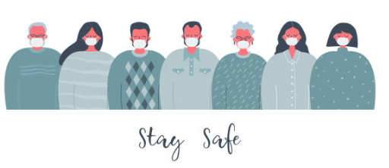
COVID-19 VACCINE

Slide 2
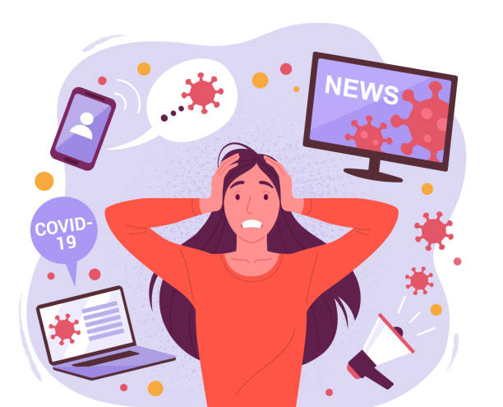
Review COVID-19 Information
Corona Virus Disease (COVID-19) is an infectious disease caused by a newly discovered corona virus.
The number 19 is used because the disease was discovered in December 2019.
COVID-19 spreads from person to person. Most commonly, it is spread when droplets from a sick person come into contact with another person's mouth, nostrils or eyes. This can happen when you are near a sick person(within 6feet) who coughs or sneezes into the air.

Slide 3
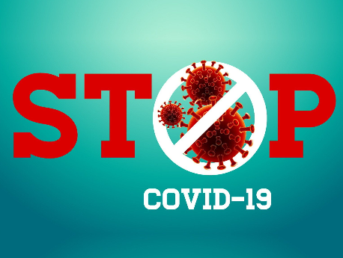

Slide 4
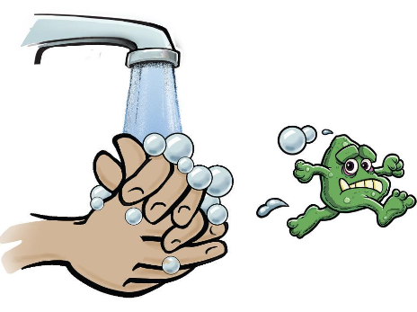
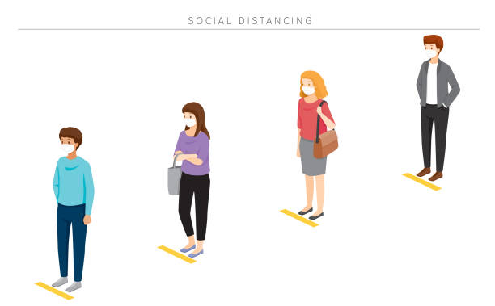
What Helps to Prevent the Spread of COVID-19
Getting vaccinated
Continue to wear your mask
Social distance (6 feet)
Wash Hands frequently (soap and water no less than 20 seconds)
Stay home/away if you have any symptoms (headache, cough, fever, sore throat or experience a loss of taste or smell)
Notify officers when experiencing any
symptoms

Slide 5
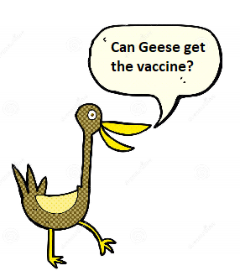
What You Can Expect to Learn
Why get the COVID vaccine?
Are the COVID vaccines safe?
Do the COVID vaccines really work?
Do younger or healthy people need the vaccine?
Who should and should not get the vaccine?

Slide 6

What You Can Expect to Learn
Do I have to pay for the vaccine?
What are different (names) of vaccines available?
What are the side effects?
How do vaccines work?
When and where can I get the vaccine?

Slide 7
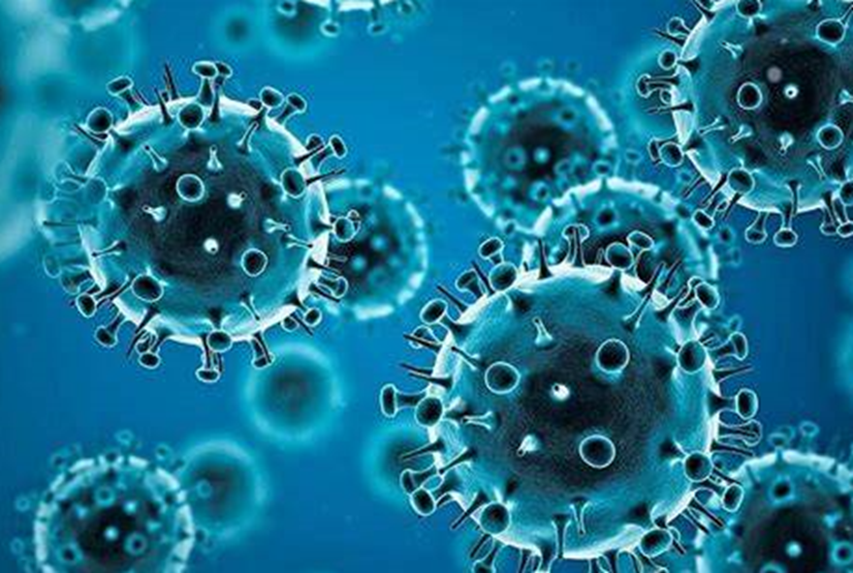
The COVID-19 Vaccine is Important!

Slide 8
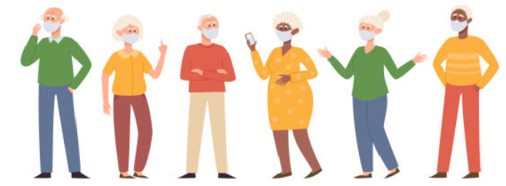
Important reasons to get the COVID Vaccine
To protect yourself, and those around you (family, friends) from COVID, especially those who might be at higher risk of getting seriously ill or dying.
To be part of helping all of us back to a more normal way of life. Once enough people get immunized, it will be much harder for COVID to spread or mutate.
You will be protected from COVID. Your risk of serious illness, hospitalization or dying from the disease will be dramatically lower.
Doctors support and trust these new vaccines and recommend them for nearly all Manitobans. It’s your choice!

Slide 9
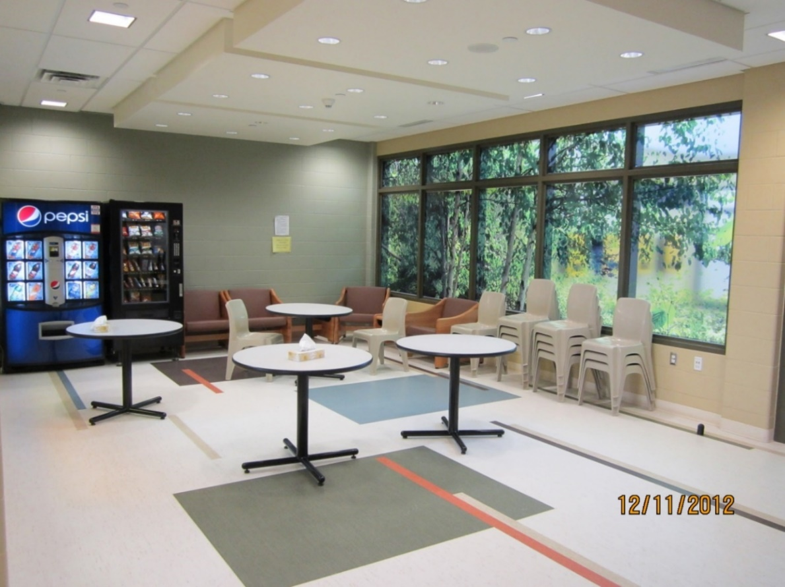
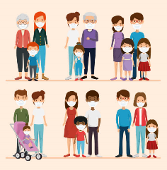
Getting the vaccine will bring us closer to a more normal life… In person visits with family, friends and supports.

Slide 10

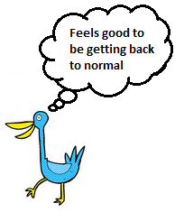
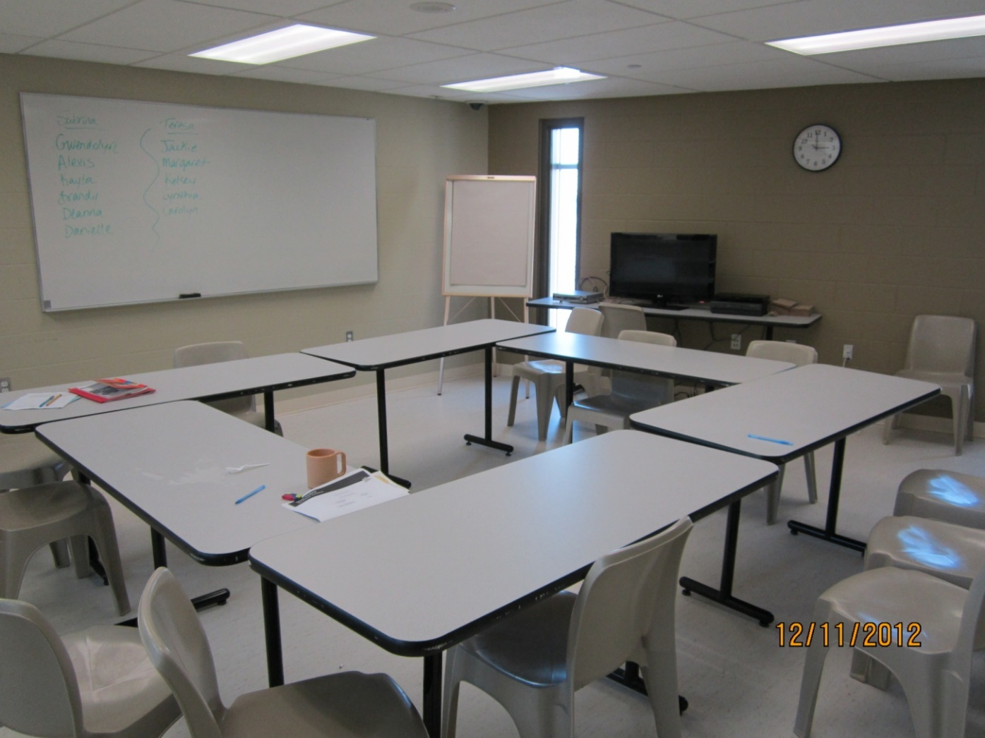
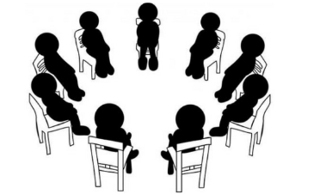
Returning to classrooms, support groups, and programs

Slide 11
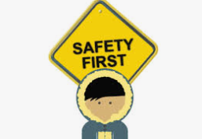
COVID-19 Vaccines are Safe
Certain COVID vaccines are approved for use in Canada and are safe.
Safety remained a top priority while developing the vaccine’s.
Canada has so far approved four vaccines that have all of the necessary clinical trials and safety data. These four vaccines have each been independently reviewed and approved in many other countries.
Health Canada and the Public Health Agency of Canada continue to monitor the safety and effectiveness of the vaccines, providing weekly updates.

Slide 12
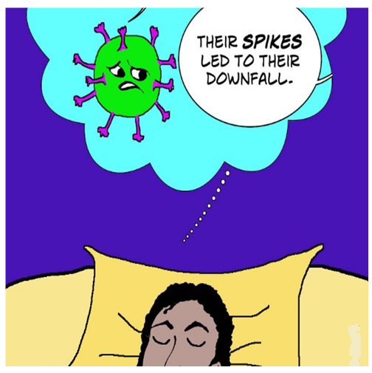
How Vaccines Work
Vaccines train our immune system so it is ready to respond if we are ever exposed to the virus that causes COVID-19. You can’t get the virus from these vaccines.
COVID-19 viruses have spikes on the surface called spike proteins, which they use to attach and enter human cells. These spikes allow the virus to infect you. The vaccines target these spike proteins, helping your immune system to recognize them in the future to prevent COVID-19 infection and illness.

Slide 13

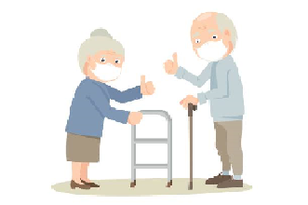
COVID Vaccines Work
Yes, all approved vaccines are effective.
The vaccines approved for use in Canada are highly effective at preventing severe disease, hospitalization and death.
They have similar protection compared to existing routine vaccines for other diseases like polio and measles, and much better effectiveness than the flu shot.
The safety and efficacy of approved COVID-19 vaccines has been demonstrated. Hundreds of millions of doses have been safely administered in dozens of countries. Research is finding the vaccines can decrease the spread of COVID-19.

Slide 14
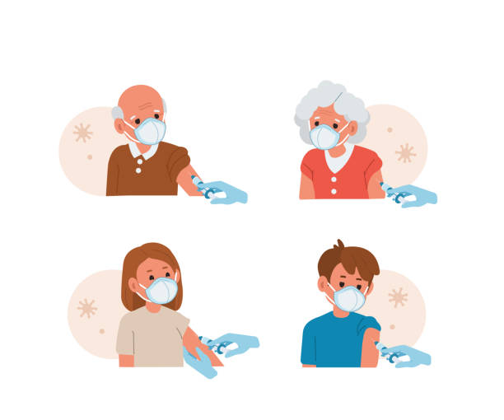

Younger and/or Healthy People Should Get the Vaccine
Three key reasons even younger adults and healthy people should get the vaccine, even if you don’t feel at risk from COVID-19:
Protect yourself: It’s not worth taking a chance with COVID when there’s a safe and effective way to prevent it.
Protect those you love: Even if you don’t see the personal benefit, think about your family and friends, or others you come in contact with. Getting the vaccine helps to protect them too.
Ending the pandemic: 70-80% of Manitobans need to get the vaccine if we want to get back to a more normal way of life. You can help by getting immunized.

Slide 15
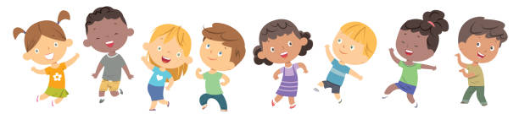
Doctors recommend it for almost everyone, including those who have recovered from COVID-19 in the past…
However, there are some people who should NOT be getting vaccinated at this time… these include:
Children and Youth
The vaccines are not yet approved for younger people, though research is underway to confirm vaccine safety and efficacy for this age group.

Slide 16

Consult a doctor if you….
Have severe allergies to vaccine ingredients. You can view the ingredient list for the approved vaccines. Severe allergies to these ingredients are very rare. Food allergies or other allergies are NOT a reason to avoid the vaccine. If you have concerns, talk to your doctor/nurse.

Slide 17
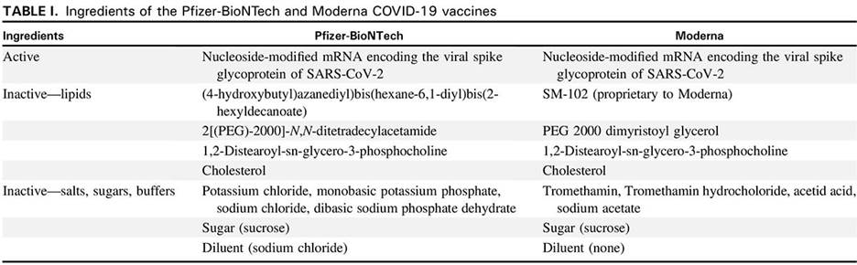
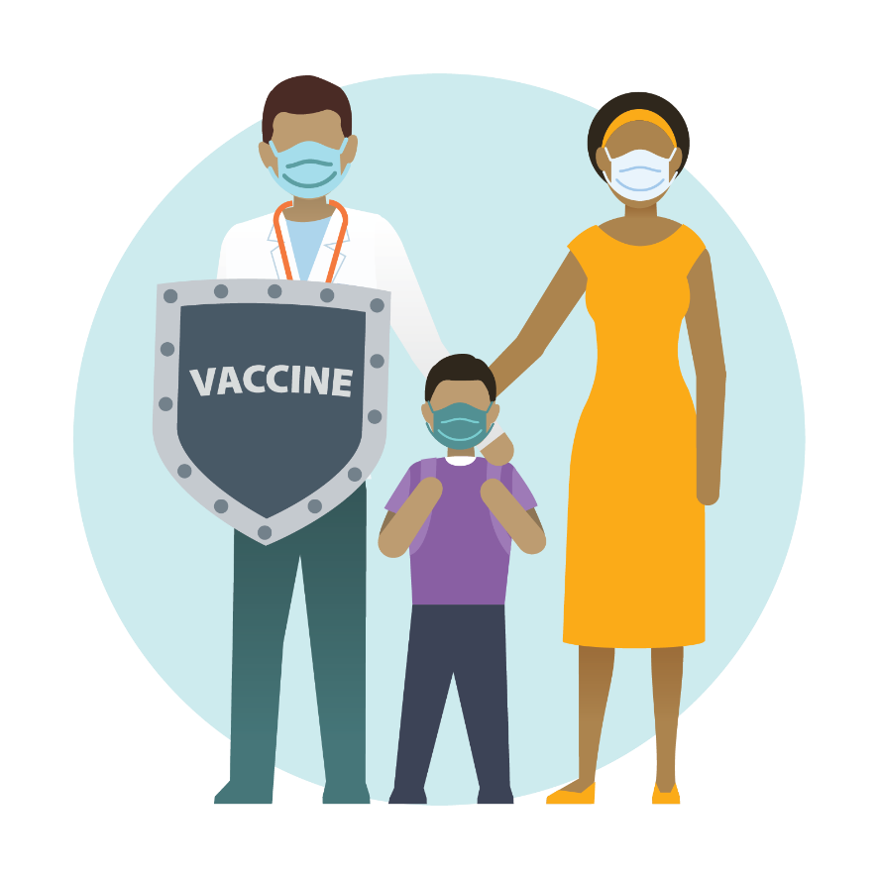
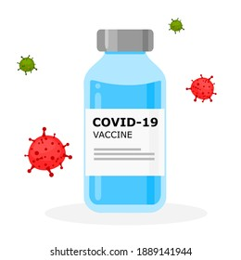
Ingredients AstraZeneca
Medicinal ingredient
Adenovirus vector vaccine
Non-medicinal ingredients
disodium edetate dihydrate (EDTA)
ethanol
L-histidine
L-histidine hydrochloride monohydrate
magnesium chloride hexahydrate
polysorbate 80
sodium chloride
sucrose

Slide 18
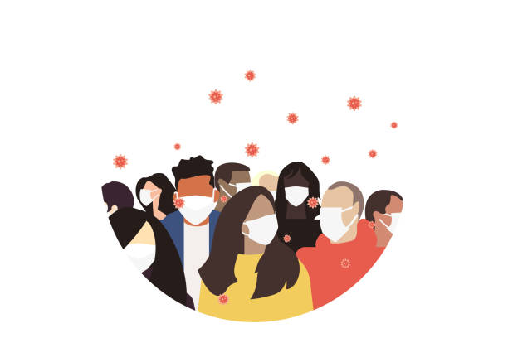
You may need more information if….
Some people may need to wait or should seek medical advice before getting immunized. This includes people who:
Have COVID-19 symptoms or those who are isolating due to a potential exposure. Wait until public health clears you before getting the vaccine.
Had a different vaccine recently (other than COVID.) It’s best to wait two weeks.

Slide 19

You May Need More Information if…
Have had severe allergies to other vaccines or injectable medications in the past, or have had an anaphylactic reaction in the past but do not know the cause. Talk to your doctor first.
If you are pregnant or breastfeeding, you can get the vaccine HOWEVER you should consult a healthcare professional first and ask to see the COVID-19 Vaccine fact sheet.
Have suppressed immune systems or are undergoing treatments that can weaken your immune system, like chemotherapy. You may be able to get the vaccine, but you should consult a doctor first.

Slide 20

There is No Cost for the COVID Vaccine
The vaccine is free!
The Canadian and Manitoba governments are covering all of the costs, from the vaccine supplies to paying the doctors and other health professionals who will administer the vaccine.

Slide 21
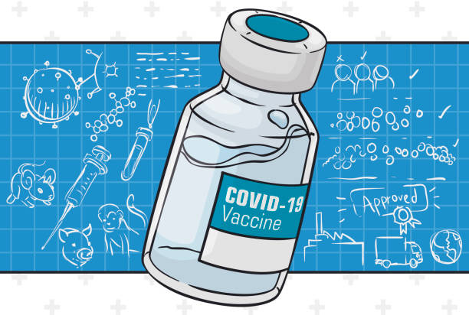
The Different Vaccines Available…
Pfizer and Moderna (mRNA Vaccines)
Johnson & Johnson (Viral Vector Vaccines)

Slide 22
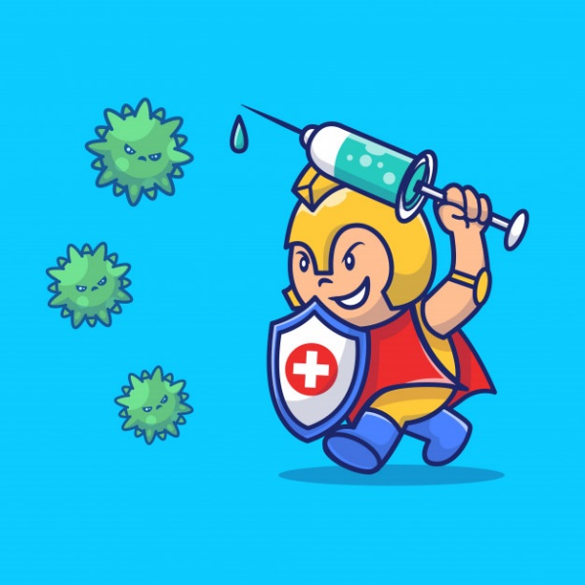
mRNA Vaccines
mRNA Vaccines like Pfizer and Moderna train our bodies to make a harmless piece of what is called spike protein found on the surface of the virus that causes COVID-19. This triggers an immune response, something in our body will remember if we are exposed to COVID-19 in the future.
While this is a new vaccine, it is not new technology. The messenger RNA response has been used for other medical treatments, including for cancer.
The mRNA vaccines do not contain the live virus that causes COVID-19, and they cannot affect our DNA in any way.

Slide 23
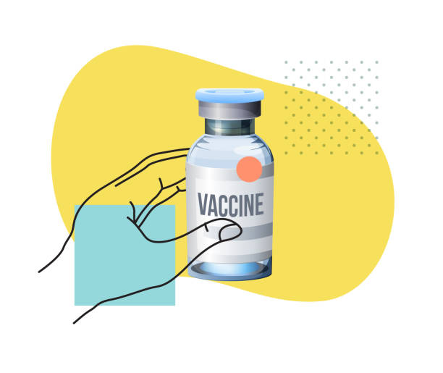
Viral Vector Vaccine
Viral Vector vaccines like Johnson & Johnson use a harmless cold virus to deliver the genetic code from the spike on the surface of the COVID-19 virus. This trains our immune system to react in the future.
This technique has been used in the past, most notably in a vaccine approved for Ebola. This type of vaccine is more rugged than the mRNA, so they don’t need to be frozen.
The Viral Vector vaccines do not contain the live virus that causes COVID-19, and they cannot affect our DNA in any way.

Slide 24




What About Side Effects?
Like any medicine, the COVID-19 vaccine can sometimes cause mild side effects.
Serious side effects are extremely rare.
Common side effects are generally mild and might include tenderness, redness, or swelling at the injection site, headache, low fever, or you may feel unwell. If you experience symptoms, they won’t last long and they are much milder than what COVID-19 can cause.

Slide 25
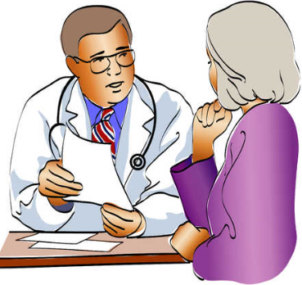
Reasons for Side Effects
Side effects occur because the vaccine triggers your immune system to start fighting. If they last longer than a week, or you get a high fever, contact your doctor or seek medical attention.
At your appointment, you are asked to stay for about 15 minutes after your immunization, to ensure medical help is available if you do have a reaction.
If you’re concerned about side effects or allergies, talk to your doctor or nurse before you receive the vaccine.

Slide 26

Steps to Get the COVID Vaccine
If in custody, you will be notified as soon as the vaccine is available (coming soon)
Requirements when in community:
Check eligibility (https://protectmb.ca)
Have Manitoba Health Card and personal identification required by the immunization clinic Make appointment online or call toll free 1-844-MAN-VACC (1-844-626-8222) to book your appointment
Arrange transportation
Sign consent form (custody included)
Receive vaccine

Slide 27

Life After the Vaccine
After you are immunized, do you still have to wear a mask and continue to social distance?
Yes - It’s important for everyone to continue using all the tools available to help stop this pandemic.
Will I get a document with proof of vaccination?
Yes – you have a right to your own personal health information. If you have a valid Manitoba Health Card and a personal e-mail address, you can access your immunization record.

Slide 28

Life After the Vaccine
With new strains of COVID-19 appearing should I wait to get vaccinated?
No – Do not wait to get vaccinated. Everyone who is eligible to get the vaccine should get it as soon as possible.
Will the vaccine work if the virus mutates?
Yes – small mutations do not affect how well the vaccine works. Scientists are continuing to monitor the variants.

Slide 29

Life after the vaccine…
Will the vaccine be mandatory?
The COVID-19 vaccine is not mandatory, however being immunized against COVID-19 helps protect you and your loved ones from serious illness and/or death caused by this virus.
Does the second dose of the vaccine have to be the same brand and type as the first dose?
Yes – right now, the plan is for people to get the same vaccine for their second dose.

Slide 30

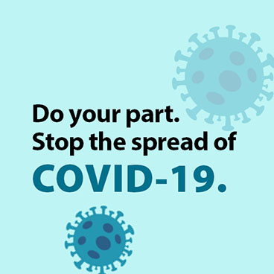

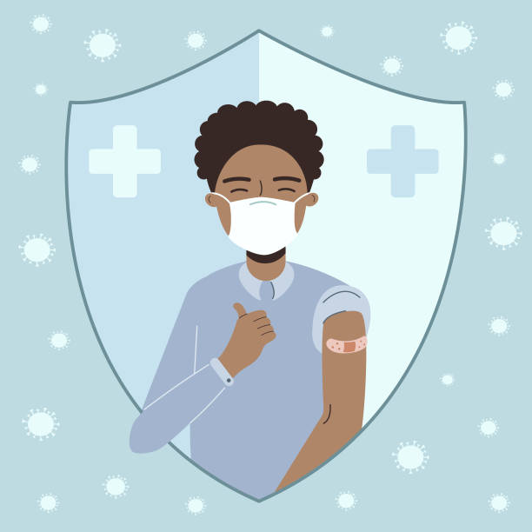

Get
Vaccinated

Slide 31


Slide 32
Additional Information can be Found
For more information about COVID-19 or the COVID-19 vaccines, talk to your health care provider.
You can also call Health Links – Info Santé in Winnipeg at 204-788-8200 or 1-888-315-9257 (toll-free in Manitoba.)
You may also speak with your case manager or nursing staff.
Or visit:
Province of Manitoba: www.manitoba.ca/covid19/index.html
Government of Canada: www.canada.ca/en/public-health/services/diseases/coronavirus-disease-covid-19.html

Slide 33
References:
https://www.manitobavaccine.ca/vaccine-facts/-Vaccine Info - Manitoba Vaccine (Public Health Factsheet March 2021)
https://protectmb.ca

