Slide 1
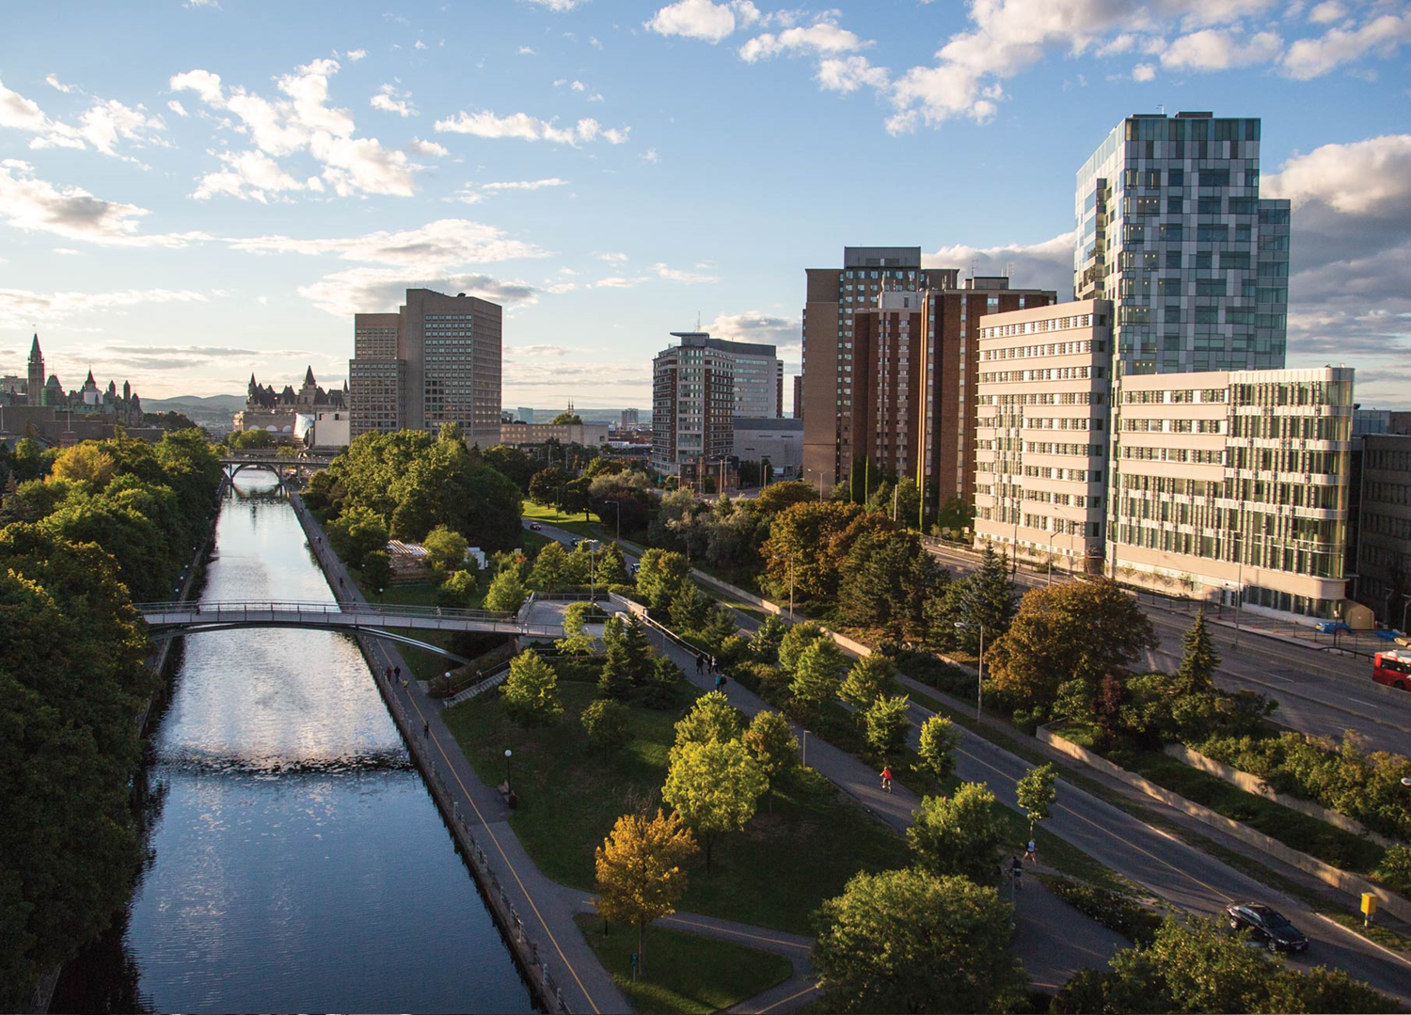

IR Customization and Outreach in Response to Funder Mandates
Designing for Faculty:
Jeanette Hatherill
Scholarly Communication Librarian
University of Ottawa, Canada
Notes:
Canadian context for OA mandates
Institutional context
Customizations
Promotion
Results

Slide 2
Presented at OR2016
Dublin, Ireland
June 15th, 2016
jeanette.hatherill@uottawa.ca

Slide 3
Canadian Federal OA Policy
Three granting councils (the “Tri-Agency”)
  Social Sciences and Humanities Research Council, Natural Science and Engineering Research Council, Canadian Institutes of Health Research
Harmonized policy introduced in May 2015
“Grant recipients are required to ensure that any peer-reviewed journal publications arising from Agency-supported research are freely accessible within 12 months of publication.”
Supports Green OA and Gold OA

Slide 4
Institutional Context @uOttawa
Medical/Doctoral university
Largest bilingual (French/English) university in the world
1200 + Regular Faculty; 2, 911 Academic Staff
79.5M$ in funding from Tri-Agency in 2014-2015
scholarly communication librarian
emerging technologies librarian (.5 FTE for IR)
~25 subject/liaison librarians
Notes:
Faculty in university-affiliated institutions, Adjunct professors ,Part-time professors, Visiting professors, Postdoctoral researchers, Research fellows, Emeritus professors, librarians

Slide 5
Support for OA
Formal program since 2008
Institutional repository, financial support, journal hosting
1 scholarly communication librarian
1 emerging technologies librarian (.5 FTE for IR)
Programmer/Analyst
~25 subject/liaison librarians

Slide 6
uO Research – our institutional repository
http://www.ruor.uottawa.ca/
  DSpace JSPUI 4.3
Integrated features to streamline self-deposit workflow
  LDAP authentication
  DOI import
  Sherpa/Romeo integration
  Embargo after file upload – (customized to pre-3.0 feature)
Notes:
UI
Open source as Best of the pre-3 Dspace,
Minimum set for input forms, streamlined as much as possible

Slide 7
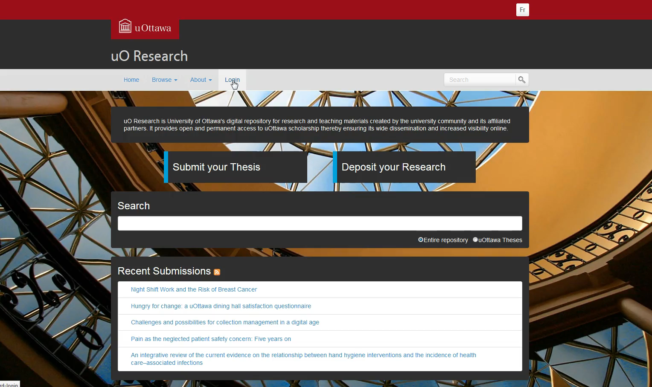

Slide 8
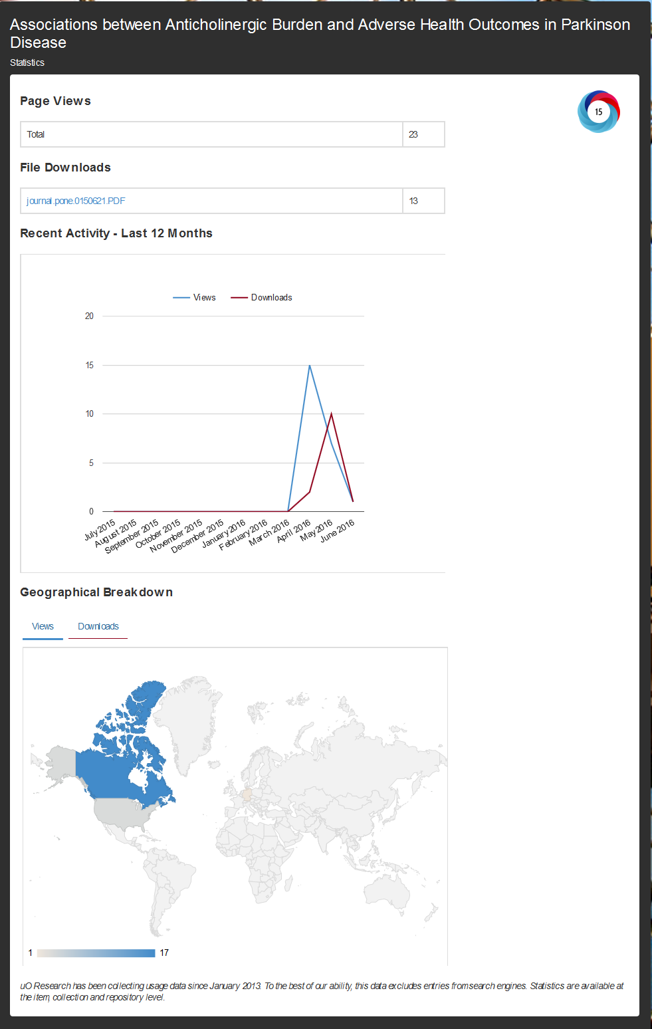
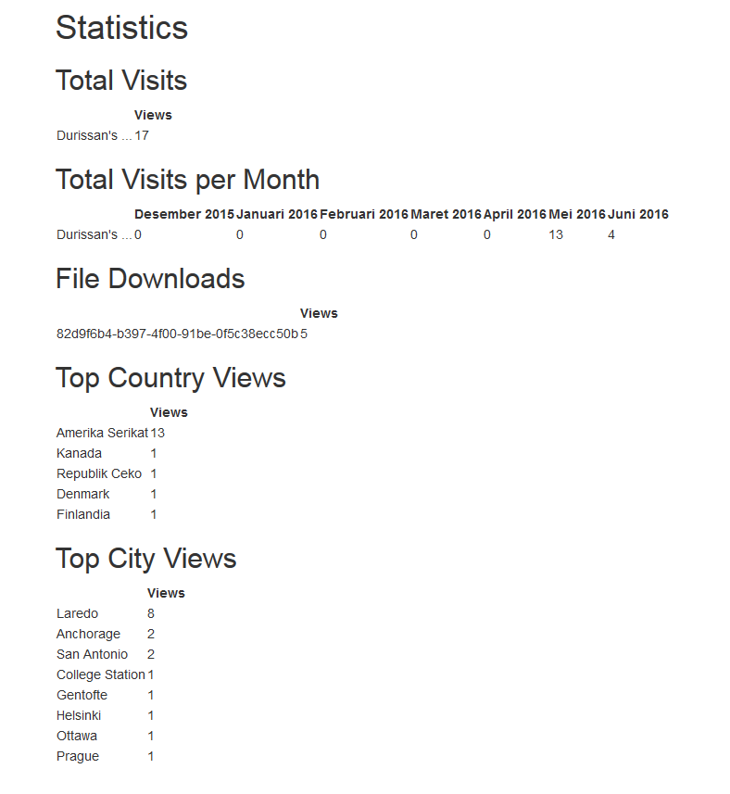
Promoting value
Statistics module customization
Altmetrics integration
Notes:
Filtering spiders – super important to filter out spiders, is everyone doing this? – we’ve added to the Dspace tech lists filter out manually = we decided to report only human visits, to give the best possible picture of repostiroy usage to our researchers, this is what you should be doing if you are using your stats to promote the value of your IR.

Slide 9
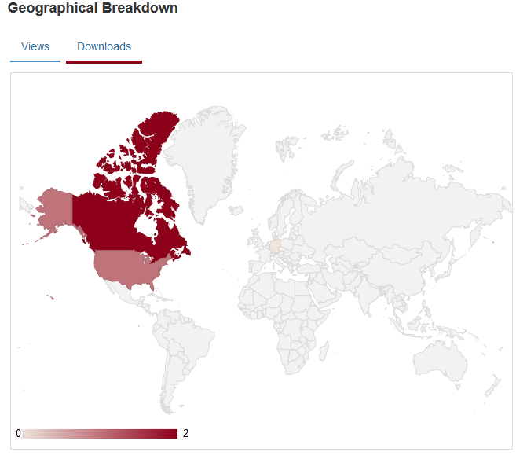
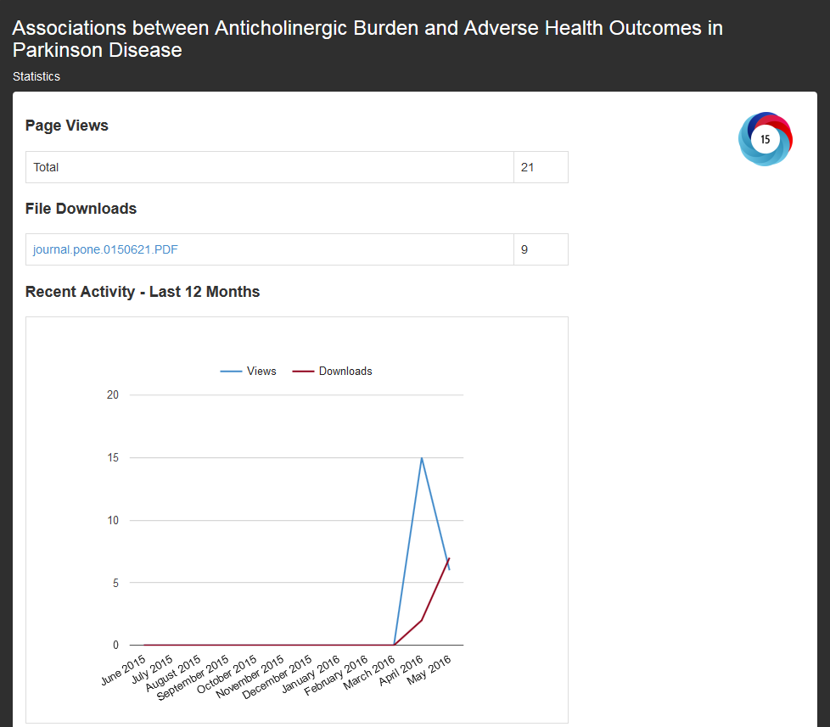
Stats & Altmetrics

Slide 10

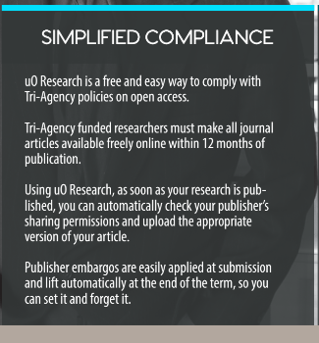
Promotion
Spring 2015: Presentations at Dep’t & Faculty Executive meetings
One year on: promoting the IR through our liaison/subject librarians
New promotional pamphlets with info on Tri-Agency Policy
List of funded researchers provided by Research Office

Slide 11
Results
May 2015
Non-thesis material made up 21% of content
June 2015 - June 2016
1,639 non-thesis deposits
SWORD integration
Increase from 21% to 26%
3% increase in the same period previous year

Slide 12
LINKS
www.ruor.uottawa.ca
www.scholarlycommunication.uottawa.ca
Public link to DSpace statistics customization code under Bitbucket version control:
https://bitbucket.org/mbattou/dspace-statistics-custom-public/commits/1abfabfc716db76310a5eefe6602c4a660c82474
Requirements and languages:
Dspace 4.3 JSPUI with Solr, all running on a Linux environment
Java, Javascript and HTM
Google Charts: https://developers.google.com/chart/

